Slide 1
Our Sun and Solar system
The neighborhood where we live

Slide 2
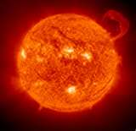
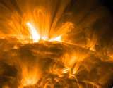
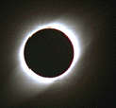
The Sun – our very own star
The Sun is the center of our solar system
The word “solar” means “of the sun”
Our sun is a medium-sized star
Our sun is medium-hot, and yellow

Slide 3
Characteristics of the Sun
The sun has layers
  The middle is called the core – it is 27,000,000 degrees!
  The outer layer is the chromosphere
  The layer under the chromosphere is the photosphere, where light and other forms of energy are released
  Under the photosphere is the convective zone where heat is released
  The layer above the core is the radiative zone

Slide 4
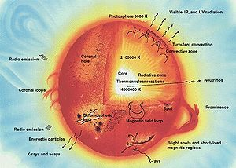
The sun is made up of gasses
  The most abundant gas is Hydrogen
  Hydrogen is undergoing fusion to make Helium, which releases a huge amount of energy
  Forms of energy released include light, heat, and various rays, like X rays and gamma rays, which are forms of radiation

Slide 5
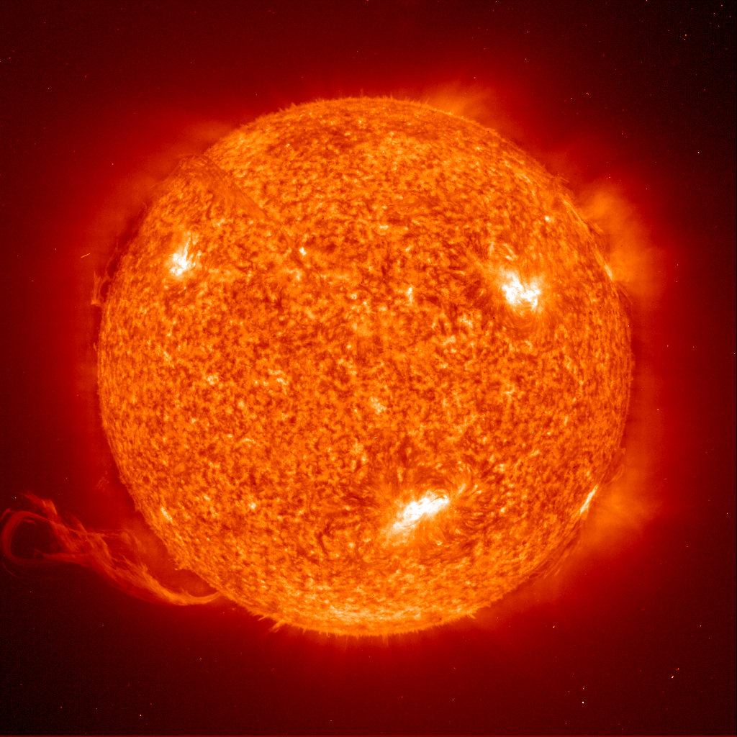
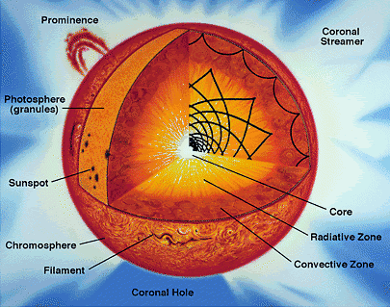
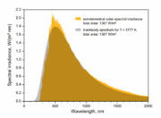

Slide 6
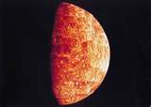
The inner four - Mercury
The inner four planets are formed mostly of rock
Mercury is first
  It has very little atmosphere
  It has no moons
  It is VERY HOT!

Slide 7
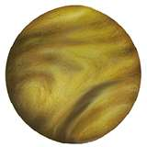
Venus
Venus is second
  It has a very thick atmosphere, and this makes the temperature the highest in the solar system
  It has no moons
  It is about the same size as Earth

Slide 8
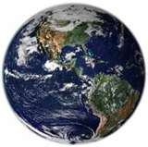
Earth
Earth is third
It has liquid water
It has a medium-thick atmosphere
It has one moon
It’s where we live

Slide 9
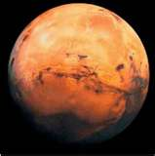
Mars
Mars is fourth
  It has a thinner atmosphere than Earth
  No surface water
  High winds sometimes
  Two moons

Slide 10
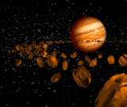
Asteroids
Between Mars and Jupiter is and asteroid belt
Lots of rocks
No liquid water

Slide 11
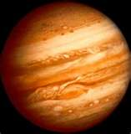
Jupiter
Jupiter, the largest planet, is fifth
Jupiter is a gas planet
It has rings, and 63 moons
The Great Red Spot is a storm that has been there ever since Galileo saw it 400 years ago!

Slide 12
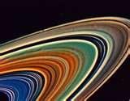
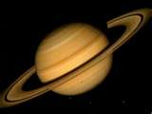
Saturn
Saturn is the sixth planet
It is also a gas planet
Saturn is famous for its rings, which are easy to see with a telescope – Galileo saw them, too
Has 56 moons

Slide 13
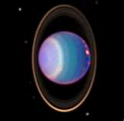
Uranus
Uranus is a gas planet, too – all four of the outer planets are
It spins sideways, probably because it was hit by a comet or asteroid
Uranus has thin rings and 27 moons

Slide 14
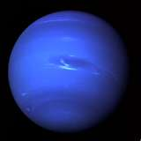
Neptune
Neptune is the farthest away
It is a gas planet
It has VERY strong winds, over 400 miles an hour
Neptune has 13 moons

Slide 15
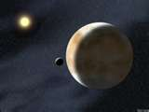
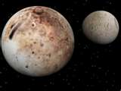
Pluto and the others
Pluto is another body now called a PLUTOID
It has an irregular orbit – tilted and elongated
It has 3 moons – one is very large
Eris, the newest body, is also a Plutoid
It has only one moon

Slide 16
More to think about…
There is at least one more planet, but it may be a giant, we just don’t know yet….
Research is always going on to help us know our way around our neighborhood – the SOLAR SYSTEM
Maybe someday YOU will travel to one of these wonderful places!

Slide 17

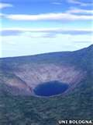
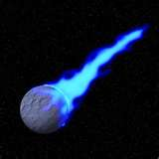
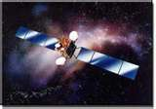
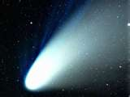

And the rest…
There are also:
  Meteors and comets
  Space dust
  Satellites
  Space junk and trash

Slide 18
This powerpoint was kindly donated to
www.worldofteaching.com
http://www.worldofteaching.com
Is home to well over a thousand powerpoints submitted by teachers. This a free site. Please visit and I hope it will help in your teaching

