Slide 1
Acids and Alkalis
Learning Objectives
To know that solutions can be sorted by whether they are: acid, alkali or neutral.
To understand that an alkali reacts with an acid to cancel it out.
To know that indicators show you how acidic or alkaline a solution is.

Slide 2
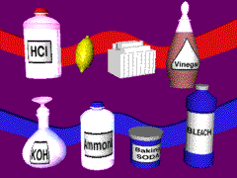
Acids and alkalis
When a substance dissolves in water it makes a solution.
Solutions can be sorted by whether they are: acid, alkali or neutral.

Slide 3

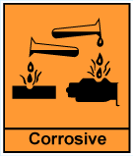
When the oxide
of some non-metals
dissolve in water
they make an acid.
Acids have a sour taste.
They are corrosive.

Slide 4
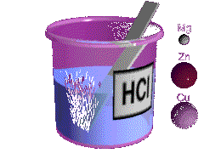
Acids react with metals and carbonates.
Metal + Acid Salt + Hydrogen
magnesium + magnesium chloride + hydrochloric acid hydrogen
Acid + Carbonate Salt + Water + Carbon
dioxide
sulphuric acid + copper sulphate + water +
copper carbonate carbon dioxide

Slide 5
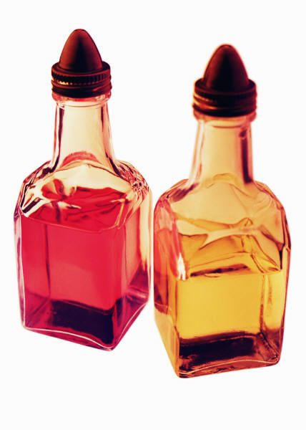

Acids
There are many acids present in our everyday lives.
Lemon juice contains citric acid, and vinegar contains ethanoic acid.
Some strong acids are hydrochloric acid, sulphuric acid and nitric acid.
Some weak acids are ethanoic acid, citric acid and carbonic acid.

Slide 6

Neutralisation
Acids and alkalis react with each other. The alkali cancels out the acid in the reaction. This is called neutralisation.
A salt is made.

Slide 7
Salts
The salt made depends on the acid and alkali used.
The salt contains the metal atom from the alkali, and part of the acid molecule.
The salts of sulphuric acid are known as sulphates.
The salts of hydrochloric acid are known as chlorides.
The salts of nitric acid are known as nitrates.

Slide 8

Alkalis
Many everyday substances are alkalis.
They feel soapy.
They are corrosive.
When the oxides of some metals dissolve in water they make an alkali solution.
Alkalis react with acids and neutralise them.

Slide 9

Alkalis
Alkalis are present in many cleaning substances in use in our homes.
Kitchen cleaners are alkaline because they contain ammonia or sodium hydroxide, which attack grease.
Calcium hydroxide and sodium hydroxide are strong alkalis.
The most recognisable and common weak alkali is ammonia.

Slide 10
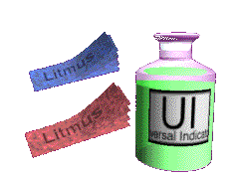
Indicators
Indicators help you find out whether a solution is acidic or not.
They change colour in acid or alkaline solutions.
Different indicators change to different colours.

Slide 11
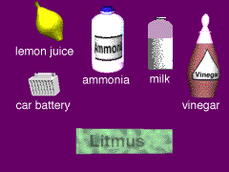
Litmus
Test
Litmus is an indicator. It changes colour in acid and alkaline solutions.
Litmus is red in an acid.
Litmus is blue in an alkali.

Slide 12
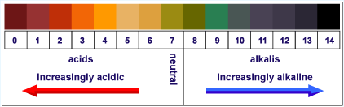
Universal Indicator
Universal indicator changes colour in acids and alkalis.
ACIDS
ALKALIS
Neutral
        Its colour shows the strength of an acid or alkali.

Slide 13
The pH scale
1 – 6
8 - 14
Alkalis
7
Acids
Neutral

Slide 14


Applications of Neutralisation
Insect Stings
Bee stings are acidic
and can be neutralised with
baking soda (bicarbonate of soda).
Wasp stings are alkaline and can be neutralised with vinegar.
Indigestion: Our stomach carries
around hydrochloric acid.
Too much of this leads to indigestion.
To cure indigestion, you can neutralise the excess acid with baking soda or specialised indigestion tablets.

Slide 15

More Applications of Neutralisation
Factory Waste: Liquid waste from factories is often acidic. If it reaches a river it will destroy and kill sea life of many forms. Neutralising the waste with slaked lime can prevent this.
Soil Treatment: When soils are too acidic (often as a result of acid rain) they can be treated with slaked lime, chalk or quicklime, all alkalis. Plants and crops grow best in neutral soils.

Slide 16
This powerpoint was kindly donated to www.worldofteaching.com
http://www.worldofteaching.com is home to over a thousand powerpoints submitted by teachers. This is a completely free site and requires no registration. Please visit and I hope it will help in your teaching.

