Slide 1
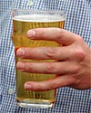
Alcohol
What’s your poison?

Slide 2
Did you know?
Yeast is the star of the drinks industry. If it feeds on sugar in the absence of oxygen, it releases carbon dioxide and ethanol - the drinkable form of alcohol Only 20% of the alcohol you swallow is absorbed by the stomach Heavy drinking is blamed for up to 33,000 deaths a year in the UK When you consume alcohol, you lose more water in your urine than you take in the drink itself Booze interferes with the nerve endings that control erections Binge drinking is thought to have serious long-term health impacts After a heavy night out drinking your body is dehydrated which causes your brain to shrink away from the skull

Slide 3
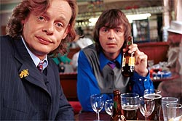
How Booze Enters Your Body "Yeah, I've had a few... but I'm still in control, definitely... just having a really, really brilliant time."It's the way so many big nights begin. Enjoying the effects of moderate alcohol consumption you've become the life and soul of the party - and don't you just love all your friends? How do you absorb those tipples?
As the drinks continue to flow, things can start to go badly wrong. How fast that happens depends what you're drinking, what you've eaten and your physical build.

Slide 4
Can you take it? Only 20% of the alcohol you swallow is absorbed by the stomach. The majority seeps into the bloodstream from the small intestine, the piece of bowel directly below the stomach. Separating the two is a trapdoor called the pyloric valve which can hold the key to how quickly you get drunk.
Lining the stomach To pace yourself on a night out eat some food with fat or protein in it before you leave the house. When the stomach is full the pyloric valve closes and the alcohol is trapped in the stomach where it is absorbed more slowly. This way your liver is given more time to break down the alcohol that's already in your bloodstream.
That fatal fizz If you're trying to catch up with your mates who've been in the pub since lunchtime, go for champagne. The bubbles in carbonated drinks can cause the pyloric valve to open, sending alcohol straight to the part of the body that absorbs it best.

Slide 5
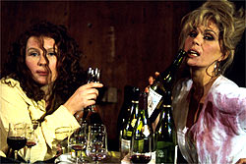
When You’re Plastered
There are plenty of words to describe it: bladdered, slaughtered, mullered, legless or as drunk as a skunk. Call it what you will, if you keep drinking beyond the early warning signs you're heading for trouble - trouble focussing, trouble speaking, trouble keeping upright.For that classic sitcom moment, the thing to do at the end of the evening is fall off the barstool. Falling over is a common mistake when drunk because alcohol affects the cerebellum, the part of the brain that controls fine movements. If finding the end of your nose with your index finger is difficult, you know your cerebellum has been affected.

Slide 6
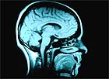
Blotto Researchers think they know why inebriated people sometimes pass out. When people stand up their blood pressure drops and a sober body responds by tightening blood vessels. After knocking back a skinful, this system no longer works, which is why standing up to leave can induce a faint.
The danger zone Drinking heavily is very dangerous. A major session can affect the medulla or brain-stem, which controls the basic functions of the body that keep you alive. Large quantities of drink cause a similar effect to general anaesthesia and lead to lack of consciousness and even death.

Slide 7
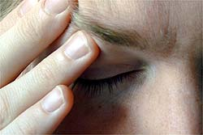
When you’re hungover
You've already signed the pledge several times over. And as you continue to examine the enamel surface of your toilet for imperfections, you vow also to give half your earnings to charity and visit grandma more often... if only you can start to feel better right now!
Waking up with a hangover is a sign that you drank far too much last night and your body didn't like it at all. Here's what's happening...

Slide 8
Dehydration
Alcohol is a diuretic, which makes you wee more. In fact, you lose far more water in your urine than you are taking in the drink itself. Dehydration causes the brain to shrink away from the skull slightly. This triggers pain sensors on the outside surface of your brain.

Slide 9
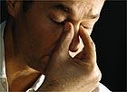
Electrolyte Imbalance & Tiriedness
Vital electrolytes such as magnesium and potassium are excreted from the body with the urine. These minerals help keep the heart beating and dangerous cardiac arrhythmias can occur after heavy drinking.
Alcohol lowers your blood sugar levels as glucose is excreted in the urine. Along with the late night, this contributes to extensive yawning the following day.

Slide 10
Attack of the free radicals
Free radicals are harmful molecules formed in the liver as it struggles to break down ethanol. Usually, these are seen off by an anti-oxidant called glutathione but its reserves can run low after a drinking session.
The foolproof hangover cure
No, sorry there isn't one. The general advice is to drink plenty of water, possibly even a sports drink to rebalance those electrolytes and go back to bed.

Slide 11
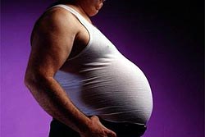
The Drinking Habit
The recommended limits of alcohol consumption are 2-3 units per day for women and 3-4 units for men. In standard UK pub measures a unit is half a pint of ordinary beer or lager, a third of a pint of strong brew, a small glass of table wine, one glass of sherry or a single whisky.
The limits were changed to a daily dose when doctors realised many people's interpretation of the weekly limits was that if they saved all their units up for Friday night they'd still be OK. In fact, binge drinking is thought to have serious long-term health impacts although this form of drinking has been less well studied.

Slide 12
Long Term Effects
The long-term toll of heavy drinking is serious and the NHS estimates it spends £164m a year treating alcohol-related conditions. One of the most serious consequences is for the liver. In response to long-term alcohol exposure it starts producing more alcohol dehydrogenase, the enzyme which it uses to break ethanol down.

Slide 13
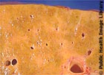
This means, you need more alcohol for the same effect. This worsens the addiction. The liver then becomes over-active, cells die and the tissue hardens. The result is cirrhosis of the liver. This incurable condition was the reason for football hero George Best's recent liver transplant.

Slide 14
Other risks of long-term drinking include heart disease, stroke, dementia and brain damage, myopathy - a weakening of the muscles - and shrivelled sex organs. Cancers related to alcohol include those of the liver, colon, rectum and breast cancer in women.
Treatment centres including the worldwide organisation Alcoholics Anonymous have helped thousands of alcoholics who want to give up drinking. Other forms of help are slowly becoming available. Disulfiram, trade name 'antabuse', is a tablet, which causes an extremely unpleasant reaction including copious vomiting when you consume alcohol. However, it's a severe form of treatment and needs a lot of extra support if it is to work.

Slide 15
This powerpoint was kindly donated to www.worldofteaching.com
http://www.worldofteaching.com is home to over a thousand powerpoints submitted by teachers. This is a completely free site and requires no registration. Please visit and I hope it will help in your teaching.

