Slide 1
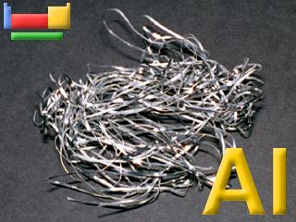
Aluminium and Titanium
These are two metals with a low density which means they are lightweight for their size.
Aluminium is used for aircraft, trains, overhead power cables, saucepans and cooking foil.

Slide 2
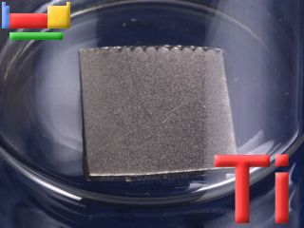

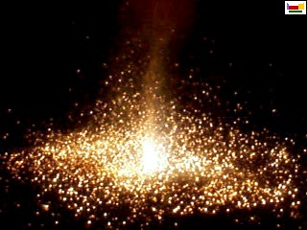
Titanium, when pure,
is a lustrous, white metal.
The metal burns in air and is the only element that burns in nitrogen. It is marvellous in fireworks.

Slide 3
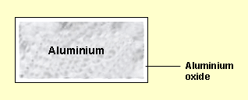
Aluminium and Titanium resist corrosion as they have a very thin layer of their oxides on the surface, which stops air and water getting to the metal.

Slide 4

Extraction
Unlike iron, aluminium and titanium
cannot be extracted from their oxides by reduction with carbon because:
Aluminium is more reactive than carbon, so the reaction does not work.
Titanium forms titanium carbide with carbon, which makes the metal brittle.

Slide 5
Aluminium is mined in huge scales as bauxite.
In order to isolate pure aluminium, impurities must be removed from the bauxite.
This is done by the Bayer process, which involves treatment with sodium hydroxide solution, followed by purification using electrolysis.

Slide 6
Titanium is isolated using the
Kroll method.
This involves the action of chlorine and carbon on the titanium ore followed by fractional distillation and then reduction with magnesium.

Slide 7

COST
Aluminium extraction is expensive because the process needs a lot of electrical energy.
Titanium extraction is expensive because the process involves several stages and a lot of energy. This especially limits the uses of titanium.

Slide 8
Summary
Aluminium and Titanium both have a low density which means they are lightweight for their size.
They resist corrosion.
They cannot be extracted by reduction.
Extraction is expensive because there are
several stages involved and the processes require a lot of energy.

Slide 9
This powerpoint was kindly donated to www.worldofteaching.com
http://www.worldofteaching.com is home to over a thousand powerpoints submitted by teachers. This is a completely free site and requires no registration. Please visit and I hope it will help in your teaching.

