Slide 1

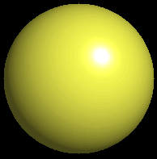

Slide 2
Key words
Symbol
Mixture
Physical change
chemical change
Proton
Liquid
Thermal energy
Freezing
Compound
chemical reaction
Molecule
electron
Neutron
Gas
vaporization
coalesce
matter
atomic number
atomic mass
periodic table
nucleus
evaporation
boiling
element
conservation of mass
Period
ductile
magnetic
condensation
sublimation
atom
precipitate
malleable
conductor
corrosion
superheated gases coalesce
deposition=frost
heterogeneous mixture
homogeneous mixture
combustibility

Slide 3
EVERYTHING in the Universe can be divided up into . . .
Forces & Particles
Gravity Matter
Magnetism Anti-Matter
Strong Nuclear Forces
Weak Nuclear Forces

Slide 4

Forces
Gravity Magnetism
Acts on Acts on
ALL matter charged particles
Always pulls Pulls or pushes
Strong & weak Nuclear Forces
hold the nucleus together

Slide 5


Forces
Gravity Magnetism
Acts on Acts on
ALL matter charged particles
Always pulls Pulls or pushes
Magnetism is about 10⁴⁰ times more powerful than gravity.
10,000,000,000,000,000,000,000,000,000,000,000,000,000.

Slide 6
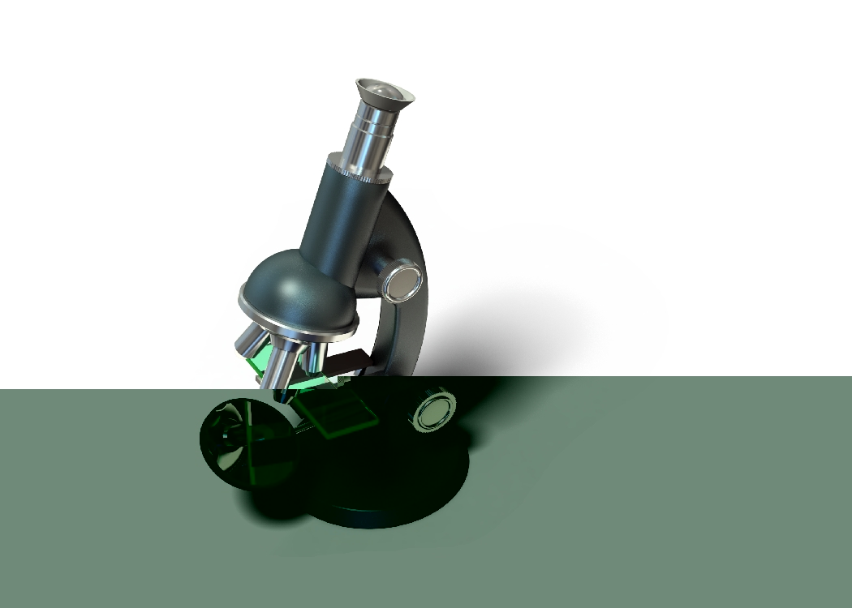
Particles
Matter anti-Matter
Example:
electron positron
e⁻¹
e⁺¹

Slide 7
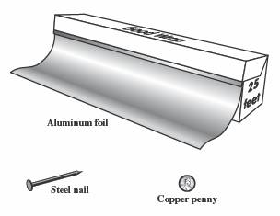
The picture below shows three objects that can be classified in the same group. Which of the following statements is true for all three of these objects?
They are metals.
They rust rapidly.
They weigh the same.
They are the same color.

Slide 8
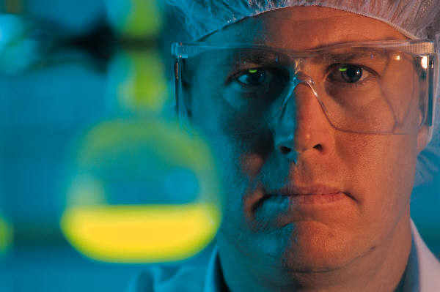
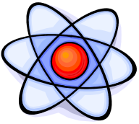
Which pair of elements is MOST similar?
Ca and F
Na and Cl
Ne and Ar
Li and H

Slide 9
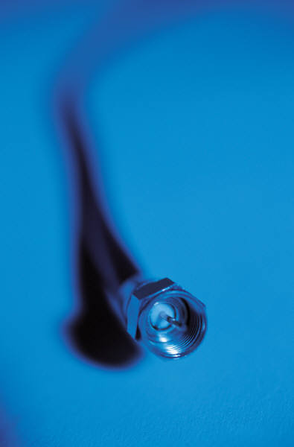
Copper is an element that is used in electrical wires. What is the smallest unit of copper that still maintains the characteristics of copper?
the atom
the electron
the nucleus
the proton

Slide 10
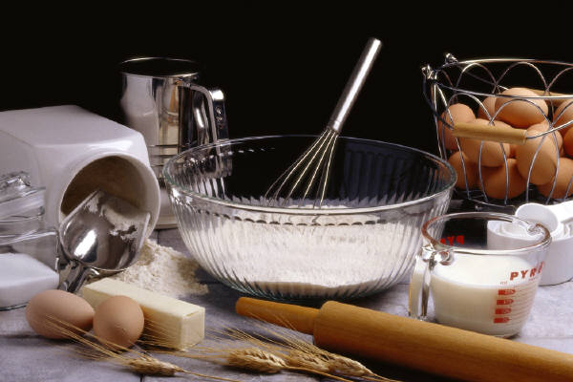
In making a pizza, which process involves a chemical change?
Mixing spices for the sauce
Slicing pepperoni for the topping
Spreading cheese on the pizza
Baking the dough to form the crust

Slide 11
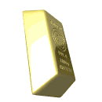
What is the smallest particle of the element gold (Au) that can still be classified as gold?
atom
molecule
neutron
proton

Slide 12
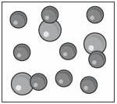
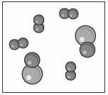
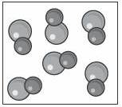
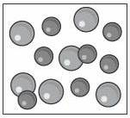
Which of the following illustrations represents a pure substance?

Slide 13
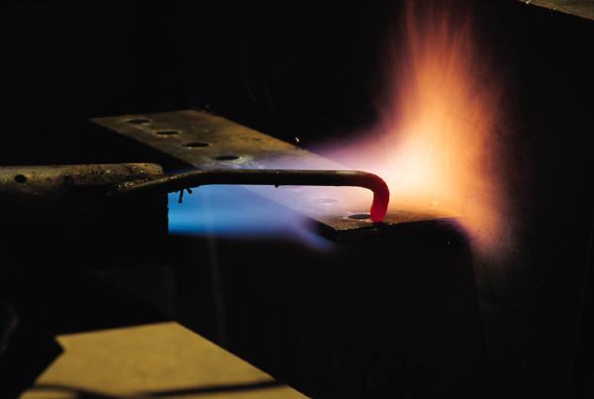
If 1 kg of the compound toluene melts at –95°C, then 500 g of toluene will
melt at –47.5°C.
melt at –95°C.
boil at 95°C.
boil at 47.5°C.

Slide 14

 | The drawing below represents a bit used in a power drill. Which of the following metals is most suitable for making this drill bit? aluminum copper gold steel

Slide 15
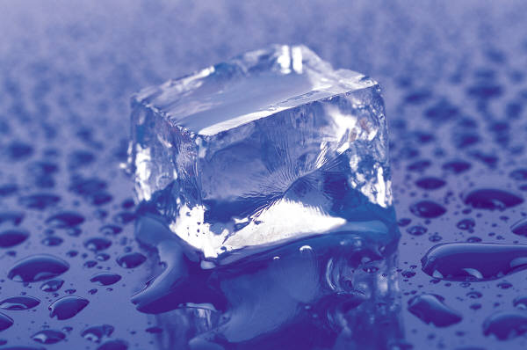
Which statement about the molecules in ice and the molecules in liquid water is correct?
The molecules in ice have more energy than the molecules in liquid water.
The molecules in ice contain different atoms than the molecules in liquid water.
The molecules in ice have more electric charge than the molecules in liquid water.
The molecules in ice are less free to move than the molecules in liquid water.

Slide 16
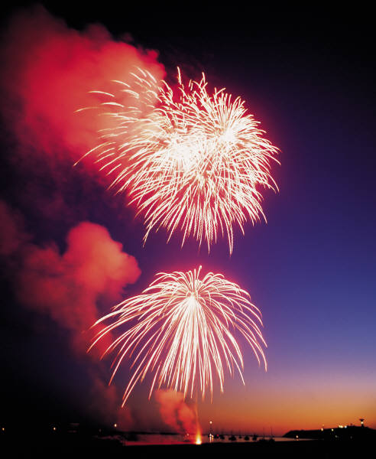
Which formulas represent compounds?
O₂, H₂O₂
CO₂, H₂O
H₂, CO₂
H₂, O₂

Slide 17

Which is an example of a chemical change?
pepper being ground onto a salad
a match being lit
sugar being dissolved in water
wood being chopped

Slide 18
Which statement is correct concerning the mass of a ball of clay?
The mass changes as the altitude of the ball of clay changes.
The mass changes as the shape of the ball of clay changes.
The mass of the ball of clay is unchanged by altitude or shape.
The mass is doubled when the ball of clay is divided into two equal pieces.

Slide 19
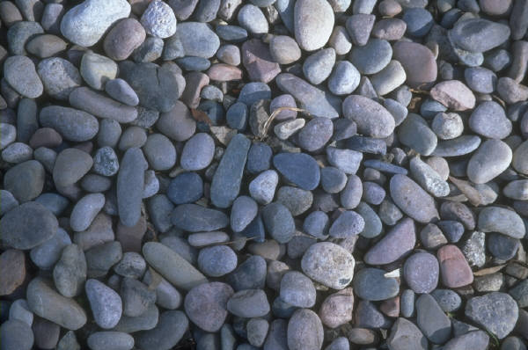

Mary wants to find the density of a small stone. Which tools will she need?
a meterstick and a thermometer
a thermometer and a balance
a balance and a graduated cylinder
a graduated cylinder and a meterstick

Slide 20




If different kinds of atoms are represented by different colored dots, which picture represents a sample of a compound?

Slide 21




If different kinds of atoms are represented by different colored dots, which picture below represents a mixture?

Slide 22

Which of the following is a compound?
oxygen
water
nitrogen
air

Slide 23
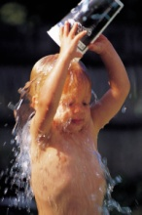
Evidence of a chemical change would be a
melting popsicle.
spinning top.
spilled bucket of water.
rusting car fender.

Slide 24

Which symbol represents carbon?
Ca
N
K
C

Slide 25
Moisture that collects on the outside of a cold glass results from the process of
evaporation.
condensation.
sublimation.
vaporization.

Slide 27
Particles
Matter
anti-Matter
Example:
Proton anti-Proton
P⁻¹
P⁺¹

Slide 28
Quarks Leptons
Matter
2
3
Up electron
Down
e⁻¹
-1
3

Slide 29
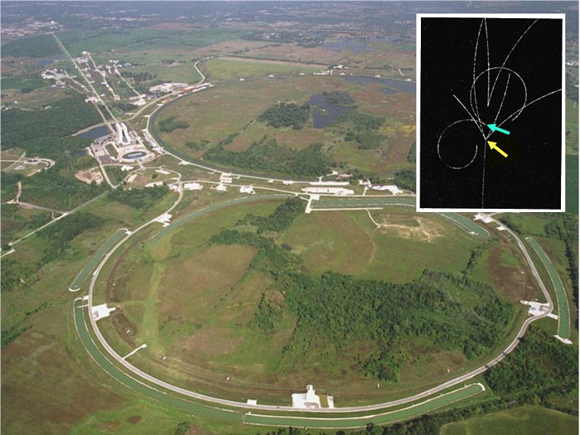

Tevatron - world's highest-energy particle accelerator.
Four miles in circumference
Particles go around at 99.9999% of the speed of light.

Slide 30
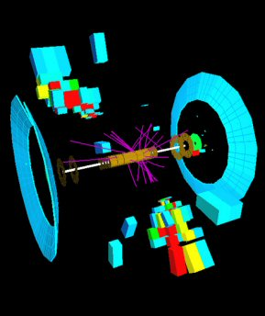



We send protons and antiprotons in opposite directions, and smash them together.

Slide 31
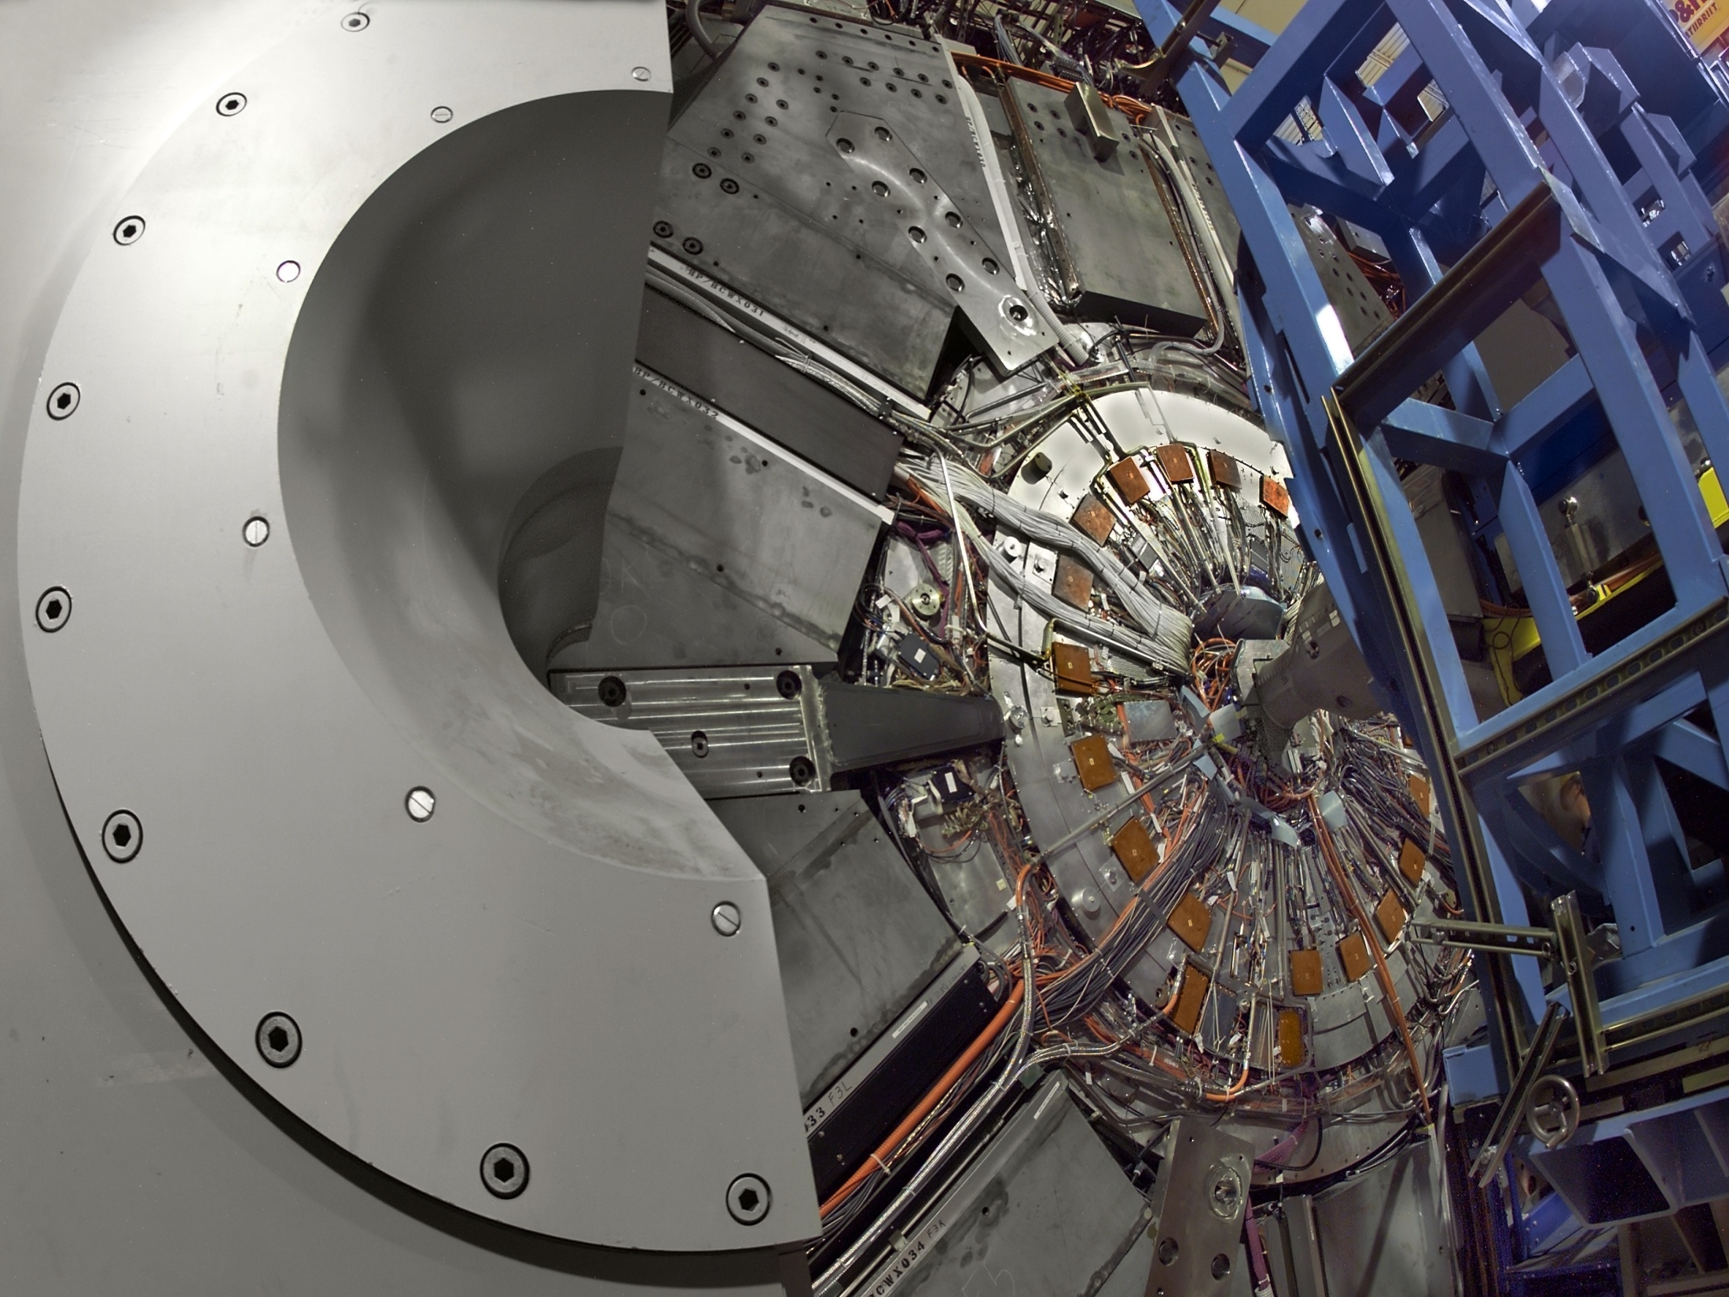
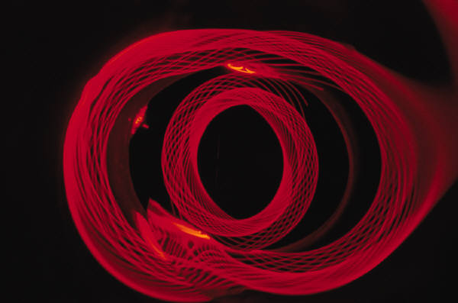
Particle
accelerator

Slide 32
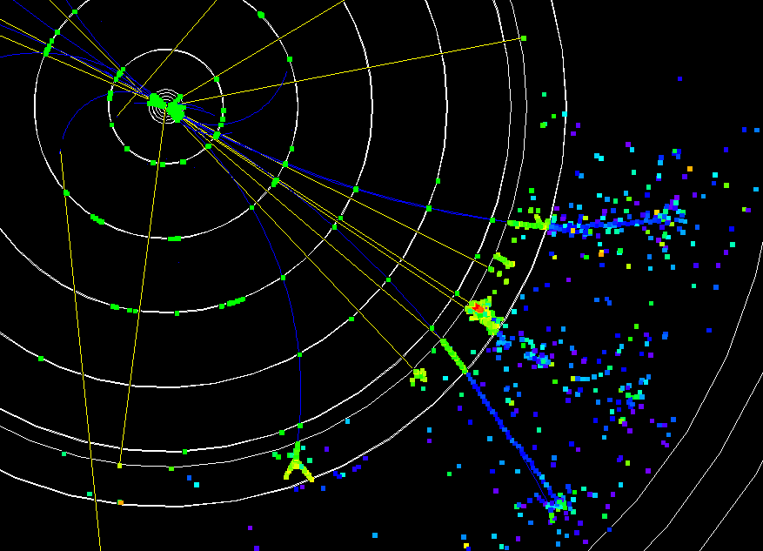

Slide 33
Proton
Made of
3 Quarks
1 up
2 down
d
u
d

Slide 34
Neutron
Made of
3 Quarks
2 up
1 down
u
d
u

Slide 35
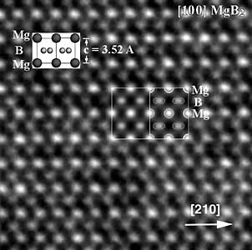
Can we see atoms?
Yes
magnesium atoms (white) above boron atoms (grey) seen by the transmission electron microscope

Slide 36
Photon a particle of light.
Electromagnetic radiation
ALL light. Visible AND invisible visible light , x-rays, gamma rays, radio waves, microwaves, ultraviolet rays, infrared.

Slide 37

Photon a particle of light
Laser

Slide 38
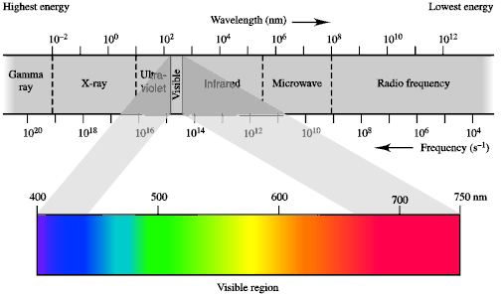
Electromagnetic radiation

Slide 39
A prism bends light.
Different Colors are bent
by different amounts.
White Light

Slide 40
Mass comparison
Proton is about
2000 x electron
Electron is about
1,000,000 x photon
e⁻¹
.
Proton Electron Photon

Slide 41
Matter
DO everything be made of matter ?
What are the building blocks of matter ?
How many elements are there?
What B da opposite of a mixture ?
Experiment (candle/hot air balloon)

Slide 42
Proton Neutron Electron
Electron shell / Electron cloud
Nucleus
The Atom

Slide 43
Nucleus
The center of the atom.
(it has protons & neutrons)
Electron shell / Electron cloud
The Atom

Slide 44
Proton Neutron Electron
Mass 1 dalton 1 dalton 0.0005
Charge +1 0 -1
1 dalton = 1 a.m.u.

Slide 45
Proton Neutron Electron
S orbital (2 electrons maximum)

Slide 46
Proton Neutron Electron
P orbital
(6 electrons maximum)

Slide 47

Proton Neutron Electron
P orbital
(6 electrons max.)

Slide 48
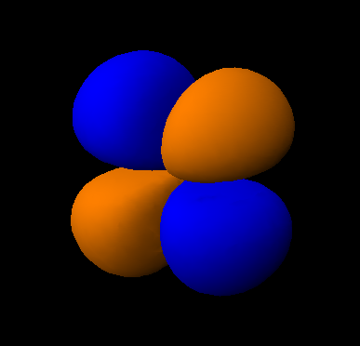
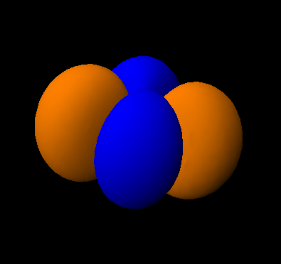
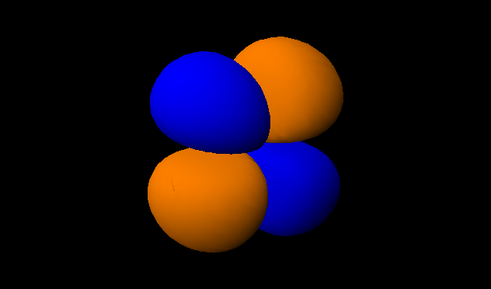
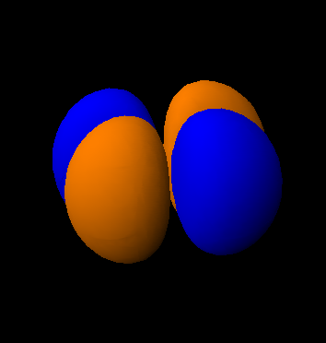
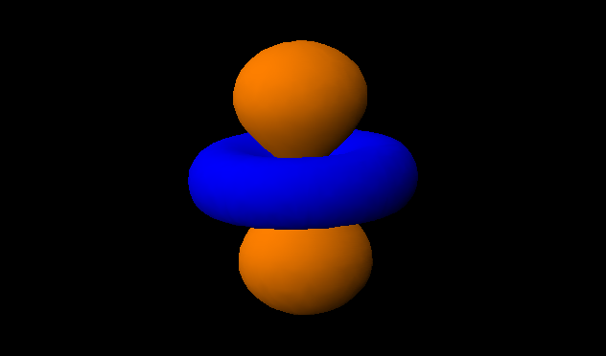
d orbitals
d
z
d
z
d
z
xz
xy
yz
x
y
y
x
y
x
d
z
d
z
x²-y²
z²
x
x
y
y

Slide 49
Proton Neutron Electron
S orbital P orbital

Slide 50
1st Shell of electrons
S orbital

Slide 51
2nd Shell of electrons
S orbital P orbital

Slide 52
3rd Shell of electrons
2 6 10
S orbital P orbital D orbital

Slide 53
4th Shell of electrons
2 6 10 14
s orbital p orbital d orbital f orbital

Slide 54
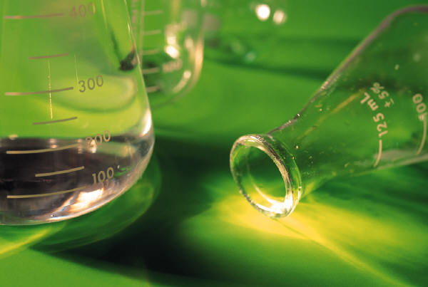
Element
Atom(s) having a specific number of Protons.

Slide 55
Elements
Made of atoms (basic unit of matter)
specific number of protons.
Over 100
H
He
Li
Be
B
C
N
O
F
Ne
Na
Mg
Al
Si
P
S
Cl
Ar

Slide 56



Electron Shells
Shell | S subshell | P subshell
1 | √ | x
2 | √ | √
3 | √ | √

Slide 57

Electron Shells
1S
2S
2P
3S
3P

Slide 58
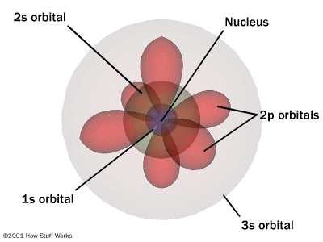

Slide 59

Atomic Number
The number of Protons in an atom.
H
1 +1
1.008
Hydrogen

Slide 60
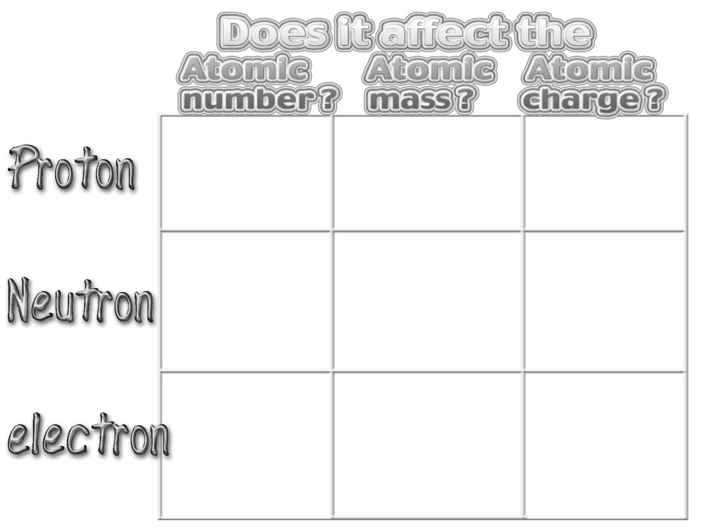
Oui
Oui
Oui
No
Oui
No
No
No
Oui

Slide 61

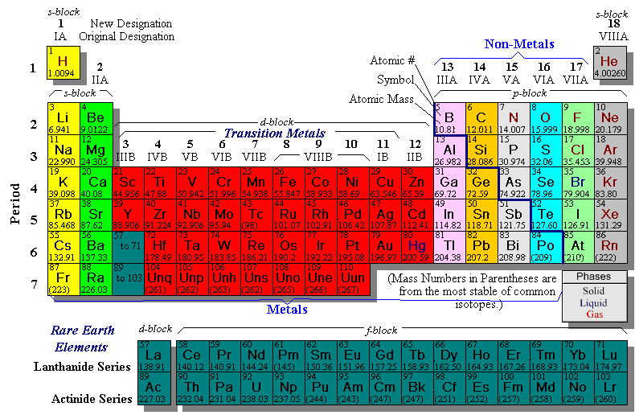

Slide 62
Dobla aqui
Sho mee
Yo pay per

Slide 63



Happines
Unhappy
Unstable
HIGH energy
Happy
Stable
LOW energy

Slide 64

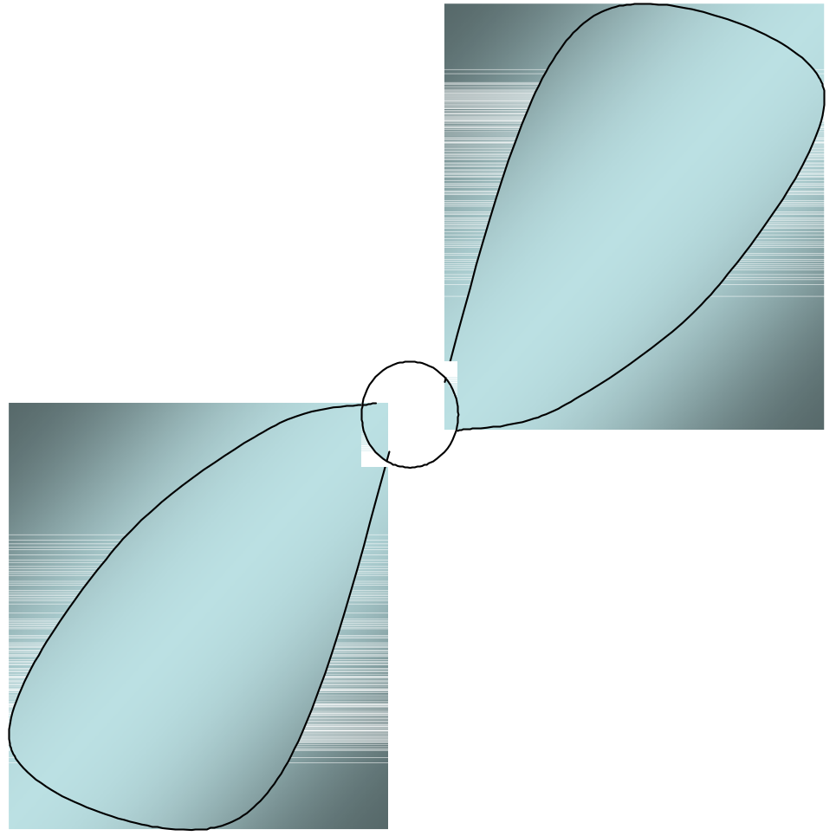
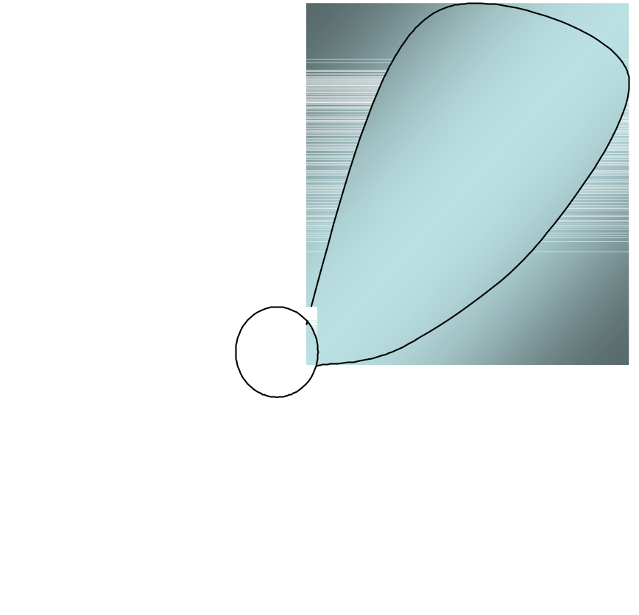
My fan club

Slide 67

atomic happiness
Electronic Balance
Zero charge FULL SHELL
P orbital full
(except He)

Slide 68

Hydrogen

Slide 69

Helium

Slide 70
Lithium

Slide 71
Beryllium

Slide 72


Boron

Slide 73
Carbon

Slide 74
Nitrogen

Slide 75
Oxygen

Slide 76
Fluorine
Halogen

Slide 77
Neon Inert Gas
Noble Gas

Slide 78

Atom
H
He
Li
Be
Shells
1S 2S 2P 3S

Slide 79
Atom
B
C
N
O
Shells
1S 2S 2P 3S

Slide 80

Atom
F
Ne
Shells
1S 2S 2P 3S

Slide 81
Atom
Na
Mg
Al
Si
Shells
1S 2S 2P 3S
?

Slide 82
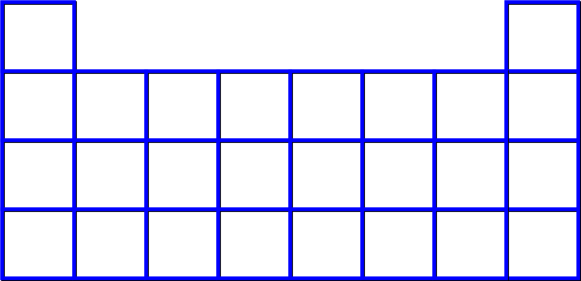


Valence Electrons
H He
Li Be B C N O F Ne
Na Mg Al Si P S Cl Ar
1 2 3 4 5 6 7 8
------------------------
The number of electrons in the outside shell.

Slide 83
Atomic number
(number of protons)
H
1 +1
Charge
average
Atomic
weight
1.008

Slide 84
Atomic number
(number of protons)
H
2 1 +1
(exact)
Atomic
weight
Charge

Slide 85
Atomic number
(number of protons)
F
9 -1
Charge
average
Atomic
weight
18.998

Slide 86
Isotopes
¹H ²H ³H

Slide 87
Isotopes
Atoms of the same element
(same number of protons) with a different number of neutrons.
H H

Slide 88
Cuanto Neutrons tienen ?
C
C
12 6
13 6

Slide 89
Isotopes
¹²C ¹³C
6 protons 6 protons
6 Neutrons 7 Neutrons

Slide 90

Isotopes
3 2 1
3 2 1
12 6
13 6
C
Legend
Proton
Neutron
Electron
C

Slide 91
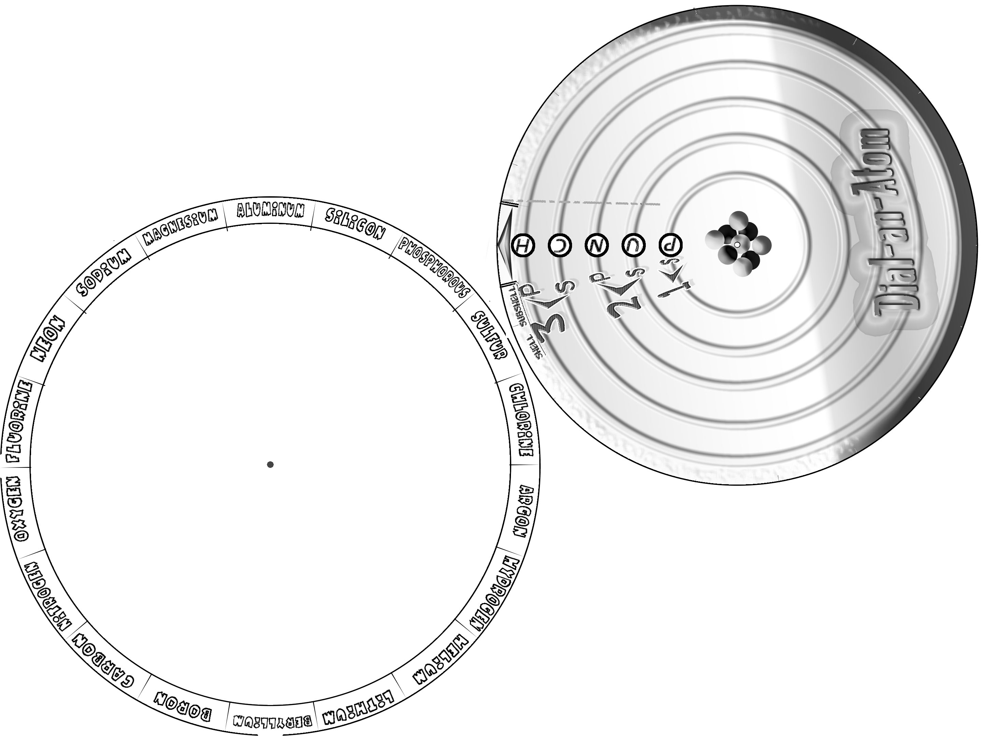

Slide 92
The rules:
The 1S orbital fills first
1S , 2S , 2P , 3S , 3P
S only holds 2
P only holds 6

Slide 93
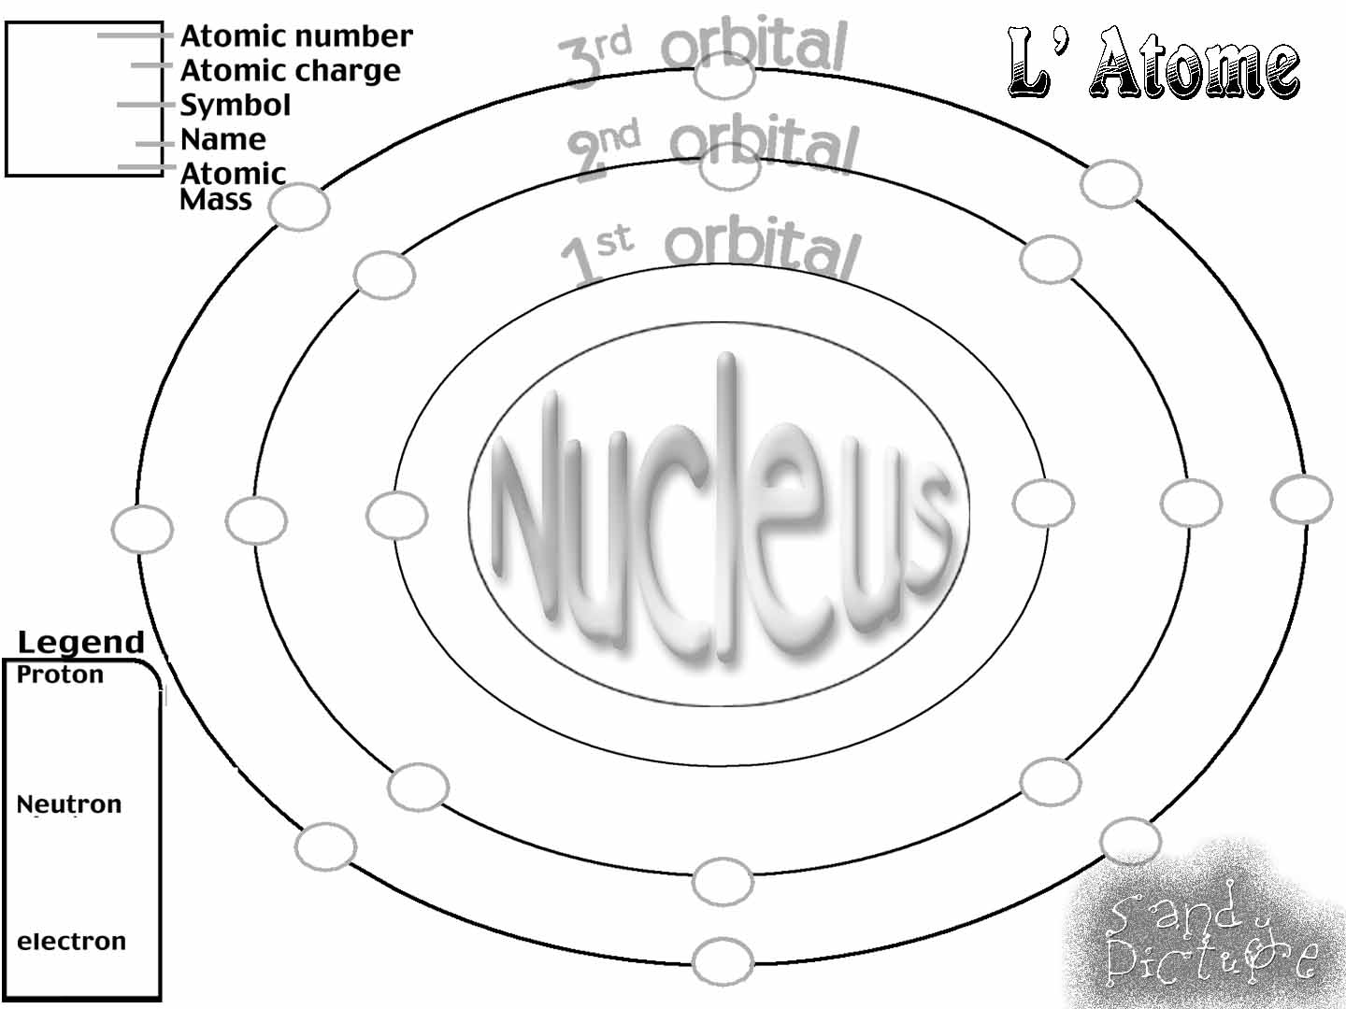

Slide 94
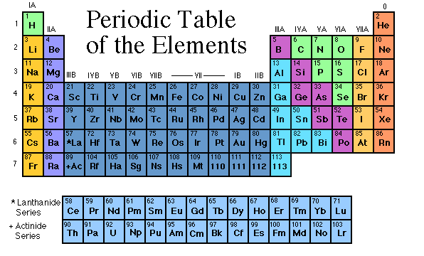
Noble (inert) Gases Group #8 atoms
P shell full
Very non-reactive
VERY happy

Slide 95
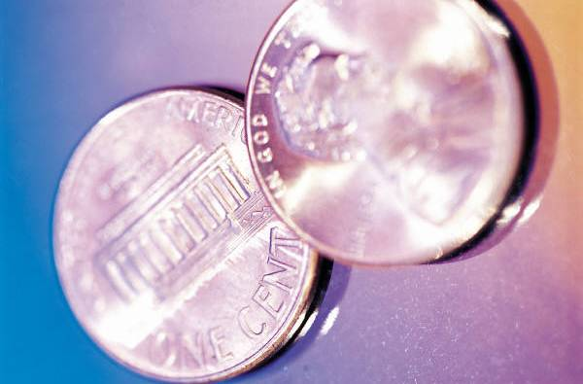


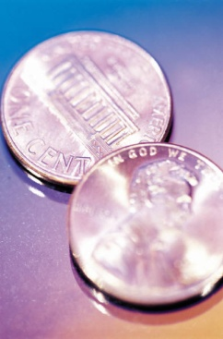
Dense
Shiny
Ductile
Metals
Extra electrons
Conductive
Malleable

Slide 96
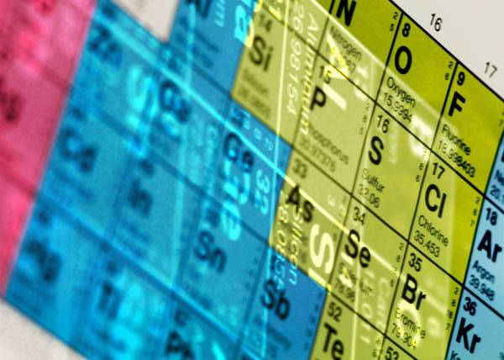
You walk into science class and discover a pile of shiny, silvery objects on your desk. Your teacher tells the class they will need to identify the element in each sample using the periodic table. Where on the periodic table, will you likely need to start looking?
a. on the right hand side
b. on the left hand side
c. near the top
d. near the bottom.

Slide 97


Metal an atom with 1-3 extra valence electrons.
Shiny
Dense
Malleable
Ductile
Electrical conductors
Thermal conductors

Slide 98
K
Na
Ca
Mg
Al
Mn
Cr
Fe
Cd
Sn
Pb
Cu
Hg
Ag
Au
Pt
Reactivity of metals
R
e
a
c
t
i
v
i
t
y
mo reactive
mo reactive

Slide 99

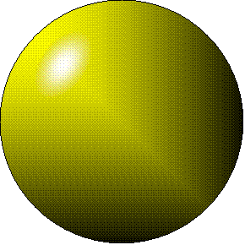
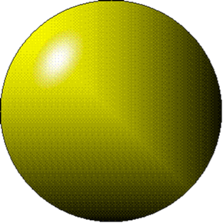
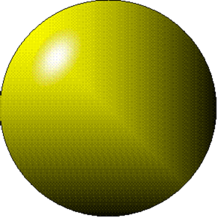
Individual metal atoms
with free outer shell electrons

Slide 100
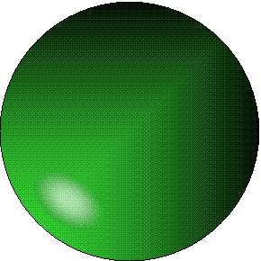

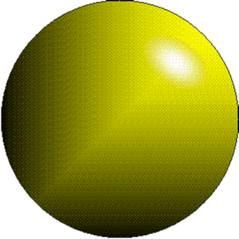
Metallic Bond the sharing of valence
electrons by neighboring metal atoms.

Slide 101
Electricity - electrons moving through a metal wire.

Slide 102
Non-Metals
missing electrons
Non-Conductive
NOT Malleable
Dull

Slide 103
Metalloids
Partly conductive

Slide 104
States of Matter
There are 4 States of Matter
(NOT really)

Slide 105
Solid

Slide 106
Liquid

Slide 107
Liquid

Slide 108
Liquid
Hot Liquid

Slide 109
Gas

Slide 110
Plasma
When atoms are so hot,
they lose ALL
of their
electrons.
“Superheated Gas”

Slide 111
Gas
Boiling
Condensation
Liquid
Sublimation
Melting
Freezing
Solid

Slide 112
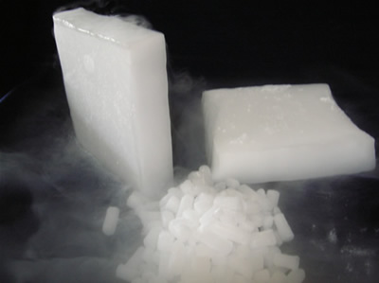


Gas
Sublimation
When a solid
turns directly
into a gas.
Liquid
Dry ice is
solid CO₂
Solid

Slide 113
Gas
Condensation
When a gas
turns into
into a liquid.
Liquid
Dry ice is
solid CO₂
Solid

Slide 114

Solid Liquid Gas Plasma
Made of
Atoms
Holds
its shape
Atoms move
past each
other

Slide 115
The solid, liquid, and gaseous states of water differ from each other in
the mass of the individual atoms.
the size of the individual atoms.
the net electrical charge of the individual molecules.
the average speed of movement of the individual molecules.

Slide 116

Fireworks contain different elements in them for displaying different colors. The different colors occur because:
a.the different elements burn at different temperatures.
b.atoms of various elements react with each other differently.
c.atoms of various elements emit light at different frequencies.
d.atoms of different elements have different numbers of protons.

Slide 117
Ionic bond
Li F
2
1
2
1

Slide 118

Ionic bond
Li F
2
1
2
1

Slide 119

Ionic bond
Li⁺¹ F⁻¹
2
1
2
1
The attraction between a cation and an anion.

Slide 120
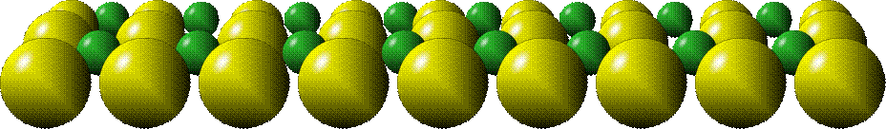
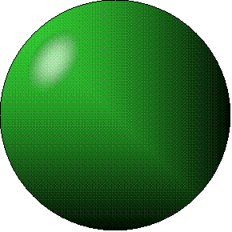
Crystal - a solid network of cations and anions held together by ionic bonds.

Slide 121


Ion
An atom or molecule with a + or – charge.

Slide 122


+
Cation
an ion with a positive charge.
Anion
an ion with a Negative charge.
-
A
I
O
N

Slide 123
Cations
H⁺ Hydrogen
Na⁺ Sodium
Mg⁺² Magnesium
Ca⁺² Calcium
Ag⁺² Silver

Slide 124
mo’ Cations
Fe⁺² Iron (II) Ferrous
Fe⁺³ Iron (III) Ferric
Cu⁺¹ Copper (I) Cuprous
Cu⁺² Copper (II) Cupric
NH₄⁺ Ammonium

Slide 125
Anions
F⁻¹ Fluoride
Cl⁻¹ Chloride
Br⁻¹ Bromide
I⁻¹ Iodide
The Halogens

Slide 126
Anions
OH⁻¹ Hydroxide
NO₂⁻¹ Nitrite
NO₃⁻¹ Nitrate
PO₄⁻³ Phosphate
SiO₄⁻² Silicate
SO₄⁻² Sulfate
MoO₄⁻³ Molybdate
B₄O₇⁻² Borate

Slide 127

Cathode Anode
NeverReady
+
-

Slide 128



SALT - a Cation and an Anion held together by an ionic bond.
opposites attract

Slide 129







Solution
Solvent Solute
H₂O NaCl

Slide 130
O
E
R
SolVent SolUte
The chemical The chemical
in a solution in a solution
that makes up that makes up
the greatest part. the least part.
N
DE
R

Slide 131

V
Sol ent
The chemical
in a solution
that makes up
the greatest part.

Slide 132





Solvent
Solute
Crystal
Salt Solution
Legend
Cation
Anion
Salt
Water

Slide 133
Covalent bond
when two atoms share a pair of electrons.
P⁺¹
P⁺¹

Slide 134

Covalent bond
when two atoms share a pair of electrons.
P⁺¹
P⁺¹
It’s like both atoms have a filled orbital.

Slide 135
Covalent Bond
The sharing of a pair of electrons between 2 atoms.
(or even 2 or 3 pairs of electrons).
H₂

Slide 136

Covalent Bond
The sharing of a pair of electrons between 2 atoms.
Li₂

Slide 137

Covalent Bond
The sharing of a pair of electrons between 2 atoms.
Cl₂

Slide 138



Molecule
Two or more atoms bonded together.
Compound Complex
A molecule with more than one element.

Slide 139











Common chemicals
H₂O₂
NH₃
NaOH
NaClO
I₂
Compound o molecule ?

Slide 140
Combustibility
The tendency to react with Oxygen O₂ .

Slide 141












Common Oxides
H + O₂
C + O₂
N + O₂
O + O₂
Si + O₂
Fe + O₂
H₂O
CO₂
NO₂
O₃
SiO₂
Fe₂O₃
Compound o molecule ?

Slide 142



Reaction Types
Nuclear
Chemical
Physical
Protons
&
Neutrons
change
Bonds
made/ broken
Electrons exchanged
No change in atoms
phase change
light emission/ absorption

Slide 143


Reaction Types
Nuclear
Proton Neutron
Change in the
Gain or lose Protons , Neutrons,
Alpha, Beta particle
Fission, Fusion, Radiation
nucleus

Slide 144



Slide 145
Reaction Types
2
1
Chemical
Bonds are made / broken
Change in oxidation states
Plasma
Li
⁺¹
P⁺¹
P⁺¹

Slide 146

evidence of Chemical Change:
development of a gas
formation of precipitate
change in color

Slide 147
NOT a Chemical Change:
crystalization
sublimation fluorescence

Slide 148
more evidence of
a Chemical Change:
light
fire
Flame Test
http://webmineral.com/help/FlameTest.shtml

Slide 149



Precipitate
formation of insoluble ionic compounds.

Slide 150

You get up in the morning and make toast for breakfast. You notice the color changes from light to dark. Later on that day in science class, your teachers asks for every day examples of physical and chemical changes.
Should you volunteer your toast as an example of a physical or chemical change?
Why?

Slide 151

Lucy noticed that her coin collection had begun to tarnish. Some of the metal in the coins had begun to change color. The formation of tarnish is most similar to which of the following changes?
shredding a piece of paper into hundreds of tiny strips
dropping a dinner plate on the floor
melting ice cubes in a glass of juice
burning a piece of paper to ashes in a fireplace

Slide 152
Simple Reactions
Synthesis
(Combination)
Decomposition
Single
Replacement
Double
Replacement

Slide 153
Synthesis
A
+
B
A
B
Decomposition
A
B
A
+
B
Single
Replacement
A
B
+
C
A
+
C
B
Double
Replacement
A
B
+
C
D
A
D
+
C
B

Slide 154
Synthesis
A
+
B
A
B
Decomposition
A
B
A
+
B
Single
Replacement
A
B
+
C
A
+
C
B
Double
Replacement
A
B
+
C
D
A
D
+
C
B

Slide 155




+
Synthesis
Decomposition
+
Single
Replacement
+
+
Double
Replacement
+
+

Slide 156


A displacement reaction:
metallic copper with silver nitrate
Cu + Ag NO₃
Ag + Cu(NO₃)₂

Slide 157





Balancing equations

Slide 158


2
Ag + Cl₂ AgCl
Total
atoms
1
2
1
1
2
2
Both sides must be equal
for ALL atoms.

Slide 159
2
2
Ag + Cl₂ AgCl
Total
atoms
1
2
1
1
2
2
2
Conservation of Matter
Both sides must be equal
for ALL atoms.

Slide 160

CH₄ + O₂→ CO₂+ H₂O
1
4
2
1
2
2
1

Slide 161

CH₄ + O₂→ CO₂+ H₂O
2
1
4
2
1
2
2
1
4
2

Slide 162
CH₄ + O₂→ CO₂+ H₂O
2
2
1
4
2
1
2
2
1
4
4
2

Slide 163
Ag + Cl₂ AgCl
Total
atoms
1
2
1
1
Both sides must be equal
for ALL atoms.

Slide 164
Reaction Types
Physical
No change in atoms / molecules
phase change (gas, liquid, solid)
light emission/absorption
Dissolving
Electrons passing through metals

Slide 165
Pure substance Mixture

Slide 166


Pure substance vs. Mixture
Only ONE element has 2 or more
or compound. elements/
(distilled water) compounds.

Slide 167

A chocolate chip cookie is an example of a _______, because ______________.
a. compound, the ingredients are chemically bonded.
b. compound, it is the same throughout.
c. mixture, you can separate out the chips.
d. mixture, you cannot distinguish between the ingredients.

Slide 168

Distilled water

Slide 169


Air is a mixture of several gases.
Name Formula amount
Nitrogen N₂ 78 %
Oxygen O₂ 21 %
Argon Ar 1 %
Carbon CO₂ 0.03 %
Dioxide

Slide 170





Air is a mixture of several gases
Name Formula amount
Neon Ne 0.002 %
Methane CH₄ 0.0002 %
Helium He 0.000524 %
Krypton Kr 0.000114 %
Hydrogen H₂ 0.00005 %
Xenon Xe 0.0000087 %
Noble (inert) Gas

Slide 171

Nitrogen, Oxygen and Helium are pure substances in a gaseous state.

Slide 172



Atoms are NOT the same as molecules.
Air and oxygen are NOT the same.
Helium and hot air are NOT the same.

Slide 173




Helium and hot air are NOT the same.

Slide 174
Diffusion
the natural mixing of two substances. It is caused by random molecular motion.

Slide 175



Radioactivity
Alpha
Particle
unstable
nucleus
Beta Particle
(Electron)
Gamma Particle
(light)
Positron
emission

Slide 176
Radioactivity
Alpha Particle
2 Protons
2 Neutrons
radioactive particles and rays
Beta Particle
(Electron)
Gamma Particle (light)

Slide 177

Radioactive decay
Radioactivity
Change in the nucleus of an atom
Loss of an Alpha, Beta, or Gamma particle

Slide 178
3 forms of Radioactive Decay
Radioactivity
Alpha emission | Changes atomic Weight | 2P 2N
Beta emission | Neutron turns into a Proton | electron
Gamma emission |  | light

Slide 179


It’s time to learn about . . .
the Mole !

Slide 180

Avogadro asked . . .
Q: If ONE Hydrogen atom weighs 1.008 daltons,
how many Hydrogen atoms would it take to weigh 1.008 grams ?
1
H
1.008

Slide 181


Answer: 6.023 x 10^{23 ←} ^{that many}
602,300,000,000,000,000,000,000
one Mole

Slide 182
Q: If ONE Sodium atom weighs
22.99 daltons,
how many Sodium atoms would it take to weigh 22.99 grams ?
one Mole
11
Na
22.990

Slide 183


What does one Mole of Lithium atoms weigh ?
What does one Mole of Carbon atoms weigh ?
What does one Mole of O₂ molecules weigh ?
What does one Mole of Water molecules weigh ?

Slide 184

Six munths ago
I cudnt evun spelt chemissed.
An now I are one.

Slide 185


Panther Productions
© 2007 Dr. Jacob Israel
All Rights Reserved

Slide 186
This powerpoint was kindly donated to www.worldofteaching.com
https://www.worldofteaching.com is home to over a thousand powerpoints submitted by teachers. This is a completely free site and requires no registration. Please visit and I hope it will help in your teaching.

