Slide 1


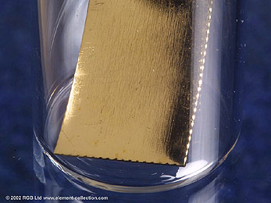
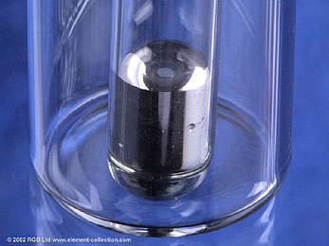
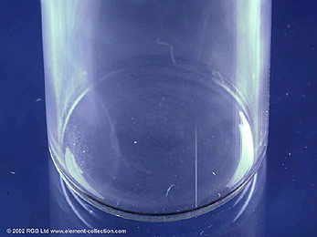
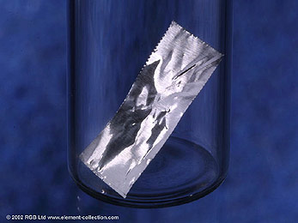
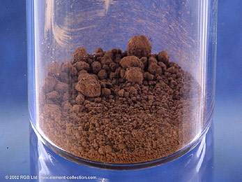
Atoms and the Periodic Table.
We can classify (arrange) elements in different ways:-
naturally occurring/made by scientists
solid/liquid/gas
metal/non-metal

Slide 2
The Periodic Table of the Elements.
The Periodic Table lists the chemical elements in increasing
atomic number.
The Periodic Table arranges elements with similar chemical properties in
groups (vertical columns).
All the elements in a group have similar
chemical properties as they have
the same number of outer electrons.

Slide 3

The Periodic Table of the elements is a useful way of classifying the elements.
A vertical column of elements in the periodic table is called a
group.
The elements in the same group of the periodic table have
similar chemical properties.
The noble gases are a group of very
unreactive elements.

Slide 4




Groups of elements have names: –
Group 1 -
the alkali metals
Between groups 2 and 3 -
the transition metals
Group 7 -
Group 0 -
the halogens
the noble gases

Slide 5
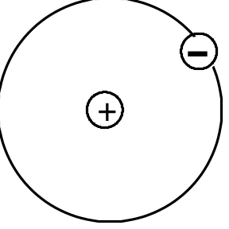
Every element is made up of very small particles called
atoms.
Atoms of different elements have a different number called the
atomic number.
Atoms have a very small, positively charged
nucleus, with negatively charged electrons outside the nucleus in
energy levels.

Slide 6
The nucleus of every atom (except hydrogen) contains two particles:-
Protons (+ve charge / mass 1amu)
Neutrons (no charge / mass 1amu)
In energy levels outside the nucleus we find
Electrons (–ve charge / mass 1/2000amu)

Slide 7
Atoms are neutral because the positive charge of the nucleus is equal to all of the negative charges of the electrons added together.
11 electrons
11 negative charges
11 protons
11 positive charges
Atoms are neutral because the numbers of protons and electrons are equal - the opposite charges cancel.

Slide 8
Nuclide notation – how many protons, neutrons, and electrons in atoms?
Mass number
(protons + neutrons)
37
Cl
Atomic number
(number of protons)
–
17
number of neutrons
20
As atoms have no charge, the number of electrons is the same as the number of protons. This atom has 17 electrons.

Slide 9
Nuclide notation – how many protons, neutrons, and electrons in ions?
Mass number
(protons + neutrons)
23
Na⁺
Atomic number
(number of protons)
–
11
12
number of neutrons
1+ charge means 1 electron less than the number of protons. This atom has 10 electrons.

Slide 10
Nuclide notation – how many protons, neutrons, and electrons in ions?
Mass number
(protons + neutrons)
16
O^{2–}
Atomic number
(number of protons)
–
8
8
number of neutrons
2– charge means 2 electrons more than the number of protons. This atom has 10 electrons.

Slide 11
Isotopes.
Isotopes are:
atoms of the same element
which have different mass numbers
due to different numbers of neutrons in each nucleus.
Most elements exist as a mixture of isotopes, e.g. chlorine has 2 isotopes
35
37
Cl
Cl
17
17

Slide 12
Relative atomic mass
The relative atomic mass of an element is the average mass of all the isotopes of that element.
The relative atomic mass of chlorine is 35.5. Chlorine has 2 isotopes
35
Cl
37
Cl
17
17
so the isotope of mass 35 is present in the largest quantity.

Slide 13
This powerpoint was kindly donated to www.worldofteaching.com
http://www.worldofteaching.com is home to over a thousand powerpoints submitted by teachers. This is a completely free site and requires no registration. Please visit and I hope it will help in your teaching.

