Slide 1
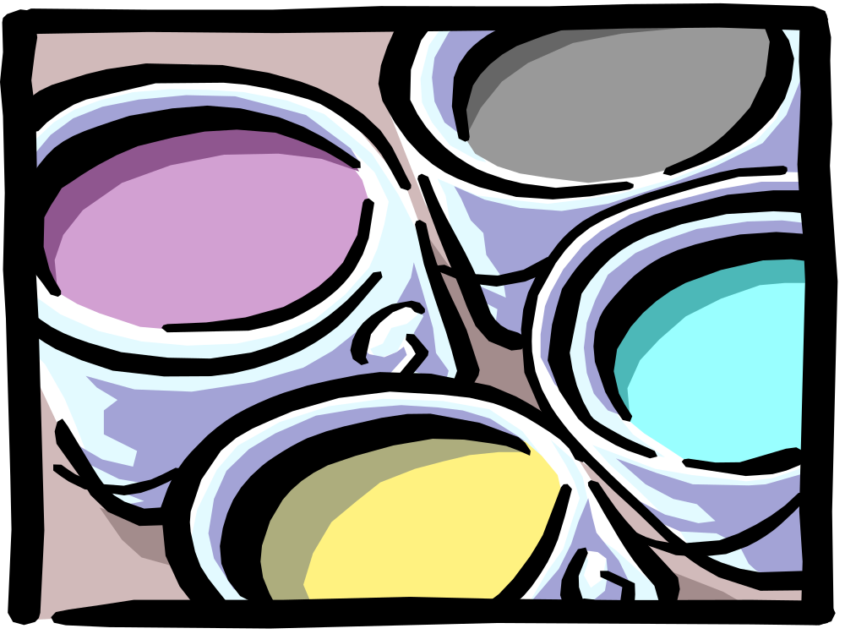
Azo Compounds

Slide 2
What are azo compounds?
Contain the -N=N- group.
Where R and R’ are arene groups more stable than alkyl groups.
Azo group is stabilised by becoming part of extended delocalised system.
Result of a coupling reaction between a diazonium salt and a coupling agent.
R-N=N-R'
Azo group

Slide 3
Diazonium salts
N⁺≡N Cl⁻
Only stable salts are aromatic - not particularly stable.
Lose -N⁺≡N as N_{2(g)}
Electron rich benzene ring stabilises the -N⁺≡N group but decomposition occurs above about 5ºC.
Add cold soln. sodium nitrite (NaNO₂) to arylamine soln. In dilute acid below 5ºC.
Diazotisation.
Prepare fresh and use immediately.

Slide 4
How the salt is made.
Acid reacts with sodium nitrite to form unstable nitrous acid.
NaNO_{2 (aq)} + HCl _{(aq)} →HNO₂ _{(aq)} + NaCl _{(aq)}
Nitrous acid reacts with the arylamine.
+ HNO₂ + H⁺ →
NH₂
N⁺≡N + 2 H₂O
phenylamine
benzenediazonium ion

Slide 5
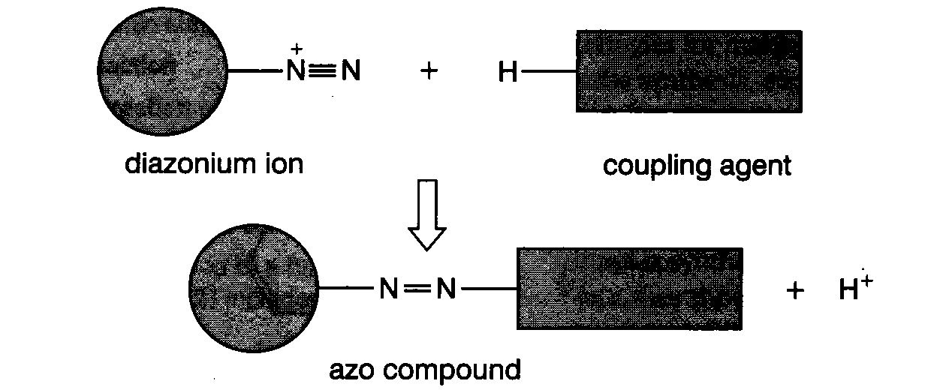
Diazo coupling reactions
A diazonium salt reacts with another compound containing a benzene ring called a coupling agent.
Diazonium salt acts as an electrophile - reacts with benzene ring of coupling agent.
Coloured precipitate of azo compound immediately forms.
Important use as dyes.

Slide 6
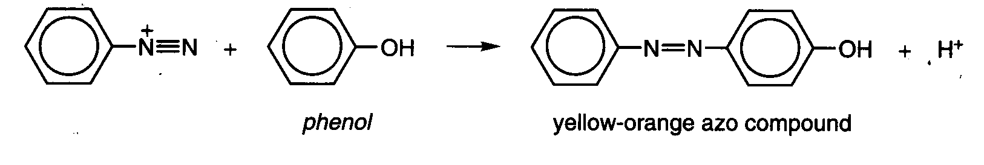
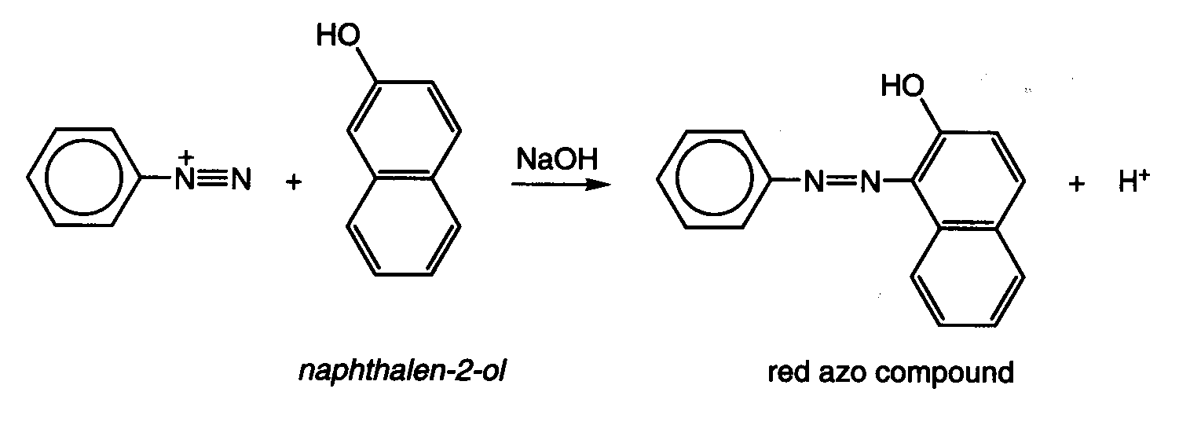
Coupling with phenols
Benzenediazonium salt and alkaline phenol gives a yellow orange azo compound
Benzenediazonium salt and alkaline naphthalen-2-ol gives a red azo compound.

Slide 7
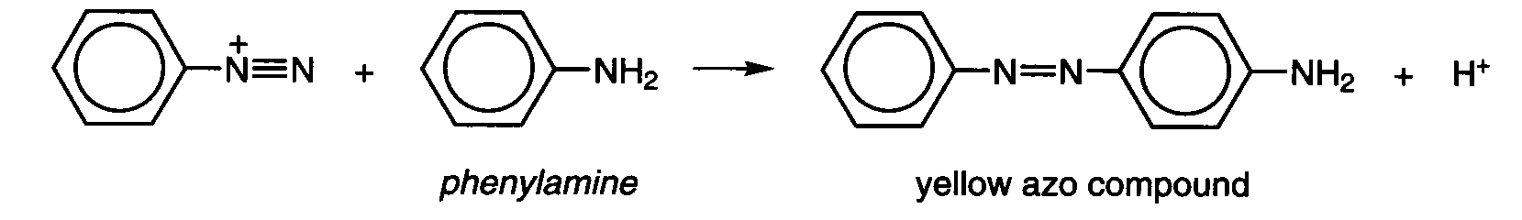
Coupling with amines
Diazonium salts couple with arylamines.
Benzenediazonium salt and phenylamine gives a yellow azo compound.
Use different diazonium salts and coupling agents to make different colours.
Azo compounds are stable so dyes do not fade.

Slide 8
This powerpoint was kindly donated to www.worldofteaching.com
http://www.worldofteaching.com is home to over a thousand powerpoints submitted by teachers. This is a completely free site and requires no registration. Please visit and I hope it will help in your teaching.

