Slide 1
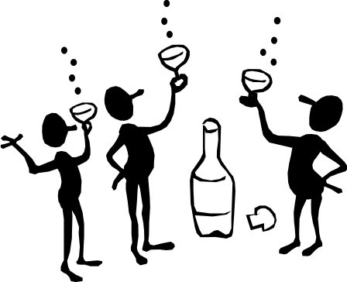
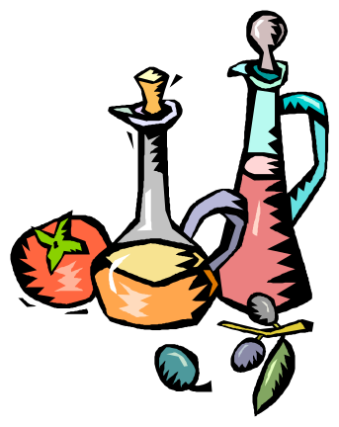
Alcohols revisited (and ethers)
and going further...
13.3 Carboxylic acids and their derivatives

Slide 2
Alcohols
homologous series containing the OH hydroxyl group.
all names end in ol eg methanol, ethanol etc.
isomers are possible for alcohols containing 3 or more carbons.
label position of OH group so that it has the lowest number possible.
polyhydric alcohols contain more than one OH group eg propane- 1,2,3,triol
OH groups attached to benzene rings are called phenols.

Slide 3
Physical properties of alcohols
Molecules are polar, in the O-H bond, O is δ⁻ and H is δ⁺
Molecules have attractive forces between the molecules called hydrogen bonds, not as strong as covalent bonds.
Higher boiling point than corresponding alkanes.
Hydrogen bonds form between alcohol and water molecules therefore they are miscible / soluble.
Long chain alcohols are less soluble.

Slide 4
Ethers
General formula R-O-R’
O-R’ alkoxy group substituted for H eg
CH₃-CH₂-CH₂-O-CH₃ methoxypropane
Longer hydrocarbon chain is parent alkane for naming.

Slide 5
Physical properties of ethers
Molecules only slightly polar.
No hydrogen on the oxygen atoms to form hydrogen bonds – only weak forces of attraction between molecules.
Boiling points similar to corresponding alkane.
Lower ethers, very volatile, highly flammable.
Only slightly soluble in water, mix well with other non-polar solvents eg alkanes. (Like dissolves like).

Slide 6
Carboxylic acid structure
Formula -COOH
Oxygen atoms not joined together.
General formula when rest of structure is an alkyl group R-COOH.
O
C
O
H
Carboxyl group

Slide 7
Naming carboxylic acids
Alkanes
CH₄ methane
CH₃ -CH₃ ethane
CH₃-CH₂-CH₃ propane.
CH₃-CH(CH₃)-CH₂-CH₃ 2-methylbutane
Carboxylic acids
H-COOH methanoic acid
CH₃ -COOH ethanoic acid
CH₃-CH₂-COOH propanoic acid
CH₃-CH(CH₃)-CH₂-COOH 3-methylbutanoic acid

Slide 8
Naming more complex examples
Two carboxylic acid groups -dioic
Carboxyl group can be attached to a benzene ring eg benzenecarboxylic acid.
COOH
COOH
COOH
ethanedioic acid
COOH
benzene-1,4-dicarboxylic acid
COOH
COOH
CH
2
benzenecarboxylic acid (benzoic acid)
COOH
propanedioic acid

Slide 9
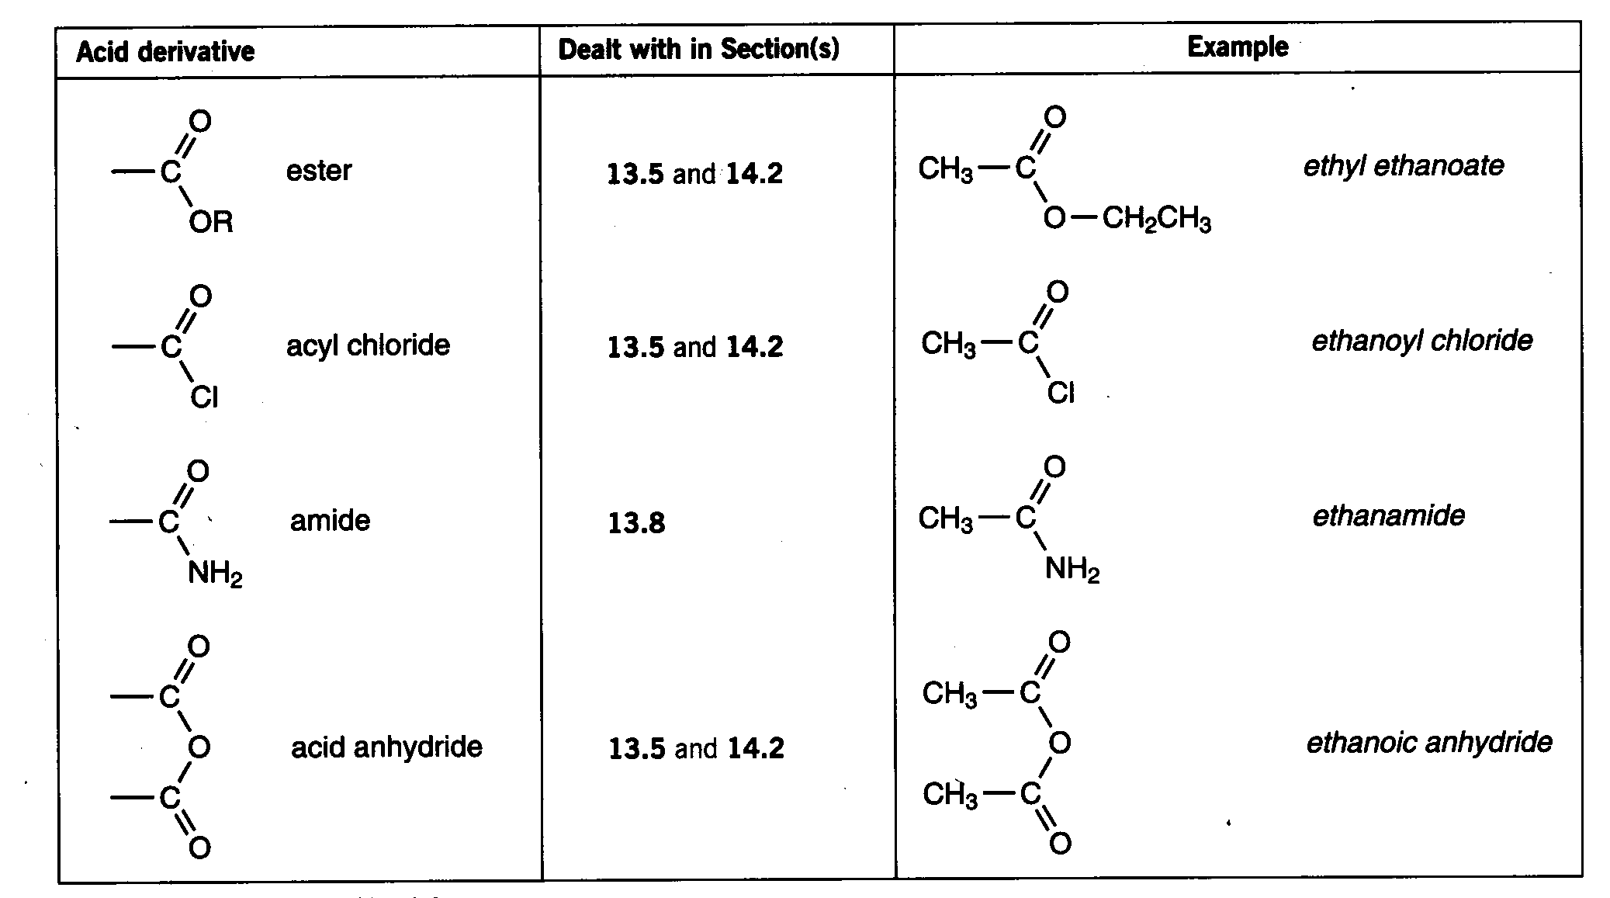
Carboxylic acid derivatives
If the -OH group is replaced carboxylic acid derivatives are formed.

Slide 10
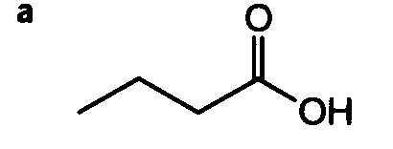
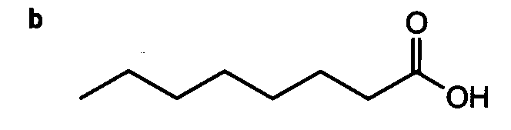
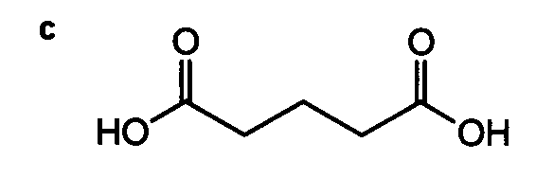
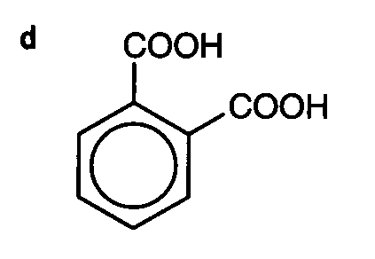
Naming practise.
Name these structures
Butanoic acid
Octanoic acid
Pentanedioic acid
Benzene-1,2-dicarboxylic acid

Slide 11
This powerpoint was kindly donated to www.worldofteaching.com
http://www.worldofteaching.com is home to over a thousand powerpoints submitted by teachers. This is a completely free site and requires no registration. Please visit and I hope it will help in your teaching.

