Slide 1
Unit 2: Bonding

Slide 2
Overview
Covalent Bonding
Ionic and Metallic Bonding
Electronegativity
Molecular Shape
Polarity
Ionic Crystals
Network Solids
Intermolecular Forces

Slide 3
Covalent Bonding
Bonds between atoms are formed through the sharing of electrons
Covalent bonds form between two non-metal atoms through sharing of pairs of electrons
Atoms have a “desire” to have their outer energy levels filled (Octet Rule)
Covalent bonding can be represented with Lewis Dot Diagrams

Slide 4
Lewis Dot Diagrams
Lewis Dot Diagrams show the sharing of electrons between atoms and where the bonds form
atoms share electrons to fill their outer energy levels (8 electrons in their outer shell)
The exception is hydrogen (2 electrons in its outer shell)

Slide 5
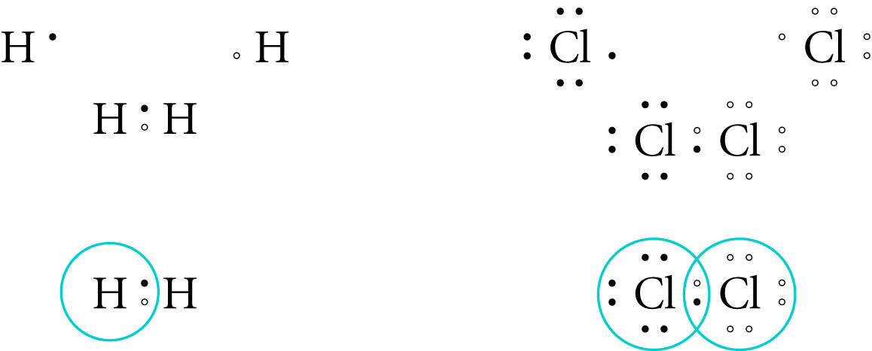
Lewis Dot Diagrams for Hydrogen and Chlorine Gas
The first row shows the atoms before they are bonded
The second row shows the sharing of electrons to fill the outer energy level
The third row has circles around the electrons to show those that belong to each atom. Where the circles overlap represents a covalent bond

Slide 6
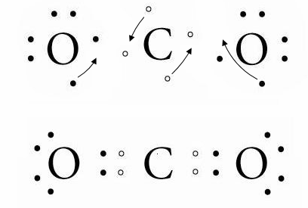
Multiple Bonds
Double and triple bonds can form between atoms in order to fill the outer energy level
This occurs when two atoms share more than one pair of electrons

Slide 7
Multiple Lewis Structures
Some molecules can have more than one possible Lewis structure, usually when one single bond and one double bond can be exchanged within the rules of drawing Lewis structures
Example of SO₂ (g)

Slide 8
Structural Diagrams
Lewis Diagrams can be converted to structural diagrams for convenience
Structural diagrams use lines to represent a bond, or a pair of electrons, but it does not show lone electron pairs
Example: Chlorine Gas

Slide 9
Lewis Dot Diagram Worksheet
Using the rules for drawing Lewis dot diagrams, complete the worksheet (LDD and structural)
For extra practice, try the Lewis Structures Thought Lab

Slide 10
Stereochemistry – The Structures of Molecular Compounds
So far we have seen molecules represented in 2-D
However, molecules are actually 3 dimensional
To predict 3 dimensional molecular shapes we use VSEPR theory (Valence-Shell Electron-Pair Repulsion)
Based on the electrostatic repulsion of electron pairs

Slide 11
Note that the repulsion force is strongest between two lone pairs and the weakest between two bonded pairs, and the repulsion between a lone pair and a bonded pair is intermediate
We apply the VSEPR theory to a central atom that has an octet of electrons in its valence shell, and there are three categories of shapes; linear, trigonal planar, and tetrahedral
In VSEPR, an electron group is a bond (single or multiple) or a lone pair

Slide 12
Linear
Forms when a central atom has two electron groups
The shape is linear because the electron groups try to arrange themselves as far apart as possible
The bond angle between the electron groups is 180⁰
The central atom is bonded to two other atoms by two double bonds or a combination of a single bond and a triple bond

Slide 13
Trigonal Planar
A central atom with three electron groups has a trigonal planar shape
The bonding angle between the electron groups is 120º
The central atom is either bonded to three atoms(trigonal planar), or two atoms and a lone pair(bent or V-shaped)

Slide 14
Tetrahedral
A central atom with four electron groups has a tetrahedral shape
The bonding angles between the electron groups is 109.5º
The central atom can be bonded to four atoms (tetrahedral), three atoms and a lone pair (trigonal pyramidal), or two atoms and two lone pairs (bent or V-shaped)

Slide 15
Information Summary
# of lone electron pairs around the central atom | # of bonds around the central atom | Shape of the molecule | Bond angles around the central atom
0 | 4 | Tetrahedral | 109.5
0 | 3 | Trigonal Planar | 120
0 | 2 | Linear | 180
1 | 3 | Pyramidal | 107.3
2 | 2 | V-shaped or bent | 104.5
1 | 2 | V-shaped or bent | 119.5

Slide 16
Steps to Predicting Molecular Shapes
Draw a primary LDD of the molecule
Determine the total number of electron groups around the central atom
Determine the types of electron groups (bonding pairs or lone pairs)
Determine which shape will accommodate the combination of electron groups

Slide 17
Electronegativity
Electronegativity is a measure of the relative ability of an element’s atoms to attract the shared electrons in a chemical bond.
Higher electronegativities mean a greater attraction for the electrons.
Fluorine is the highest with a value of 4.0

Slide 18
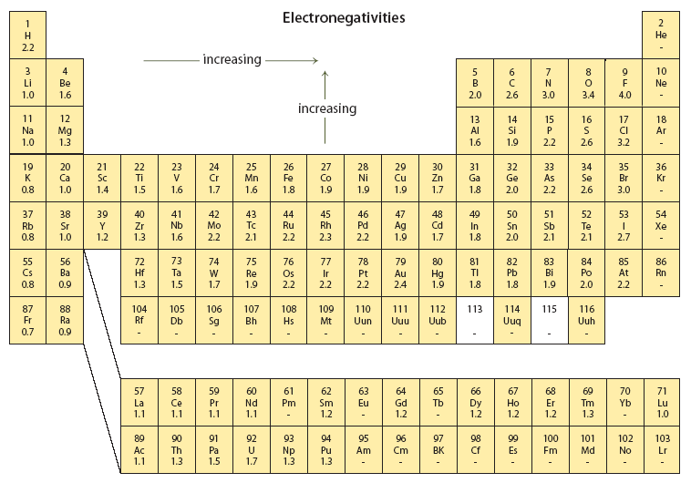

Slide 19
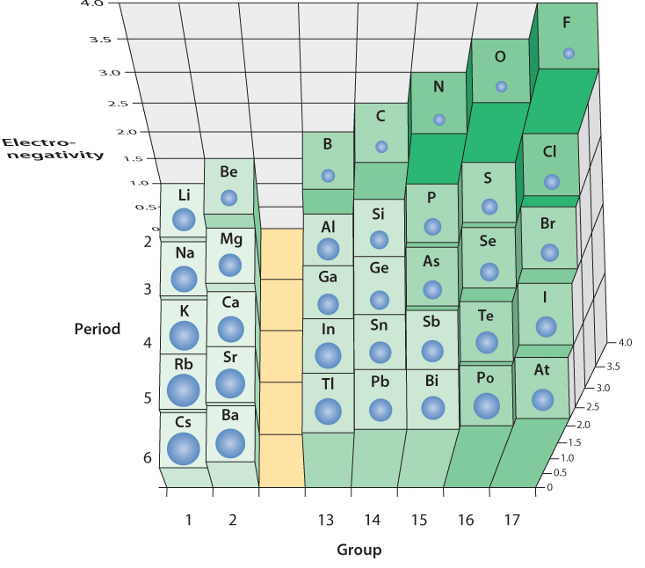

Slide 20
Electronegativity
For main group elements, electronegativity tends to increase with the group number (left to right on the periodic table).
Notice the noble gases do not have electronegativities, why is that?
Electronegativities also increase as you move vertically up a group number.

Slide 21
Atom Size
For any period in the periodic table, as you move right the size of the atom decreases
Why does this trend exist?

Slide 22
Atom size
As the number of protons increases, the force attracting the electrons increases
The electrons are pulled closer to the nucleus of the atom

Slide 23
Polarity
The difference of electronegativity between two bonding atoms can be measured by subtracting the smaller number from the larger number.
The difference in the two electronegativities determines the nature of the bond

Slide 24
Polarity
Bonds that are sharing electrons UNEQUALLY between two atoms are called POLAR COVALENT BONDS
If the atoms are identical (equal electronegativity), the bond will not be polar. This is called NON-POLAR COVALENT BONDS

Slide 25
Polar covalent bonds have a positive “pole” and a negative “pole” so they are also referred to as “bond dipoles”
Polar covalent bonds have an electronegativity difference between 0 and 1.7
Ionic bonds have an electronegativity difference between 1.7 and 3.3

Slide 26
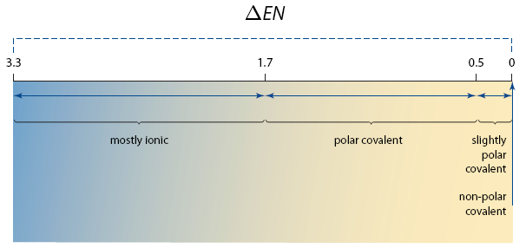

Slide 27
Polar Molecules
Are molecules that contain polar bonds necessarily polar?
Examples of H₂O and CO₂
To determine if a molecule is polar we need to look at the overall direction of polarity
Draw in polarity arrows on your molecule and determine if the molecules are polar or not

Slide 28
Ionic Bonds
Ionic bonds form from the electrostatic attraction between oppositely charged ions
Atoms become ionic by losing or gaining electrons from the atom it is bonding with
Remember that an atom will lose its electrons to fill its outer level if its valence level is less than half full, as it is with metals

Slide 29
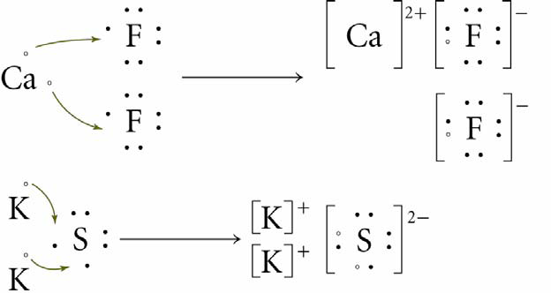
Electron Exchange and Ionic Bond Formation

Slide 30
Metallic Bonding
Metals can form bonds with other metals, but it is neither covalent or ionic
Metals cannot share electrons to form an octet of electrons around each atom
Imagine 8 sodium atoms all trying to share the same 8 electrons

Slide 31
Although metal atoms do not form covalent or ionic bonds with each other, there must be relatively strong attractive forces holding the atoms together or else the metals would be in a gaseous state
In metallic bonding, the valence electrons are delocalized, which means they are free to move from one atom to the next

Slide 32
Because the electrons are free to move, all of the atoms share all of the valence electrons
It is the electrostatic force between the positively charged metal ions and the negative electrons that make the metallic bond

Slide 33
Ionic Crystals
Rather than one metal bonding to one non-metal, ionic substances have their ions packed together in a crystal lattice
The crystals can also be represented in a ball and stick model

Slide 34
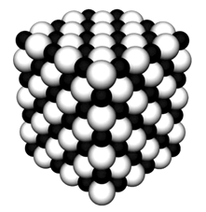
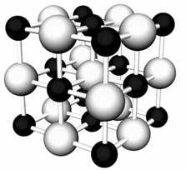


Slide 35
The sticks represent the attractive forces between the ions
Since all the attractions are equal, there are no pairs of ions to be identified as molecules
Therefore the formula only represents the ratio of the ions in the crystal

Slide 36
The smallest ratio of ions in the crystal is called a formula unit, not a molecule
Shape of the macroscopic crystals is determined by the way their ions pack together
The smallest set of ions in a crystal needed to make the pattern is called a unit cell

Slide 37
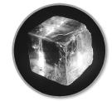
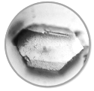

Table Salt Sucrose Uncut Diamond

Slide 38
The size of each ion influences the pattern of ions
Another influence is the relative charge of the ions, and therefore the ratio of ions in the crystal

Slide 39
Crystal formation
Many beautiful crystal formations can be found in nature as well as in the laboratory

Slide 40
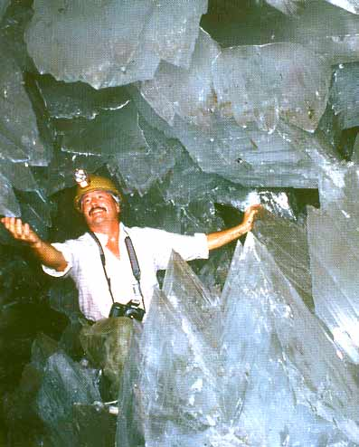
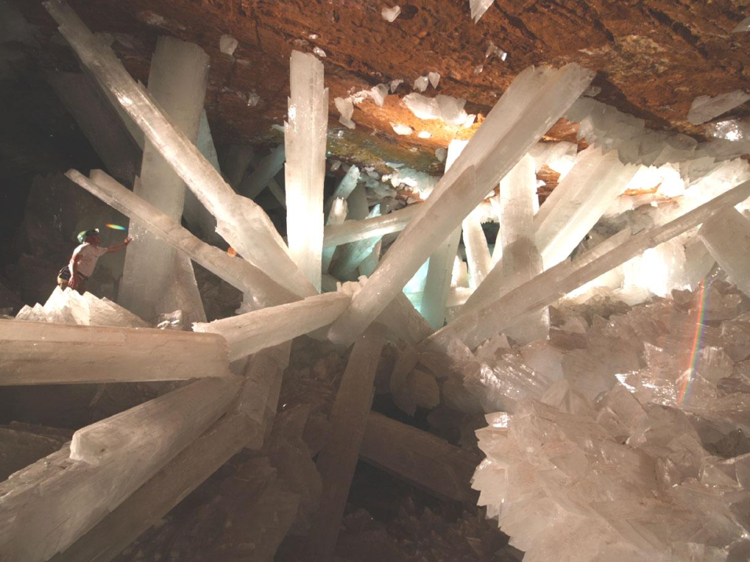
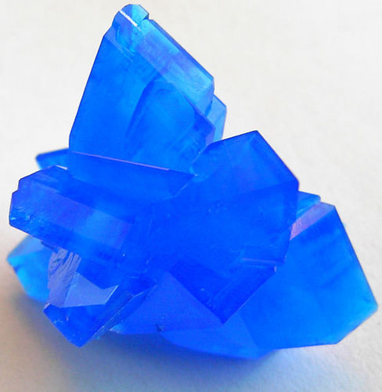

Slide 41
Network Solids
Like ionic crystals, but they are held together with covalent bonds
Single elements can form an array of different network solids
Eg. Carbon forms graphite, diamond, nanotubes (pg. 60)

Slide 42
Each different network solid of the same element just has different arrangement of the atoms
Some network solids contain two different elements
Eg. Silicon Dioxide (sand, quartz)

Slide 43
Questions

Slide 44
Intermolecular Forces
Covalent bonds exist between atoms within a molecular compound
These covalent bonds are called intramolecular forces
Forces holding entire molecules together are called intermolecular forces

Slide 45
Dipole-Dipole Forces
Occurs between polar molecules
Polar molecules have a positive pole and a negative pole so they are called dipoles
When two dipoles come close to each other, the positive pole of one is attracted to the negative pole of the other

Slide 46
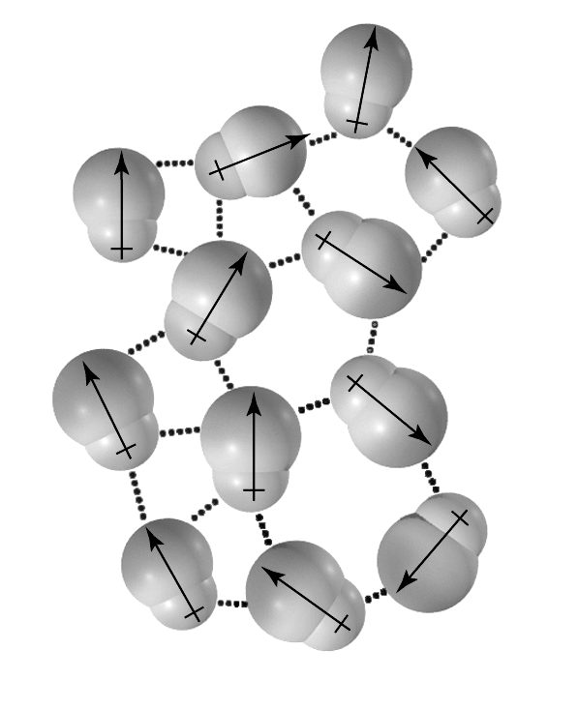
Dipole-Dipole Attractions

Slide 47
Each molecule can be attracted to four or more other polar molecules at the same time
This is called Dipole-Dipole Attraction
Not as strong as ionic attraction, but can be strong enough to stabilize a solid crystal
Eg. Table sugar

Slide 48
Hydrogen Bonding
Special dipole-dipole attraction that occurs between hydrogen and highly electronegative atoms such as oxygen, nitrogen, or fluorine
The positive nucleus of the hydrogen atom is attracted to the slightly negative charge on the other atom
Much stronger than other dipole-dipole attractions

Slide 49
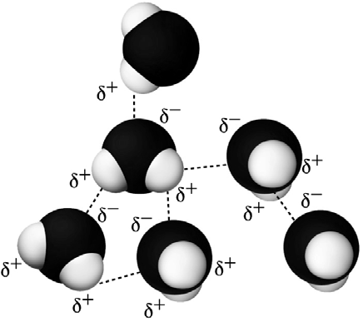

Slide 50
Hydrogen Bonding in Water
Hydrogen bonding is an important factor that influences the structure and properties of water
One oxygen atom can be hydrogen bonded to as many as 6 other hydrogen atoms in other water molecules

Slide 51
Hydrogen Bonds in Ice
Each water molecule is hydrogen bonded to four other water molecules
The water molecules in ice are farther apart than in liquid water, therefore ice is less dense than liquid water**
Hydrogen bonds are the strongest in the form shown in the next diagram

Slide 52
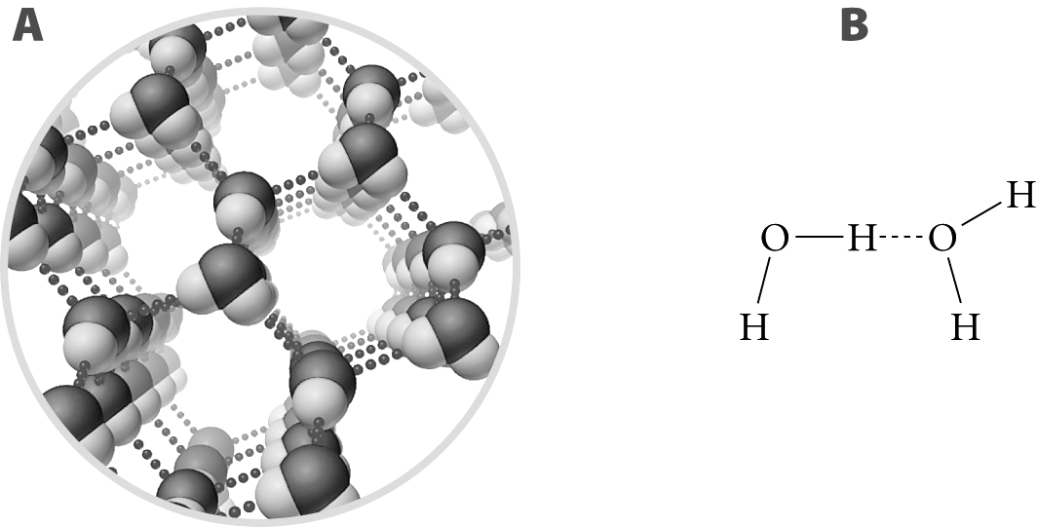

Slide 53
Unique Properties Reading
Read the handout on the unique properties of water

Slide 54
London Dispersion Forces
Dispersion forces act between all molecules, but in non-polar molecules they are the only force
Even though there are no permanent dipoles in non-polar molecules, it is possible to induce dipoles

Slide 55
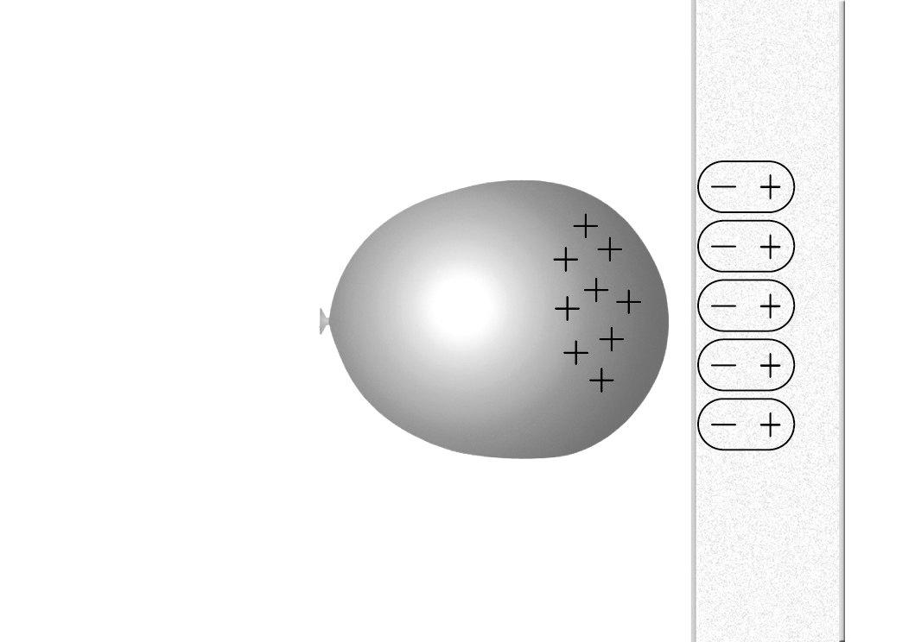

Slide 56
Non-polar molecules also spontaneously form temporary dipoles
Electrons are in constant, rapid motion
For a brief moment the electron distribution can be uneven
This can form a positive pole and a negative pole in the molecule

Slide 57
The temporary dipole in the molecule can induce a temporary dipole in the next molecule, like the balloon and the wall
The process disperses through the substance

Slide 58
Factors Affecting Magnitude
Two factors affect LD forces:
  Increased electrons = increased probability of a temporary dipole forming
  Linear shapes have greater London dispersion forces

Slide 59
Structures and Properties of Compounds
The state of a substance (solid, liquid or gas) depends on the strength of the intermolecular forces
As particles gain kinetic energy (heat) they break their intermolecular bonds and change state

Slide 60
Time of Hydrogen Bonding
FYI – hydrogen bonds in liquid water break and reform 100 000 000 000 (10¹¹) times every second

Slide 61
Melting and Boiling Points
Melting and boiling points of ionic substances and metals are about the same magnitude
Melting and boiling points of molecular substances are much lower
What does that tell us about the forces?

Slide 62
Ionic bonds are much stronger if the ions have a large charge
So ionic compounds that have ions with large charges will have higher melting/boiling points

Slide 63
Molecular Forces
Of the molecular compounds, dipoles that form hydrogen bonds are the strongest
Dipole-dipole forces are weaker than hydrogen bonds
Non-polar molecules that have London dispersion forces are the weakest

Slide 64
Therefore, hydrogen bonded substances have the highest melting/boiling points, dipole-dipole have lower melting/boiling points, and non-polar substances have the lowest melting/boiling points

Slide 65
Mechanical Properties of Solids
Metals are malleable because of the nature of metallic bonds (positive ions in a sea of electrons)
Ionic substances are brittle because if a layer of the crystal is shifted down one position, like ions will be aligned and repel
Non-polar molecular substances are usually soft and easily broken

Slide 66
Conductivity
The ability of a substance to transfer electrical current
For this to occur, charged particles (ions or electrons) must be able to move freely

Slide 67
Metals are good conductors because their electrons are free to move throughout the metallic structure
Ionic solids do not conduct electric current because the ions are held together in a rigid structure

Slide 68
Ionic substances that are dissolved in water are good conductors because the charged ions are free to move in the solution
Some network solids can conduct electricity because of delocalized electrons (graphite)
Molecular compounds cannot conduct electricity in pure form or dissolved in water

Slide 69
Review Questions
Pg. 137
  #3,4,6-14, 16, 19, 21, 22, 25-29, 31, 34-39, 41, 43, 47, 48, 51, 57, 60
  brdebenham@cbe.ab.ca

Slide 70
This powerpoint was kindly donated to
www.worldofteaching.com
http://www.worldofteaching.com
Is home to well over a thousand powerpoints submitted by teachers. This a free site. Please visit and I hope it will help in your teaching
Notes:
70

