Slide 1
CHEMISTRY…
IS THIS WHAT YOU THINK?

Slide 2





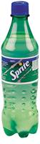
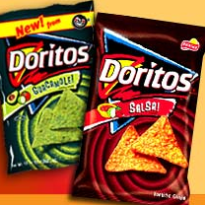



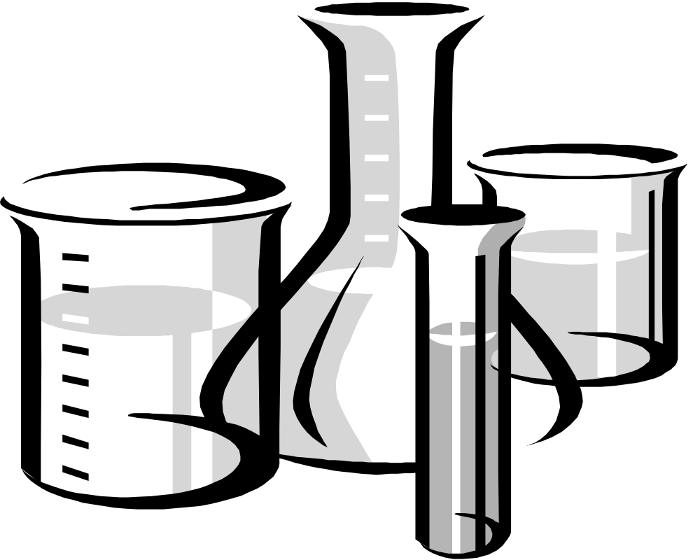











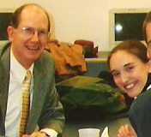

Chemistry is Life!
And who are the chemists?

Slide 3
“My Vision”
-Too often kids get to high school chemistry and they are scared before they even begin.
-My goal is to shape a positive image in their minds about chemistry so that they can be more prepared mentally for high school.
-I will do this by showing them how applicable chemistry is to every day life. It is the study of everything, and it is the central science.

Slide 4

Fun & Chemistry?
Mol Day- Last Thursday, October 23, Beginning at 6:02a.m. and ending at 6:02p.m. Get it? Avogadro's number is 6.02 x 1023
Chemistry Jokes
There are hundreds on the internet- Here is one link: http://library.thinkquest.org/10429/gather/jokes.htm
Q. What is the dieter's element?
A. Nobelium
Poems/Language Arts Connections
“Mary had a little lamb.
But now it is no more.
For what she thought was H20
Was H2So4.”
Periodic Table of Elements Fun
-Cool Song:
http://www.privatehand.com/flash/elements.html
-Periodic Class Project

Slide 5
Chemistry
“The Central Science”
Astronomy
Nuclear Chemistry
Health and Medicine
Biology
Physics
Biology
Geology
Plant Sciences
Biochemistry
Environmental Science

Slide 6

Mini Lesson: Chemical Reactions
Definition: A Process which produces chemical change.
Review- Chemical vs. Physical Change
Bonds are broken
Reactants and Products
Reactants
Products

Slide 7

Mini Lesson:Chemical Reactions
Quick Demo
“Film Canister Rockets” an example of a Chemical Reaction

Slide 8

3 Major Groupings of Chemical Reactions
Precipitation Reactions
Oxidation-Reduction Reactions
Acid-Base Neutralization Reactions

Slide 9


Precipitation Reactions
Precipitation reactions: When an insoluble solid called a precipitate forms when reactants are formed together.
For example, when Carbon Dioxide is mixed with Calcium Hydroxide (limewater), the precipitate Calcium carbonate is formed.
Ca(OH)2+CO2→H2O+CaC03
Calcium Carbonate is found in chalk!

Slide 10

Oxidation/Reduction Reactions
EXAMPLE:
Take a penny, file of the copper to expose the zinc in the inside.
Place it in HCl, and zinc is oxidized.
Zn(s) + HCl(aq) Zn2+(aq) + Cl - (aq) + H2(g)
Zinc gains a positive charge, and is oxidized.
A reaction in which electrons are transferred from one atom to another.
Oxidation: The loss of electrons by an atom
Reduction: The gain of electrons by an atom.

Slide 11

Acid-Base Neutralization Reactions
When an acid reacts with a base to yield water and a salt.
Acid= compounds that produce H+ ions when dissolved in water
Base= compounds that produce OH- ions when dissolved in water.
Neutralization involves H+ and OH- ions and always yields water (H2O) and a salt.
Demo: a typical example:
HCl + NaOH H2O + NaCl

Slide 12
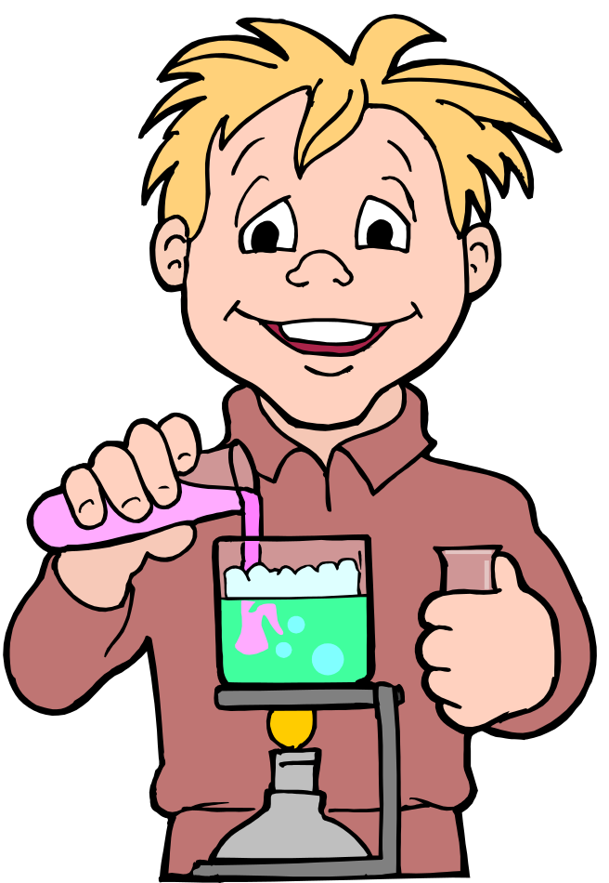
Chemical Reaction Inquiry Lab: “Chemical Baggie Science”
Students are given the following three chemicals:
1. Calcium chloride - CaCl2
2. Sodium Bicarbonate - NaHCO3
3. Bromothymol Blue
They are also given a 10 ml graduated cylinder and plastic baggies. They are told that they must try every combination possible from the three chemicals that they are given. The reactions can be conducted in sealed plastic baggies. After making some initial observations, students must conduct an experiment of their choice based on the scientific method.

Slide 13
Hot Pack/ Cold Pack Lab/Demo
Locate the chemicals that are in hot packs and cold packs.
Demonstrate how the packs work by performing two different kinds of reactions.
Endothermic and Exothermic
Elephant’s Toothpaste
Mix: Saturated Solution of Manganese Dioxide with 12% solution of Hydrogen Peroxide and detergent. You can add stripes of food coloring for dramatic effect.

Slide 14

The End

Slide 15
This powerpoint was kindly donated to www.worldofteaching.com
http://www.worldofteaching.com is home to over a thousand powerpoints submitted by teachers. This is a completely free site and requires no registration. Please visit and I hope it will help in your teaching.

