Slide 1



Reaction Types
Nuclear
Chemical
Physical
Protons
&
Neutrons
change
Bonds
made/ broken
Electrons exchanged
No change in atoms
phase change
Density
Substances can be identified by their properties.

Slide 2
Reaction Types
2
1
Chemical
Bonds are made / broken
Change in oxidation states
Li
⁺¹
P⁺¹
P⁺¹

Slide 3



Chemical Bonds
Strong <----------------> Weak

Slide 4
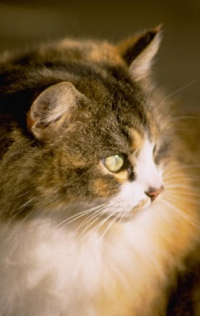
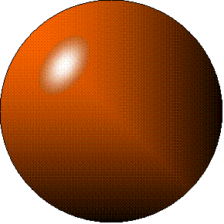
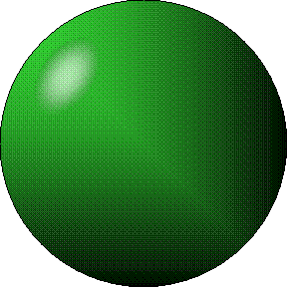
+
Cation
an ion with a positive charge.
Anion
an ion with a Negative charge.
-
A
I
O
N

Slide 5
Ionic bond
Li F
2
1
2
1

Slide 6
Ionic bond
Li F
2
1
2
1

Slide 7
Ionic bond
Li⁺¹ F⁻¹
2
1
2
1
The attraction between a cation and an anion.

Slide 8
Cations
H⁺ Hydrogen
Na⁺ Sodium
Mg⁺² Magnesium
Ca⁺² Calcium
Ag⁺¹ Silver

Slide 9
mo’ Cations
Fe⁺² Iron (II) Ferrous
Fe⁺³ Iron (III) Ferric
Cu⁺¹ Copper (I) Cuprous
Cu⁺² Copper (II) Cupric
NH₄⁺ Ammonium

Slide 10
Anions
F⁻¹ Fluoride
Cl⁻¹ Chloride
Br⁻¹ Bromide
I⁻¹ Iodide
The Halogens

Slide 11
Anions
OH⁻¹ Hydroxide
NO₂⁻¹ Nitrite
NO₃⁻¹ Nitrate
PO₄⁻³ Phosphate
SiO₄⁻² Silicate
SO₄⁻² Sulfate
MoO₄⁻³ Molybdate
B₄O₇⁻² Borate

Slide 12
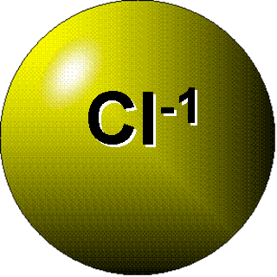
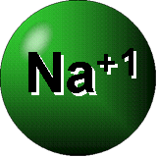
SALT - a Cation and an Anion held together by an ionic bond.
opposites attract

Slide 13
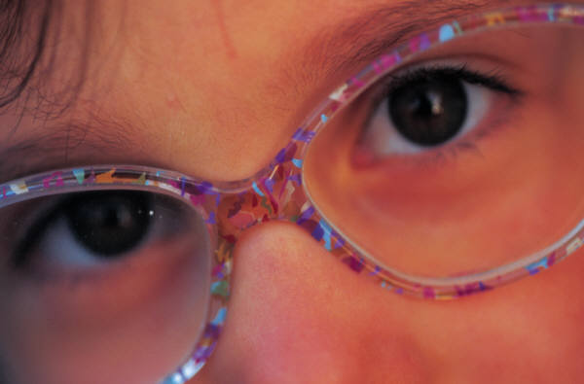
An engineer searching for a material to develop a new kind of “indestructible” eyeglass frame would desire what characteristics?
High hardness, high elasticity, high brittleness.
Low elasticity, high brittleness.
Low brittleness, high hardness, high elasticity.
High brittleness, low hardness, low elasticity.
None of the above

Slide 14
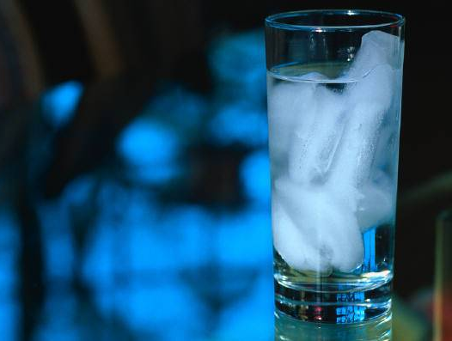
Ice cubes float in a glass of water because:
a.the ice is losing mass through the melting process.
b.the colder ice is more dense.
c.liquid water is less dense than ice cubes.
d.the molecules of ice are arranged in an orderly way so that there is an unusually large amount of empty space in the ice cubes.
e.None of the above

Slide 15
A hot air balloon rises because
molecules become lighter when heated.
molecules move faster and farther apart when heated.
molecules are less attracted by gravity when heated.
molecules become charged and repel each other when heated.

Slide 16

The solid, liquid, and gaseous states of water differ from each other in
the mass of the individual atoms.
the size of the individual atoms.
the net electrical charge of the individual molecules.
the average speed of movement of the individual molecules.

Slide 17
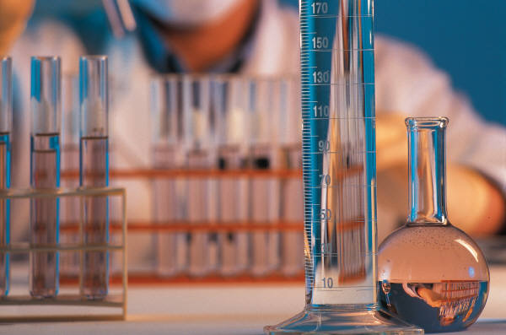
The molecules in a test tube filled with cold water move more slowly than the molecules in a large tank of warm water. What is responsible for this difference in molecule speed?
pressure
volume
weight
heat

Slide 18
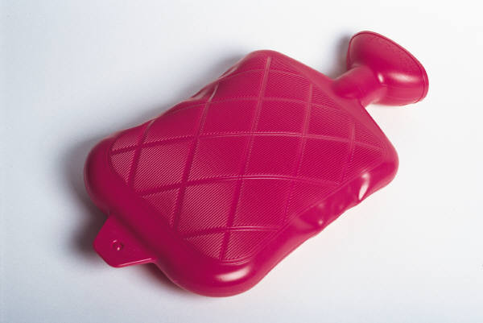
Heat can cause ice to change to liquid water by
filling the spaces between molecules.
causing molecules to move faster and farther apart.
increasing the distance between electrons within molecules.
increasing the attraction between molecules

Slide 19
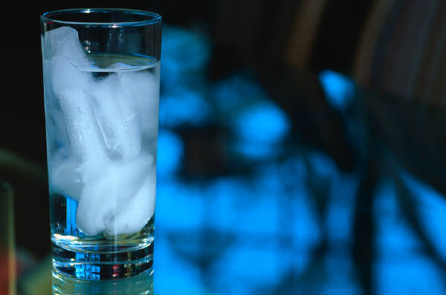
If you saw an ice cube sink after it was placed in what you thought was a glass of water, which question should you probably ask?
What kind of liquid is in the glass?
Will the ice melt slower or quicker?
How fast did the ice cube sink?
How soon would the ice cube start to float?

Slide 20
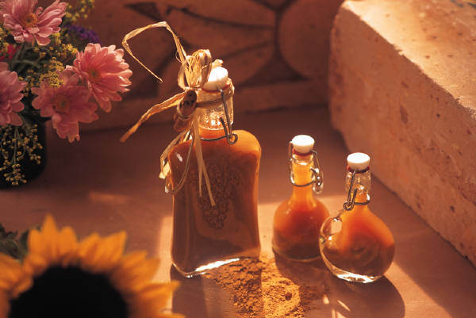
What will happen if you mix vinegar and baking soda?
It will explode.
Nothing will happen.
It will bubble up rapidly.
It will turn bright red.

Slide 21
Which is a metric unit for density?
g/cm
cm/g
g/cm³
cm³/g

Slide 22

When a gas forms a liquid, which process is taking place?
freezing
condensation
boiling
evaporation

Slide 23

Which unit correctly describes density?
pounds/square inch
kilograms/square meter
milligrams/square centimeter
grams/milliliter

Slide 24
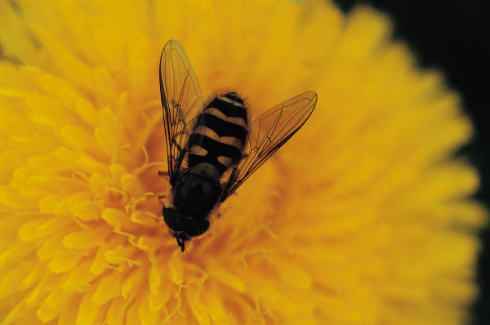
Based on the melting points shown in the table, which material would still be a solid at 400°C?
beeswax
gold
lead
oxygen
Substance Melting Point (°C)
Beeswax 62
gold 1,063
lead 327
oxygen –218

Slide 25
A chemical change for a piece of metal would be
being bent in half.
getting cut into two pieces.
being painted.
getting rusty.

Slide 26
Which symbolizes a molecule of a compound?
He
Be
N₂
NaCl

Slide 27

Putting sand and salt together makes
a compound.
an element.
a mixture.
a solution.

Slide 28

Plastic, wood, and iron are all made up of
cells.
atoms.
carbon.
plants.

Slide 29

Water is
a compound.
an element.
a solution.
a mixture.

Slide 30
An atom is to an element, as a molecule is to a
metal.
nonmetal.
metalloid.
compound.

Slide 31
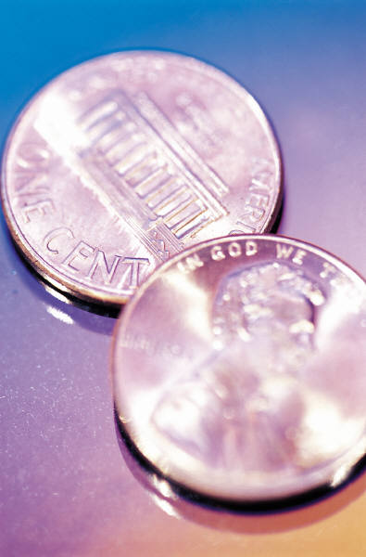

In 1982, the composition of US pennies was changed. According to the information in the table, 1985 pennies
are more dense than 1981 pennies.
are less dense than 1981 pennies.
are equal in density to 1981 pennies.
cannot be compared to 1981 pennies
1981 Pennies | 1985 Pennies
Mass (g) | Volume (cm³)
3.5 | 0.9
Mass (g) | Volume (cm³)
2.5 | 0.9

Slide 32
All of the substances on the periodic table are classified as elements because they
are pure substances.
are composed of atoms.
cannot be broken down into other substances.
cannot be dissolved in water or other liquids.

Slide 33
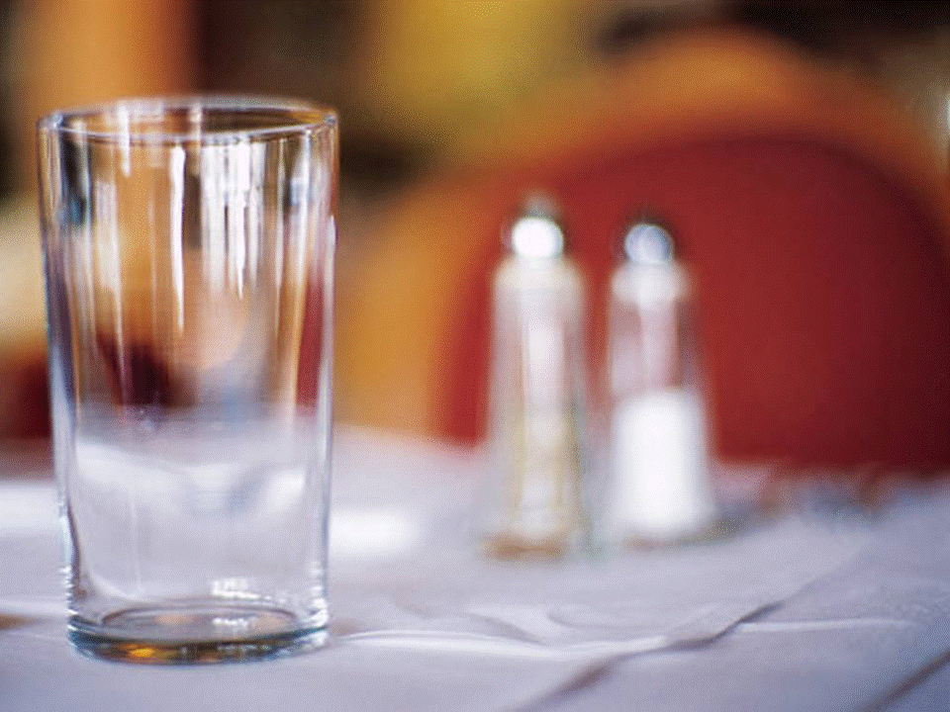
Salt (NaCl) is a common substance. Salt is which of these?
atom
element
compound
mixture

Slide 34
Each element is assigned an atomic number, which is the same as
the number of electrons in the atom's nucleus.
the number of protons in the atom's nucleus.
the number of neutrons in the atom's nucleus.
the number of protons and neutrons in the atom's nucleus

Slide 35
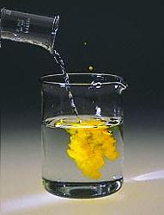

Mr. Davis performs a chemical reaction for the class. Which of these does NOT show evidence that a chemical reaction has occurred ?
Change in color
Change in shape
Formation of gas
Formation of a precipitate

Slide 36
Which is the correct symbol for the element sodium?
S
Se
Cl
Na

Slide 37
Which statement is usually true about the electrical properties of metals?
Metals have high electrical resistance.
Lightweight metals are the best conductors.
Metals and plastics are both good insulators.
Metals are good electrical conductors.

Slide 38
Students poured different liquids to see how the liquids became layered. The denser liquids at the bottom, the lighter liquids at the top. What tool was used in this experiment?
a balance scale
a thermometer
a magnet
a graduated cylinder

Slide 39
Tom places four objects in a tank of water. He makes the following observations. Which statement is correct based on Tom's observations?
The rock and the chalk have a density greater than water.
The rock and the chalk have a density less than water.
The cork and the can of soda have a density equal to water.
The cork and the can of soda have a density greater than water
A cork floats. | A soda can floats.
A rock sinks. | A piece of chalk sinks.

Slide 40
The chemical symbol Al represents which metal on the periodic table?
arsenic
antimony
aurum
aluminum

Slide 41
Covalent bond
when two atoms share a pair of electrons.
P⁺¹
P⁺¹

Slide 42

Covalent bond
when two atoms share a pair of electrons.
P⁺¹
P⁺¹
It’s like both atoms have a filled orbital.

Slide 43


Covalent Bond
The sharing of a pair of electrons between 2 atoms.
(or even 2 or 3 pairs of electrons).
H₂

Slide 44



Covalent Bond
The sharing of a pair of electrons between 2 atoms.
Li₂

Slide 45
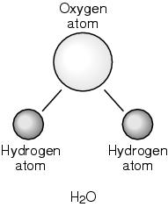
When one oxygen and two hydrogen atoms combine, what forms?
a different atom
a different element
a molecule
a neutron

Slide 46

Covalent Bond
The sharing of a pair of electrons between 2 atoms.
Cl₂

Slide 47

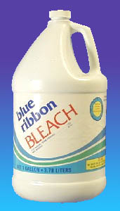
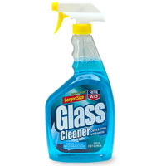
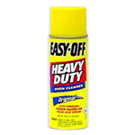

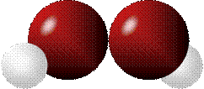
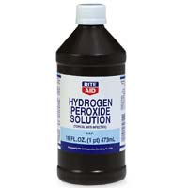
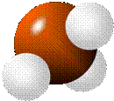
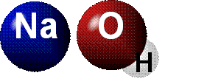

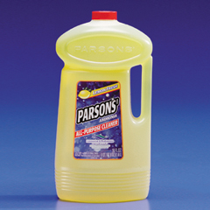

Common chemicals
H₂O₂
NH₃
NaOH
NaClO
I₂
Compound o molecule ?

Slide 48
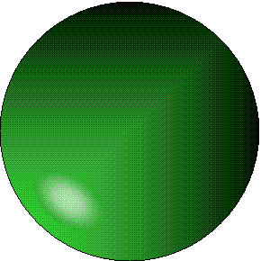


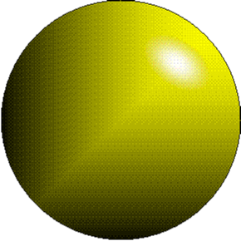
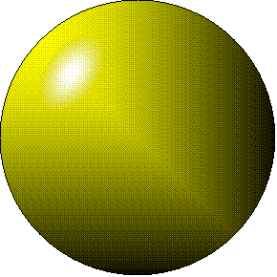
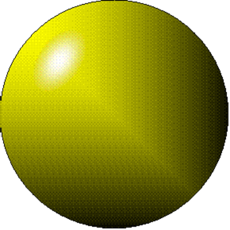
Metallic Bond the sharing of valence
electrons by neighboring metal atoms.

Slide 49
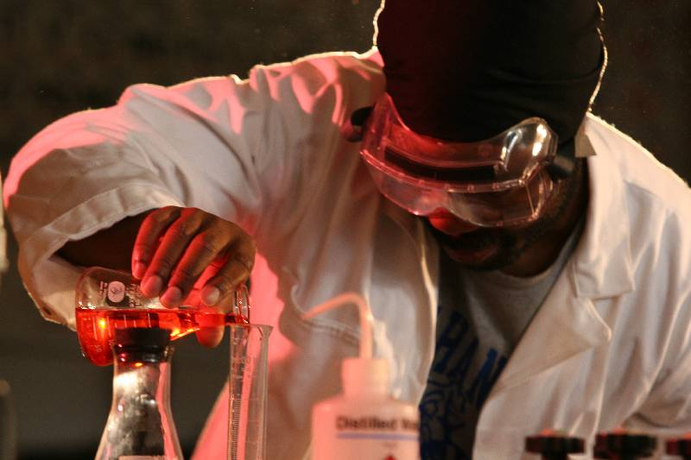


Slide 50

Oxygen naturally occurs in which physical state?
solid
liquid
gas
plasma

Slide 51
Reaction Types
2
1
Chemical
Bonds are made / broken
Change in oxidation states
Plasma
Li
⁺¹
P⁺¹
P⁺¹

Slide 52
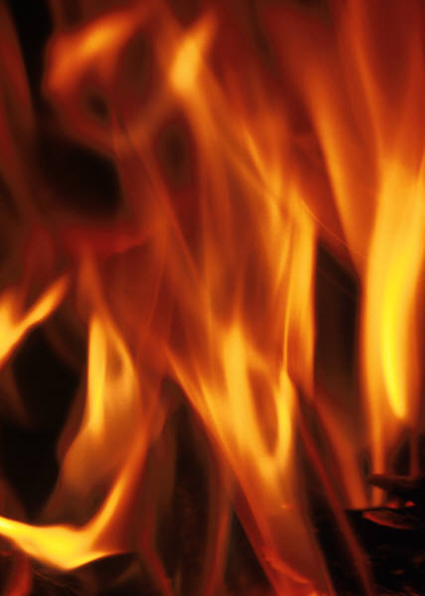
Chemical properties/ changes/ reactions (i.e., reactivity, combustibility).
development of a gas, formation of precipitate, and change in color).
Reactivity
Combustibility
Gas formation
Precipitate
Color change

Slide 53
A difference between physical change and chemical change is that
chemical change involves energy while physical change does not.
physical change involves energy while chemical change does not.
different kinds of molecules are present after a physical change but not after a chemical change.
different kinds of molecules are present after a chemical change but not after a physical change

Slide 54
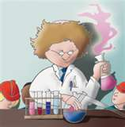
Reactivity
The tendency to undergo a chemical change.
ree ack tih vih T

Slide 55
Reactivity
H
He
Li
Be
B
C
N
O
F
Ne
Na
Mg
Al
Si
P
S
Cl
Ar
Mo
Less
Less
Mo
NON
reactive

Slide 56
Calorimeter
crystal lab
carbohydrate lab
fatty acid lab
amino acid lab
convection lab
density lab
density II lab
radioactive decay lab

Slide 57
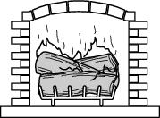
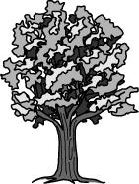
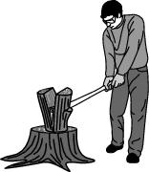
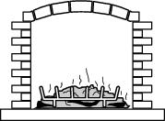
Which picture shows only a physical change in the wood?

Slide 58
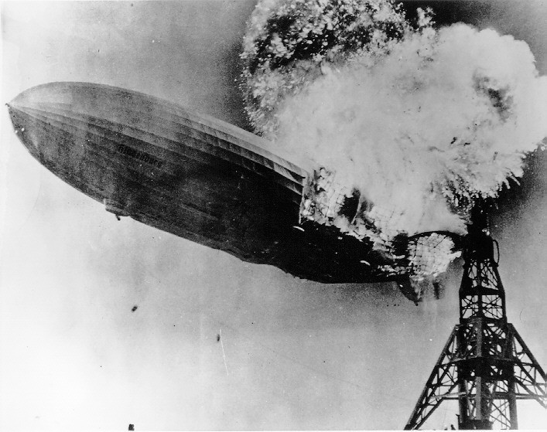
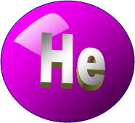

Hydrogen-VERY reactive.
Helium-Non-reactive.

Slide 59
On the periodic table, nitrogen is represented by N (atomic number 7). N is a chemical
equation.
period.
symbol.
group (family).

Slide 60
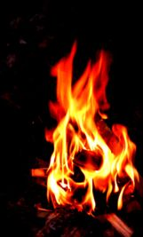
Combustion - chemical reaction between a fuel and an oxidant, producing and light (flames).

Slide 61
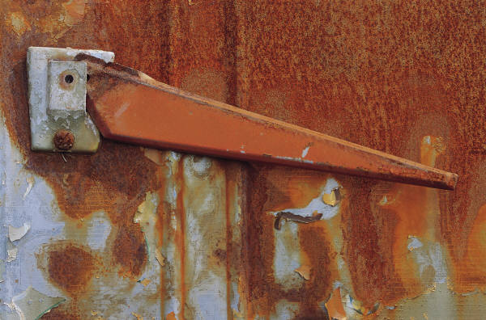

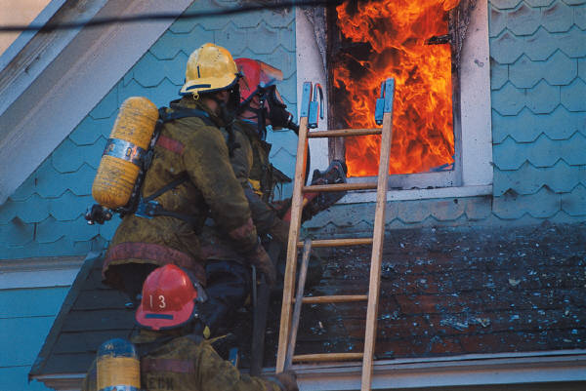

Combustibility
The tendency to react with Oxygen, releasing heat.
O₂
BURNING

Slide 62

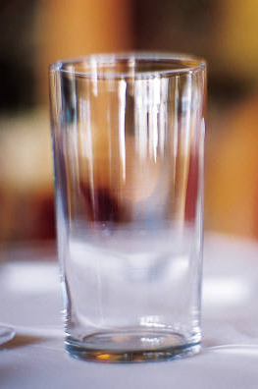
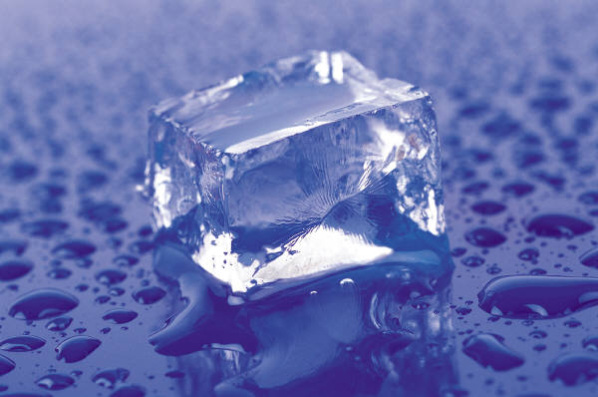
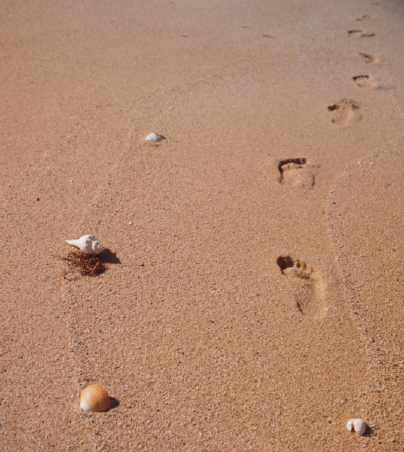
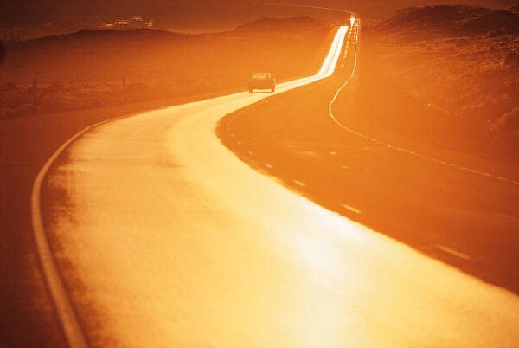
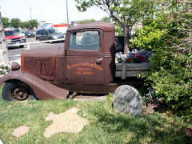

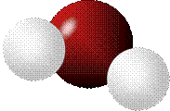


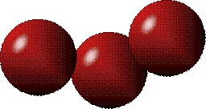
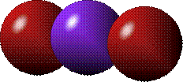
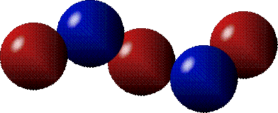
Common Oxides
H + O₂
C + O₂
N + O₂
O + O₂
Si + O₂
Fe + O₂
H₂O
CO₂
NO₂
O₃
SiO₂
Fe₂O₃
Compound o molecule ?

Slide 63
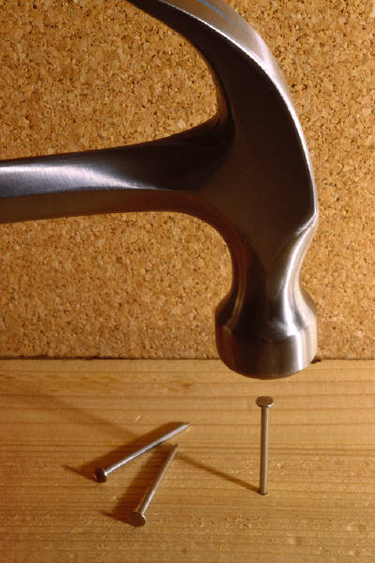
Which action would result in a chemical change?
crumpling several sheets of paper
pounding a nail into a piece of wood
peeling and slicing a carrot
making blueberry muffins

Slide 64
Metals and Non-metals prefer to react with each other.
One loses electrons,
the other gets electrons.
determine how it will react with other substances.
produce new substances which have new properties.

Slide 65





Lithium Fluorine

Slide 66
Reaction Types
2
1
Chemical
Bonds are made / broken
Change in oxidation states
Plasma
Li
⁺¹
P⁺¹
P⁺¹

Slide 67

evidence of Chemical Change:
development of a gas
formation of precipitate
change in color

Slide 68
NOT a Chemical Change:
crystalization
fizz fluorescence

Slide 69



Precipitate the formation of insoluble ionic compounds.
Does NOT dissolve in water.

Slide 70



Happines
Unhappy
Unstable
HIGH energy
Happy
Stable
LOW energy

Slide 71



energy
Reactants Products
(unstable) (stable)
energy
Reactants Products
(stable) (unstable)

Slide 72

You get up in the morning and make toast for breakfast. You notice the color changes from light to dark. Later on that day in science class, your teachers asks for every day examples of physical and chemical changes.
Should you volunteer your toast as an example of a physical or chemical change?
Why?

Slide 73


A different chemical substance is formed when a
piece of cloth is cut.
cup breaks.
candle burns.
piece of chalk breaks.

Slide 74

Lucy noticed that her coin collection had begun to tarnish. Some of the metal in the coins had begun to change color. The formation of tarnish is most similar to which of the following changes?
shredding a piece of paper into hundreds of tiny strips
dropping a dinner plate on the floor
melting ice cubes in a glass of juice
burning a piece of paper to ashes in a fireplace

Slide 75

Which is an example of a chemical change?
ice melting
salt crystals being ground to powder
water evaporating
wood burning

Slide 76

The law of
Conservation of matter - matter can neither be created nor destroyed.
(Actually, NOT really true).
Matter does not “magically appear" or" disappear”.

Slide 77
Simple Reactions
Synthesis
(Combination)
Decomposition
Single
Replacement
Double
Replacement

Slide 78
Synthesis
A
+
B
A
B
Decomposition
A
B
A
+
B
Single
Replacement
A
B
+
C
A
+
C
B
Double
Replacement
A
B
+
C
D
A
D
+
C
B

Slide 79
Synthesis
A
+
B
A
B
Decomposition
A
B
A
+
B
Single
Replacement
A
B
+
C
A
+
C
B
Double
Replacement
A
B
+
C
D
A
D
+
C
B

Slide 80
+
Synthesis
Decomposition
+
Single
Replacement
+
+
Double
Replacement
+
+

Slide 81


A displacement reaction:
metallic copper with silver nitrate
Cu + Ag NO₃
Ag + Cu(NO₃)₂

Slide 82


The study of chemicals that make up living things.

Slide 83

Biochemicals
Main categories
Sugars (carbohydrates)
Proteins
Fats (lipids)
DNA

Slide 84




Protein structure
Hair, nails and
muscles are made
of Proteins

Slide 85


Sugars
Sugars are called carbohydrates.
They are made of a circle of carbons and one oxygen.
They can be linked in a chain to form COMPLEX sugars.
C
O
C
C
C
C

Slide 86


Slide 87



Fats (lipids)
Fatty Acids are a kind of Fat or oil.
They are basically a
chain of carbons,
with a COOH group.
COOH
group

Slide 88

DNA is
stored in the
Nucleus (center)
of the cell.

Slide 89




It is made up of four “letters” called A, G, T and C.

Slide 90

All plant and animal life on Earth contains what element?
sulfur
carbon
silicon
aluminum

Slide 91
Solvent
Concentration
the amount of solute dissolved in a solvent.
Solute
Low------------------- High
dilute dy loot concentrated

Slide 92
Solubility -how likely it is for a solute to dissolve in a solvent.
insoluble soluble
Low High

Slide 93


Wawa

Slide 94


=
Dey da same

Slide 95





Acid

Slide 96
Base

Slide 97


pH- the amount of H⁺ ions in a solution.
Whatchyall lookin at bra ?
1 2 3 4 5 6 7 8 9 10 11 12
ACID
extra H⁺¹ ions (protons)
BASE
fewer H⁺¹ ions.
extra OH⁺¹ ions.

Slide 98



pH | H₂O | H⁺
1 | 10 | 1
2 | 100 | 1
3 | 1000 | 1
Strong ACID
HCl Hydrochloric acid
H₂SO₄ Sulfuric acid
HNO₃ Nitric acid
Weak ACID
CH3COOH Acetic acid
H₂CO₃ Carbonic acid
Citric acid

Slide 99

pH paper
Red Litmus paper
Blue Litmus paper

Slide 100





Balancing equations

Slide 101


2
Ag + Cl₂ AgCl
Total
atoms
1
2
1
1
2
2
Both sides must be equal
for ALL atoms.

Slide 102
2
2
Ag + Cl₂ AgCl
Total
atoms
1
2
1
1
2
2
2
Conservation of Matter
Both sides must be equal
for ALL atoms.

Slide 103

CH₄ + O₂→ CO₂+ H₂O
1
4
2
1
2
2
1

Slide 104

CH₄ + O₂→ CO₂+ H₂O
2
1
4
2
1
2
2
1
4
2

Slide 105
CH₄ + O₂→ CO₂+ H₂O
2
2
1
4
2
1
2
2
1
4
4
2

Slide 106
Ag + Cl₂ AgCl
Total
atoms
1
2
1
1
Both sides must be equal
for ALL atoms.

Slide 107
LiCl + Na⁺¹ → NaCl + Li⁺¹
Na + Cl₂ → NaCl
H₂O₂ → H₂O + O₂
KI + Mg⁺² → MgI₂ + K⁺¹
AgNO3+ NaCl → AgCl + NaNO₃
LiCl + NaOH → NaCl + LiOH

Slide 108
Catalyst cat a list
a substance which alters the rate of a chemical reaction.
It is unchanged at the end of the reaction.

Slide 109
Experiment with the changes of states of a substance (i.e. water, dry ice).
Chart- state changes: melting, boiling, freezing, evaporation, condensation, and sublimation.

Slide 110





Platinum catalyst
2 CO + O₂ ^{Pt} 2 CO₂
stabilized
intermediates

Slide 111


How to read a
Phase Diagram
Solid
Liquid
Gas

Slide 112
How to read a
Phase Diagram
normal
pressure

Slide 113
How to read a
Phase Diagram
Low
pressure

Slide 114
How to read a
Phase Diagram
especial

Slide 115

8th Grade Major Concepts/Skills Concepts/Skills to Maintain
Nature of matter
Atomic Theory/Periodicity
Conceptual Acid/Base—Phase changes
Law of Conservation of Matter
Law of Conservation of Energy
Conceptual Laws of Motion and Forces
Conceptual Energy Transformation
Wave properties
Electrical/Magnetic forces

Slide 116

Six munths ago
I cudnt evun spelt chemissed.
An now I are one.

Slide 117



Panther Productions
© 2007 Dr. Jacob Israel
All Rights Reserved

Slide 118










-1
Matter
+1
O
H
He

Slide 119
Matter
-1
Ionic
O
-1
H
He

Slide 120
This powerpoint was kindly donated to www.worldofteaching.com
http://www.worldofteaching.com is home to over a thousand powerpoints submitted by teachers. This is a completely free site and requires no registration. Please visit and I hope it will help in your teaching.

