Slide 1
Covalent Bonding

Slide 2
Chlorine atom 2,8,7

Slide 3
2 Chlorine atoms
Outer shells only

Slide 4
Chlorine molecule Cl₂
Electrons shared
Each outer shell has 8 electrons
Forces (bonds) between atoms in the molecule very strong
Forces between molecules very weak
Molecular or covalent compounds are usually gases or liquids –
they have low melting points and low boiling points
Molecules have no overall electric charge

Slide 5
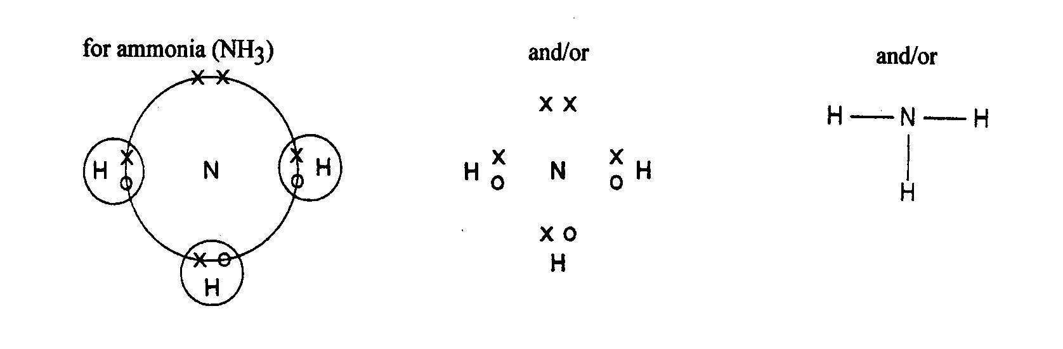
Covalent bonds can be represented in 3 ways:

Slide 6
Chlorine Cl₂
Cl
Cl
Cl
Cl
Cl
Cl

Slide 7
Covalent Bonds:
Water H₂O
Methane CH₄
Ammonia NH₃
Hydrogen H₂
Hydrogen Chloride HCl
Oxygen O₂
N.B. Oxygen has a double bond

Slide 8
Oxygen
16
O
8
Oxygen atom 2,6

Slide 9
2 Oxygen atoms (outer shells only)
Double covalent bond
O
O
Visit www.worldofteaching.com
For 100’s of free powerpoints

