Slide 1
Earth Materials. Module 06
In this module you should study:
The uses of Limestone as a building material and as a raw material for making other useful materials.
The formation of Crude Oil and how it is processed to produce a range of useful materials, including Plastics via Polymerisation.
How the Atmosphere of the Earth formed and developed
How the Earth’s landscape is changing as a result of the Rock cycle and Tectonic Plate movement

Slide 2
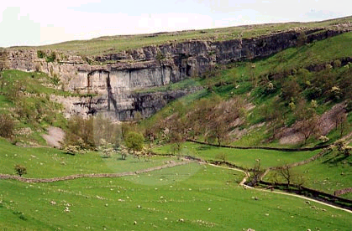
Limestone
Limestone is a commonly occurring rock which can be used not only for building, but also for making many other useful materials including Lime, Cement and Glass. It is also added to Bread and Toothpaste.
Limestone is a sedimentary rock, formed from the bones and shells of sea creatures living millions of yeas ago.
Limestone is mainly a chemical compound called
Calcium Carbonate CaCO₃

Slide 3
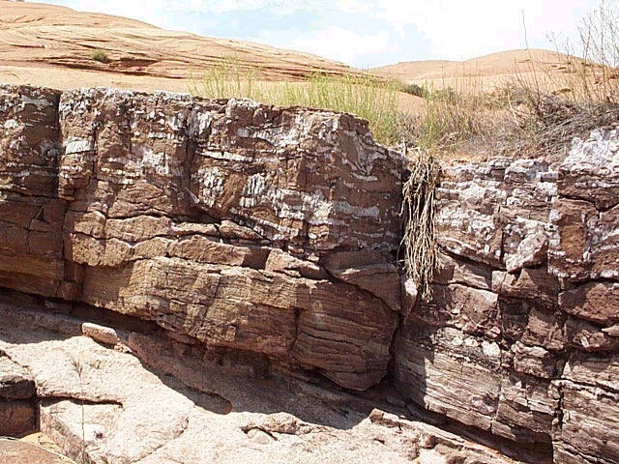
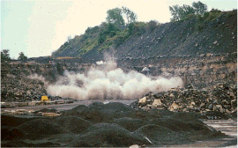
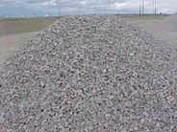
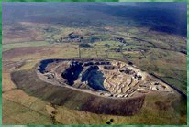
Limestone is quarried, then ground up into smaller pieces
Quarrying does however have environmental impacts

Slide 4
Carbonates generally can neutralise acids, so powdered limestone may be used without any more processing, to neutralise the acidity of lakes and soil
Acid + Carbonate Salt + Water +Carbon Dioxide
Adding too much Limestone will not cause too much damage to the environment. Also it does not get washed out by heavy rain as an alkali would.
Carbonates generally break down when they are heated. This is called Thermal Decomposition.

Slide 5
Limestone heated in a Kiln undergoes Thermal Decomposition to form Quicklime Calcium Oxide CaO
Calcium Carbonate Calcium Oxide + Carbon Dioxide
Thermal Decomposition
CaCO₃ CaO + CO₂
Limestone
Quicklime
Quicklime is a very strong alkali, which reacts with water to produce Slaked Lime Calcium Hydroxide Ca(OH)₂ (Lime water), this is also an alkali used to reduce acidity in soil.
Calcium Oxide + Water Calcium Hydroxide
CaO + H₂0 Ca(OH)₂
Quicklime
Slaked Lime (Lime Water)

Slide 6
Reminder:
If you breath into Lime water, it goes milky because the Carbon Dioxide in your breath produces INSOLUBLE Calcium Carbonate, but if you continue to breath into it, the solution will go clear again because the Calcium Carbonate reacts with more Carbon Dioxide and Water to form SOLUBLE Calcium Hydrogen Carbonate.
(This will become more important when we consider changes to the atmosphere).
So, We can think of it like a cycle:
Limestone Breaks down when heated, to form Quicklime, but this reacts with water to form Slaked lime. Slaked lime in turn will react with Carbon Dioxide to form Limestone again.

Slide 7
Calcium Carbonate Calcium Oxide + Carbon Dioxide
Thermal Decomposition
CaCO₃ CaO + CO₂
Limestone
Quicklime
Calcium Oxide + Water Calcium Hydroxide
CaO + H₂0 Ca(OH)₂
Quicklime
Slaked Lime (Lime Water)
Calcium Hydroxide + Carbon Dioxide Calcium Carbonate
Ca(OH)₂ + CO₂ CaCO₃
Calcium Carbonate +Water + Carbon Dioxide Calcium Hydrogen Carbonate
CaCO₃ + H₂O + CO₂ Ca(HCO₃)₂

Slide 8
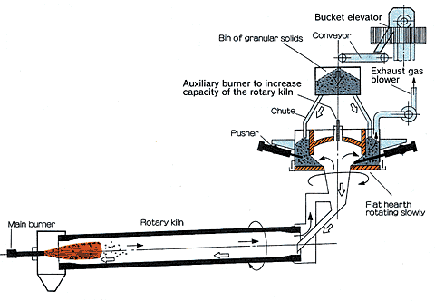
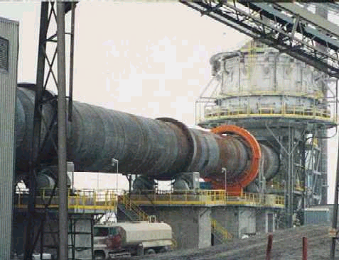
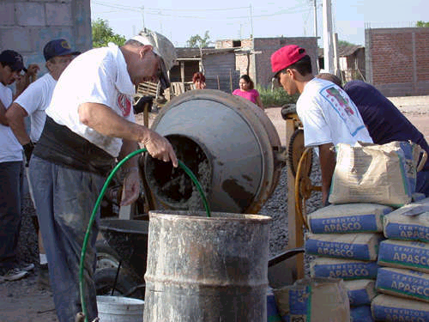
Cement
Cement is produced by heating powdered limestone and clay, in a Rotary Kiln
Concrete
This is made by mixing together: Cement, Sand, Rock chippings and water. The mixture sets quickly, then hardens slowly producing rock-like concrete.

Slide 9
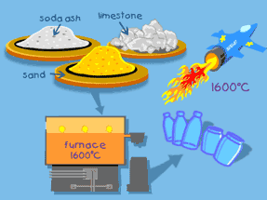
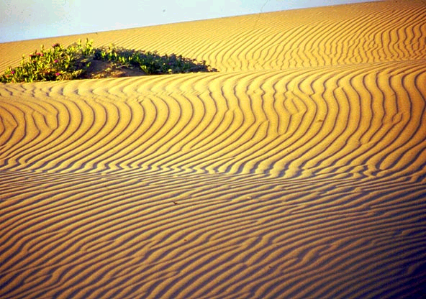
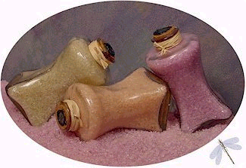
Glass
There are many different types of glass, each with its own properties and uses, but essentially, Glass is made by heating together a mixture of:
Powdered Limestone
Sand
Soda
(Sodium Carbonate.) Bath Salts

Slide 10
How can so many useful products
be made from Crude Oil?
What should we remember from Key Stage 3?
Crude oil is obtained from the Earth’s crust.
It was formed from the remains of organisms which lived millions of years ago.
It is a fossil fuel.
The fossil fuels coal, oil and natural gas have resulted from the action of heat and pressure over millions of years, in the absence of air, on material from animals and plants (organic material) which has been covered by layers of sedimentary rock. (Syllabus statement)

Slide 11
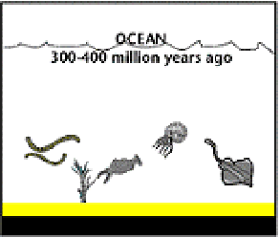
Like all fossil fuels, Crude Oil was formed millions of years ago.
Tiny Sea creature and plants died and were buried on the ocean floor. Over time they became covered with layers of silt and mud. All the Oxygen which would have caused them to rot was squeezed out.

Slide 12
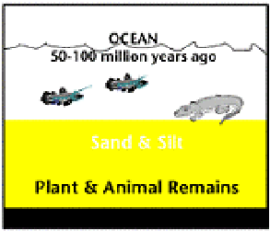
Over millions of years, the remains were buried deeper and deeper. The enormous heat and pressure turned the organic material in their remains into Crude Oil and Methane (Natural Gas)

Slide 13
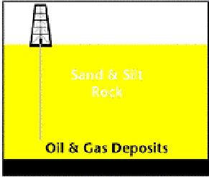
Today, the Crude Oil lies covered by layers of sedimentary rock. We have to drill down through the rock to reach rock formations which contain Oil and Gas deposits. They occur in bands of porous (spongy) rock.

Slide 14
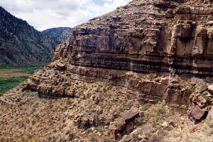
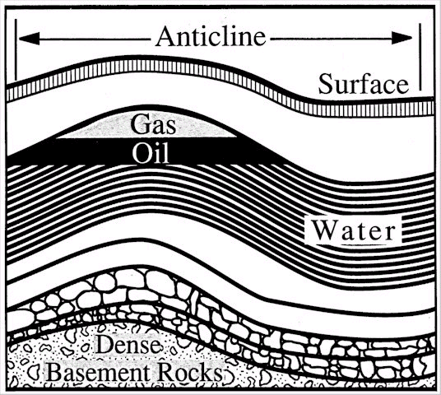
The Oil is often found in porous rock
Sometimes it is visible in bands of shale

Slide 15
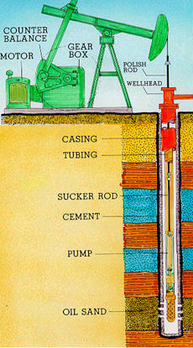
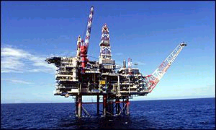
To get it out, we have to drill down into the Earth’s crust
Often the drilling rigs are located miles offshore, on drilling platforms.

Slide 16
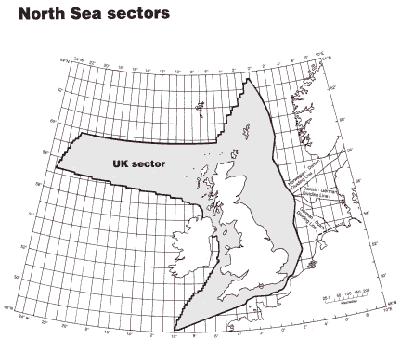
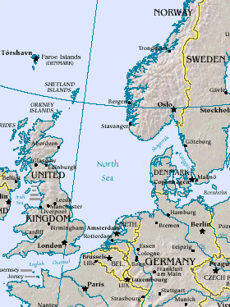
The United Kingdom drills for Oil in ‘Oil fields’ beneath the North Sea

Slide 17
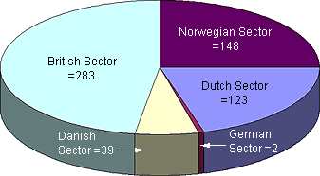
We ‘Share’ the Oil field with others in Europe, having a claim to the fields

Slide 18
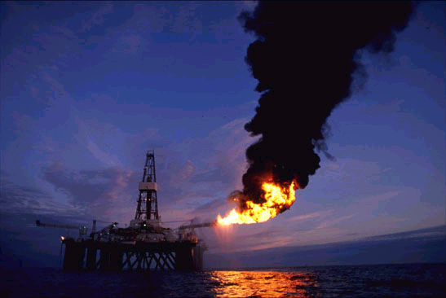
Oil platforms in the North Sea are huge
They stand on tall legs anchored to the sea bed

Slide 19
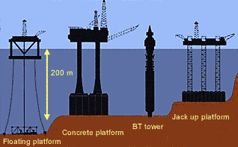

Slide 20
Crude oil is a mixture of compounds.
The compounds are mainly made up of the Elements:
Carbon (C)
and
Hydrogen (H)
They are referred to as Hydrocarbons

Slide 21
The Chemical and Physical properties of Hydrocarbon Molecules in the mixture are unchanged by the fact that they are in a mixture:
This means that each compound in the mixture will boils at its own, unique, boiling point.
This helps us to separate the mixture

Slide 22
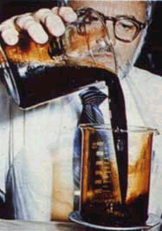
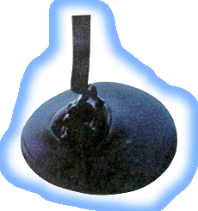
Since it is a mixture, crude Oil found in one location may be different to that found in another.

Slide 23
Hydrocarbons are made up of the elements Carbon and Hydrogen only
Carbon atoms have four electrons in their outer energy level which they use to form bonds with.
C
This means that they can make four covalent bonds with other things.

Slide 24
Covalent bonds are made by sharing electrons with other atoms
H
H
C
H
H
They can form bonds with Hydrogen atoms, by sharing electrons.

Slide 25
This diagram represents the hydrocarbon molecule Methane CH₄. You will know it as Natural Gas
H
H
C
H
H
H
H
C
H
Structural formula
H

Slide 26
Carbon atoms can also form covalent bonds to other Carbon atoms, forming ‘Carbon chains’
This would represent a molecule of the Hydrocarbon Ethane,
formula C₂H₆
H
H
H
C
C
H
H
H
How would molecules of Propane C₃H₈ and Butane C₄H₁₀ be drawn?

Slide 27

Carbon atoms form the ‘Spine’ of Hydrocarbon molecules.
The Hydrocarbons in Crude Oil are made up of single bonds only. They are said to be Saturated Hydrocarbons, because there are no spare bonds for any more Hydrogen atoms.
We call this family of Hydrocarbons Alkanes, they have the General Formula: C_{n} H_{(2n+2).} E.g. Pentane: C₅H₁₂

Slide 28
The number of carbon atoms in the Hydrocarbon molecules in Crude Oil varies from 1carbon to over 70 carbons atoms.
The number of atoms present affects the boiling point of the compound.
This means that each molecule has a different boiling point.

Slide 29
The molecules with the least number of carbon atoms in them have the lowest boiling point.
Methane CH₄ Boiling Point = - 163 Celsius
Ethane C₂H₆ Boiling Point = - 87 Celsius
Propane C₃H₈ Boiling Point = - 43 Celsius
Butane C₄H₁₀ Boiling Point = - 0.5 Celsius

Slide 30
Methane = -163
Ethane = - 87
Propane = - 43
Butane = - 0.5
The boiling point increases as the length of the carbon chain gets bigger.
Having different boiling points means that the molecules can be separated into simpler mixtures by:
Fractional Distillation.

Slide 31

Reminder!
Distillation is a separation technique using the fact that different compounds boil at different temperatures (they have different boiling points.) Remember separating pure water from Inky water in year 7?
When a mixture of different compounds is heated, the ones with the lowest boiling point will evaporate first.
Later vapour is condensed back into liquid.

Slide 32
There are many Hydrocarbon compounds in Crude Oil and this complex mixture is separated into a simpler mixture.
This simper mixture is made up of Fractions, groups of Hydrocarbons with similar carbon chain lengths.
The Crude Oil is first heated to make it Evaporate, then it is allowed to cool at different temperatures, so that different Fractions Condense at different points.
This process is called Fractional Distillation.

Slide 33
LPG for calor gas stoves
Average carbon atoms = 3
40^{O}C
Average carbon atoms = 8
Petrol for fuel
Naphtha for chemicals
Average carbon atoms = 10
Paraffin for aeroplanes
Average carbon atoms = 12
Diesel for Fuel
Average carbon atoms = 20
Fuel Oil for heating
Average carbon atoms = 40
Hot Crude Oil in
Lubricating Oil for machines
Average carbon atoms = 80
Temperature decreasing
Bitumen for Roads
Average carbon atoms = 120
350^{O}C

Slide 34
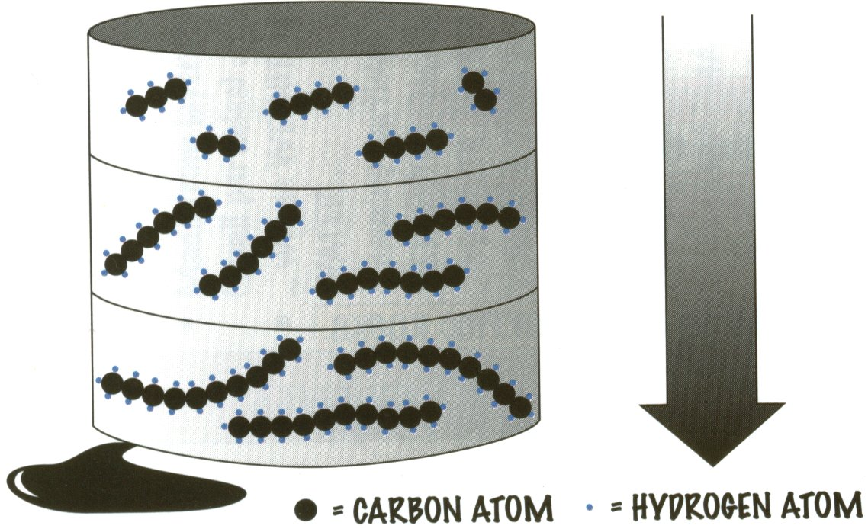
The larger the molecule,
(the more Carbons atoms there are) :
The more Viscous it is (the less easily it flows).
The less easily it ignites (the less Flammable it is).
The less Volatile it is (the harder it is to turn from a liquid into a vapour).
The higher its Boiling Point is.
All these points mean that large Hydrocarbons are less use as fuels than smaller Hydrocarbons.

Slide 35
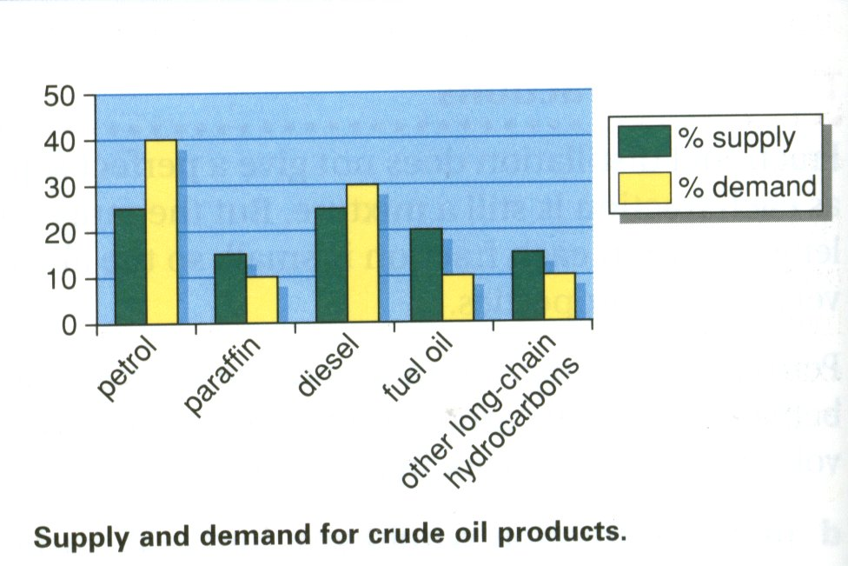
Since shorter molecules release energy quicker by burning, there is a greater demand for shorter molecules than for longer ones.
Longer molecules are broken down or Cracked into shorter, more useful ones.

Slide 36
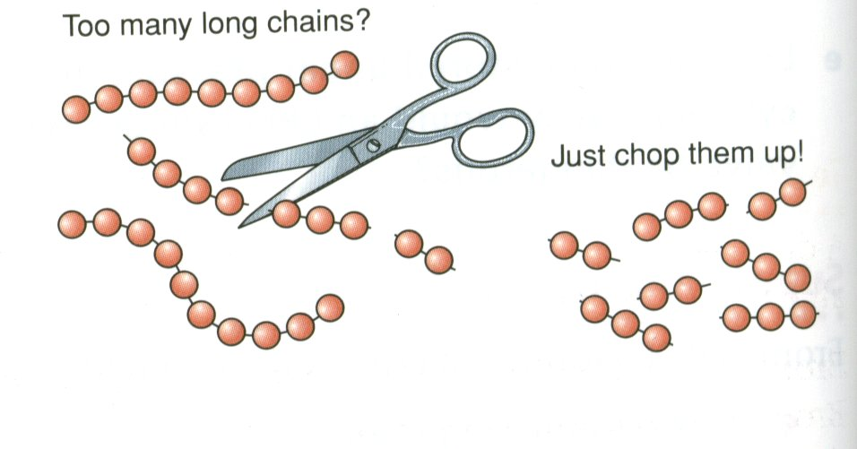
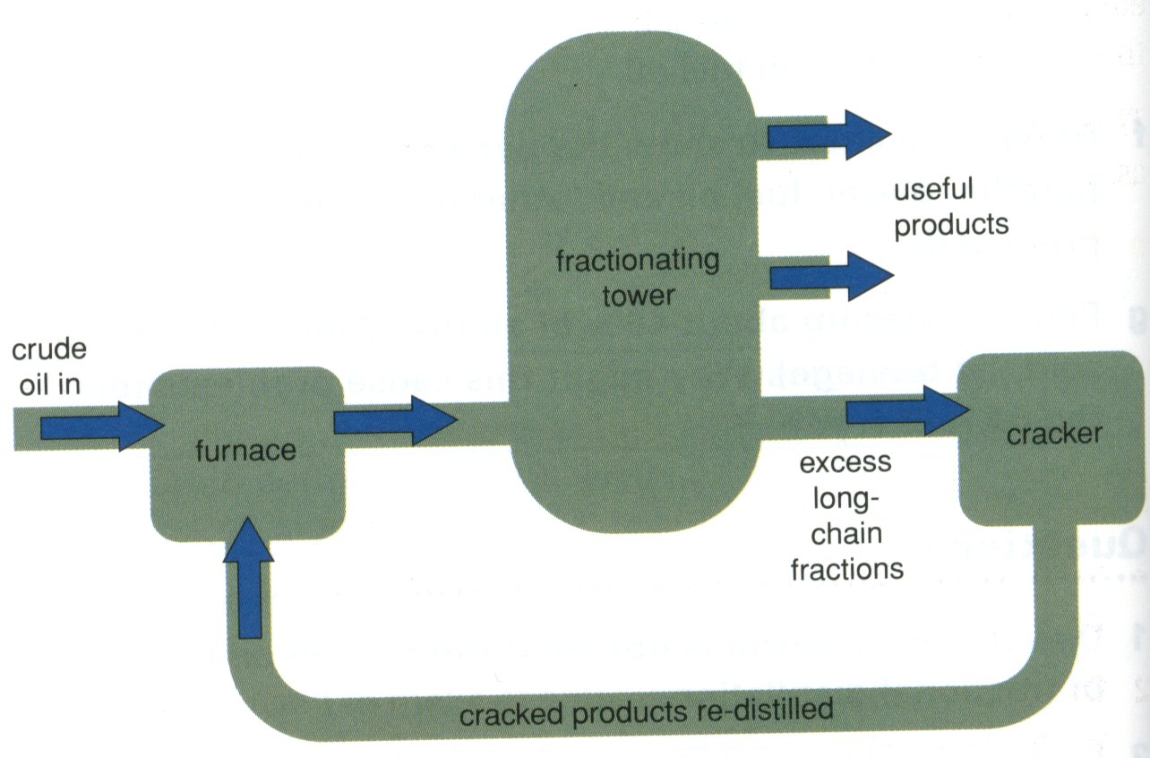
The process is called Catalytic Cracking.
The hot Hydrocarbons are vaporised and passed over a hot Catalyst. A Thermal Decomposition reaction occurs. The products contain some molecules which are useful as fuels and some which are useful to make plastics from.

Slide 37
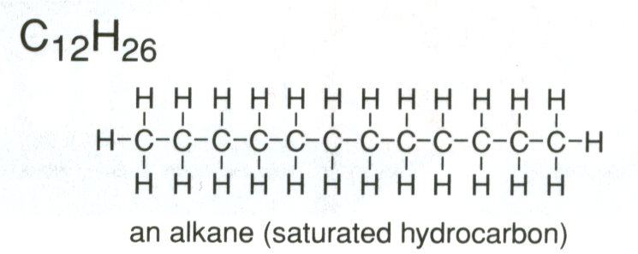
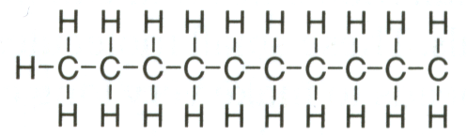
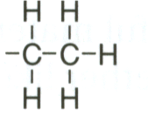
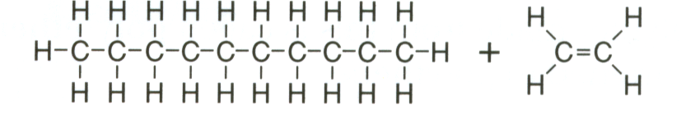
More about Catalytic Cracking
Cracking involves breaking a bond between two carbon Atoms. The ‘free’ ends of the broken bonds are very unstable, so the two new molecules rearrange themselves.
One ‘free’ end picks up a hydrogen atom to make an Alkane, the other joins onto the next carbon atom to make a carbon-carbon double bond, to form an Alkene.
Cracking
C₁₀H₂₂
a Saturated Alkane
C₂H₄
an Unsaturated Alkene

Slide 38
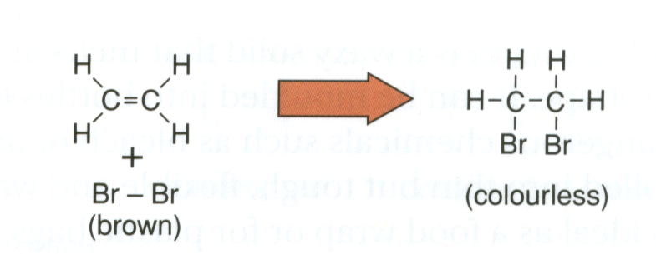
A Test for Unsaturated Hydrocarbons
The Carbon - Carbon double bond is very reactive. Some molecules like Bromine, can be added across the double bond
Bromine water added to an Alkene,will go from yellow - orange to colourless, as the Bromine reacts with one of the Carbon - Carbon bonds.

Slide 39
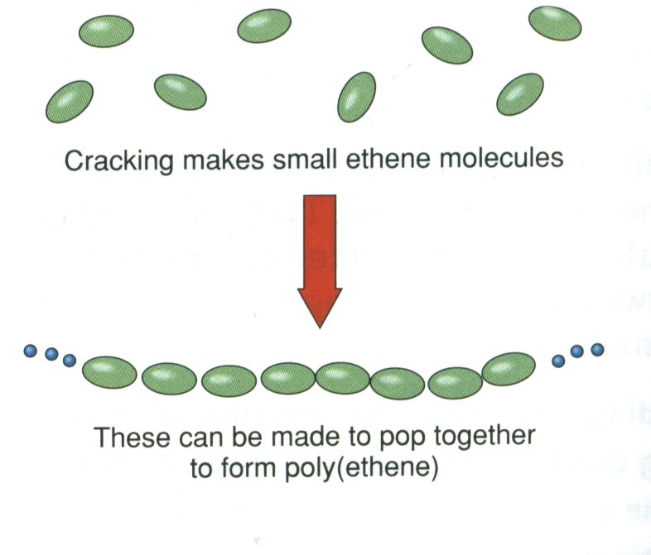
Why bother about Alkenes?
The double bond in Alkenes makes them very reactive.
Alkene molecules can be added together to form longer molecules called Polymers.
The process is called POLYMERISATION.
Why bother to cut hydrocarbons up, just to stick them back together again?
Choosing the right Alkene allows us to ‘tailor make’ the polymer with just the properties we need. Plastics are polymers.

Slide 40
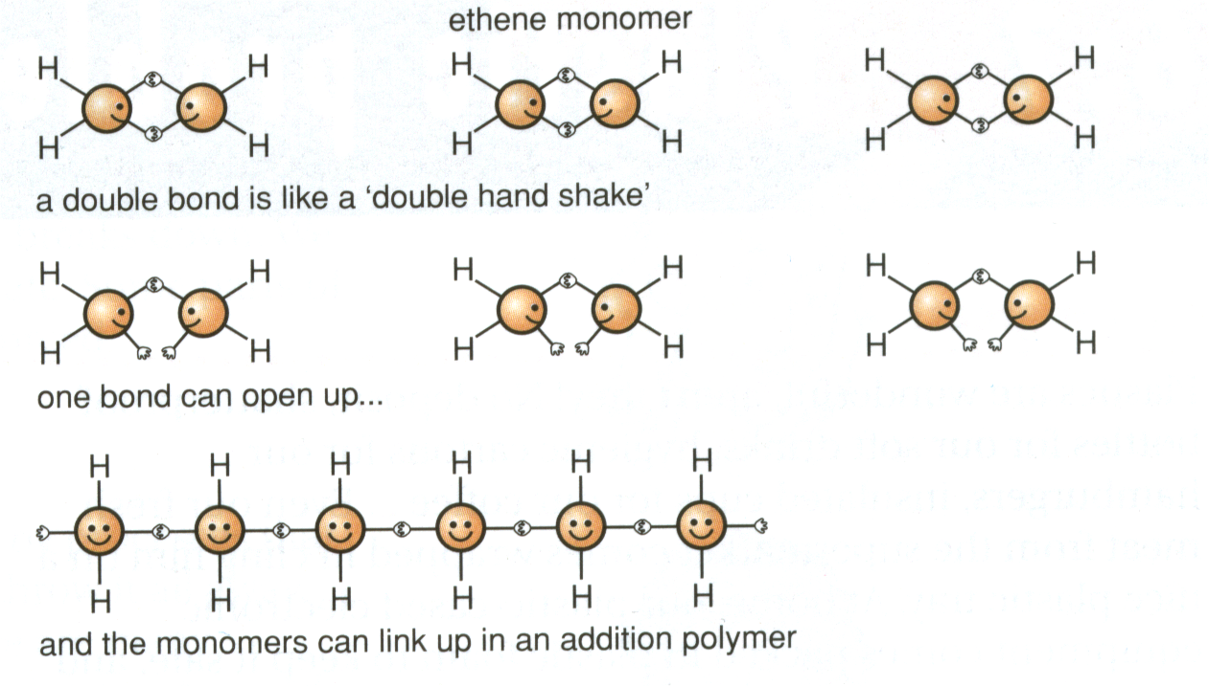
Addition Polymerisation
Molecules of Alkenes are referred to as Monomer molecules. If they are added together, with no other compounds being involved, the process is called Addition Polymerisation.
E.g. Polymerising ETHENE to make Poly(ethene) Polythene.

Slide 41
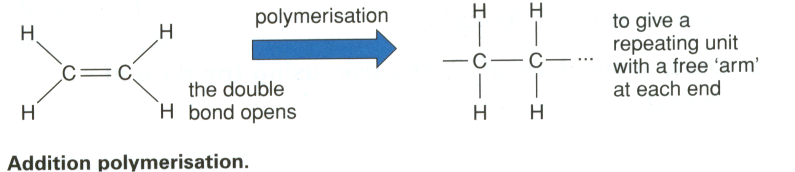
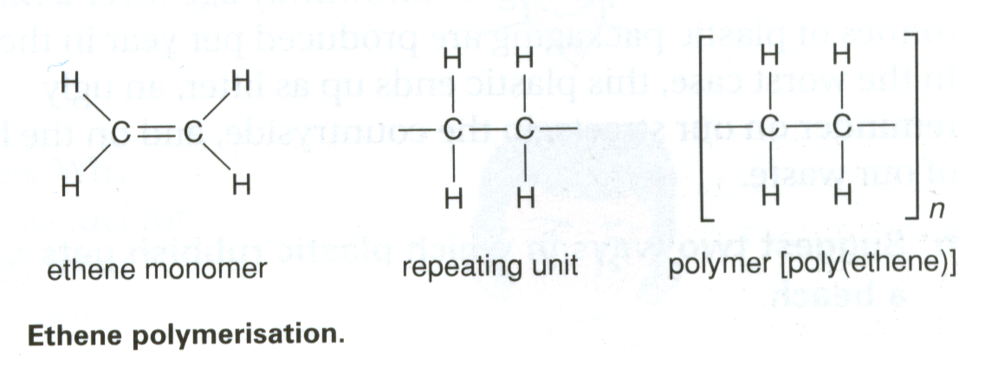
Ethene to Poly(ethene)

Slide 42
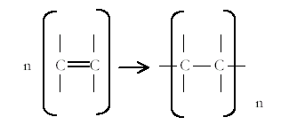
Representing Polymerisation
For any addition polymerisation, the way to represent it is basically the same.
For ‘n’
(any number) of monomer molecules.
The repeating unit will be repeated ‘n’ number of times

Slide 43
E.g. The polymerisation of Ethane C₂H₄ :
H
H
H
H
H
H
H
H
Monomer
Ethene
Unsaturated hydrocarbon
Polymer
Poly(ethene)
Good for plastic bags & buckets etc..

Slide 44
E.g. The polymerisation of Propene C₃H₆ :
H
H
H
H
H
CH₃
H
CH₃
Monomer
Propene
Unsaturated hydrocarbon
Polymer
Poly(propene)
Good for ropes etc..

Slide 45
E.g. The polymerisation of Styrene :
H
H
H
H
H
C₆H₅
H
C₆H₅
Styrene Monomer
Poly(styrene)
Polymer
Packaging, foam cups etc.

Slide 46
E.g. The polymerisation of Vinyl Chloride :
H
H
H
H
H
Cl
H
Cl
Vinyl Chloride
Monomer
Poly(vinylchloride) PVC
Polymer
Window frames, waterproof clothing etc..

Slide 47
E.g. The polymerisation of Tetrafluroethene :
F
F
F
F
F
F
F
F
Tetrafluroethene
Monomer
Poly(tetrafluroethene) PTFE
(Non-stick coating - Teflon)
Polymer

Slide 48
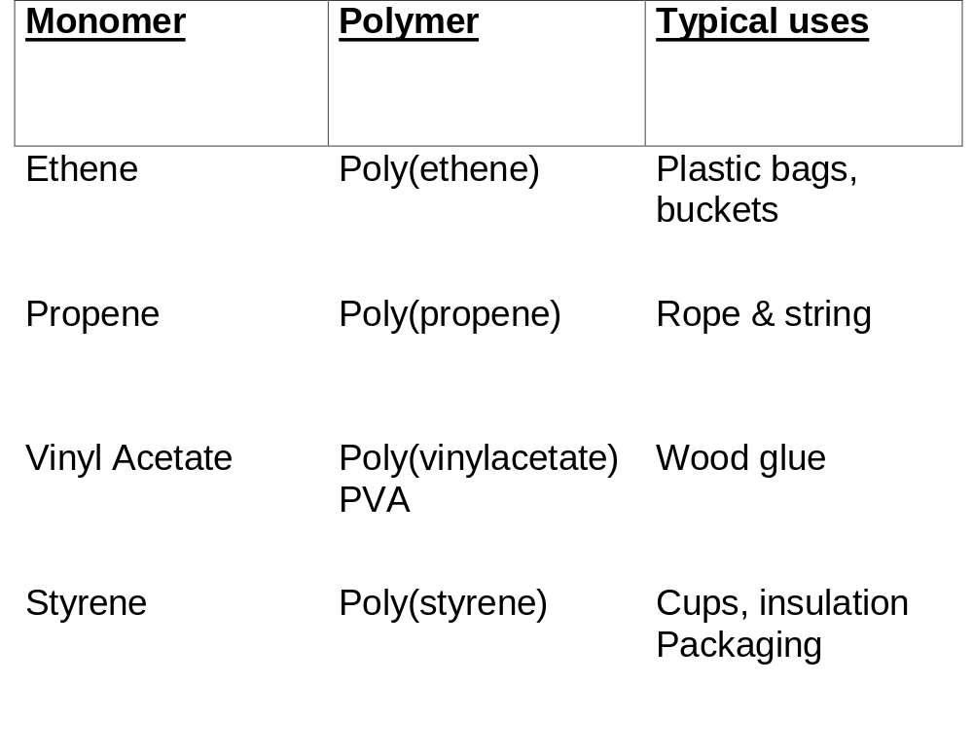
Some uses of Plastics

Slide 49
      Problems with Plastics
  The co-valent bonds holding the long molecules together are very strong. Few bacteria can make them rot down. They tend not to be Biodegradable.(What does this word mean?)
  This makes disposing of plastics difficult:
Burning them produces oxides of Carbon, Hydrogen and sometimes Sulphur and other toxic compounds:
Carbon Dioxide, Sulphur Dioxide, Water vapour
They fill up land-fill sites.
(Why should these factors be a problem?)

Slide 50
Why not recycle plastics?
Recycling plastics is complicated by several issues:
•Not all plastics lend themselves to recycling
•Different types of plastic have different properties, and so separation is very important.
•The economics of recycling are not always favourable, as the market is prone to fluctuate. For example, when oil prices fall the production of ‘new’ plastics become cheaper, so providing its recycled counterpart with greater competition.
•Unlike some countries a lack of subsidy in the UK makes a recycling industry more difficult to sustain, so nationally our recycling performance tends to lag behind many of our European neighbours.
However, increasing pressures on landfill sites, and our need to conserve natural resources makes recycling of plastics an important step forwards.

Slide 51
Why not burn them then?
Waste to Energy Process (WEP)
In instances where there is a high proportion of thermosetting plastic, or the waste is highly contaminated such as in the domestic waste stream, the best use of resources may be to burn the plastic waste and using the energy to generate heat and power.
Plastics have a high-energy content, so although they are roughly only 10% of household waste they contain over 30% of the energy content
In modern WTE plants the combustion process is highly controlled and combined with extensive air pollution and ash management systems. This enables the process to comply with government regulations for air, water and solid waste emissions.

Slide 52
The need for a balanced solution
    Plastics are clogging up land-fill sites and incinerating them adds to green-house gases and produces toxic gases: Ban plastic packaging and force supermarkets to revert to paper bags and glass bottles etc..
    Plastics come from a valuable resource. Most plastic products have their type stamped on them (e.g.. ABS), get councils to force residents into recycling different types of plastics in different bins.
    Plastics are mainly hydrocarbons like fossil fuels. We burn fossil fuels in power stations, so just burn plastics instead, being careful to scrub the fumes. This will save some fossil fuels and generate electricity at the same time.
    Investigate the economics: To make 1000 glass bottles from raw materials takes the equivalent of 230kg Oil, making 1000 plastic bottles takes just 100kg.
To make 1000 paper bags takes 47kg Oil, to make 1000 plastic bags takes just 32kg.
Using plastic uses less Oil, doing less damage.

Slide 53
This powerpoint was kindly donated to www.worldofteaching.com
http://www.worldofteaching.com is home to over a thousand powerpoints submitted by teachers. This is a completely free site and requires no registration. Please visit and I hope it will help in your teaching.

