Slide 1
Empirical Formula
From percentage to formula

Slide 2
The Empirical Formula
The lowest whole number ratio of elements in a compound.
The molecular formula the actual ratio of elements in a compound
The two can be the same.
CH₂ empirical formula
C₂H₄ molecular formula
C₃H₆ molecular formula
H₂O both

Slide 3
Calculating Empirical
Just find the lowest whole number ratio
C₆H₁₂O₆
CH₄N
It is not just the ratio of atoms, it is also the ratio of moles of atoms
In 1 mole of CO₂ there is 1 mole of carbon and 2 moles of oxygen
In one molecule of CO₂ there is 1 atom of C and 2 atoms of O

Slide 4
Calculating Empirical
Pretend that you have a 100 gram sample of the compound.
That is, change the % to grams.
Convert the grams to mols for each element.
Write the number of mols as a subscript in a chemical formula.
Divide each number by the least number.
Multiply the result to get rid of any fractions.

Slide 5
Example
Calculate the empirical formula of a compound composed of 38.67 % C, 16.22 % H, and 45.11 %N.
Assume 100 g so
38.67 g C x 1mol C = 3.220 mole C 12.01 gC
16.22 g H x 1mol H = 16.09 mole H 1.01 gH
45.11 g N x 1mol N = 3.219 mole N 14.01 gN

Slide 6
3.220 mole C
16.09 mole H
3.219 mole N
C_{3.22}H_{16.09}N_{3.219}
If we divide all of these by the smallest
one It will give us the empirical formula

Slide 7
Example
The ratio is 3.220 mol C = 1 mol C 3.219 molN 1 mol N
The ratio is 16.09 mol H = 5 mol H 3.219 molN 1 mol N
C₁H₅N₁ is the empirical formula
A compound is 43.64 % P and 56.36 % O. What is the empirical formula?

Slide 8
43.6 g P x 1mol P = 1.4 mole P 30.97 gP
56.36 g O x 1mol O = 3.5 mole O 16 gO
P_{1.4}O_{3.5}

Slide 9
Divide both by the lowest one
P_{1.4}O_{3.5}
The ratio is 3.52 mol O = 2.5 mol O 1.42 mol P 1 mol P
P₁O_{2.5}

Slide 10
Multiply the result to get rid of any fractions.
2 X
P₁O_{2.5}
= P₂O₅

Slide 11
Caffeine is 49.48% C, 5.15% H, 28.87% N and 16.49% O. What is its empirical formula?

Slide 12
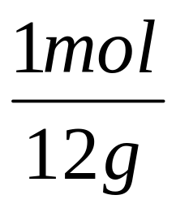
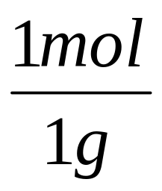
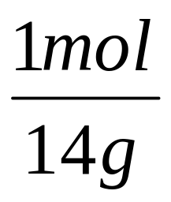
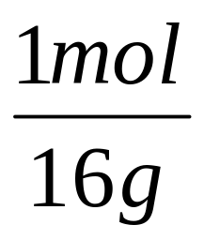
49.48 C
5.15 H
28.87 N
16.49 O
= 4.1mol
We divide by
lowest (1mol O)
and ratio
doesn’t change
= 5.2mol
= 2.2mol
Since they are
close to whole
numbers we will
use this formula
= 1.0mol

Slide 13
C_{4.12}H_{5.15}N_{2.1}O₁
OR C₄H₅N₂O₁
empirical mass = 97g

Slide 14
Empirical to molecular
Since the empirical formula is the lowest ratio the actual molecule would weigh more.
By a whole number multiple.
Divide the actual molar mass by the mass of one mole of the empirical formula.
Caffeine has a molar mass of 194 g. what is its molecular formula?

Slide 15
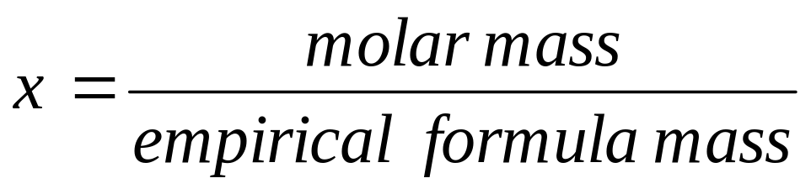
Find x if
194 g
97 g
= 2
2 X
C₄H₅N₂O₁
C₈H₁₀N₄O₂.

Slide 16
Example
A compound is known to be composed of 71.65 % Cl, 24.27% C and 4.07% H. Its molar mass is known (from gas density) is known to be 98.96 g. What is its molecular formula?

Slide 17
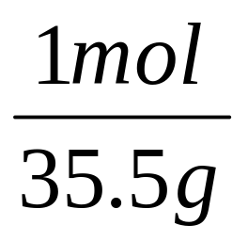
Example
71.65 Cl
24.27C
4.07 H.
= 2.0mol
= 2.0mol
= 4.0mol

Slide 18
Cl₂C₂H₄
We divide by
lowest (2mol )
Cl₁C₁H₂
would give an empirical wt of 48.5g/mol
Its molar mass is known (from gas density)
is known to be 98.96 g. What is its molecular
formula?

Slide 19
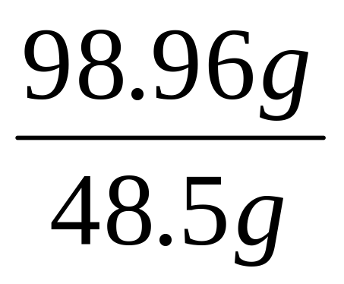
would give an empirical wt of 48.5g/mol
Its molar mass is known (from gas density)
is known to be 98.96 g. What is its molecular
formula?
= 2
=

Slide 20
2 X Cl₁C₁H₂
= Cl₂C₂H₄

Slide 21
This powerpoint was kindly donated to www.worldofteaching.com
http://www.worldofteaching.com is home to over a thousand powerpoints submitted by teachers. This is a completely free site and requires no registration. Please visit and I hope it will help in your teaching.

