Slide 1
Energy and conservation

Slide 2
What are our main energy sources?
Industrialised countries need large amounts of energy
Most of this energy comes form fossil fuels which are burnt in power stations, factories, homes and vehicles
These fossil fuels formed millions of years ago, and are non-renewable
Once the fossil fuels have been used up there will be no more to replace them

Slide 3

Oil is useful for other things too
Oil is a mixture of different compounds
We can separate these substances by a process called fractional distillation
These fractions include fuels like petrol, diesel and aviation fuel
Parts of oil are also used to make plastics, medicines, paints, dyes and even wax candles

Slide 4
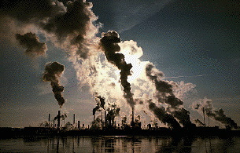
Problems with burning fossil fuels
Huge amounts of carbon dioxide are given off into the atmosphere
Carbon dioxide causes global warming or the greenhouse effect
coal-burning power stations also give off sulphur dioxide gas which leads to acid rain

Slide 5

What is the greenhouse effect?
Carbon dioxide gas acts like the glass in a greenhouse
Infrared radiation from the Sun is usually reflected back into space
Greenhouse gases stop this, and heat is reflected back to the Earth again

Slide 6
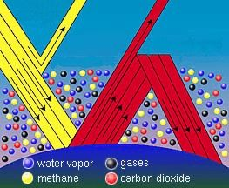

Slide 7
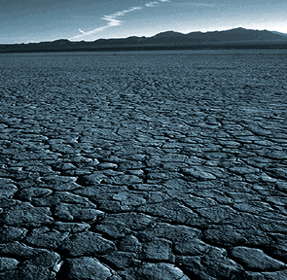
What are the problems with global warming?
  The average temperature of the Earth will rise
  This can lead to droughts

Slide 8
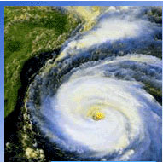
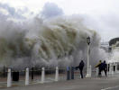
  Extremes of weather will occur hurricanes and storms

Slide 9

  The increase in temperature will speed up the melting of the polar ice caps

Slide 10

  Global warming will therefore lead to floods

Slide 11

So all this burning of fossil fuels leading to an Earth that is suffering form many environmental problems

Slide 12

Other problems from the pollution from burning fossil fuels:
Lead poisoning has been shown to affect the development and progress of children living near motorways
Dust and gases in the air can lead to smog above large industrialised cities
A hole is developing in the ozone layer which therefore will not filter out harmful ultra-violet rays from the Sun

Slide 13
We need to conserve our fossil fuels
The electricity we produce from burning fossil fuels could also be made using renewable energy resources
It makes sense to save the oil we have left for making fuel for transport and for making plastics
We could try to save wasting energy from fossil fuels during domestic use in our homes and from waste transport consumption of fuel

Slide 14





Alternative energy sources
Wind energy
Hydroelectric energy
Solar energy
Tidal energy
Nuclear energy
Geothermal energy
Biomass energy

Slide 15

Problems with nuclear fuels
Nuclear power stations can produce large amounts of energy from small amounts of nuclear fuel. (Radioactive materials naturally release heat)
Nuclear radiation is extremely dangerous
High safety standards are needed
Waste materials stay radioactive for thousands of years
There have been some disastrous accidents at nuclear power stations which have affected all living things in the area

Slide 16
Write an article for a newspaper or a magazine, outlining the need for energy conservation
Plan:
Fossils fuels: uses
Fossil fuels : why we need to conserve them
Fossil fuels: problems of pollution
Alternative energy sources (advantages & disadvantages)
Problems with nuclear fuels

Slide 17
This powerpoint was kindly donated to www.worldofteaching.com
http://www.worldofteaching.com is home to over a thousand powerpoints submitted by teachers. This is a completely free site and requires no registration. Please visit and I hope it will help in your teaching.

