Slide 1
Functional Groups
What is the family name?

Slide 2
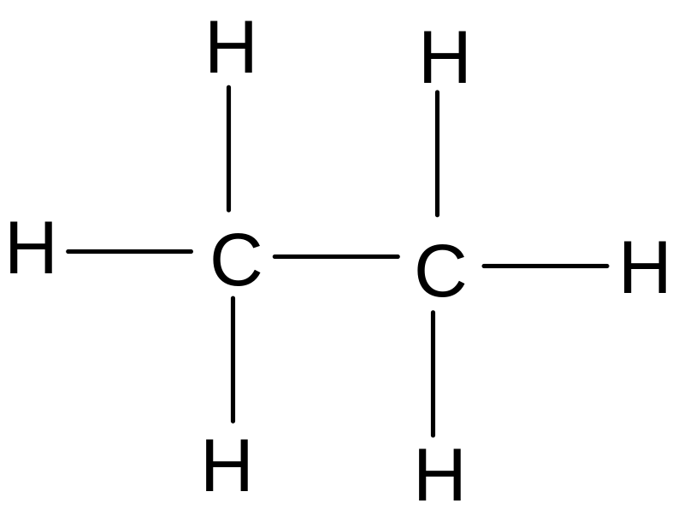
alkanes
Only carbon and hydrogen
All single bonds

Slide 3
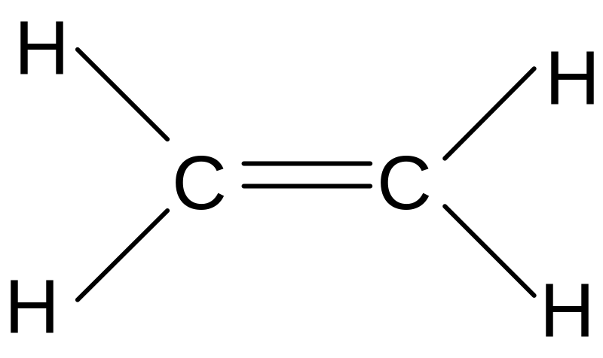
alkenes
Only carbon and hydrogen
A carbon to carbon double bond

Slide 4
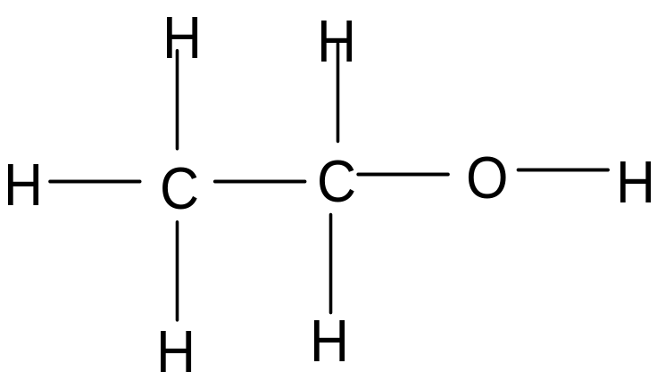
alcohols
Only one oxygen
Has an O-H group

Slide 5
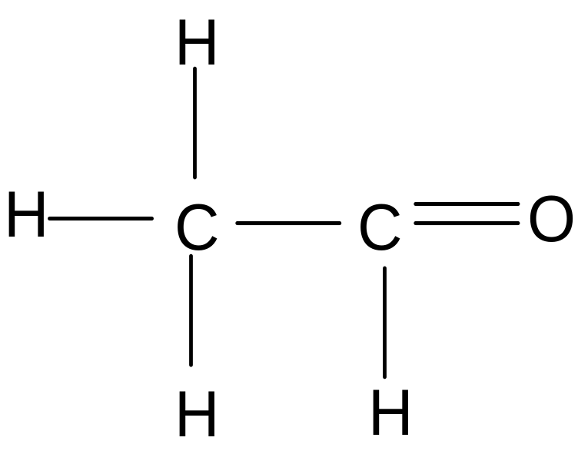
Aldehydes / sugars
Only one oxygen
Has a C=O group

Slide 6
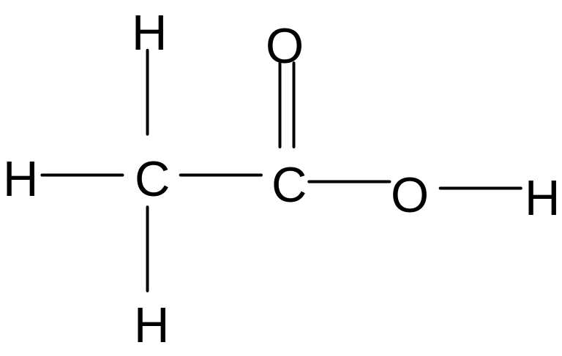
Acids
Has 2 oxygens
Has an O-H group

Slide 7
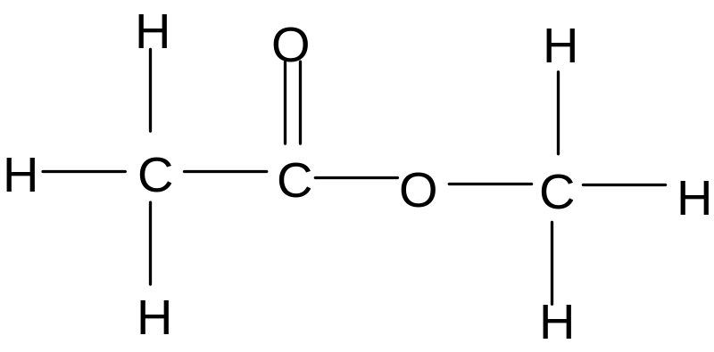
Esters
Has 2 oxygens
One oxygen is in a carbon sandwich
Ester loves to eat her carbon sandwich ?

Slide 8
What family does it belong to ?
alkene
Only carbon and hydrogen
A carbon to carbon double bond

Slide 9
What family does it belong to ?
Aldehyde / sugar
Only one oxygen
Has a C=O group

Slide 10
What family does it belong to ?
alcohol
Only one oxygen
Has an O-H group

Slide 11
What family does it belong to ?
acid
Has 2 oxygens
Has an O-H group

Slide 12
What family does it belong to ?
alkane
Only carbon and hydrogen
All single bonds

Slide 13
What family does it belong to ?
ester
Has 2 oxygens
One oxygen is in a carbon sandwich
Ester loves to eat her carbon sandwich ?

Slide 14
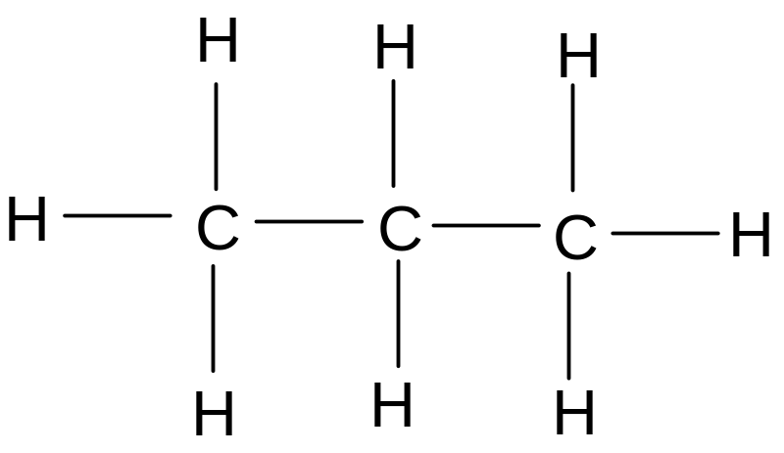
This is an …..
alkane

Slide 15
This is an ….
alkene

Slide 16
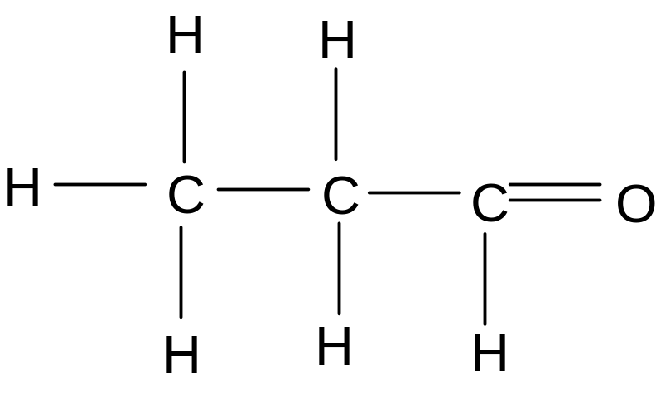
This is an ...
aldehyde

Slide 17
This is an ...
alkane

Slide 18
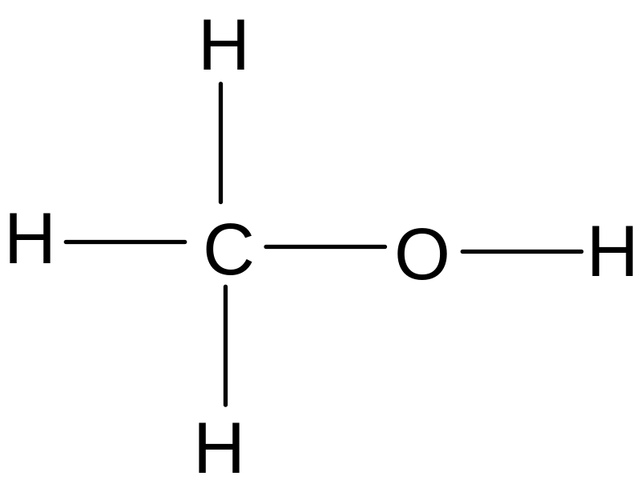
This is an ...
alcohol

Slide 19
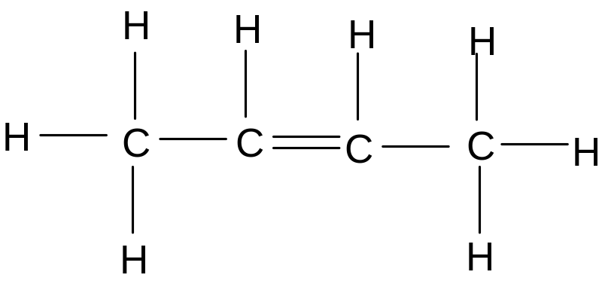
This is an ...
alkene

Slide 20
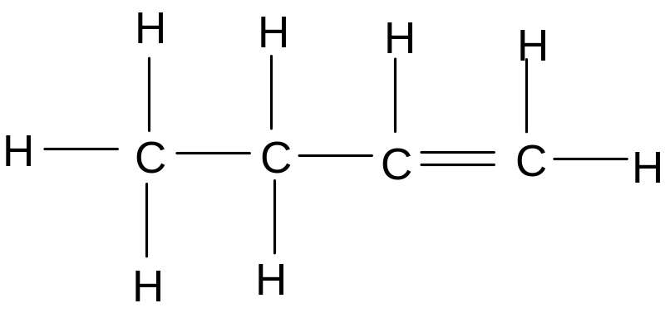
This is an ...
alkene

Slide 21
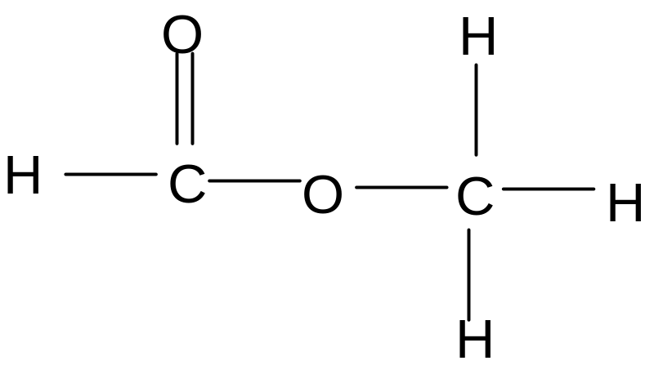
This is an …..
ester

Slide 22
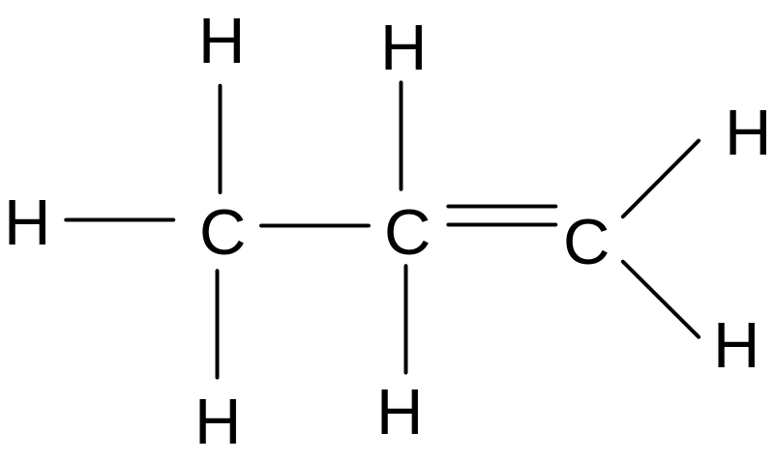
This is an ...
alkene

Slide 23
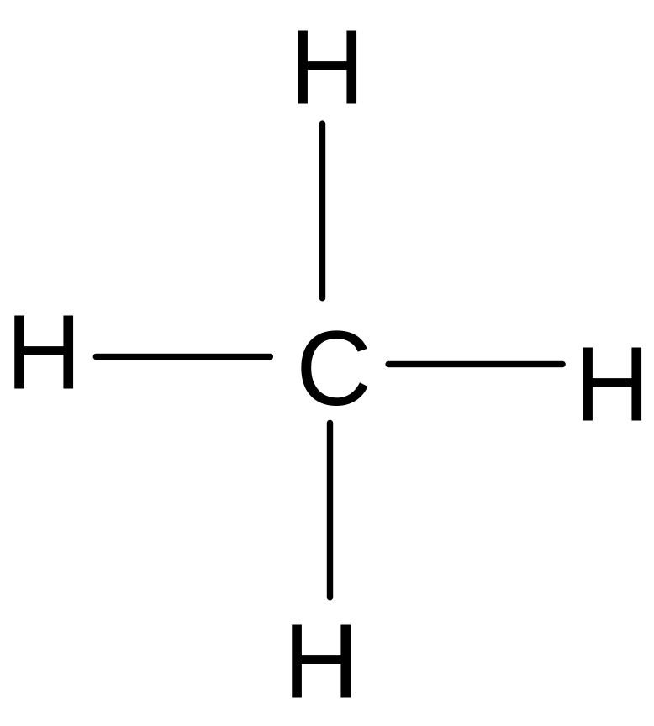
This is an ...
alkane

Slide 24
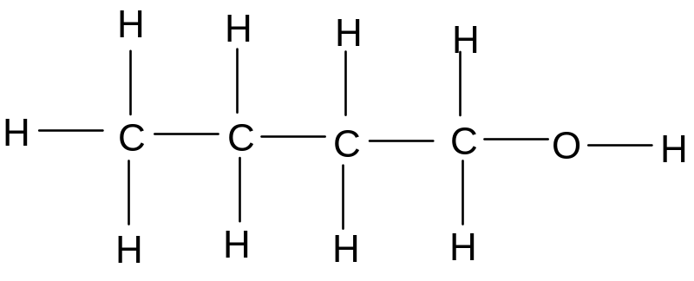
This is an ...
Alcohol

Slide 25
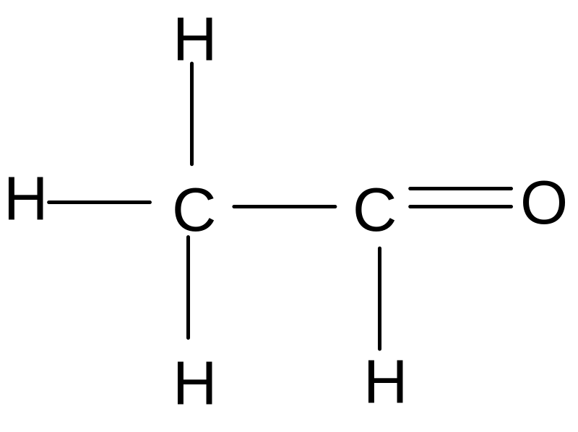
This is an ...
Aldehyde.

Slide 26
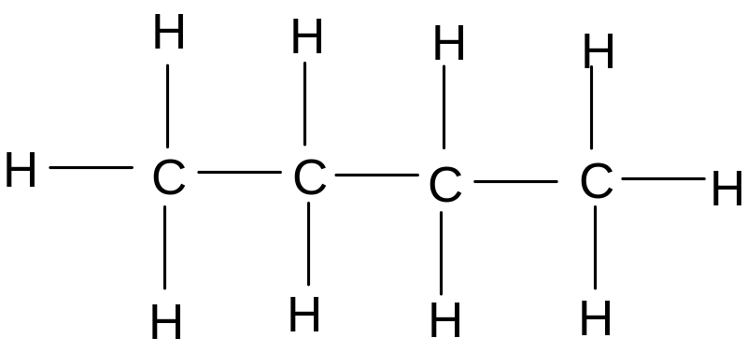
This is an ...
alkane

Slide 27
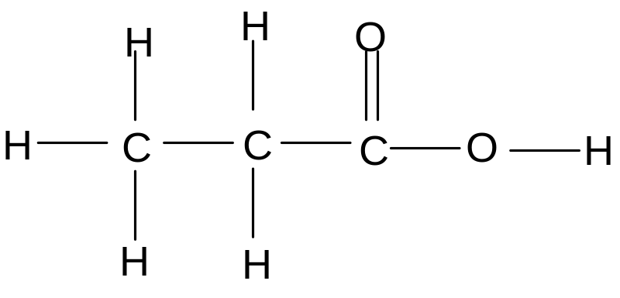
This is an ...
acid

Slide 28
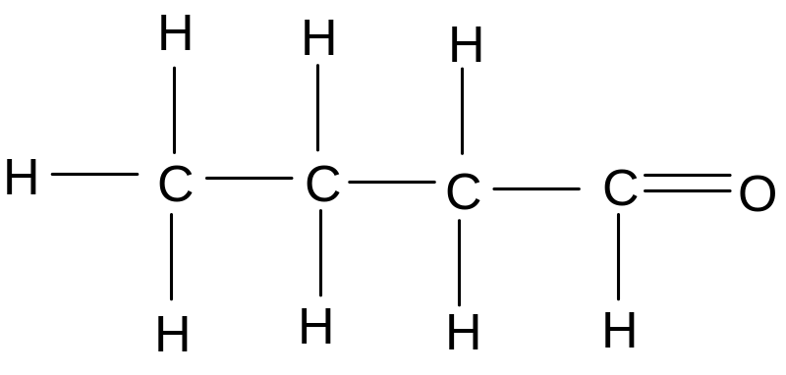
This is an ...
aldehyde

Slide 29
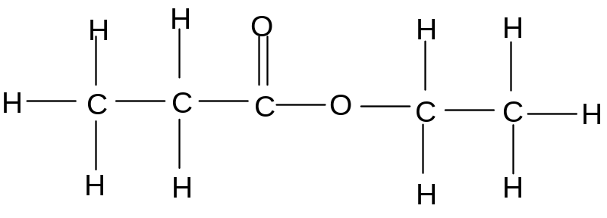
This is an ...
ester

Slide 30
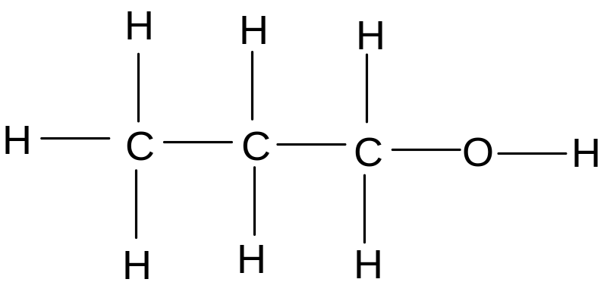
This is an ...
alcohol

Slide 31
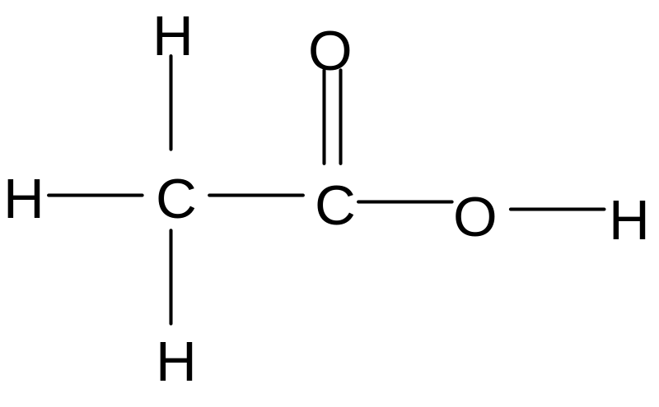
This is an ...
acid

Slide 32
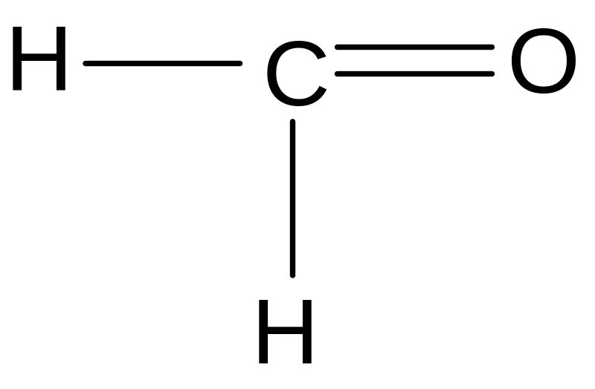
This is an ...
aldehyde

Slide 33
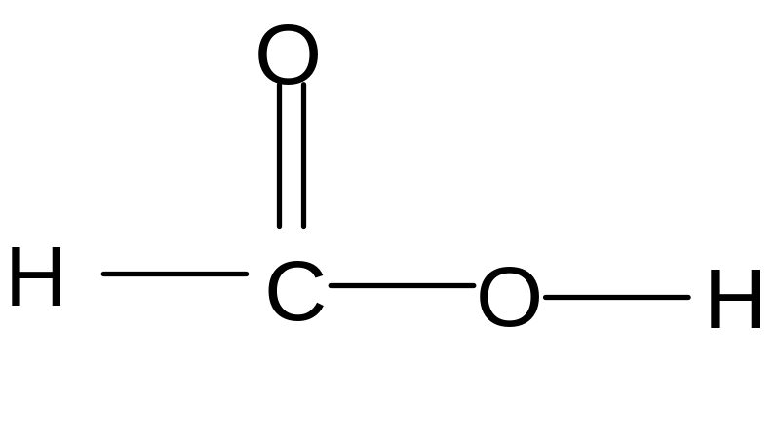
This is an ...
acid

Slide 34
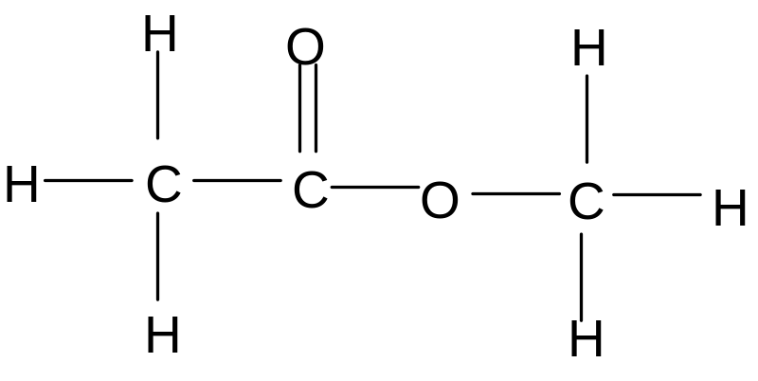
This is an ...
ester

Slide 35
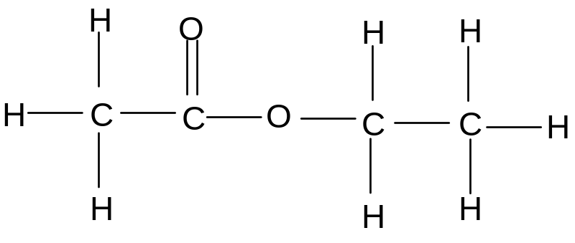
This is an ...
ester

Slide 36
This is an ...
acid

Slide 37
Well done !

Slide 38
This powerpoint was kindly donated to www.worldofteaching.com
http://www.worldofteaching.com is home to over a thousand powerpoints submitted by teachers. This is a completely free site and requires no registration. Please visit and I hope it will help in your teaching.

