Slide 1
Green Chemistry

Slide 2
GREEN CHEMISTRY
DEFINITION
  Green Chemistry is the utilisation of a set of principles that reduces or eliminates the use or generation of hazardous substances in the design, manufacture and application of chemical products .
  GREEN CHEMISTRY IS ABOUT
  Waste Minimisation at Source
  Use of Catalysts in place of Reagents
  Using Non-Toxic Reagents
  Use of Renewable Resources
  Improved Atom Efficiency
  Use of Solvent Free or Recyclable Environmentally Benign Solvent systems

Slide 3
Green Chemistry Is About...
^{Waste}
^{Materials}
^{Hazard}
Reducing
^{Risk}
Energy
Cost

Slide 4
Why do we need Green Chemistry ?
Chemistry is undeniably a very prominent part of our daily lives.
Chemical developments also bring new environmental problems and harmful unexpected side effects, which result in the need for ‘greener’ chemical products.
A famous example is the pesticide DDT.

Slide 5
Green chemistry looks at pollution prevention on the molecular scale and is an extremely important area of Chemistry due to the importance of Chemistry in our world today and the implications it can show on our environment.
The Green Chemistry program supports the invention of more environmentally friendly chemical processes which reduce or even eliminate the generation of hazardous substances.
This program works very closely with the twelve principles of Green Chemistry.

Slide 6
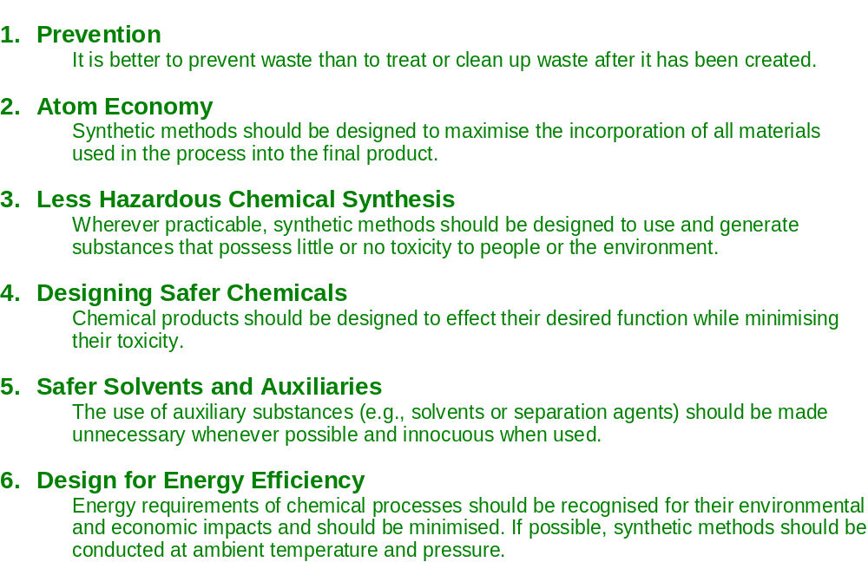
The 12 Principles of Green Chemistry (1-6)

Slide 7
The 12 Principles of Green Chemistry (7-12)
    7 Use of Renewable Feedstocks
      A raw material or feedstock should be renewable rather than depleting whenever technically and economically practicable.
    8 Reduce Derivatives
      Unnecessary derivatization (use of blocking groups, protection/de-protection, and temporary modification of physical/chemical processes) should be minimised or avoided if possible, because such steps require additional reagents and can generate waste.
    9 Catalysis
      Catalytic reagents (as selective as possible) are superior to stoichiometric reagents.
    10 Design for Degradation
      Chemical products should be designed so that at the end of their function they break down into innocuous degradation products and do not persist in the environment.
    11 Real-time Analysis for Pollution Prevention
      Analytical methodologies need to be further developed to allow for real-time, in-process monitoring and control prior to the formation of hazardous substances.
    12 Inherently Safer Chemistry for Accident Prevention
      Substances and the form of a substance used in a chemical process should be chosen to minimise the potential for chemical accidents, including releases, explosions, and fires.

Slide 8
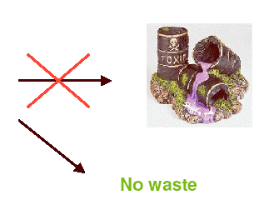
“It is better to prevent waste than to treat or clean up waste after it is formed”
Chemical
Process

Slide 9
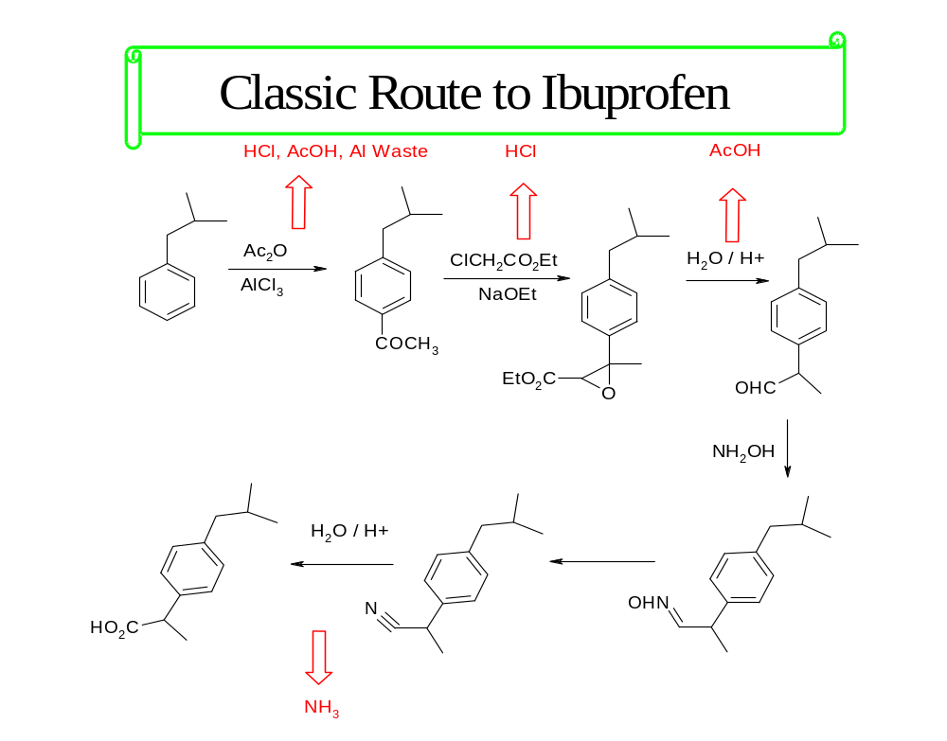

Slide 10
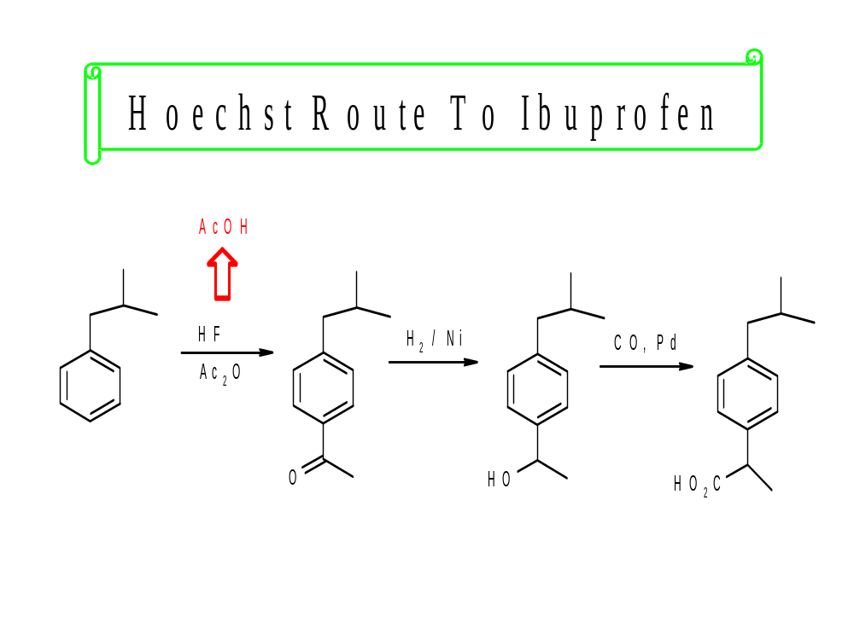

Slide 11
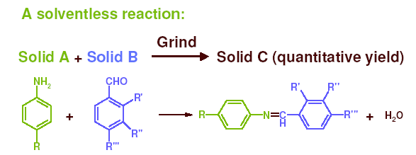
“The use of auxiliary substances (e.g. solvents, separation agents, etc.) should be made unnecessary wherever possible, and innocuous when used”

Slide 12
“Energy requirements should be recognized for their environmental impacts and should be minimized.
Synthetic methods should be conducted at ambient pressure and temperature”

Slide 13
Heating
Cooling
Stirring
Distillation
Compression
Pumping
Separation
GLOBAL WARMING
Energy Requirement
(electricity)
Burn fossil
fuel
CO₂ to
atmosphere

Slide 14
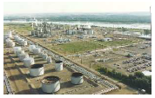
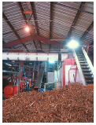
“A raw material of feedstock should be renewable rather than depleting wherever technically and economically practical”
Non-renewable
Renewable

Slide 15
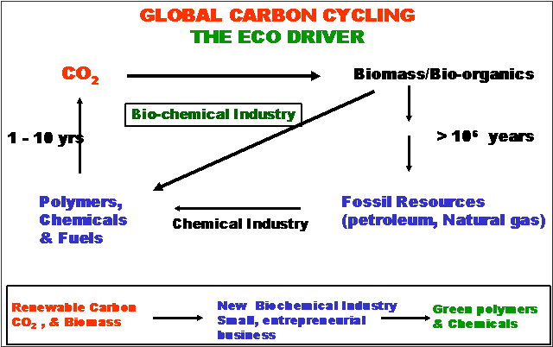

Slide 16
Resource Depletion
Renewable resources can be made increasingly viable technologically and economically through green chemistry.
Carbondioxide
Biomass
Nanoscience
Solar
Waste utilization

Slide 17
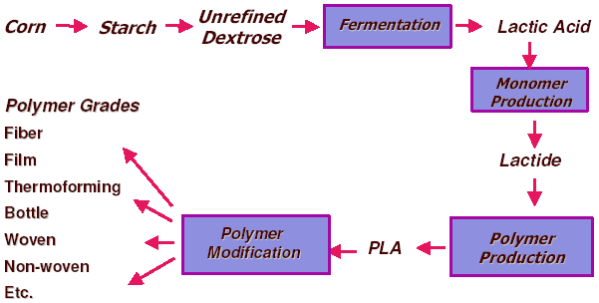
Poly lactic acid (PLA) for plastics production

Slide 18
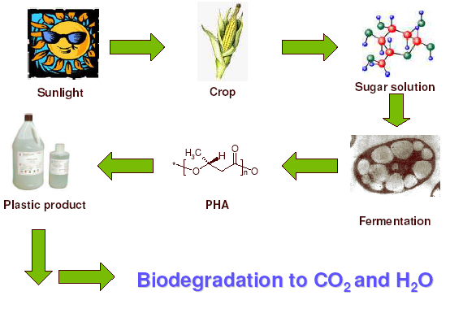
Polyhydroxyalkanoates (PHA’s)

Slide 19
The major uses of GREEN CHEMISTRY
Energy
Global Change
Resource Depletion
Food Supply
Toxics in the Environment

Slide 20
Energy
The vast majority of the energy generated in the world today is from non-renewable sources that damage the environment.
  Carbon dioxide
  Depletion of Ozone layer
  Effects of mining, drilling, etc
  Toxics

Slide 21
Energy
Green Chemistry will be essential in
  developing the alternatives for energy generation (photovoltaics, hydrogen, fuel cells, biobased fuels, etc.) as well as
  continue the path toward energy efficiency with catalysis and product design at the forefront.

Slide 22
Global Change
Concerns for climate change, oceanic temperature, stratospheric chemistry and global distillation can be addressed through the development and implementation of green chemistry technologies.

Slide 23
Resource Depletion
Due to the over utilization of non-renewable resources, natural resources are being depleted at an unsustainable rate.
Fossil fuels are a central issue.

Slide 24
Resource Depletion
Renewable resources can be made increasingly viable technologically and economically through green chemistry.
  Biomass
  Nanoscience & technology
  Solar
  Carbon dioxide
  Chitin
  Waste utilization

Slide 25
Food Supply
While current food levels are sufficient, distribution is inadequate
Agricultural methods are unsustainable
Future food production intensity is needed.
Green chemistry can address many food supply issues

Slide 26
Food Supply
Green chemistry is developing:
  Pesticides which only affect target organisms and degrade to innocuous by-products.
  Fertilizers and fertilizer adjuvants that are designed to minimize usage while maximizing effectiveness.
  Methods of using agricultural wastes for beneficial and profitable uses.

Slide 27
Toxics in the Environment
Substances that are toxic to humans, the biosphere and all that sustains it, are currently still being released at a cost of life, health and sustainability.
One of green chemistry’s greatest strengths is the ability to design for reduced hazard.

Slide 28
Pollution Prevention Hierarchy
Prevention & Reduction
Recycling & Reuse
Increasing Greenness
Treatment
Disposal

Slide 29
Conclusion
Green chemistry Not a solution to all environmental problems But the most fundamental approach to preventing pollution.

Slide 30
Thank you

Slide 31
This powerpoint was kindly donated to www.worldofteaching.com
http://www.worldofteaching.com is home to over a thousand powerpoints submitted by teachers. This is a completely free site and requires no registration. Please visit and I hope it will help in your teaching.

