Slide 1
Group 16, the Oxygen Group

Slide 2
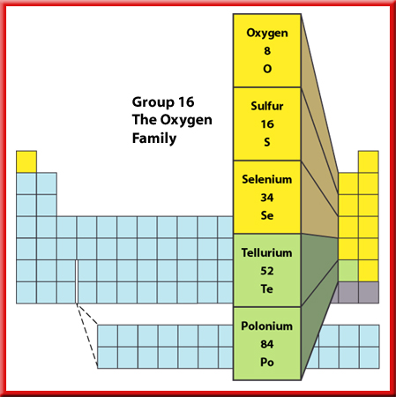
Representative Elements
Group 16—The Oxygen Family
The first two members of Group 16, oxygen and sulfur, are essential for life.
The heavier members of the group, tellurium and polonium, are both metalloids.

Slide 3
Representative Elements
Group 16—The Oxygen Family
Ozone, a less common form of oxygen, is formed in the upper atmosphere through the action of electricity during thunderstorms.
The presence of ozone is important because it shields living organisms from some harmful radiation from the Sun.

Slide 4
Representative Elements
Group 16—The Oxygen Family
Sulfur is a solid, yellow nonmetal.
Large amounts of sulfur are used to manufacture sulfuric acid, one of the most commonly used chemicals in the world.
Sulfuric acid is a combination of sulfur, hydrogen, and oxygen.
It is used in the manufacture of paints, fertilizers, detergents, synthetic fibers, and rubber.

Slide 5

Representative Elements
Group 16—The Oxygen Family
Selenium conducts electricity when exposed to light, so it is used in solar cells, light
meters, and photographic materials.

Slide 6
Representative Elements
Group 16—The Oxygen Family
Its most important use is as the light-sensitive component in photocopy machines.
Traces of selenium are also necessary for good health.

Slide 7
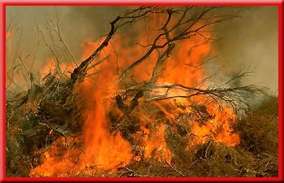
Representative Elements
Group 16—The Oxygen Family
About 20 percent of Earth’s atmosphere is the oxygen you breathe.
Oxygen is abundant in Earth’s rocks and minerals because it readily combines with other elements.
Oxygen also is required for combustion to occur.

Slide 8
This powerpoint was kindly donated to www.worldofteaching.com
http://www.worldofteaching.com is home to over a thousand powerpoints submitted by teachers. This is a completely free site and requires no registration. Please visit and I hope it will help in your teaching.

