Slide 1
The Ionic Bond

Slide 2
Helium, neon and argon are atoms which do not react with other atoms.
We call them the Inert Gases (or Noble Gases) because of this.
Each of these gases has a full outer electron shell (orbit).
2p2n
10p10n
18p22n
He
4
Ne
20
2
10
40
Ar
2,8
18
2,8,8

Slide 3
Sodium
23
Na
11
e.c. 2,8,1
11p
12n
11 protons
12 neutrons
11 electrons

Slide 4
Chlorine
35
Cl
17
e.c. 2,8,7
17p
17 protons
18n
18 Neutrons
17 electrons

Slide 5
The Sodium atom has 1 Electron in it’s outer shell.
Na
e.c. 2,8,1
Atom
The Sodium loses 1 electron to leave a complete outer shell.
It is now a Sodium ion with a charge of 1 +
(Na ⁺)
+
e.c. (2,8)⁺
Ion

Slide 6
The Chlorine atom has 7 electrons in it’s outer shell.
Cl
e.c. 2,8,7
Atom
-
The Chlorine gains 1 electron to gain a complete outer shell.
It is now a Chlorine ion with a charge of 1 -
(Cl ⁻ )
e.c. (2,8,8)⁻
Ion

Slide 7
The Ionic Bond
Sodium atom
Na
Chlorine atom
Cl
Sodium ion
(Na ⁺)
+
-
Chlorine ion
(Cl ⁻)
The sodium atom loses one electron to attain a complete outer shell and become a positive ion (Na ⁺).
The Chlorine atom gains one electron to attain a complete outer shell and become a negative ion (Cl –).
Strong electrostatic forces attract the sodium and chlorine ions.

Slide 8
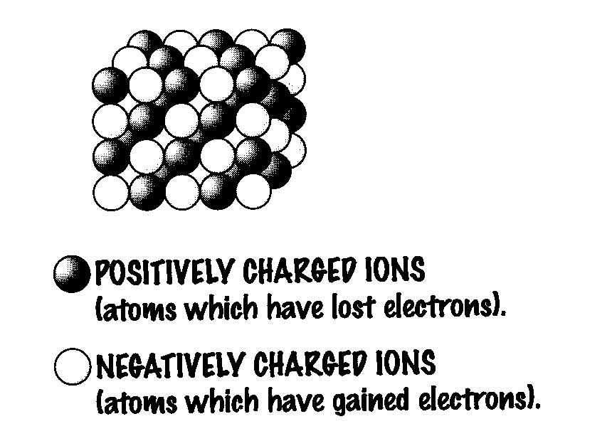
Ionic Compounds
Held together by strong electrostatic forces
Opposite charges attract
High melting points and boiling points
Regular structures – giant ionic lattices
When melted or dissolved ionic compounds conduct electricity
Visit www.worldofteaching.com
For 100’s of free powerpoints

