Slide 1
Lab Tests, results, and Sulphuric acid

Slide 2
Testing for carbon dioxide
Gas
Limewater
Limewater turns milky/cloudy

Slide 3
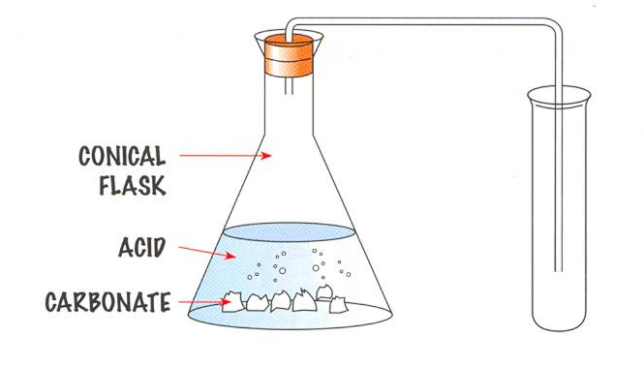
Adding acid to carbonates
Carbonates are compounds containing carbon and oxygen. When an acid is added to a carbonate the carbonate starts to fizz. A gas called _________ _______ is produced.
Calcium carbonate + hydrochloric acid calcium chloride + carbon dioxide + water
CaCO_{3(s)} + HCl_{(aq)} CaCl_{2(aq)} + CO_{2(g)} + H₂O_{(l)}
2

Slide 4
Flame tests
Compound | Colour of flame

Slide 5

Flame tests
Compounds containing lithium, sodium, potassium, calcium and barium can be recognised by burning the compound and observing the colours produced:
Lithium
Red
Sodium
Yellow
Potassium
Lilac
Calcium
Brick red
Barium
Green

Slide 6
Metal ions
Metal compounds in a solution contain metal ions. For example, consider calcium chloride:
Calcium is in group 2 and has two electrons in its outer shell, so it will form a Ca²⁺ ion.
Chlorine is in group 7 so a chloride ion will be Cl⁻
Calcium chloride has the formula CaCl₂

Slide 7
Metal ions and precipitates
Some metal ions form precipitates, i.e. an insoluble solid that is formed when sodium hydroxide is added to them. Consider calcium chloride:
Ca²⁺_{(aq)} + OH⁻ Ca(OH)_{2 (s)}
2

Slide 8
Metal ions and precipitates
Some metal ions form precipitates, i.e. an insoluble solid that is formed when sodium hydroxide is added to them. Consider calcium chloride:
Ca²⁺_{(aq)} + OH⁻ Ca(OH)_{2 (s)}
2
Metal ion | Precipitate formed | Colour
Calcium Ca²⁺ | Calcium hydroxide: Ca²⁺_{(aq)} + OH⁻_{(aq)} Ca(OH)_{2 (s)} | White
Aluminium Al³⁺
Magnesium Mg²⁺
Copper_{(II)} Cu²⁺
Iron_{(II)} Fe²⁺
Iron_{(III)} Fe³⁺

Slide 9
Testing for chloride and sulphate ions
For each test state: 1) The colour of the precipitate
2) What compound it is
Test 1: Chloride ions
Add a few drops of dilute nitric acid to the chloride ion solution followed by a few drops of silver nitrate.
Precipitate formed = silver chloride (white)
Test 2: Sulphate ions
Add a few drops of dilute hydrochloric acid to the sulphate ion solution followed by a few drops of barium chloride.
Precipitate formed = barium sulphate (white again)

Slide 10
Ammonium, nitrate, bromide and iodide ions
Ammonium ions:
Add sodium hydroxide and test the gas using damp litmus paper – ammonia gas turns damp litmus paper blue.
Nitrate ions:
Add sodium hydroxide followed by aluminium powder and test using damp litmus paper.
Bromide and iodide ions:
Add a few drops of dilute nitric acid followed by a few drops of silver nitrate solution. A pale yellow precipitate should be formed for bromide ions and a darker yellow precipitate for iodide ions.

Slide 11
Thermal decomposition
A “thermal decomposition” reaction occurs when a compound breaks down (“decomposition”) through the action of heat.
Practical work:
Perform a thermal decomposition reaction on each of these compounds and state:
The colour changes you observed
The reaction that happened
Copper carbonate:
CuCO_{3 (s)} CuO_{(s)} + CO_{2 (g)} (Green – Black)
Zinc carbonate:
ZnCO_{3 (s)} ZnO_{(s)} + CO_{2 (g)} (White – Yellow)

Slide 12
Sulphuric acid
Sulphuric acid has many important uses – car batteries, detergents, fertilisers etc.
How sulphuric acid is made:
Step 1: Burn sulphur in air:
Sulphur + oxygen sulphur dioxide
Step 2: Pass the sulphur dioxide over a vanadium oxide catalyst at 450^{O}C:
Sulphur dioxide + oxygen sulphur trioxide
Step 3: Dissolve the sulphur trioxide in sulphuric acid:
Sulphur trioxide + conc. sulphuric acid oleum
Step 4: Add water to the oleum:
Oleum + water sulphuric acid

Slide 13
Sulphuric acid
Step 2 in the manufacture of sulphuric acid is an example of a reversible reaction:
Endothermic
2SO₂ + O₂ 2SO₃
Exothermic
What would happen if the temperature was decreased?
The reaction would favour the production of sulphur trioxide BUT the reaction would happen at a slower rate.
Solution – use 450^{O}C as a compromise

Slide 14
This powerpoint was kindly donated to www.worldofteaching.com
http://www.worldofteaching.com is home to over a thousand powerpoints submitted by teachers. This is a completely free site and requires no registration. Please visit and I hope it will help in your teaching.

