Slide 1
Topic 10 : Making Electricity
Electricity passing along metal wires is a flow of
electrons.
In a cell/battery, electricity comes from a chemical reaction
chemical energy
electrical energy.
Cells/batteries need replaced as the chemicals
are being used up in the reaction to supply electricity.
Some cells/batteries are rechargeable, e.g.
nicad cells (nickel-cadmium cells) and
the lead-acid battery used in cars/vans/buses.

Slide 2
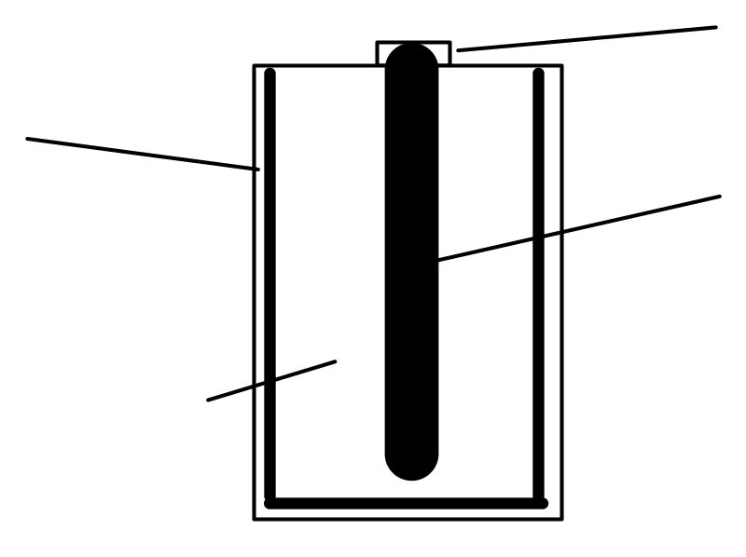
Dry Cells
metal cap
zinc case
carbon rod
(graphite)
ammonium chloride
The ammonium chloride in the cell is an example of an
electrolyte.
The purpose of the electrolyte is to
complete the circuit.

Slide 3
Electricity can be produced by connecting different metals together (with an electrolyte) to form a
cell.
Different pairs of metals connected in a cell give different voltages. This enables us to construct an
electrochemical series (see data booklet - page 7)
Voltmeter.
Two different metals.
V
Electrolyte, e.g. sodium chloride solution.

Slide 4
Displacement reactions.
When a piece of magnesium metal is added to a solution of copper(II)sulphate, the blue colour of the solution fades and the magnesium is covered with a brown solid.
magnesium
copper(II)sulphate solution

Slide 5
Displacement reactions.
When a piece of magnesium metal is added to a solution of copper(II)sulphate, the blue colour of the solution fades and the magnesium is covered with a brown solid.
magnesium
copper(II)sulphate solution

Slide 6
Displacement reactions.
When a piece of magnesium metal is added to a solution of copper(II)sulphate, the blue colour of the solution fades and the magnesium is covered with a brown solid.
magnesium
copper(II)sulphate solution

Slide 7
Displacement reactions.
When a piece of magnesium metal is added to a solution of copper(II)sulphate, the blue colour of the solution fades and the magnesium is covered with a brown solid.
magnesium
copper(II)sulphate solution

Slide 8
Displacement reactions.
When a piece of magnesium metal is added to a solution of copper(II)sulphate, the blue colour of the solution fades and the magnesium is covered with a brown solid.
magnesium
copper(II)sulphate solution

Slide 9
Magnesium is higher in the electrochemical series than copper.
Magnesium gives electrons to the copper ions.
The copper ions gaining these electrons form copper atoms (brown solid).
The magnesium atoms lose electrons to form colourless ions which dissolve in the solution.

Slide 10
The solution was blue due to the copper(II) ions.
As the copper ions are being changed to copper atoms, the blue colour fades.
The copper ions have been displaced from the solution as copper atoms.
A displacement reaction will occur when a metal is placed in a solution of metal ions, if the metal is higher in the electrochemical series than the metal ions.

Slide 11
Ion-electron equations can be used to show the reaction (use page 7 of data booklet).
Mg atoms lose electrons to form Mg ions
Start with
Mg atoms
Mg²⁺ + 2e Mg
Electrons given to Cu ions
Cu²⁺ + 2e Cu
End with
Cu atoms
Cu ions gain electrons to form Cu atoms

Slide 12
The ion-electron equations can be re-written to show each step in the reaction:
Mg Mg²⁺ + 2e
Mg²⁺ + 2e Mg
Cu²⁺ + 2e Cu

Slide 13
Electricity can be produced by connecting two different metals in solutions of their metal ions.
A
e⁻
e⁻
Copper
Zinc
Ion bridge/salt bridge
Copper sulphate solution
Zinc chloride solution
Electrons flow in the wires
from the metal high in the electrochemical series
to the lower metal.

Slide 14
The purpose of the “ion bridge” (“salt bridge”) is to complete the circuit.
A
e⁻
e⁻
Copper
Zinc
Ion bridge/salt bridge
Copper sulphate solution
Zinc chloride solution
Ions flow through solutions and
through the ion bridge/salt bridge.
The movement of ions through the ion bridge completes the circuit.

Slide 15
Cells/batteries compared to mains electricity.
Ease of transport:
cells/batteries are highly portable / mains electricity is not!
Safety:
cell/battery voltages/currents are safer than those of mains electricity.
Costs:
cells/batteries are much more expensive.
Uses of finite resources:
making cells/batteries uses up more finite resources than producing mains electricity.

Slide 16
Reactions of metals with dilute acids can establish the position of hydrogen in an electrochemical series, e.g. Magnesium and hydrochloric acid
Mg atoms lose electrons to form Mg ions
Start with
Mg atoms
Mg²⁺ + 2e Mg
Electrons given to H ions
2H⁺ + 2e H₂
End with
H molecules
H ions gain electrons to form H atoms
Metals above hydrogen in the electrochemical series react with dilute acids to produce hydrogen gas. Metals below hydrogen do not react with dilute acids.

Slide 17
The ion-electron equations (page 7 in data booklet) can be re-written to show each step in the reaction:
Mg Mg²⁺ + 2e
Mg²⁺ + 2e Mg
2H⁺ + 2e H₂

Slide 18
Oxidation and Reduction
OIL RIG
oxidation is loss reduction is gain
OF ELECTRONS
Oxidation is a loss of electrons by a reactant in any reaction.
Reduction is a gain of electrons by a reactant in any reaction.

Slide 19
Oxidation and Reduction
In a redox reaction, reduction and oxidation go on together.
REDOX
reduction oxidation
A metal element reacting to form a compound is an example of oxidation.
A compound reacting to form a metal element is an example of reduction.

Slide 20
Oxidation and reduction in complex ion-electron equations (page 7 in data booklet),
e.g. as written in data booklet
SO₄²⁻(aq) + 2H⁺(aq) + 2e --> SO₃²⁻(aq) + H₂O(l)
this shows reduction (electrons on the reactant side of the arrow).
Reversing this ion-electron equation gives
SO₃²⁻(aq) + H₂O(l) --> SO₄²⁻(aq) + 2H⁺(aq) + 2e
which shows oxidation (electrons on the product side of the arrow).

Slide 21
This powerpoint was kindly donated to www.worldofteaching.com
http://www.worldofteaching.com is home to over a thousand powerpoints submitted by teachers. This is a completely free site and requires no registration. Please visit and I hope it will help in your teaching.

