Slide 1

BELLWORK
What is matter?
What is mass and how does it compare to weight?
What word is used to describe the amount of space an object takes up?

Slide 2
Matter and Change
Unit III Properties of Matter

Slide 3
Matter and Change
Anything that takes up space and has mass.
Weight is a measure of the pull of gravity on an object; mass is the amount of matter the object contains.
Volume.

Slide 4
Matter and Change
What states of matter are represented in the photograph?
What must you do to a substance to change it’s physical state?

Slide 5
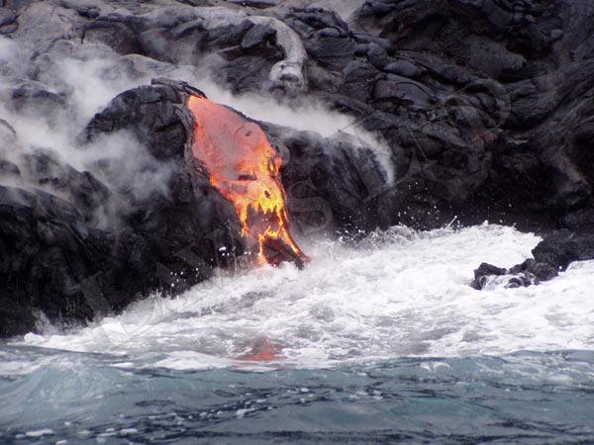
Matter and Change

Slide 6
Matter and Change
The mass of an object is the amount of matter the object contains. A golf ball has a greater mass than a table tennis ball. The golf ball, therefore, contains more matter.

Slide 7
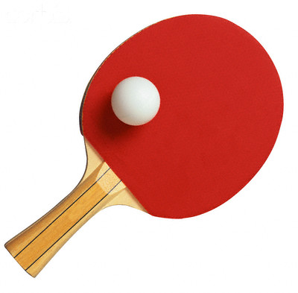

Matter and Change

Slide 8
Matter and Change
Materials differ in terms of the kind of matter they contain.
Table sugar is always 100% sucrose.
It always has the same chemical composition.
Matter that has a uniform and definite composition is called a substance.

Slide 9
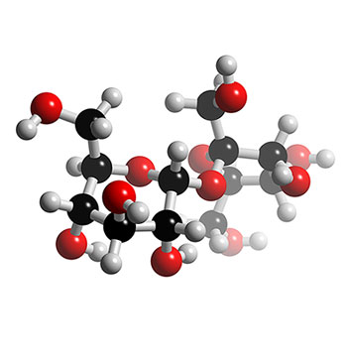
Matter and Change

Slide 10
Matter and Change
Substances contain only one kind of matter.
Which of these two is a substance?
H20 or Lemonade?

Slide 11
Matter and Change
All samples of a substance have the same physical properties.
All crystals of sucrose taste sweet and dissolve completely in water.

Slide 12
Matter and Change
A physical property is a quality or condition of a substance that can be observed or measured without changing the substance’s composition.

Slide 13
Matter and Change
Examples of physical properties include:
1.- COLOR
2.- SOLUBILITY
3.- ODOR
4.- HARDNESS

Slide 14
Matter and Change
5.- DENSITY
6.- MELTING POINT
7.- BOILING POINT

Slide 15
Matter and Change
Physical properties help chemists
identify a substance based on their characteristics.
Which substance is this?
“Colorless liquid that boils at 100 ˚C and melts at 0 ˚C” ???????
“Colorless liquid that boils at 78 ˚C
and melts at -117 ˚C” ???????

Slide 16
Matter and Change
Important properties of the States of Matter
Property Solid Liquid Gas or vapor
Shape | Definite | Indefinite | Indefinite
Volume | Definite | Definite | Indefinite
Expansion on heating | Very slight | Moderate | Great
Compressi-bility | Almost incompre-ssible | Almost incompre-ssible | Readily compressible

Slide 17
Matter and Change
SOLIDS
Coal, sugar, ice and iron.
Definite shape and volume.
The shape doesn’t depend on the shape of their container.
The particles are packed tightly together, they are almost incompressible.
Solids expand only lightly when heated

Slide 18
Matter and Change
LIQUIDS
Water, milk and blood.
Takes the shape of their container (flows).
Particles are packed closely together, but not rigidly packed.
The volume that a liquid occupies is always constant, no matter what shape it takes.
Almost incompressible, with a tendency to expand when heated.

Slide 19
Matter and Change
GASES
Takes the shape and form of their container (flowable).
Particles are spaced far apart.
Gases expand without limit to fill any space.
Gases are easily compressed.

Slide 20
Matter and Change
VAPOR
The gaseous state of a substance that is generally a liquid or solid at room temperature.
Steam (the gaseous state of matter) is referred to as a vapor because water is a liquid at room temperature.
Moist air contains water vapor.

Slide 21
Matter and Change
PHYSICAL CHANGE
A type of change that alters a given material without changing it’s chemical composition.
Examples include: cutting, grinding, bending, the melting of the metal gallium, the freezing of water and the condensation of steam to water.

Slide 22
Matter and Change
PHYSICAL CHANGE
Other verbs or actions related to physical changes include: boil, freeze, dissolve, melt, condense, break, split, crack, grind, cut, crush and bend.

Slide 23
This powerpoint was kindly donated to
www.worldofteaching.com
http://www.worldofteaching.com
Is home to well over a thousand powerpoints submitted by teachers. This a free site. Please visit and I hope it will help in your teaching
Notes:
23

