Slide 1
Metals in Industry, working with metals

Slide 2
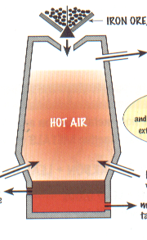
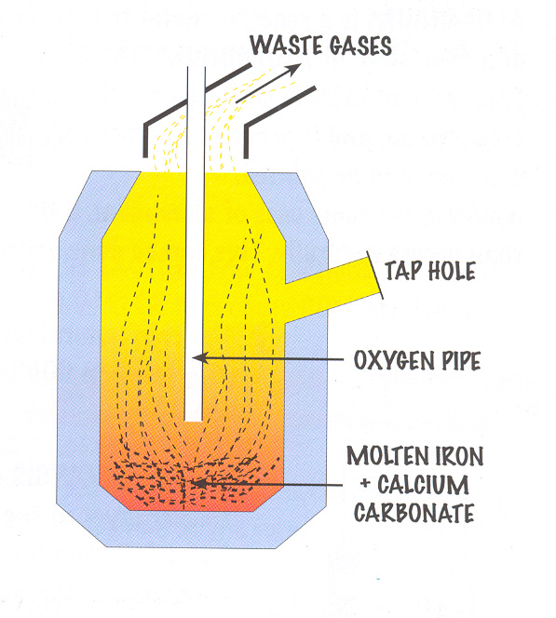
Iron and Steel
In previous work we considered the role of the blast furnace in extracting iron from its ore.
The iron contains roughly 5% carbon and different metals and is very ________. In order to reduce these impurities and convert the iron into _________ the molten iron is transferred into another furnace where it is mixed with recycled scrap iron and pure ___________. The oxygen reacts with the metal impurities to form ________ oxides. Calcium carbonate is also added to remove some of the acidic oxides as _______ when the furnace is tilted.
Words – slag, brittle, steel, oxygen, acidic

Slide 3
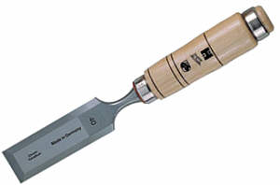

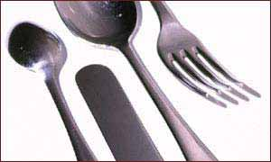
Making steel – the reactions
1) Mixing oxygen with silicon impurities:
Silicon + oxygen Silicon oxide
2) Decomposition of limestone:
Calcium carbonate calcium oxide + carbon dioxide
3) Adding these products together:
Silicon oxide + calcium oxide calcium silicate
Steel with a high carbon content is strong but brittle
Steel with a low carbon content is easily shaped
Steel with chromium and nickel is called stainless steel

Slide 4
Titanium
Titanium is a strong metal used in planes, replacement hip joints, bikes etc. Two steps are used in its manufacture:
Step 1: Convert titanium dioxide (ore) to titanium chloride
Step 2: Displace the titanium using sodium or magnesium:
Titanium chloride + sodium titanium + sodium chloride
In this reaction the titanium is displaced my a more reactive metal. This reaction is done in an argon atmosphere to avoid any further reactions.
Titanium ions have a charge of 4+ and gain four electrons to become titanium atoms. This is a reduction reaction.

Slide 5
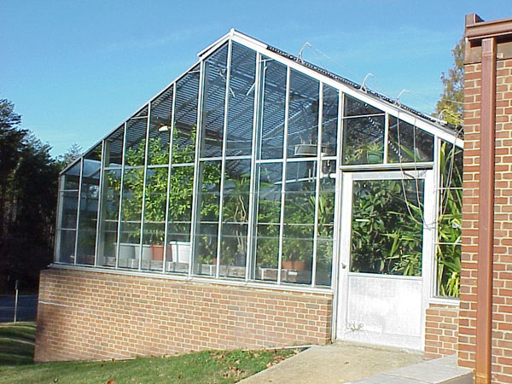
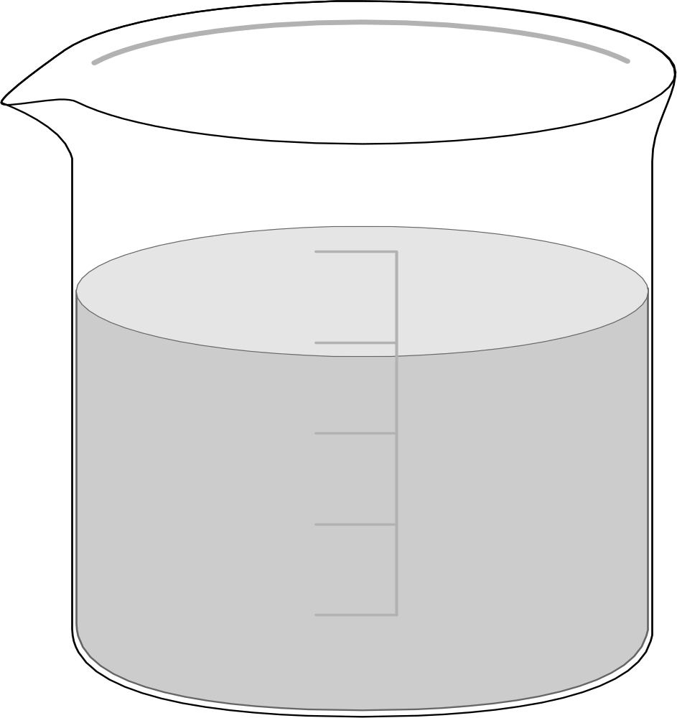
Aluminium
Aluminium is a fairly reactive metal that doesn’t corrode due to forming a thin layer of aluminium oxide. This explains why greenhouses don’t rust and don’t need to be painted.
A thicker layer of aluminium oxide can be made artificially. There are two stages:
1) Remove the natural layer by placing the aluminium in sodium hydroxide.
++++
----
2) Use electrolysis on sulphuric acid with the aluminium as the positive electrode. This is called anodising.
Al
H₂SO₄

Slide 6
Electroplating
Silver electrode
++++
----
Object to be plated
Solution containing silver ions

Slide 7
This powerpoint was kindly donated to www.worldofteaching.com
http://www.worldofteaching.com is home to over a thousand powerpoints submitted by teachers. This is a completely free site and requires no registration. Please visit and I hope it will help in your teaching.

