Slide 1
Mixtures
Unit III Properties of Matter

Slide 2
BELLWORK
What is a mixture?
How can it be separated?
Can you provide another example?.

Slide 3
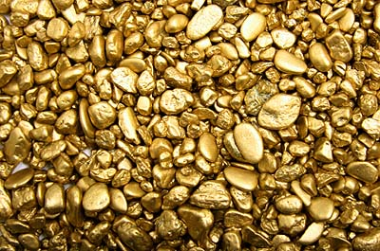
BELLWORK

Slide 4
Mixtures
A mixture is a physical blend of two or more substances.
Their composition varies (Air).
There are two types of mixtures: homogenous and heterogenous

Slide 5
Mixtures
Heterogenous mixtures
Is the type of mixture that is not uniform in composition.
If you were to sample one portion of such a mixture, it’s composition would be different from that of another portion.

Slide 7
Mixtures
Homogenous mixture
Is the type of mixture that has a completely uniform composition throughout itself.
It’s components are evenly distributed throughout the sample.

Slide 8
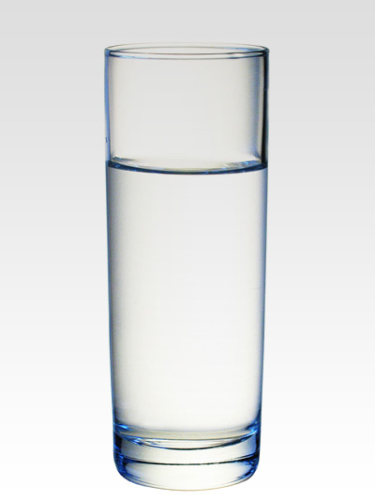

Slide 9
Homogenous or Heterogenous?
Air
Salt water
Tea
Brass
Vinegar
Hydrogen peroxide
Steel
Salad dressing
Apple
Sand
Paint
Granite
Laundry detergent
Cereal

Slide 10
Solutions
Is the special name that scientists give to homogenous mixtures.
Solutions may be gases, liquids or solids.
An example: solution of sugar in water.

Slide 11
Solutions
Some common types of solutions
System Examples
Gas-gas | CO₂ and O in N (air)
Liquid-gas | Water vapor in air
Gas-liquid | CO₂ in H₂O (Soda water)
Liquid-liquid | Acetic acid in H₂O (vinegar)
Solid-liquid | NaCl in H₂O (brine)
Solid-solid | Cu in Ag (Sterling silver)

Slide 12
Phases
Any part of a system with uniform composition and properties is called a phase.
On a homogenous mixture you have “one phase” only.
On a heterogenous mixture you have “two or more phases”.

Slide 13
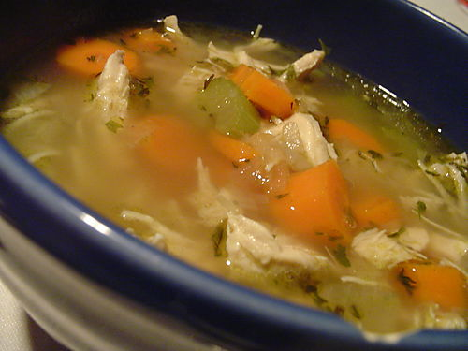
Phases in a heterogenous mixture

Slide 14
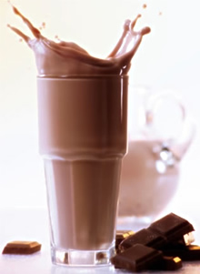
Phases in a homogenous mixture

Slide 15
Separating Mixtures
Suppose you had a mixture of iron nails, salt and water…
How would you separate this mixture completely?
Based on which physical properties would you base your method on?

Slide 16
Separating Mixtures
How would you separate the components in tap water?
Distillation
A liquid is boiled to produce vapor that is then condensed again to a liquid

Slide 17
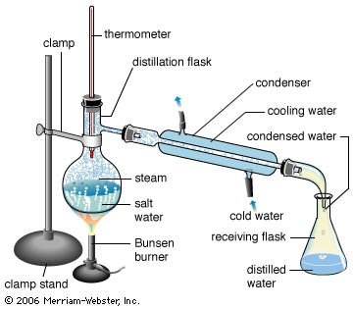
Separating Mixtures

Slide 18
Mixtures
Sample problem
How can a mixture of iron fillings and aluminum fillings be separated?
1.-Analyze: Plan a problem solving strategy
List the properties of iron and aluminum and look for something that would be useful in separating the mixture

Slide 19
Mixtures
2.- Solve: Apply the problem-solving strategy.
Iron:
Metal
Grayish
Not soluble in water
Attracted to a magnet
Aluminum:
Metal
Grayish
Not soluble in water
Not attracted to magnets
Make use of a property that differentiates the metals; use a magnet to attract the iron fillings.

Slide 20
Mixtures
3.-Evaluate: Does the result make sense?
Because the magnet attracts iron but not aluminum filings, the iron would be removed while the aluminum would be left behind.

Slide 21
Practice Problems
What physical properties could be used to separate iron filings from salt?
Which of the following are homogenous? heterogenous?
1.-Spaghetti sauce 4.-Cough syrup
2.-Glass 5.-Mixture of nitrogen gas
3.-Muddy Water and helium gas

Slide 22
This powerpoint was kindly donated to
www.worldofteaching.com
http://www.worldofteaching.com
Is home to well over a thousand powerpoints submitted by teachers. This a free site. Please visit and I hope it will help in your teaching
Notes:
22

