Slide 1
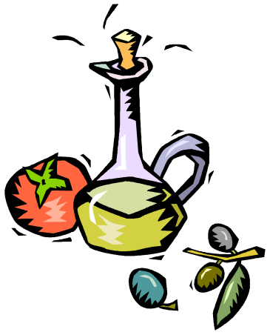
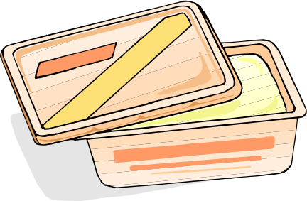
13.6 Oils and Fats

Slide 2
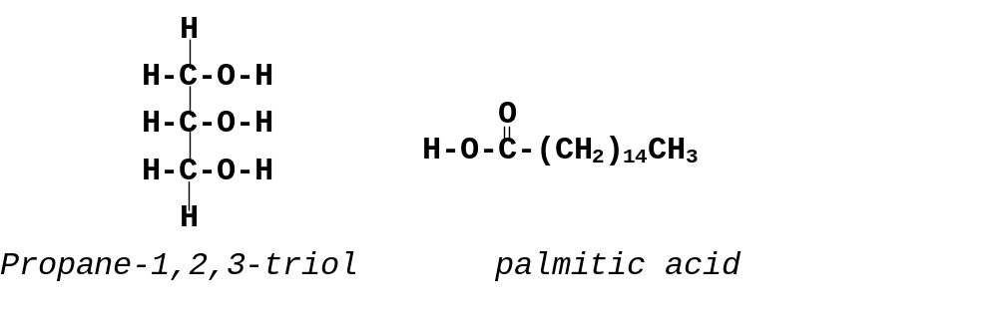
Chemical structure.
Oils and fats – important for storing chemical energy in living things.
Oils are liquids – fats are solids.
Made from esters of propane-1,2,3,triol (glycerol) + long chain carboxylic acids RCOOH.

Slide 3
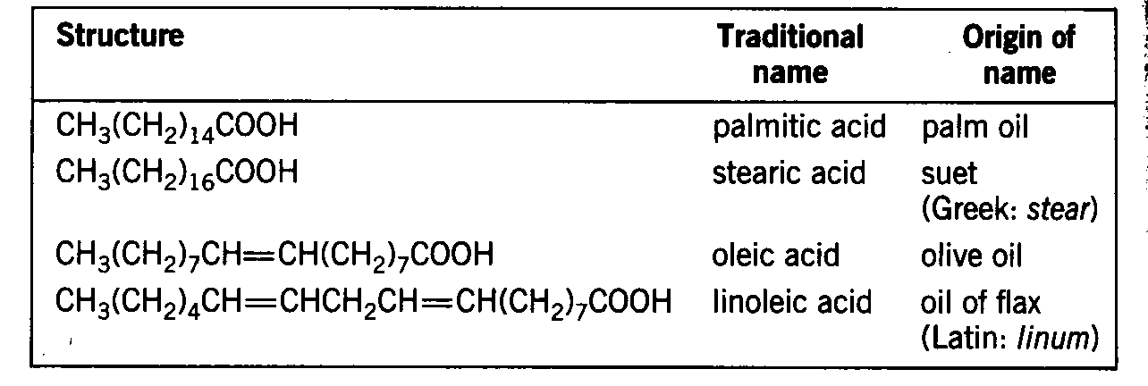
Table 11 Common fatty acids

Slide 4
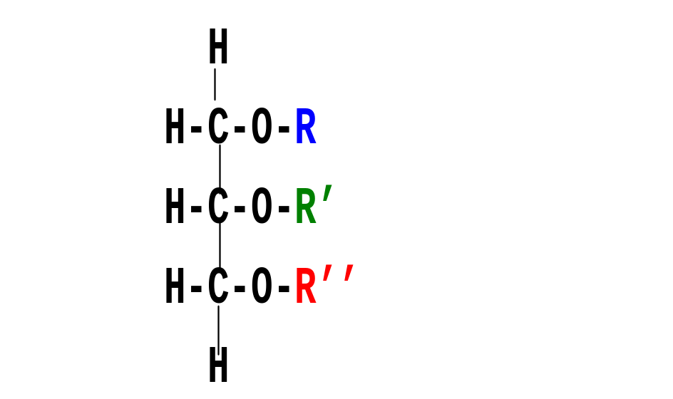
Types of triesters
Triesters (triglycerides) – 3 carboxylic acids react with triol.
Mixed triesters – three acid groups, not all alike often found in natural oils and fats.

Slide 5
Fats and fatty acids.
Unbranched hydrocarbon chains.
Called fatty acids – occur in fats!!!
Fully unsaturated / 3 or 4 double bonds.
Still known by old names – systematic names too long.
Thought to cause blockage of blood vessels and heart disease, especially the saturated ones.

Slide 6
Fat facts!
Natural oils and fats are mixtures of triesters.
Can be split up by hydrolysis, heat with conc. NaOH.
Triester + NaOH → glycerol + sodium salt of acid
Basis of soap manufacture eg. “Palmolive”
Convert sodium salts to free acids by adding dil. HCl or other mineral acid.

Slide 7
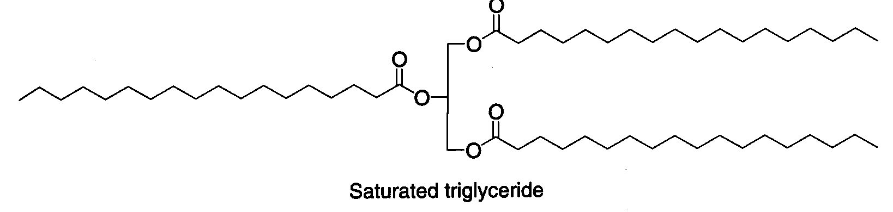
Solid or...?
Fatty acids present in mixture affect the properties.
Saturated triglycerides pack closely together.
Attractive forces - higher melting point.

Slide 8
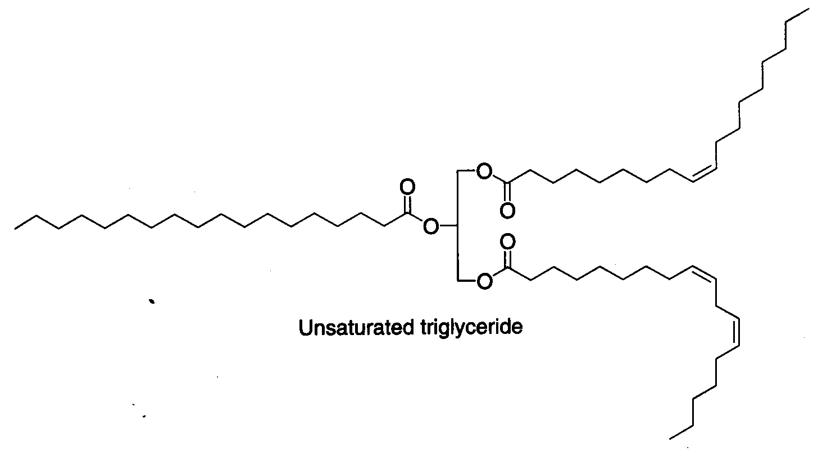
…or Liquid?
Unsaturated triglyceride molecules cannot pack closely together because of cis double bonds - causes kinks!
Intermolecular forces are weaker.
Less energy needed to separate molecules - lower melting point.

Slide 9
Converting oil to fat.
Fat free milk
Hydrogen
Oil mixture
Margarine
Refiner
Hydrogenation
Blender
Emulsifier
Catalyst
Flavourings etc.
Processes involved
Chemicals involved
Most natural oils need processing to make them fit for use.
Hydrogenation of unsaturated oils - make margarine.
Controlled hydrogenation makes oils more solid.
Pass H₂ through heated oil - nickel catalyst.
Add flavourings, salt, vitamins etc.

Slide 10
This powerpoint was kindly donated to www.worldofteaching.com
http://www.worldofteaching.com is home to over a thousand powerpoints submitted by teachers. This is a completely free site and requires no registration. Please visit and I hope it will help in your teaching.

