Slide 1
Ch 3: Elements, atoms, ions, and the periodic table

Slide 2
Right now our picture of the atom: protons (+1) and neutrons (()) in nucleus and electrons (-1) in region outside the nucleus.
Electrons are involved in bond formation when compounds are formed. So we want to see if there is some order in how electrons are arranged about the nucleus. Also we want to see if there are some general trends for the elements so we can get some general idea about how groups of elements react.

Slide 3
3.1 The periodic law and the periodic table

Slide 4
Early periodic tables
1817: Döbreiner's triads – 3 elements w/ regularly varying properties: S Se Te
1865: Newlands – "law of octaves", about 55 elements
Early tables were based on mass number (A) or “combining weight”

Slide 5
Modern periodic table
1869: Mendeleev and Meyer – "properties of the elements are a periodic function of their atomic weights;" 63-element table.
1913: Moseley – X-ray emission spectra vary with atomic number (Z)
Modern periodic law:

Slide 6
______: horizontal rows (seven in all); properties of elements in period show no similarity.
Note that the lanthanides (period six) and the actinides (period seven) are at the bottom of the table

Slide 7
_______: (families) are the columns of elements. The elements in the groups have similar chemical properties and predictable trends in physical properties.
Groups also have labels. Group A elements are the _____________ elements and the Group B are the ___________ elements.
Note that there is another way of labeling the groups with nos. 1-18.

Slide 8
We give some groups names
IA are the
IIA the
VIIA the
VIIIA the

Slide 9
Metals and nonmetals
_______ are shiny, good conductors of heat and electricity, malleable, ductile, and form cations (positive ions, loss of electrons) during chemical change.
___________ are not shiny. They are poor conductors, brittle. They frequently form anions (negative, gain of electrons) in chemical changes.

Slide 10
Metalloids have some characteristics of both metals and nonmetals. They are B, Si, Ge, As, Sb, Te, Po, At.
How to tell metals from nonmetals: Be B Al Si Ge As Sb Te Po At

Slide 11
Some elements are gases at room temperature: hydrogen, nitrogen, oxygen, fluorine, chlorine, VIIIA’s; two are liquids--bromine and mercury (Hg); the rest are solids.

Slide 12
More info from periodic table
26 atomic number Fe chemical symbol 55.85 atomic mass

Slide 13
Question 3.2 plus a few others:
the symbol of the noble gas in period 3
the lightest element in Group IVA
the only metalloid in Group IIIA
the element whose atoms contain 18 protons
the element in period 5, Group VIIA
Give the name, atomic number and atomic mass for Mg

Slide 14
3.20: for each of the elements Ca, K, Cu, Zn, Br and Kr answer:
which are metals?
which are representative metals?
which tend to form positive ions
which are inert or noble gases

Slide 15
3.2 Electron arrangement and the periodic table
Electron arrangement: tells us how the electrons are located in various orbitals in an atom--will explain a lot about bonding

Slide 16
Skip ahead to the quantum mechanical atom, pp 62 on
Heisenberg uncerrtainty princple and deBroglie wave-particle duality concept lead to concept of electrons in orbitals, not orbits. Waves are spread out in space and this concept contradicts the Bohr model where electrons had very specific locations.

Slide 17
Schrödinger combined wave and particle mechanics (mass) to describe an e- in an atom.
The solns to the eqn are called wave functions.
The wave function completely describes (mathematically) the behavior of the e- in an atom.

Slide 18
A wave function describes an orbital of a certain energy. Not all energies are allowed (energy of e- is quantized).
An _______ is a region in space where there is a large probability of finding an electron.
Each atomic orbital has a characteristic energy and shape.
The concept of quantization is a mathematical consequence of solving the Schroedinger equation, not an assumption.

Slide 19
Principal energy levels (shells)
The principal energy levels are designated by the quantum no. n.
Allowed values of n:
Each e- in an atom can be found only in certain allowed principal energy levels (shells) (designated by the q. no. n)

Slide 20
Larger the value of n, the more likely we are to find the e- at a larger distance from the nucleus with a larger energy (not as stable).
Each energy level is subdivided into ________. The number of sublevels in an energy level is equal to the

Slide 21
n = 1
n = 2
n=4

Slide 22
No. of electrons in a principal energy level
Each principal energy level can hold at most _________ electrons
So n= 1
n= 2
n = 5

Slide 23
Sublevels
Principal energy levels are subdivided into sublevels.
Sublevels have the designation s, p, d, f and in terms of energy s<p<d<f.
The value of n tells us how many sublevels are in a principal energy level.

Slide 24
So for n = 1 there is one sublevel __. The 1 gives us the principal energy level and the s tells us the type of orbital that is found in that sublevel.
For n =2 we have __and __ sublevels making up that energy level.
For n= 3 we have
For n =4 we have
For n=5 we have
We don’t worry about any type of orbital (sublevel) beyond f.

Slide 25
Orbitals
An orbital is a region in space where there is a large probability of finding an electron.
Each orbital can hold at most _ electrons. So an orbital can be
Types of orbitals are designated by the s, p, d, f letters.

Slide 26
The s sublevel is made up of _ orbital shaped like a sphere and can hold at most _ electrons.
The p sublevel is made up of ______orbitals. Since each orbital can hold a maximum of 2 electrons, the set of p sublevels can hold a total of _____ electrons.

Slide 27
The d sublevel is made up of ______ orbitals. Since each orbital can hold a maximum of 2 electrons, the set of d sublevels can hold a total of ___ electrons.
The f sublevel is made up of ______ orbitals. Since each orbital can hold a maximum of 2 electrons, the set of f sublevels can hold a total of __ electrons.

Slide 28
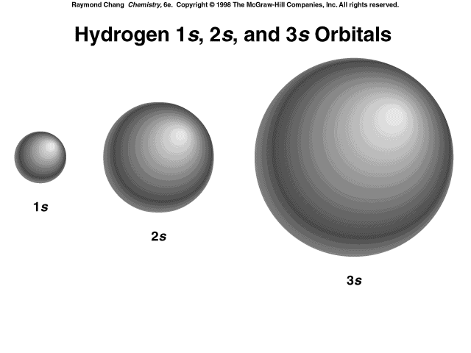

Slide 29
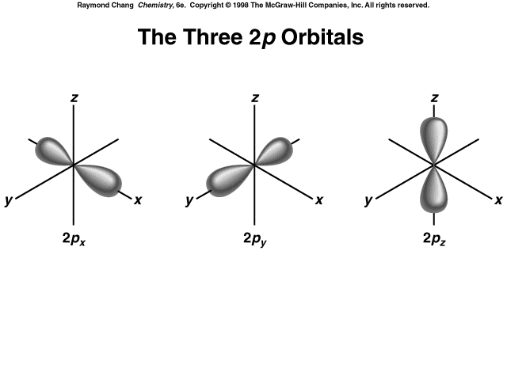
Same except for orientation in space

Slide 30
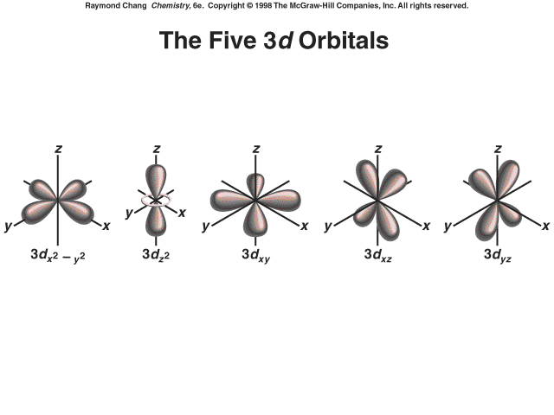
Same except for orientation in space

Slide 31
Electron spin
Each orbital can hold at most two electrons. Electrons also have spin (turning on an axis) and have magnetic properties (deflected in magnetic field). Electrons in the same orbital must have opposite spins. If they have opposite spins the electrons are said to be paired.

Slide 32
What to do with all this info?
Rules for writing electron configuration:
1. The no. of electrons in neutral atom = atomic no. (no. of protons)
2. Fill the lowest energy sublevel completely, then the next lowest, etc.
3. No more than two electrons can be placed in a single orbital. The electrons have opposite spins in the same orbital. (2 electrons in s, 6 in p, 10 in d, 14 in f)

Slide 33
4. For n=1,
For n =2
For n=3,
For n=4,
Remember the order of filling as follows:

Slide 34
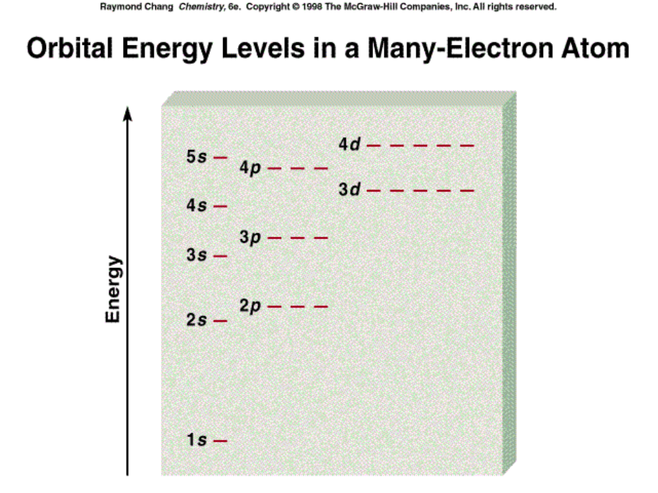

Slide 35
How to remember the energy order
1s
2s 2p
3s 3p 3d
4s 4p 4d 4f
5s 5p 5d 5f 5g
6s 6p 6d 6f 6g 6h
7s 7p 7d 7f

Slide 36
Let’s do some electron configurations

Slide 37
Abbreviated electron configuration
₂He 1s²
₁₀Ne 1s²2s²2p⁶
₁₈Ar 1s²2s²2p⁶3s²3p⁶
₃₆Kr 1s²2s²2p⁶3s²3p⁶4s²3d¹⁰4p⁶
These configurations are for ground state configurations--lowest energy.

Slide 38
Valence electrons, p 59
Valence electrons are the electrons located in the _________ orbitals and are the ones involved in forming chemical bonds. The valence electrons have the largest _ value for the A elements.
For representative elements the number of valence electrons in an atom =

Slide 39
Don’t worry about inner core of electrons (smaller n) since these are filled levels and don’t enter into bond formation ( for A groups)

Slide 40
Valence electron configuration for A groups
Group IA
Group IIA
Group IIIA
Group IVA
Group VA
Group VIA
Group VIIA
Group VIIIA

Slide 41
Where do you get the numerical value for the n for the valence electrons?
You find the _______ number!!!
Can you use this information to make electron configuration easier?

Slide 42
Valence electron configuration for:
P
Bi
Sr
Te
I
Cs

Slide 43
3.3: The octet rule
It has been noted that extra stability occurs when an atom or ion has 8 electrons in the outermost energy level (2 or 0 for the first period).

Slide 44
Group IA ns¹
Lose
Group IIA ns²
Loses
Group IIIA ns²np¹
Loses
Group IVA ns²np²
Group VA ns²np³
Gains
Group VIA ns²np⁴
Gains
Group VIIA ns²np⁵
Gains
Group VIIIA ns²np⁶

Slide 45
Group IA
Group IIA
Group IIIA
Group VA
Group VIA
Groupr VIIA
Names of ions: for cations--name of element plus ion
For anions: replace the last syllables of the element name by --ide + ion.

Slide 46
Transition metal cations
No simple rules as for A groups
Cu⁺, Cu²⁺
Fe²⁺, Fe³⁺
Au⁺, Au³⁺

Slide 47
H⁻
H⁺
Li⁺
Be²⁺
B³⁺
N³⁻
O²⁻
F⁻

Slide 48
What’s the ion formed by
P
Ba
S
N
I
Cs

Slide 49
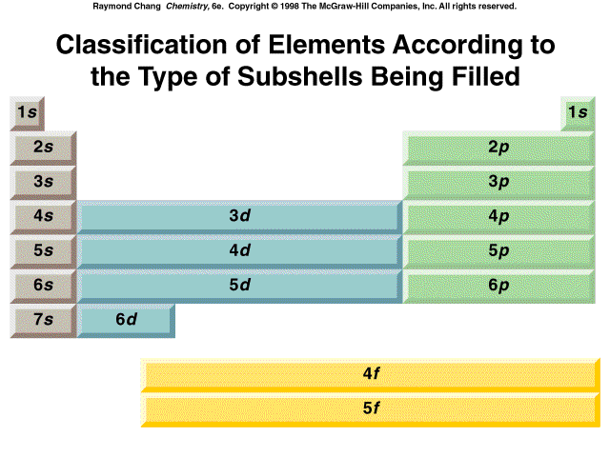

Slide 50
Isoelectronic
Atoms or ions
F⁻ [He] 2s² 2p⁶
O²⁻ [He] 2s² 2p⁶
Name a cation isoelectronic with O²⁻

Slide 51
Question 3.12
Which of the following pairs of atoms and ions are isoelectronic?
Cl⁻, Ar
Na⁺, Ne
Mg²⁺, Na⁺
Li⁺, Ne
O²⁻, F⁻

Slide 52
Which of the following groups are isoelectronic with each other?
Na⁺, Mg²⁺, Ne
Cl⁻, F⁻, Ar
Na⁺, Mg²⁺, Al³⁺, N³⁻, O²⁻, F⁻, Ne

Slide 53
3.4: Trends in the periodic table
Think of atom as sphere whose radius is determined by the location of the e’s furthest from the nucleus.
So atomic radius (size) determined by:
1. Larger value of n for atom in a group, the larger the atom size. Size _________ from top to bottom in group.

Slide 54
Size across a period
As go across a period (n stays the same), the no. of protons in the nucleus increases. The e’s are very spread out and each electron feels the pull of the increasing +charge of the nucleus uninfluenced by the other electrons and size __________ as go from left to right across a period.

Slide 56
Group size increases
Period size decreases (with some exceptions)

Slide 57
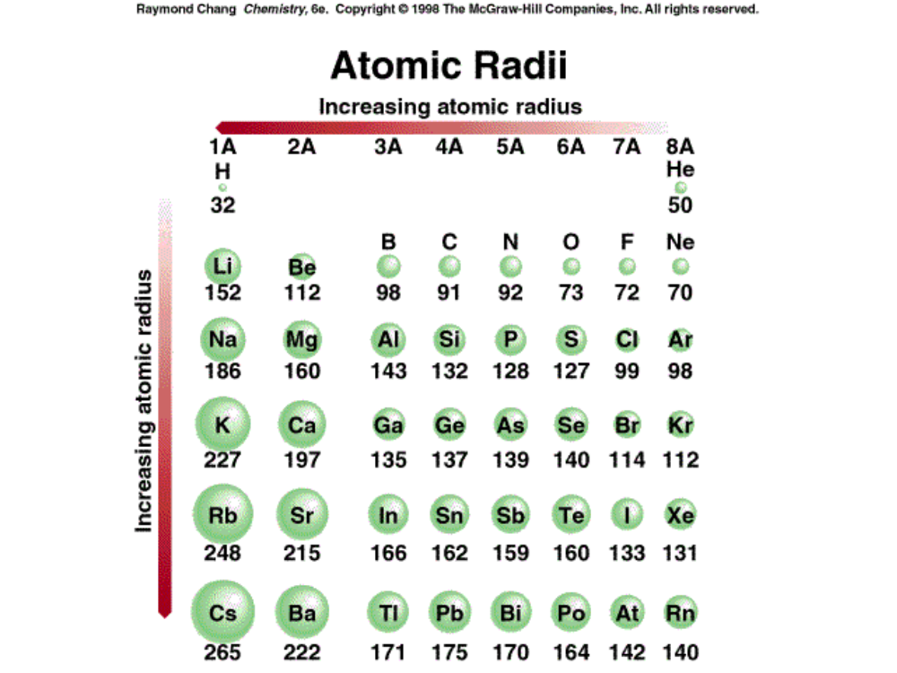

Slide 58
3.62; Arrange each of the lists according to increasing atomic size:
Al, S, P, Cl, Si
In, Ga, Al, B, Tl
Sr, Ca, Ba, Mg, Be
P, N, Sb, Bi, As
Na, K, Mg

Slide 59
Ion size
Same charge, in group, size __creases
Size of parent to cation:
Parent cation
Size of parent to anion:
Parent anion
Fe²⁺ Fe³⁺

Slide 60
Which is smaller?
Cl or Cl-
Na or Na⁺
O²⁻ or S²⁻
Mg²⁺ or Al³⁺
Au⁺ or Au³⁺

Slide 61
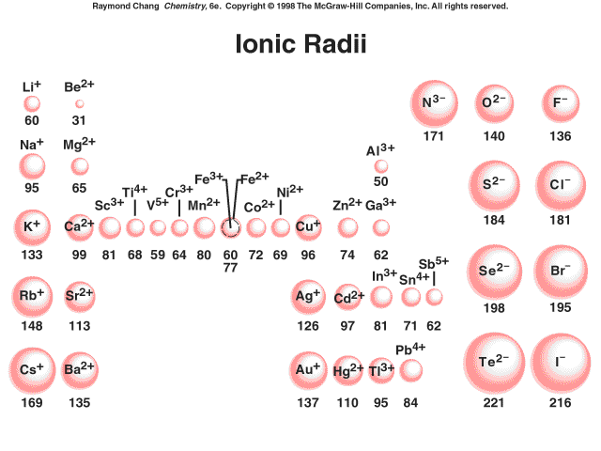

Slide 62
Note for isoelctronic series:
Na⁺, Mg²⁺, Al³⁺, N³⁻, O²⁻, F⁻,
N³⁻> O²⁻> F⁻> Na⁺> Mg²⁺> Al³⁺
Most positive ion the smallest, most negative the largest

Slide 63
Ionization energy
Minimum energy required to remove an electron from a ground-state, gaseous atom
Energy always positive (requires energy)
Measures how tightly the e⁻ is held in atom (think size also)
Energy associated with this reaction:

Slide 64
Trends in ionization energy
Top to bottom in group: 1st I.E. __creases. Why?
Across a period, 1st I.E. __creases (irregularly) Why? Note that noble gases have the largest I.E. in a given period; the halogens the next highest; the alkali metals the lowest, etc.

Slide 65
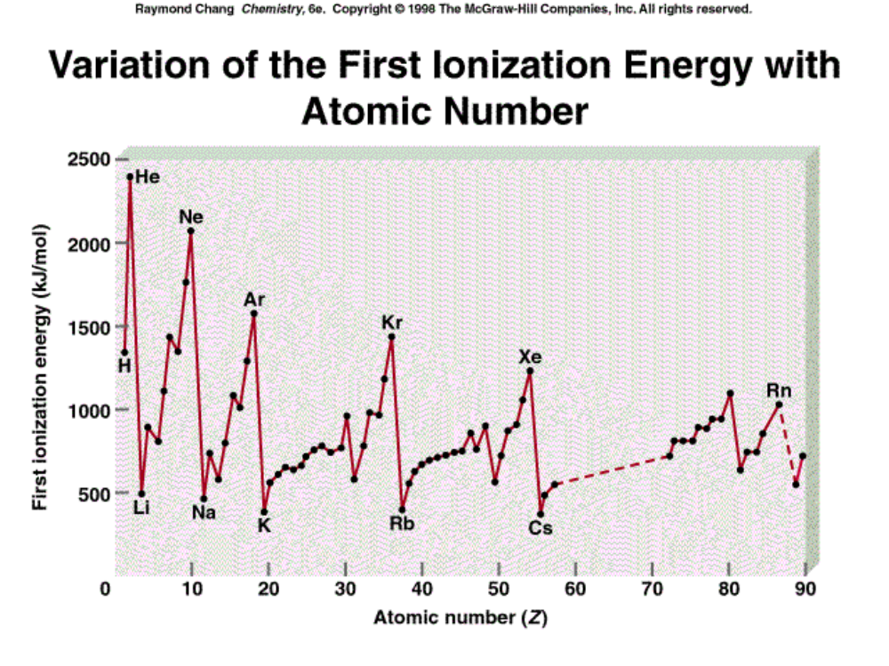
Variation of I₁ with Z
In a group (column), I₁ decreases with increasing Z.
valence e^{’s} with larger n are further from the nucleus, less tightly held

Slide 66
Variation of I₁ with Z
Across a period (row), I₁ mainly increases with increasing Z.
Because of increasing nuclear charge (Z)

Slide 67
Arrange in order of increasing I.E.
N, O, F
Li, K, Cs
Cl, Br, I

Slide 68
Electron affinity
Electron affinity is energy change when an e⁻ adds to a gas-phase, ground-state atom
Energy associated with this reaction:
Positive EA means that energy is released, e- addition is favorable and anion is stable!
First EA’s mostly positive, a few negative

Slide 69
Trends in electron affinities
Decrease down a group and increase across a period in general but there are not clear cut trends as with atomic size and I.E.
Nonmetals are more likely to accept e-s than metals. VIIA’s like to accept e-s the most.

Slide 70
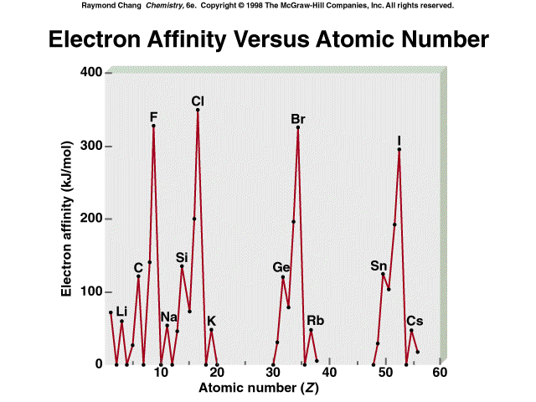

Slide 71
This powerpoint was kindly donated to www.worldofteaching.com
http://www.worldofteaching.com is home to over a thousand powerpoints submitted by teachers. This is a completely free site and requires no registration. Please visit and I hope it will help in your teaching.

