Slide 1
THE PERIODIC TABLE
In 1869 the Russian chemist Dmitri Mendeleev and the German chemist J. Lothar Meyer, working independently, found that when the elements were arranged in order of atomic weight they could place them in horizontal rows (one under another), so that the elements in each vertical column had similar properties.

Slide 2
THE PERIODIC TABLE
This tabular arrangement of the elements in rows and columns, highlighting the regular repetition of properties of the elements is called a periodic table.

Slide 3
THE PERIODIC TABLE
It was shown in the early part of last century (1900s) that the elements are characterized by their atomic numbers, rather than their atomic weights. The modern periodic table lists the atomic number, atomic symbol, and atomic weight of each element.

Slide 4
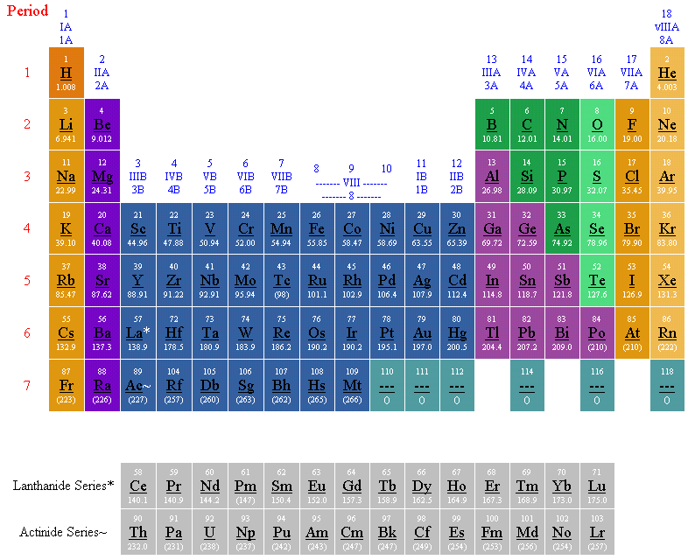

Slide 5
THE PERIODIC TABLE
METALS | NONMETALS | METALLOIDS
A substance or mixture that has a characteristic luster or shine, is generally a good conductor of heat & electricity, & is malleable & ductile. | An element that does not exhibit the characteristics of a metal; they are generally solids or gases and are usually hard, brittle substances. | An element having both metallic and nonmetallic properties. They are usually good semiconductors
Except for mercury, the metallic elements are solids at room temperature (~20° C) | Bromine is the only liquid nonmetal.

Slide 6
This powerpoint was kindly donated to www.worldofteaching.com
http://www.worldofteaching.com is home to over a thousand powerpoints submitted by teachers. This is a completely free site and requires no registration. Please visit and I hope it will help in your teaching.

