Slide 1
Rates of Reactions and Enzymes

Slide 2
Rates of Reaction
Chemical reactions occur when different atoms or molecules collide:
For the reaction to happen the particles must have a certain amount of energy – this is called the ACTIVATION ENERGY.
The rate at which the reaction happens depends on four things:
The temperature of the reactants,
Their concentration
Their surface area
Whether or not a catalyst is used

Slide 3
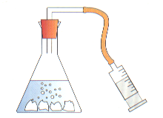
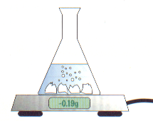
Measuring rate of reaction
Two common ways:
1) Measure how fast the products are formed
2) Measure how fast the reactants are used up

Slide 4
Rate of reaction graph
Amount of product formed
Slower rate of reaction here due to reactants being used up
Fast rate of reaction here
Slower reaction
Time

Slide 5
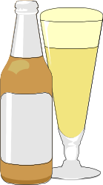
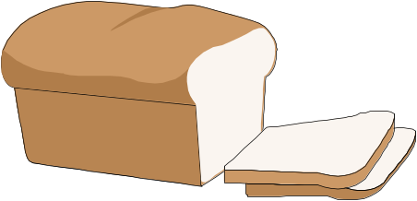
Enzymes
Enzymes are biological catalysts. They help the reactions that occur in our bodies by controlling the rate of reaction.
Yeast is an example of an enzyme. It is used to help a process called fermentation:
Sugar Alcohol + carbon dioxide
The alcohol from this process is used in making drinks and the carbon dioxide can be used to make bread rise.
Enzymes work best in certain conditions:
Enzymes are denatured beyond 40^{O}C
Could be protease (found in the stomach)
Could be amylase (found in the intestine)
Enzyme activity
40⁰C
Temp
pH
pH

Slide 6

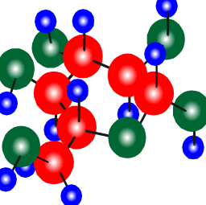
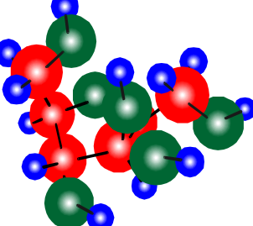
Uses of enzymes
Daz
1) Enzymes are used in washing powders to help digest food stains. Biological washing powders will only work on 40⁰C or lower.
2) Enzymes are used in baby foods to “pre-digest” the proteins.
3) Enzymes are used to convert starch into sugar which can then be used in food.
4) Conversion of glucose into fructose – glucose and fructose are “isomers” (they have the same chemical formula), but fructose is sweeter.

Slide 7
This powerpoint was kindly donated to www.worldofteaching.com
http://www.worldofteaching.com is home to over a thousand powerpoints submitted by teachers. This is a completely free site and requires no registration. Please visit and I hope it will help in your teaching.

