Slide 1

Reactions and Equations Lab
Parts A, B, &C
Spring 2003
Beth Shadrick
GCHS
Chemistry 10-12

Slide 2
Purpose
To observe 7 reactions
To identify and write formulas for the reactants and products of those reactions
To balance the equations for the reactions

Slide 3
Evidence of Chemical Reaction
Part A
R1 Mg ribbon is ash-like now
R2 Litmus test indicates a base
Part B
R1 Solid turns white, steam comes from test tube
R2 Solid turns blue again

Slide 4
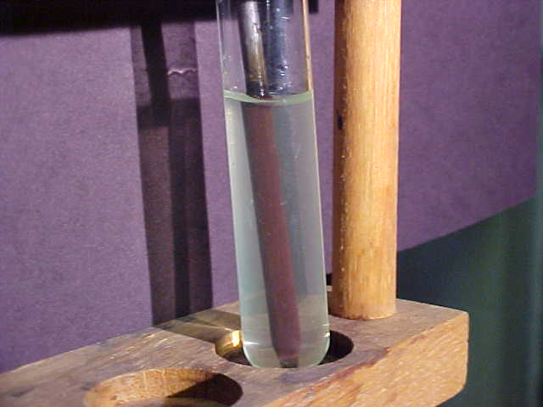
Evidence of Chemical Reaction
Part C
R1 Fe nail is now coated in Cu and the solution has changed from a blue color to a greenish color

Slide 5
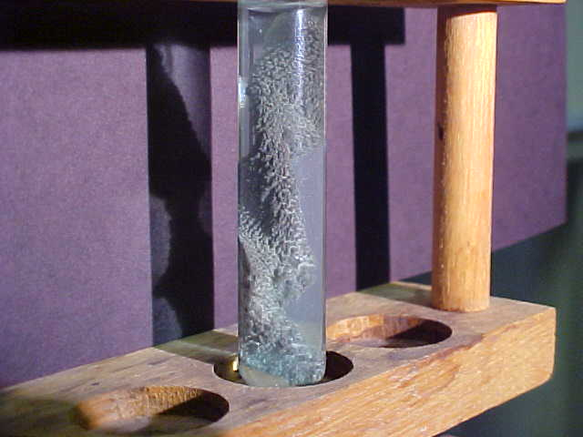
Evidence of Chemical Reaction
Part C
R2 Cu metal is now coated with Ag and the solution is beginning to take on a slightly blue tint

Slide 6
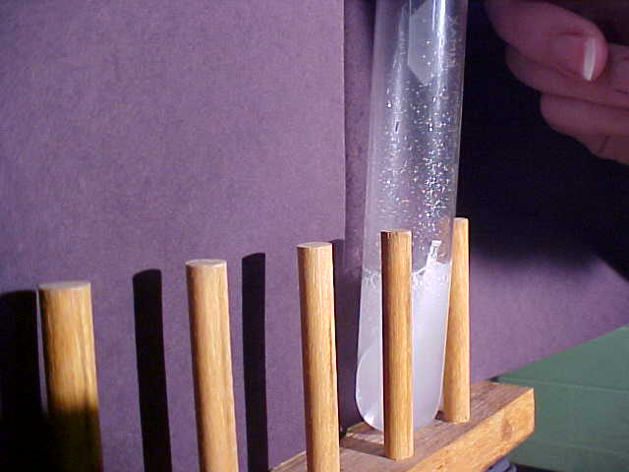
Evidence of Chemical Reaction
Part C
R3 HCl solution begins to vigorously bubble when the Mg ribbon is added. Gases are evident as they wisp through the air into the collecting tube; gas is flammable

Slide 7
Word Equations Part A
A1: Magnesium plus oxygen yields ?
A2: A1 product plus water yields ?

Slide 8
Word Equations Part B
B1: Copper (II) Sulfate Pentahydrate is heated to yield ?
B2 Anhydrous Copper (II) Sulfate plus water yields ?

Slide 9
Word Equations Part C
C1 Iron plus Copper (II) Sulfate yields… ?
C2 Copper plus Silver Nitrate yields… ?
C3 Magnesium plus Hydrochloric Acid yields… ?

Slide 10
Instructions
Complete the word equations by predicting the products, use the information you gathered by observation to help in the predictions
Be sure to include the state of the substance for the reactants and products
Classify the reaction

Slide 11

The End
Complete the equations for the reactions
Then you may go finish Part D of the lab instructions. You will need the solubility rules.

Slide 12
This powerpoint was kindly donated to www.worldofteaching.com
http://www.worldofteaching.com is home to over a thousand powerpoints submitted by teachers. This is a completely free site and requires no registration. Please visit and I hope it will help in your teaching.

