Slide 1
A Brief History of
Communism in
Russia
Animal Farm
Mrs. Trevizo
Sophomore English

Slide 2
Terms
Capitalist System
  free enterprise; if you work hard you can get ahead; you can start your own business and become a millionaire, or lose every penny
Socialist
a person who wants to change society

Slide 3
Terms
Communist System
everyone works to his or her ability and receives according to his or her need; totally economic equality; no one gets ahead, but no one starves either.
Czarist Government
a government ruled by a Czar, who had absolute powers similar to a king

Slide 4
Terms
5. Deported
sent away from a country into exile
Idealistic
  overly optimistic thinking
Totalitarianism
a one-party-rules-everything type of government

Slide 5
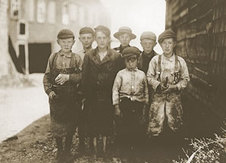
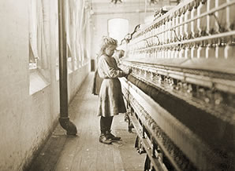
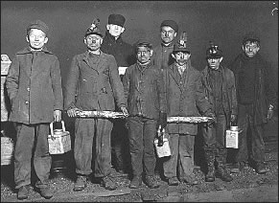
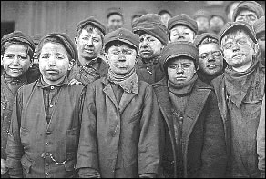
A Brief History
In the mid 1800’s , the capitalist system was going strong in Europe and America.
But, the profits of businesses came at the expense of workers who labored 14 to 18 hours a day under unsafe conditions. There were no child labor laws, and wages were barely livable for the common worker.

Slide 6
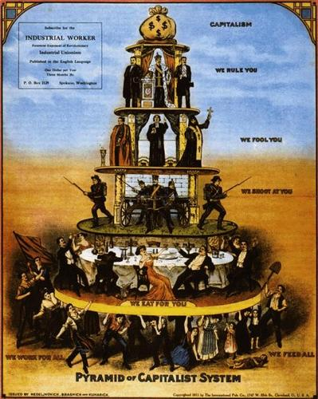
This diagram from 1867 perfectly illustrates the inherent genius within the capitalist system and how it is indestructible: it has a strong base built on inequality. Like the ancient pyramids of Egypt, the capitalist system is based upon the pyramid shape which yields great unknown powers and like those great historic monuments, was built from the sweat and blood of slaves. If we stay strong the capitalism will stay with us for thousands of years to come just like the great pyramids.

Slide 7
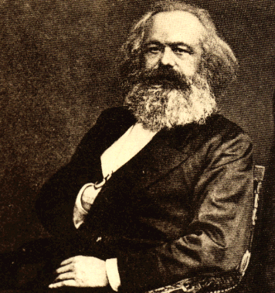
A Brief History…
In 1847, an international workers’ group asked Karl Marx, a German philosopher, to draw up a plan for their organization. The group was called the Communist League. Marx wrote a plan called The Manifesto of the Communist Party.

Slide 8
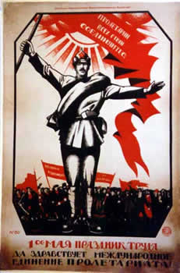
A Brief History…
Marx envisioned a workers’ revolt followed by a kind of paradise where each person would work according to his or her ability and receive according to his or her need. Marx saw the final stage of his communist system being total worldwide economic equality.

Slide 9
A Brief History…
About this time, labor laws were passed in Western Europe and America that made the work place more safer and more tolerable of workers. The worldwide revolution that Marx foresaw never came to pass.

Slide 10
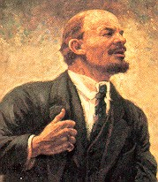
A Brief History…
The people that followed Marx’s thinking were called Socialists. The Socialists split into two groups.
The milder group wanted to bring about communism slowly by passing new laws.
The other group (we’ll call them Communists) stuck to Marx’s original idea of a major worker revolt. The Communists were a small extremist group compared to the total number of Socialists. They formed a political party called the Bolshevik Party , which was led by a man named Nikolai Lenin .

Slide 11
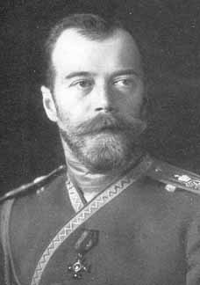
A Brief History…
Russia at this time was being poorly managed by a Czarist government, ruled by Czar Nicholas II . Most of the Russian people were still underpaid workers on land owned by a small number of wealthy landlords.

Slide 12
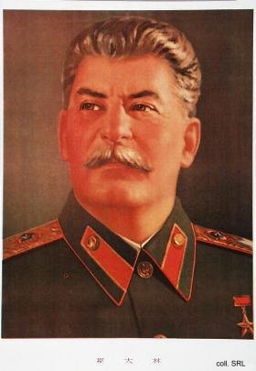
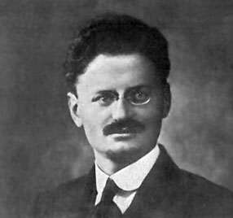
A Brief History…
In 1917 a revolution occurred in Russia. The Bolshevik Party successfully overthrew Czar Nicholas II. Besides Lenin, there were two other men who were leaders in the
Bolshevik party: Leon Trotsky , a man who believed in using terrorism, and Joseph Stalin, a strong ruthless man.

Slide 13
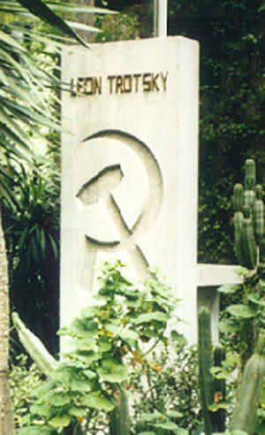
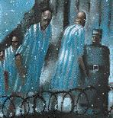
A Brief History…
In 1926, Lenin died, and there was a power struggle between Trotsky and Stalin. Stalin gained control and Trotsky went to Mexico and was later assassinated. As the new Russian leader, Stalin deported to Siberia all those who did not agree with him. His secret police also used random arrests, torture, and mass executions to maintain his dictatorship. Anyone could be a victim of these killings, or “purges” for no apparent reason.

Slide 14
A Brief History…
The idealistic goals of Marx, had turned into a system that was in many ways more terrifying than the rule by the Czars. There was no freedom in the new system, which was based on military rule. Forced labor created wealth for a limited few, while the lives of most people changed very little or got worse. Terrorist police prevented uprisings by unhappy people.

Slide 15
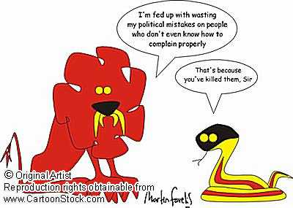
A Brief History…
The communist type of government that came about after the revolution in 1917 was “totalitarian”. Totalitarianism is when one party or group has total control of everything.

Slide 16
The
End

Slide 17
This powerpoint was kindly donated to www.worldofteaching.com
http://www.worldofteaching.com is home to over a thousand powerpoints submitted by teachers. This is a completely free site. Please visit and I hope it will help in your teaching.

