Slide 1
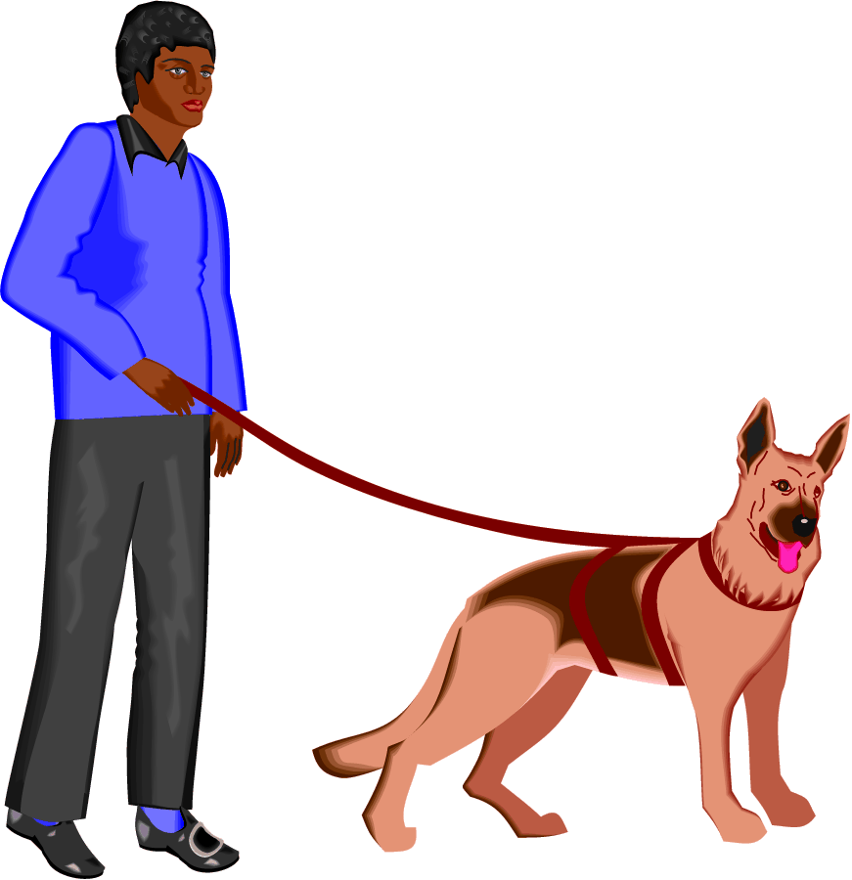
Empowering African American
Males

Slide 2
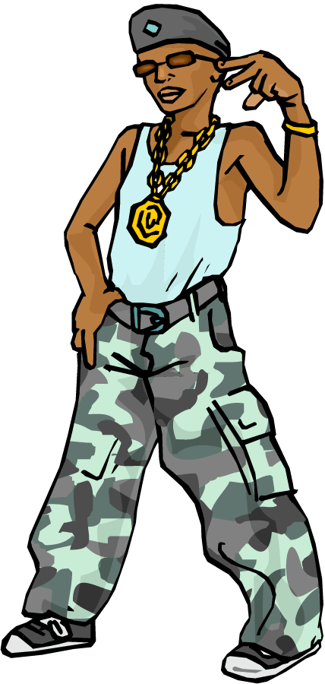
Stereotypes
Stereotypes are dangerous perceptions we all have.
Checking one’s own attitude and hidden behaviors.

Slide 3
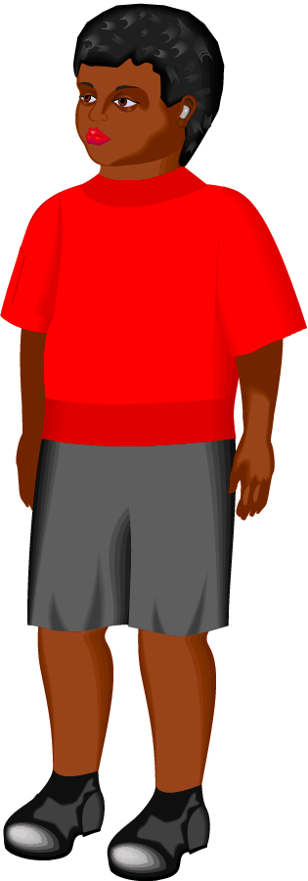
African American Males are 72% less likely to attend college than Caucasian Males.
Over represented in Special education programs.
Have higher levels of behavior problems in the school setting.
Are often feared by teachers regardless of the teacher’s race.
The odds are against them.

Slide 4

Need Your Help
Identify college as an opportunity
Increase self-esteem
Identify what the student needs to do to reach his goals
Network within the child’s community

Slide 5
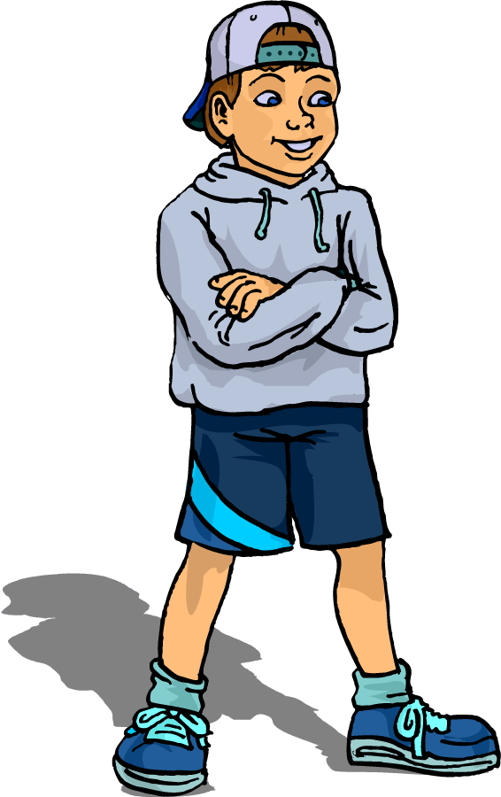
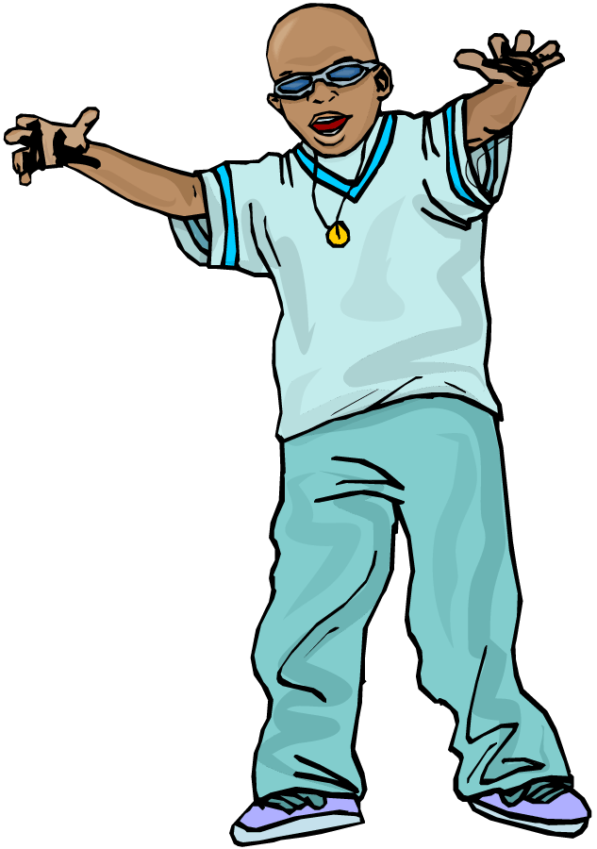
Make African American History Part of Regular Curriculum
Help the students to understand that all of
our history involves interaction with one another
Seek and teach about positive African American
role models

Slide 6
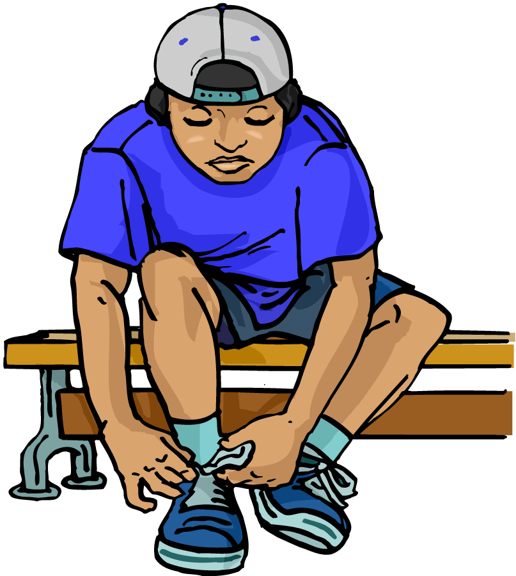
Learn About the Community
Become a part of the child’s community
Establish a safety net around the child by using the circle of trust model
Talk with community leaders
Talk with the child’s next school level teachers

Slide 7
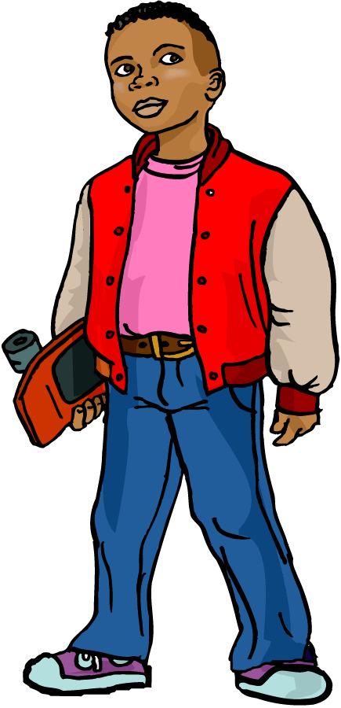
Self-Esteem
Low self-esteem is the #1 cause for Black males acting out behaviors
Stop pitying them, start helping the child to see his own skin color as the gift
it is……

Slide 8
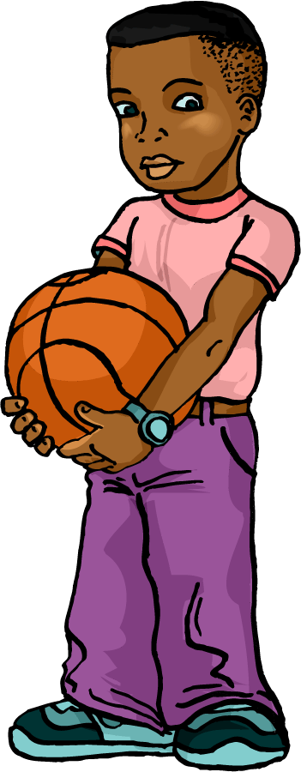
Give students the gift of high expectations
Talk to the child daily about college
Ask the child what college he is going to attend
If the child does not know, help him explore some colleges
Discuss financial programs available in his future

Slide 9
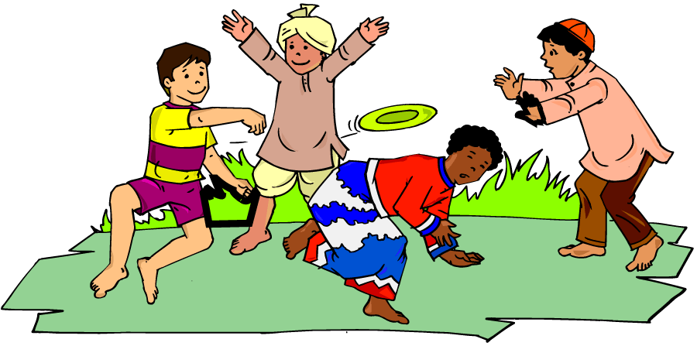
Believe!
Children know when you are acting
Show the child that you believe in him
Praise the child often
Look for positives even when they are hard to find
Notes to mom, a warm smile, a compliment can go a long way

Slide 10
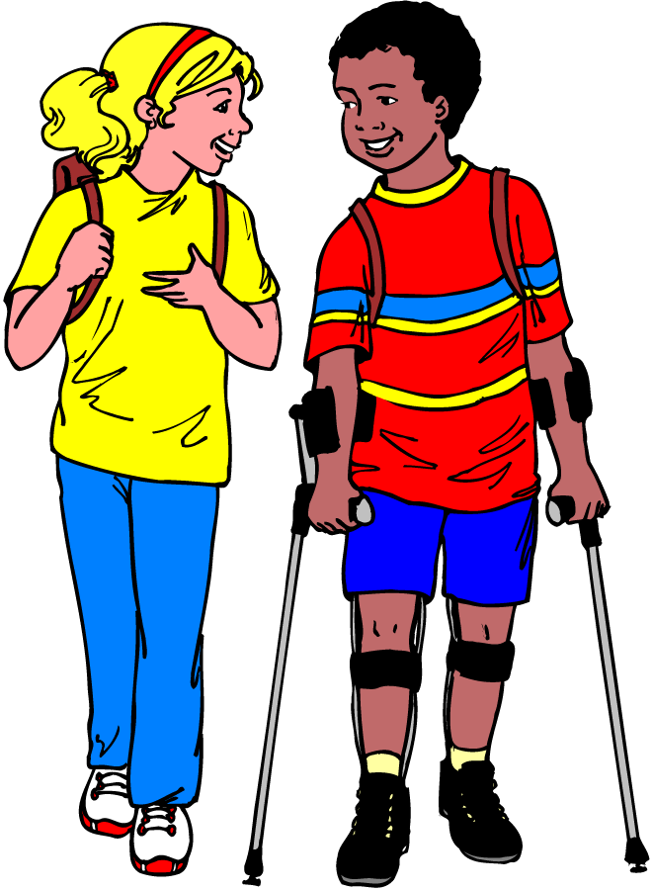
Create a Committee
Don’t go ugh!
Plug, all your talents together
To find what works best
For the boys in your school
Without a catalyst for change for the positive, African American males will continue to fall to the wayside.
Be the catalyst!

Slide 11
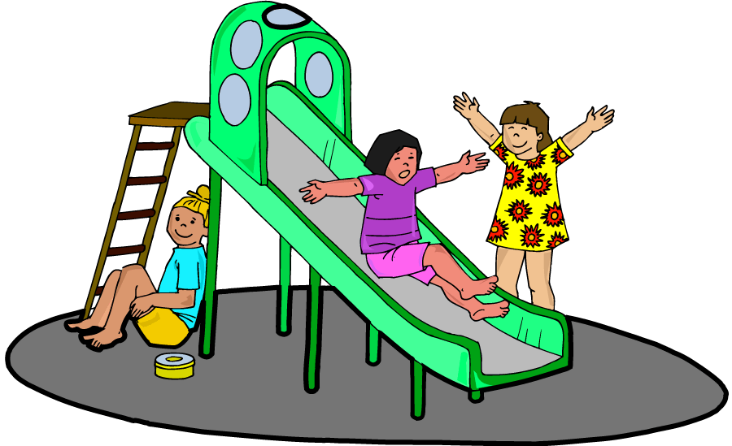
Love
Is the strongest word anyone of us knows.

Slide 12
This powerpoint was kindly donated to www.worldofteaching.com
http://www.worldofteaching.com is home to over a thousand powerpoints submitted by teachers. This is a completely free site and requires no registration. Please visit and I hope it will help in your teaching.

