Slide 1
Animal Farm
By George Orwell
Allegory - Satire - Fable
“All animals are equal, but some are more equal than others.”

Slide 2
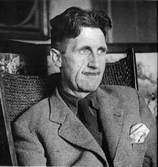
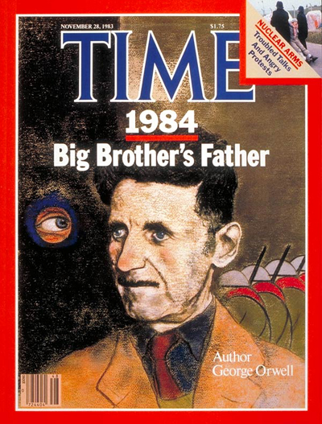
George Orwell
British Author & Journalist
1903-1950
Born in India
  At that time India was a part of the British Empire, and Blair's father, Richard, held a post as an agent in the Opium Department of the Indian Civil Service.
  The Blair family was not very wealthy - Orwell later described them ironically as "lower-upper-middle class". They owned no property, had no extensive investments; they were like many middle-class English families of the time, totally dependent on the British Empire for their livelihood and prospects.
Noted as a novelist and critic, as well as a political and cultural commentator
One of the most widely admired English-language essayists of the 20th century
Best known for two novels critical of totalitarianism in general, and Stalinism in particular:
  Animal Farm
  Nineteen Eighty-Four
“Liberty is telling people what they do not want to hear.”

Slide 3
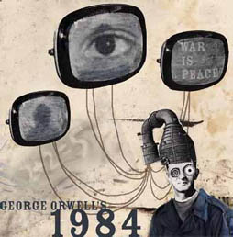
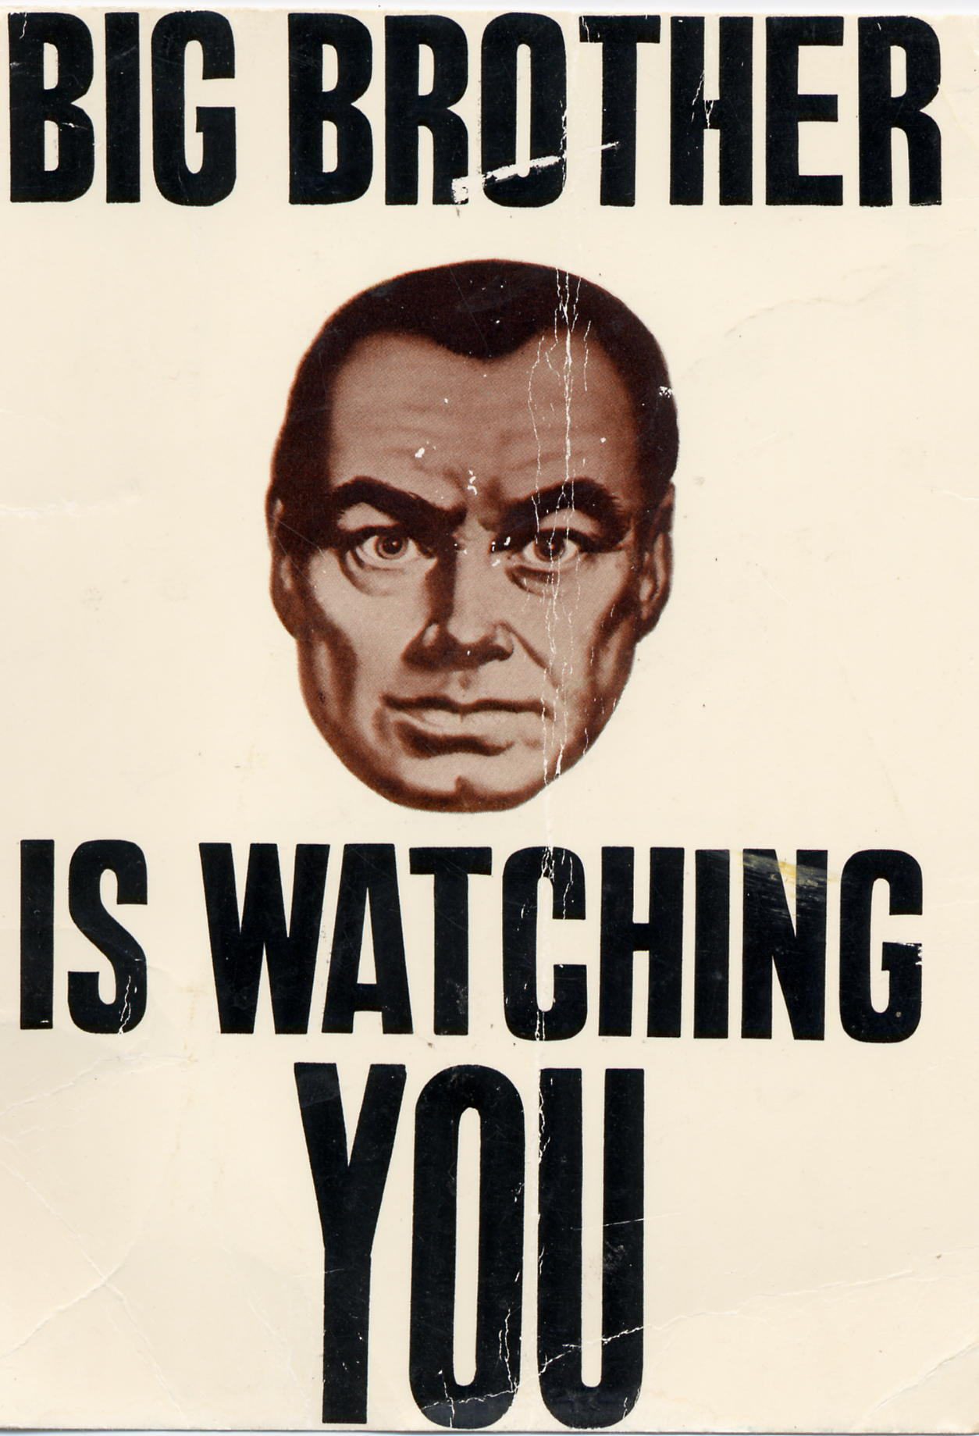

1984
The novel, published in 1949, takes place in 1984 and presents an imaginary future where a totalitarian state controls every aspect of life, even people's thoughts. The state is called Oceania and is ruled by a group known as the Party; its leader and dictator is Big Brother.

Slide 4
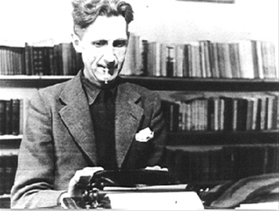
George Orwell and His Beliefs
Orwell was a person who had a reputation for standing apart and even making a virtue of his detachment.
This “outsider” position often led him to oppose the crowd.
Orwell’s beliefs about politics were affected by his experiences fighting in the Spanish Civil War.
He viewed socialists, communists, and fascists as repressive and self-serving.
He was skeptical of governments and their willingness to forsake ideas in favor of power.
  Interesting Fact:
  George Orwell’s real name was Eric Blair.

Slide 5
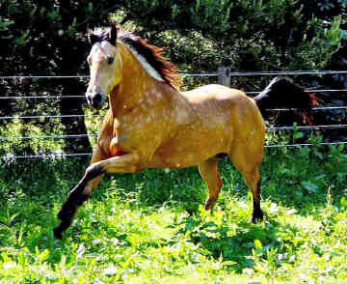
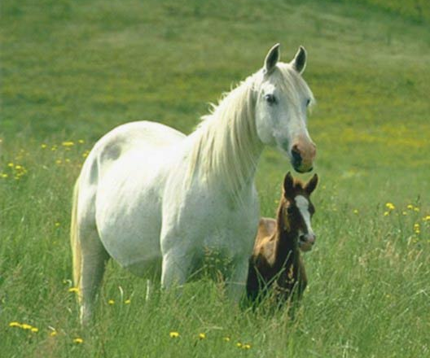
Why Animals?
In explaining how he came to write Animal Farm, Orwell says he once saw a little boy whipping a horse and later he wrote,
  “It struck me that if only such animals became aware of their strength we should have no power over them, and that men exploit animals in much the same way as the rich exploit the [worker].”

Slide 6
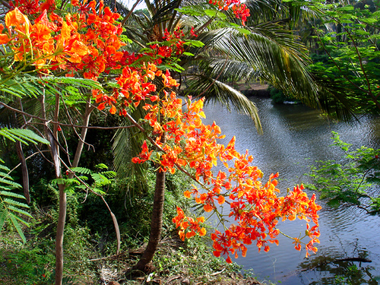

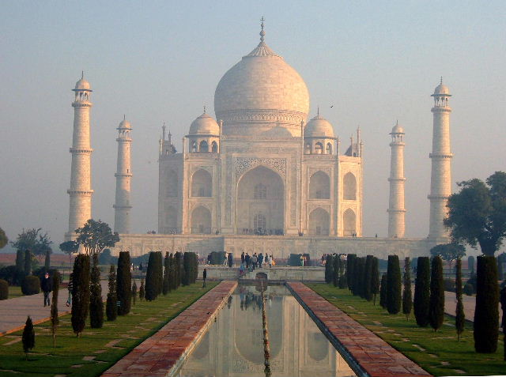
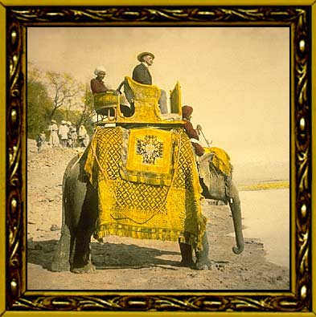
George Orwell in India
He was born in India and spent his early years there since his father held a post there.
  He was a lonely boy who liked to make up stories and talk with imaginary companions.
As an adult, he worked for the Imperial Police in British occupied India.

Slide 7
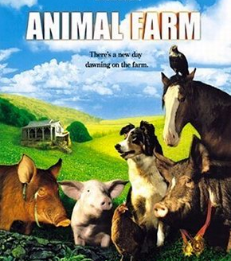
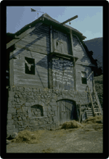
What is Animal Farm?
A masterpiece of political satire, Animal Farm is a tale of oppressed individuals who long for freedom but ultimately are corrupted by assuming the very power that had originally oppressed them.
The story traces the deplorable conditions of mistreated animals who can speak and who exhibit many human characteristics. After extreme negligence by their owner, the animals revolt and expel Mr. Jones and his wife from the farm.
The tale of the society the animals form into a totalitarian regime is generally viewed as Orwell's critique of the communist system in the former Soviet Union.
  Interesting Fact: Orwell initially struggled to find a publisher for Animal Farm.

Slide 8
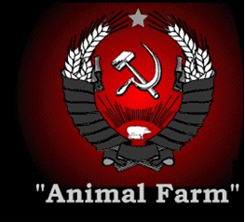
Significance Today
But why – now that Soviet Communism has fallen and the Cold War is over –does Animal Farm deserve our attention? The answer lies in the power of allegory. Allegorical fables, because they require us to make comparisons and connections, can be meaningful to any reader in any historical period. The story of Animal Farm will always have lessons to teach us about the ways that people abuse power and manipulate others.
Orwell's chilling story of the betrayal of idealism through tyranny and corruption is as fresh and relevant today as when it was first published in 1945.

Slide 9
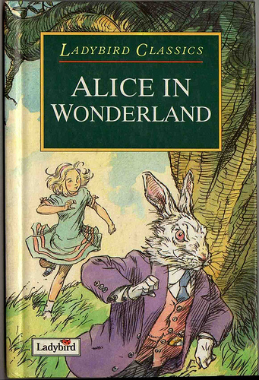
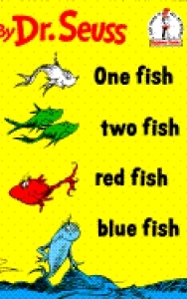
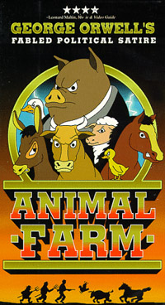
Children’s Book? – No!
After Animal Farm was published in 1945, George Orwell discovered with horror that booksellers were placing his novel on children’s shelves. According to his housekeeper, he began traveling from bookstore to bookstore requesting that the book be shelved with adult works. This dual identity — as children’s story and adult satire — has stayed with Orwell’s novel for more than fifty years.

Slide 10
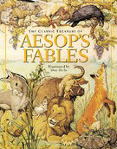
The Fable
  The fable is one of the oldest literary forms - much, much older than the novel or the short story. A fable is usually short, written in either verse or prose, and conveys a clear moral or message. The earliest fables still preserved date back to 6th Century Greece B.C.E. The author of these fables, Aesop, used animal characters to stand for human "types." For example, a fox character might embody the human characteristics of cunning and cleverness. Though Aesop's animal fables were ostensibly about animals, they were really instructional tales about human emotions and human behavior.

Slide 11
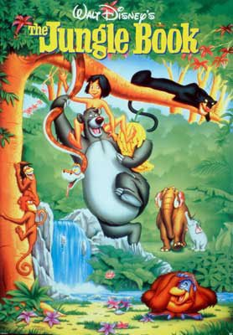
Animal Fables
The most popular animal fables of the 20th Century are the Just So Stories (1902) written by Rudyard Kipling. Kipling's fables were adapted by Disney in the movie The Jungle Book. Orwell admired Kipling and the Just So Stories would seem to have influenced the form of Animal Farm. Orwell took the short animal fable and expanded it to the length of a short novel in the form of an allegory.

Slide 12


Allegory
  Most fables have two levels of meaning. On the surface, the fable is about animals. But on a second level, the animals stand for types of people or ideas. The way the animals interact and the way the plot unfolds says something about the nature of people or the value of ideas. Any type of fiction that has multiple levels of meaning in this way is called an allegory.

Slide 13
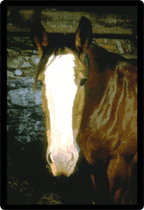
Allegory (cont’d)
Animal Farm is strongly allegorical, but it presents a very nice balance between levels of meaning. On the first level, the story about the animals is very moving. You can be upset when Boxer is taken away by the horse slaughterer without being too aware of what he stands for. But at the same time, each of the animals does serve as a symbol. The story's second level involves the careful critique Orwell constructed to comment on Soviet Russia.
Boxer

Slide 14
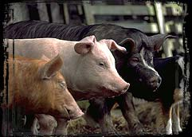
Allegory (cont’d)
Yet there is no reason that allegory must be limited to two levels. It is possible to argue that Animal Farm also has a third and more general level of meaning. For instance, the pigs need not only represent specific tyrannical soviet leaders. They could also be symbols for tyranny more broadly: their qualities are therefore not simply the historical characteristics of a set of actual men but are the qualities of all leaders who rely on repression and manipulation.
Squealer, Snowball, & Napoleon

Slide 15
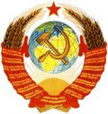
Satire
In a satire, the writer attacks a serious issue by presenting it in a ridiculous light or otherwise poking fun at it. Orwell uses satire to expose what he saw as the myth of Soviet socialism. Thus, the novel tells a story that people of all ages can understand, but it also tells us a second story— that of the real-life revolution.
Soviet Coat of Arms

Slide 16
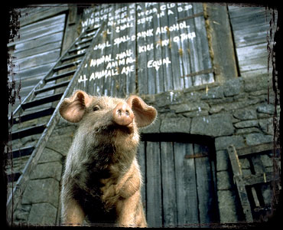
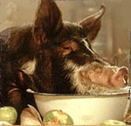
Irony
Irony results when there is a disparity between what an audience would expect and what really happens. Orwell uses a particular type of irony – dramatic irony. He relies on the difference between what the animals understand and what we, the audience, can conclude about the situation at Animal Farm.
We know just what the animals know, but we can see so much more of its significance than they can. The conclusions we reach that the animals never quite get to – that the pigs are decadent, corrupt, and immoral – are all the more powerful because we arrive at them ourselves, without the narrator pointing these things out directly.
Snowball below the commandments.
Napoleon overindulging himself.

Slide 17
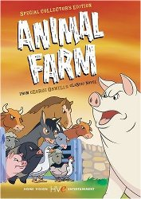
Irony (cont’d)
Orwell uses dramatic irony to create a particularly subtle satire. Satire stages a critique of an individual, group, or idea by exaggerating faults and revealing hypocrisies. The dramatic irony of Animal Farm achieves this aim indirectly. We see the hypocrisy that the animals don't and therefore understand in this backward fashion that the book is deeply critical of the pigs.

Slide 18
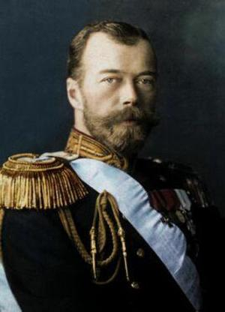
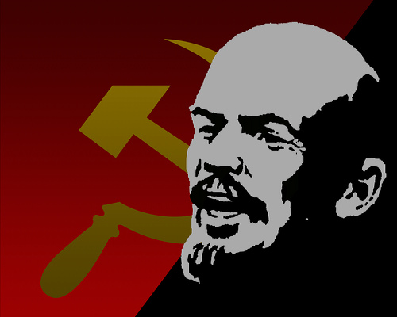
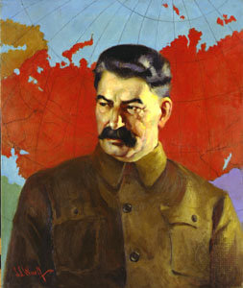
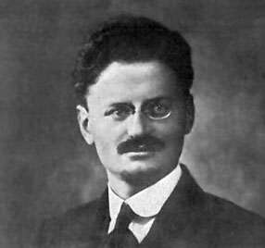
When History and Literature Merge
Critics often consider Animal Farm to be an allegory of the Russian Revolution. In the early 1900s, Russia’s Czar Nicholas II faced an increasingly discontented populace. Freed from feudal serfdom in 1861, many Russian peasants were struggling to survive under an oppressive government. By 1917, amidst the tremendous suffering of World War I, a revolution began. In two major battles, the Czar’s government was overthrown and replaced by the Bolshevik leadership of Vladimir Lenin. When Lenin died in 1924, his former colleagues Leon Trotsky, hero of the early Revolution, and Joseph Stalin, head of the Communist Party, struggled for power. Stalin won the battle, and he deported Trotsky into permanent exile.
Czar Nicholas II
Vladimir Lenin
Leon Trotsky
Joseph Stalin

Slide 19
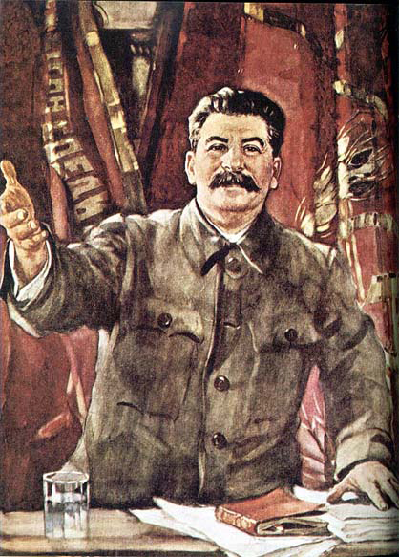
Joseph Stalin
Once in power, Stalin began, with despotic urgency and exalted nationalism, to move the Soviet Union into the modern industrial age. His government seized land in order to create collective farms. Stalin’s Five Year Plan was an attempt to modernize Soviet industry. Many peasants refused to give up their land, so to counter resistance Stalin used vicious military tactics. Rigged trials led to executions of an estimated 20 million government officials and ordinary citizens. The government controlled the flow and content of information to the people, and all but outlawed churches.
Joseph Stalin

Slide 20
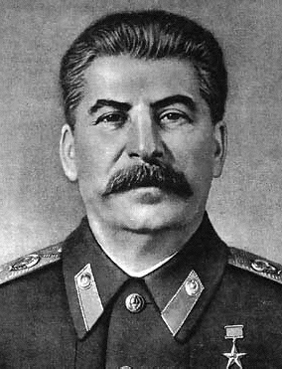
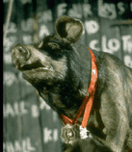
Napoleon = Joseph Stalin
Napoleon
  Boar who leads the rebellion against Farmer Jones
  After the rebellion’s success, he systematically begins to control all aspects of the farm until he is an undisputed tyrant.
Joseph Stain
  The communist dictator of the Soviet Union from 1922-1953 who killed all who opposed him.
  He loved power and used the KGB (secret police) to enforce his ruthless, corrupt antics.

Slide 21
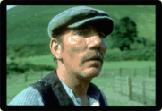
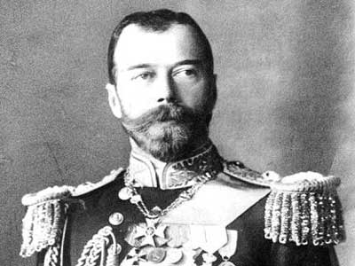
Farmer Jones = Czar Nicholas II
Farmer Jones
  The irresponsible owner of the farm
  Lets his animals starve and beats them with a whip
  Sometimes shows random kindness
Czar Nicholas II
  Weak Russian leader during the early 1900s
  Often cruel and brutal to his subjects
  Displays isolated kindess

Slide 22
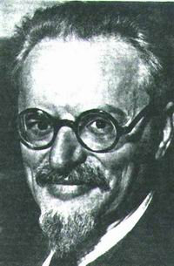
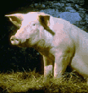
Snowball = Leon Trotsky
Snowball
  Boar who becomes one of the rebellion’s most valuable leaders.
  After drawing complicated plans for the construction of a windmill, he is chased off of the farm forever by Napoleon’s dogs and thereafter used as a scapegoat for the animals’ troubles.
Leon Trotsky
  A pure communist leader who was influenced by the teachings of Karl Marx.
  He wanted to improve life for people in Russia, but was driven away by Lenin’s KGB.

Slide 23
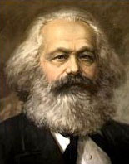
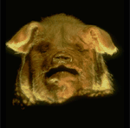
Characters
Old Major
  An old boar whose speech about the evils perpetrated by humans rouses the animals into rebelling.
  His philosophy concerning the tyranny of Man is named Animalism.
  He teaches the animals the song “Beasts of England”
  Dies before revolution
Karl Marx
  The inventor of communism
  Wants to unite the working class to overthrow the government.
  Dies before the Russian Revolution

Slide 24
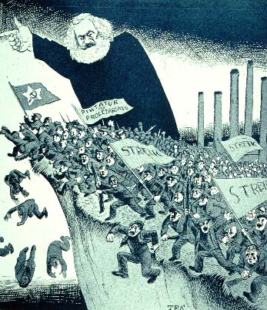
Who is Karl Marx?
Many of the ideals behind the Soviet revolution were based on the writings and teachings of Karl Marx. A German intellectual who lived in the mid-1800s, Marx believed that societies are divided into two segments, a working class and an owner class. The working class creates all the products, while the owner class enjoys all the benefits of these products. This class division leads to inequality and oppression of the working class. Marx’s objective was to create a classless society in which the work is shared by all for the benefit of all, and he believed revolution was the way to achieve this goal.

Slide 25
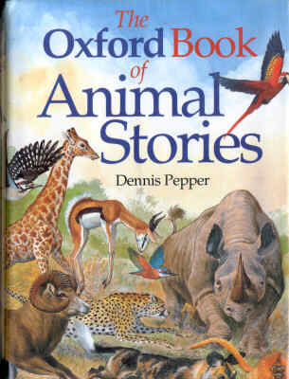
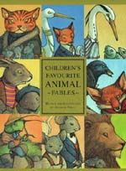
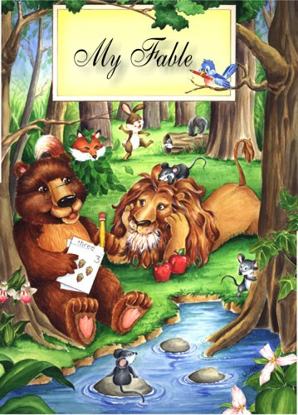
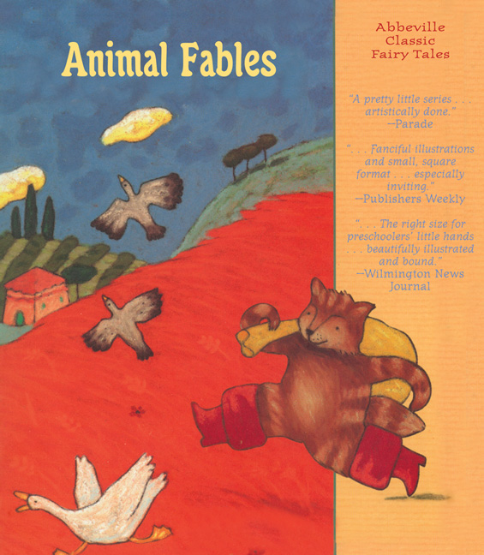
Characterization in Fables
We already know that a fable is a narration intended to enforce a useful truth. Fables have two important characteristics. First, they teach a moral or lesson. In Animal Farm, the moral involves Orwell’s views about Soviet politics. Second, the characters are most frequently animals. These animal characters often function as a satiric device to point out the follies of humankind. Though Old Major, Snowball, and Napoleon may represent Karl Marx, Leon Trotsky, and Joseph Stalin, many of the story characters are much more general. Some animals are grouped together as a single character—“the sheep,” “the hens,” and “the dogs.” Orwell also capitalizes on the traits generally associated with particular animals, such as sheep as followers and dogs as loyal.

Slide 26
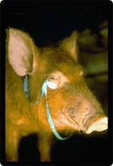
Squealer & Boxer
Squealer
  A big mouth pig who becomes Napoleon’s mouthpiece. Throughout the novel, he displays his ability to manipulate the animals’ thoughts through the use of hollow, yet convincing rhetoric.
  Represents the propaganda department that worked to support Stalin’s image; the members of the department would use lies to convince the people to follow Stalin.
Boxer
  A dedicated but dimwitted horse who aids in the building of the windmill but is sold to a glue-boiler after collapsing from exhaustion.
  Represents the dedicated, but tricked communist supporters of Stalin. Many stayed loyal even after it was obvious Stalin was a tyrant. Eventually they were betrayed, ignored, and even killed by him.
Squealer
Boxer

Slide 27
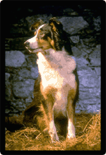
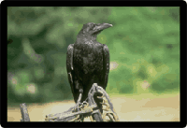
Jessie & Moses
Jessie
  The farm's sheepdog, she keeps tabs on the pigs and is among the first to suspect that something is wrong at Animal Farm.
Moses
  A tame raven and sometimes-pet of Jones who tells the animals stories about a paradise called Sugarcandy Mountain.
  Moses represents religion. Stalin used religious principles to influence people to work and to avoid revolt.
Jessie
Moses

Slide 28
More Characters
Pilkington
Jones' neighbor, he finds a way to profit from Animal Farm by forming an alliance with the pigs.
Muriel
A goat who believes in the rebellion, she watches as Animal Farm slips away from its founding principles.
Mollie
A vain horse who resists the animal rebellion because she doesn't want to give up the petting and treats she receives from humans. Mollie represents vain, selfish people in Russia and throughout the world who ignored the revolution and sought residence in more inviting countries.
Benjamin
The most cynical of all the animals, the farm's donkey doubts the leadership of the pigs but is faithfully devoted to Boxer. Benjamin represents all the skeptical people in Russia and elsewhere who weren’t sure revolution would change anything.
The Sheep
Not tremendously clever, the sheep remind themselves of the principles of animalism by chanting "four legs good, two legs bad."
The Dogs
Napoleon’s private army that used fear to force the animals to work; they killed any opponent of Napoleon. The dogs represent Stalin’s loyal KGB (secret police). The KGB were not really police, but mercenaries used to force support for Stalin.

Slide 29
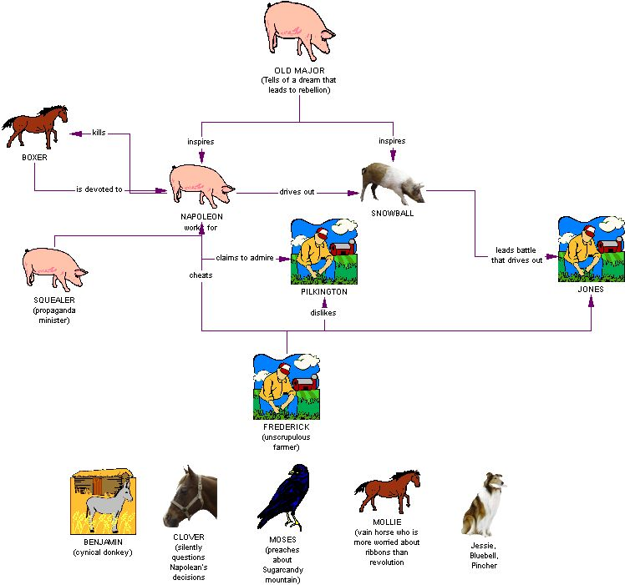

Slide 30
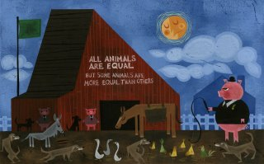
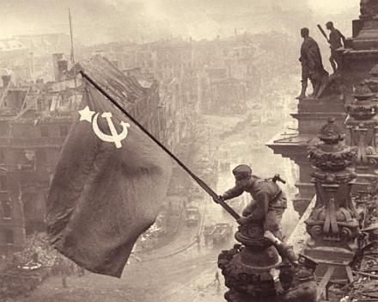
Animalism = Communism
Animalism
  Taught my Old Major
  No rich, but no poor
  Better life for workers
  All animals are equal
  Everyone owns the farm
Communism
  Invented by Karl Marx
  All people are equal
  Government owns everything
  People own the government

Slide 31
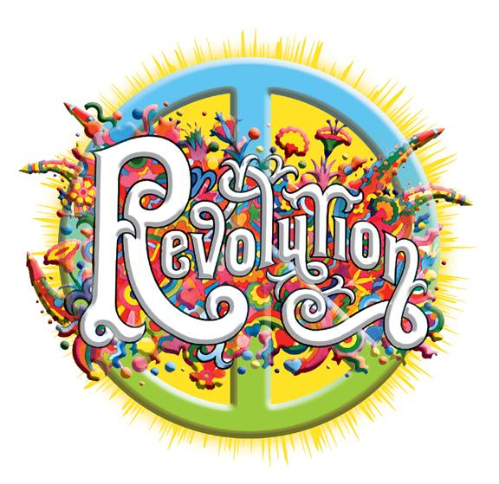
Animal Farm Revolution
= Russian Revolution
Animal Farm Revolution
  Was supposed to make life better for all, but . . .
    Life was worse at the end.
    The leaders became the same as, or worse than the other farmers (humans) they rebelled against.
Russian Revolution
  Was supposed to fix the problems created by the Czar, but . . .
    Life was even worse after the revolution.
    Stalin made the Czar look like a nice guy.

Slide 32
This powerpoint was kindly donated to www.worldofteaching.com
http://www.worldofteaching.com is home to over a thousand powerpoints submitted by teachers. This is a completely free site and requires no registration. Please visit and I hope it will help in your teaching.

