Slide 1
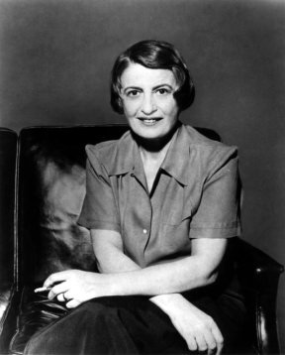
Anthem
By Ayn Rand
(1905-1982)

Slide 2
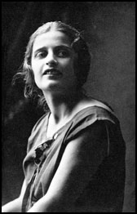
Ayn Rand
She was born in St. Petersburg, Russia, on February 2, 1905.
She opposed the mysticism and collectivism of Russian culture.
She witnessed both the Kerensky and Bolshevik Revolutions during her teenage years in Russia.
The communist victory in Russia resulted in the confiscation of her father's pharmacy and periods of near-starvation for her family.
When introduced to American history in her last year of high school, she immediately took America as her model of what a nation of free men could be.
In late 1925 she obtained permission to leave Soviet Russia for a visit to relatives in the United States.
Although she told Soviet authorities that her visit would be short, she was determined never to return to Russia, and she never did.

Slide 3
Key Facts
type of work · Novella
genre · Anti-Utopian (The world presented is the world as it should NOT be.)
time and place written · The United States, 1937
narrator · Equality 7-2521 writes the journal of the events as they transpire over the course of several months.
point of view · Equality 7-2521 speaks in the first person (plural) He will refer to himself as “we” instead of “I.”
tone · Equality 7-2521 records his thoughts and actions in a straightforward manner, with no trace of irony.
tense · Present, with some past-tense narration

Slide 4
Key Facts
setting (time) · Sometime in the distant future, after the collapse of the social order because of the common acceptance of collectivist values
setting (place) · An unidentified city; much of the first half of Anthem is narrated from a tunnel underground where Equality 7-2521 is hiding, and the second half is narrated from a forest where he has taken refuge from a society that hates him.
protagonist · Equality 7-2521
symbols · Light; the forest; manuscripts

Slide 5
Key Literary Terms
Theme:
The central or dominant idea behind the story; the most important aspect that emerges from how the book treats the subject
Point of View:
The position or vantage point from which the events of a story seem to come and are presented to the reader
Setting:
When and where the short story, play, or novel takes place
Narrator:
The one who tells the story
Motif:
A recurrent device, formula, or situation that often serves as a signal for the appearance of a character or event

Slide 6
Collectivism vs. Individualism
Collectivism – the subjugation of the individual to the group – whether to a race, class, or state does not matter. In Anthem, Ayn Rand will present a collectivist society that is stagnant and primitive, and the word "I" is obsolete.
The individual . . .
is owned by the group
has no right to a private existence
has no right to lead his own life, pursue his own happiness, or use his own property
exists only as part of the group

Slide 7
Collectivism vs. Individualism
Individualism/Objectivism – regards every man as an independent, sovereign entity who possesses an inalienable right to his own life, a right derived from his nature as a rational being. Individualism does not mean that one can do whatever he feels like doing; it means that every man or woman is an individual and has the same rights.
The individual . . .
has rights
will not run anyone else’s life, nor let anyone run theirs
will not rule or be ruled
will not be a master nor a slave
will not sacrifice themselves to anyone, nor sacrifice anyone to themselves

Slide 8
Selflessness
Anthem dramatizes the view that the self is destroyed in a collectivist society.
Selflessness is shown in the following ways:
No one has a personal name because under collectivism, individuals are interchangeable.
To prefer one person over another (as a friend or romantic partner) is committing the cardinal sin known as the “Transgression of Preference.”
It is wrong to disagree, to have independent thoughts, or to ask questions because these things will set you apart from others.
Self-assertion is forbidden.
All decisions are made by the “Council” in the name of the whole.
Individuals have no rights.
Everything which is not permitted by the law is forbidden.

Slide 9
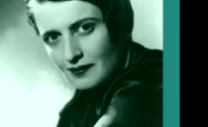
Selflessness (cont’d)
Anthem depicts what happens to a society that implements selflessness. The result is what Ayn Rand believes is a subhuman society; what makes human beings human is having a self, which means having a mind.
A selfless individual is a mindless individual.
To practice selflessness, one must abstain from thinking and obey one’s masters. One must merge himself into the group and obliterate the individual identity. The result is a society of mindless robots as found in Anthem.

Slide 10
Free Will
When people have free will, they can make choices, make up their own mind, makes decisions, and can direct their own lives by the ideas and values they adopt.
In Anthem all the characters actually have free will, although most will believe that they do not. It appears that all the individuals are brainwashed, with no power to control their own lives.
Even the so-called “robots” who submit to the authorities have free will; they are robots by choice – they were not forced to obey. They do so voluntarily.
The characters in Anthem are depressed, without hope or ambition. They make no effort to accomplish anything and merely go along with orders.
Ayn Rand holds that free will means “the choice to think or not.” Most of the characters have chosen not to think.
The main character in Anthem will rely on his own judgment rather than to take the beliefs of his leaders as automatically true. Therefore, free will is exercised.

Slide 11
Motifs
A motif is a recurrent device, formula, or situation that often serves as a signal for the appearance of a character or event. The following motifs are present in Anthem.
The use of darkness and light
The presence of ignorance and knowledge
The idea of transgression and damnation

Slide 12
Motifs (cont’d)
Fear
Fear in Anthem characterizes those social lepers who do not have enough sense of themselves to understand that each individual is the center of his or her universe.
Naming
In the society in Anthem, naming is a form of identifying one’s possessions as one’s own. For this reason, Equality 7-2521 names the Golden One on two separate occasions, names himself, and searches relentlessly for the word “I.”
Shapelessness
Like fear, shapelessness in Anthem connotes evil because it illustrates a lack of willingness or ability to believe in something and to stand behind it.

Slide 13
Places of Importance
Home of Infants
Home of Students
Palace of Mating
Home of Street Sweepers, Scholars, Leaders . . .
Home of Peasants
Home of the Useless
Palace of Corrective Detention
City Cesspool
City Theater
Uncharted Forest

Slide 14
Key Characters & Organizations
Equality 7-2521 > The Unconquered >Prometheus
Liberty 5-3000 > The Golden One > Gaea
Fraternity 2-5503
International 4-8818
Solidarity 9-6347
Union 5-3992
The Transgressor of the Unspeakable Word
The Saint of the Pyre
Key Organizations:
Council of Eugenics
Council of Vocations
World Council of Scholars

Slide 15
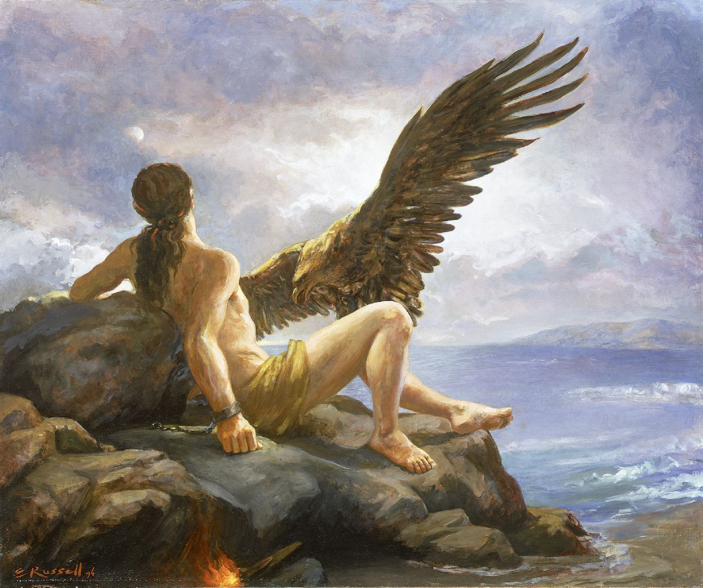
Equality 7-2521’s New Name
Equality 7-2521
The Unconquered
Prometheus
In Greek mythology, Prometheus surpassed all in cunning and deceit. He held no awe for the gods, and he ridiculed Zeus. Prometheus was the creator of man. He stole fire from heaven and gave it to his human creations.

Slide 16
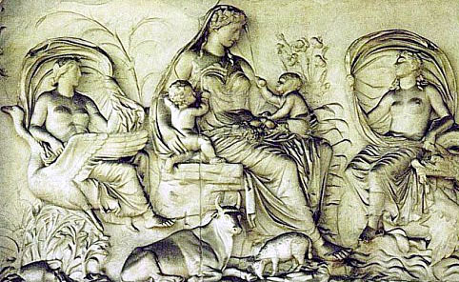
Liberty 5-3000’s New Name
Liberty 5-3000
The Golden One
Gaea
In Greek mythology, Gaea is known as Earth or Mother Earth. She is considered the primeval divinity of earth, one of the primal elements who first emerged at the dawn of creation, along with air, sea, and sky. She was the great mother of all.

Slide 17
The Ayn Rand Institute (ARI)
The Ayn Rand Institute (ARI) is a nonprofit organization that works to introduce young people to Ayn Rand's novels, to support scholarship and research based on her ideas, and to promote the principles of reason, rational self-interest, individual rights and laissez-faire capitalism to the widest possible audience.
The major ARI objective is to cultivate a generation of intellectuals who will be effective advocates for the fundamentals of reason, rational self-interest, individual rights and capitalism. These professionals will be capable of articulating those ideas, at the highest level, to peers and students through publishing and teaching.
The ARI gives free copies of Ayn Rand’s novels to teachers and classrooms all over the world.
The ARI also gives out thousands of dollars each year through its essay contests.
http://www.aynrand.org

Slide 18
This powerpoint was kindly donated to www.worldofteaching.com
http://www.worldofteaching.com is home to over a thousand powerpoints submitted by teachers. This is a completely free site and requires no registration. Please visit and I hope it will help in your teaching.

