Slide 1
“Bernice Bobs Her Hair”
By F. Scott Fitzgerald

Slide 2
Life during The Jazz Age
Prohibition led to
  Illegal parties, underground nightclubs serving alcohol
  Economic Boom
    Lots of new money, young and rich
  Entertainment Industry
    Jazz- wild music that is on-the-edge
    Movies- depicting, among other socially taboo subjects, parties and sexuality

Slide 3
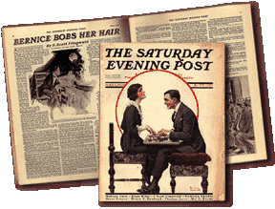
“Bernice Bobs Her Hair” by F. Scott Fitzgerald
A story about:
  Youth
  Being popular
  Trying to fit in

Slide 4
Let’s Brainstorm…
What do teens do TODAY, in terms of fashion and image, that could be considered…
  Trendy?
  Rebellious?
  Taboo?
  Controversial?
  (let’s generate a list together as a class)
Now, who is the influence for these trends & fads?

Slide 5
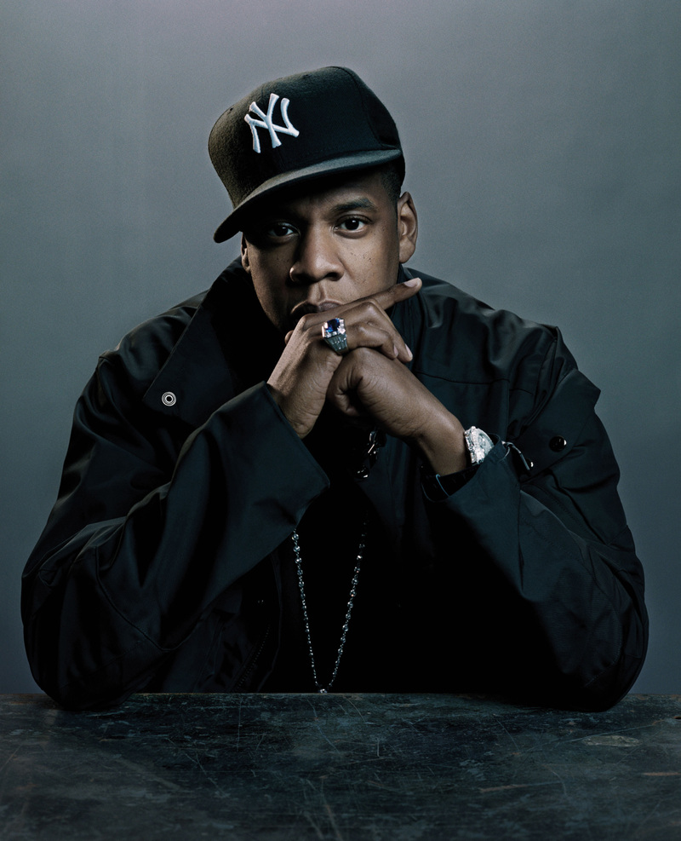
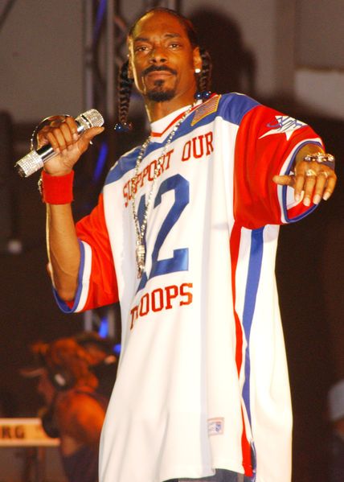

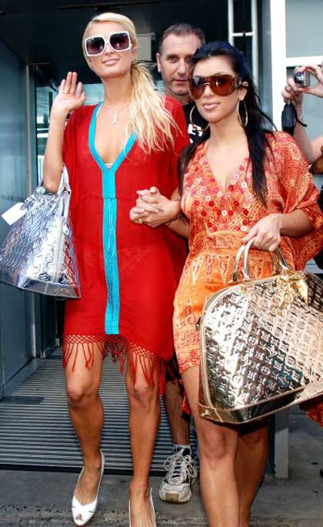
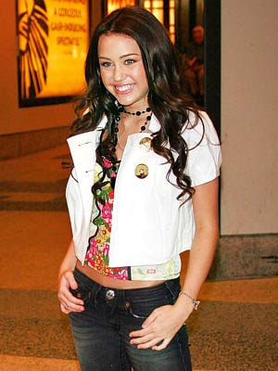
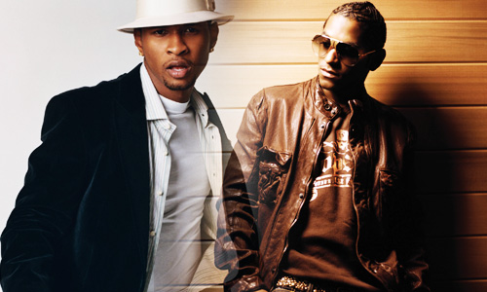

Slide 6
So who set the trends of earlier generations?

Slide 7
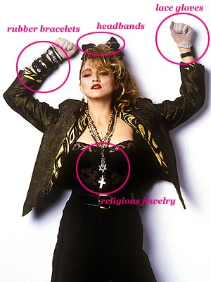
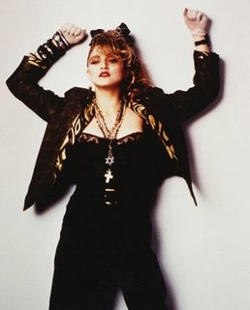
Fashion and Trends of the ‘80s
Major influence????
MADONNA!!!

Slide 8
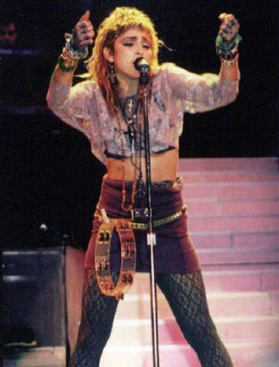
Fashion and Trends of the ‘80s
MADONNA!!!
  Lots of make-up
  Exposed mid-drift
  Underwear becomes “outerwear”
  Religious jewelry taboos

Slide 9
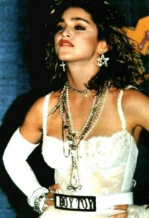
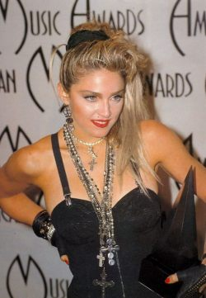
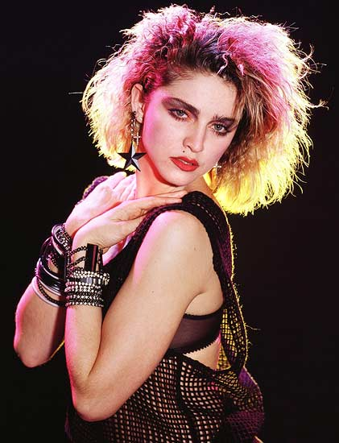
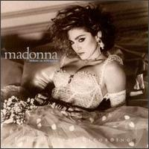
Controversial!

Slide 10
And what they did THEN…
Teens in Fitzgerald’s day weren’t so different from teens in the ‘80s or today.
So what did they do that was considered, trendy, rebellious, taboo, controversial?

Slide 11
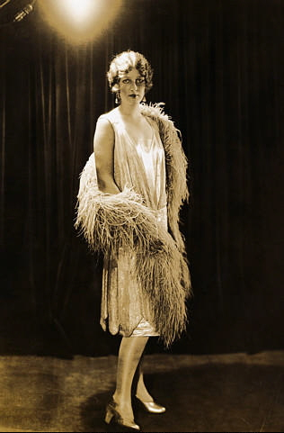
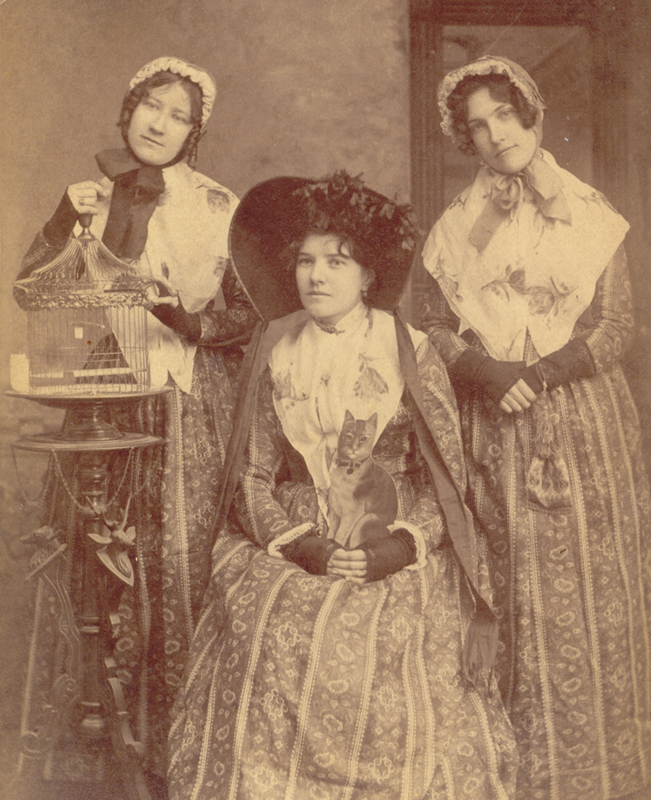
And what they did THEN…
Girls wore short, straight dresses and cut their hair.
It was shocking and rebellious- and it got attention!
This was a big no-no to these children of the conservative Victorians!

Slide 12
So, as you study this story…
Notice what the popular teens are doing, how they behave and how they interact with others.
Pay attention to the main characters.
  What are Marjorie, Warren and Bernice each like?
  Do you know people like these characters?
Think of a time when you may have done something to be more popular, or to be liked more.
  Is that so different from Bernice?
  Did it work out differently for you?

Slide 13
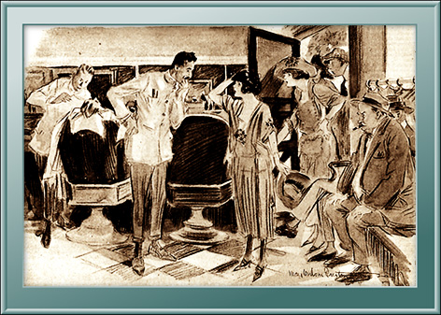

Slide 14
This powerpoint was kindly donated to
www.worldofteaching.com
http://www.worldofteaching.com
Is home to well over a thousand powerpoints submitted by teachers. This a free site. Please visit and I hope it will help in your teaching
Notes:
14

