Slide 1

Collective Nouns
S. Sushila Naidu
PRT,
K.V. NTPC Ramagundam

Slide 2
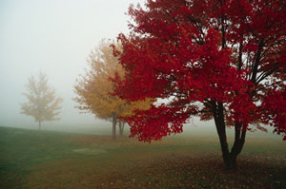
A collective noun is a
word used to define
a group of objects,
where "objects"
can be people,
animals,
emotions,
inanimate
things ...

Slide 3

A flock of birds

Slide 4

A herd of elephants

Slide 5
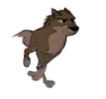
A pack of wolves

Slide 6

A shoal of fishes

Slide 7
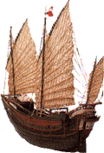
A fleet of ships

Slide 8


A crowd of people

Slide 9
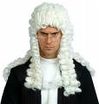
A jury of judges

Slide 10




A pride of Lions

Slide 11

A kindle of kittens

Slide 12
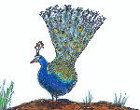

A muster of peacocks

Slide 13

A leap of Leopard

Slide 14
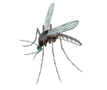
A scourge of mosquitoes

Slide 15


A parliament of owls

Slide 16


A creche of penguins

Slide 17

A swarm of rats

Slide 18
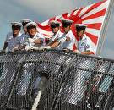
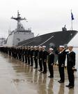
A crew of sailors

Slide 19
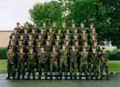

A platoon of soldiers

Slide 20


A flight of stairs

Slide 21

A Swarm of Bees

Slide 22
This powerpoint was kindly donated to
www.worldofteaching.com
http://www.worldofteaching.com
Is home to well over a thousand powerpoints submitted by teachers. This a free site. Please visit and I hope it will help in your teaching
Notes:
22

