Slide 1
CONJUNCTIONS

Slide 4
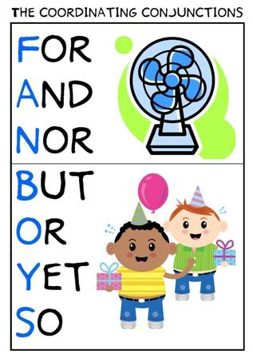

Slide 5
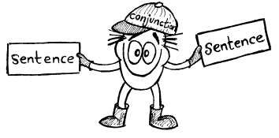

Slide 6
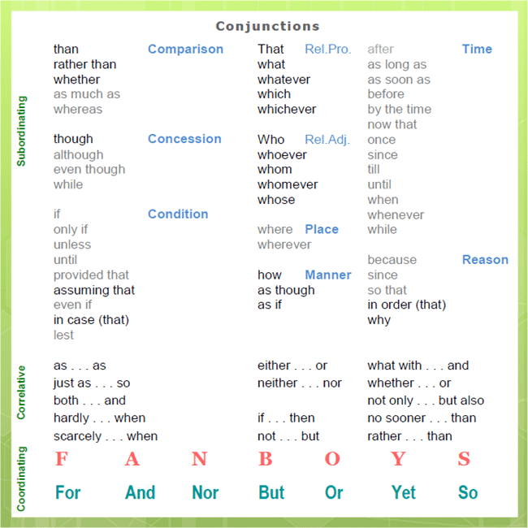

Slide 8
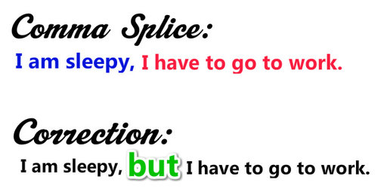

Slide 9
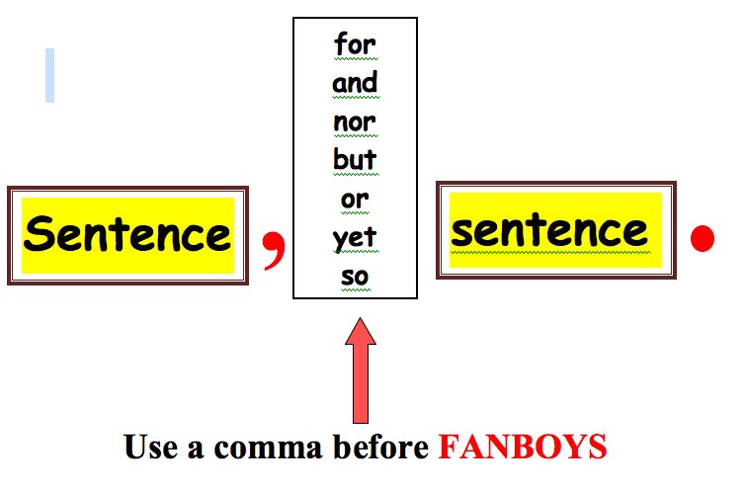

Slide 10
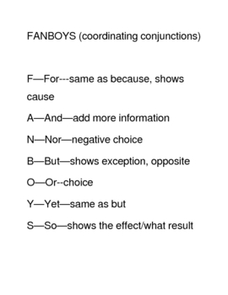

Slide 11
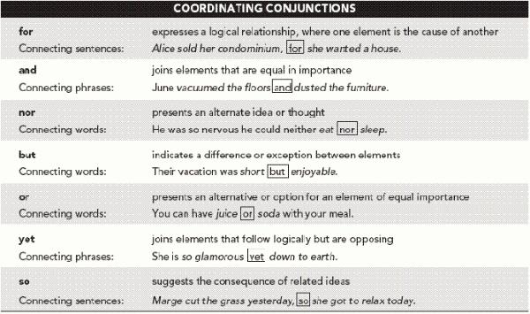

Slide 13
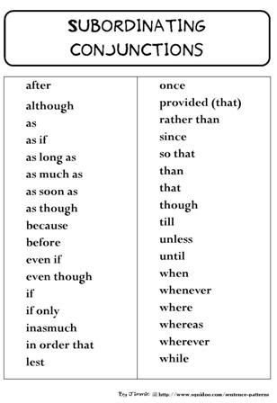

Slide 14
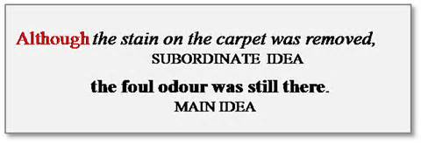

Slide 17
Subordinating Conjunctions A subordinating conjunction introduces a dependent clause and indicates the nature of the relationship among the independent clause(s) and the dependent clause(s).

Slide 18
Fun Activity:
1. _________ he claims that he is innocent, everyone knows he is guilty. While Now that In order that 2. _________ you're here, I'm going to tell you a secret. Whereas Now that In order that 3. _________ you like him personally, you have to agree that he's done a lot for the company. If only Rather than Whether or not 4. _________ I prefer to live in an apartment, my wife wants to buy a house. Until Whereas Because 5. _________ I had seen that movie three times, I watched it again. Although Whereas Unless

Slide 19
6. _________ you already know the answer, why are you asking me? Although Since Whereas 7. _________ you go to the beach, call your brother. Because Although Before 8. _________ giving the money to my sister, I gave it to my cousins. Though Rather than Whereas 9. _________ she calls me, I feel happy. Whenever Although While 10. _________ the test starts, you will not be able to talk. Whatever Once Because

Slide 20
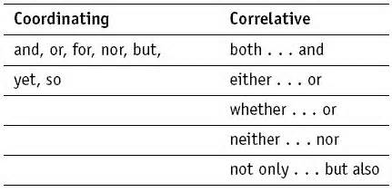

Slide 22
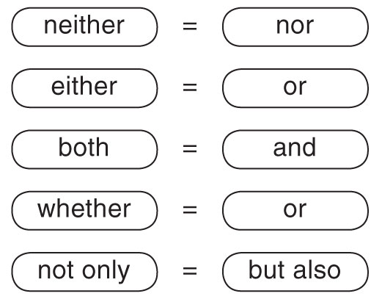

Slide 23
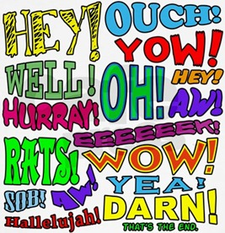

Slide 24
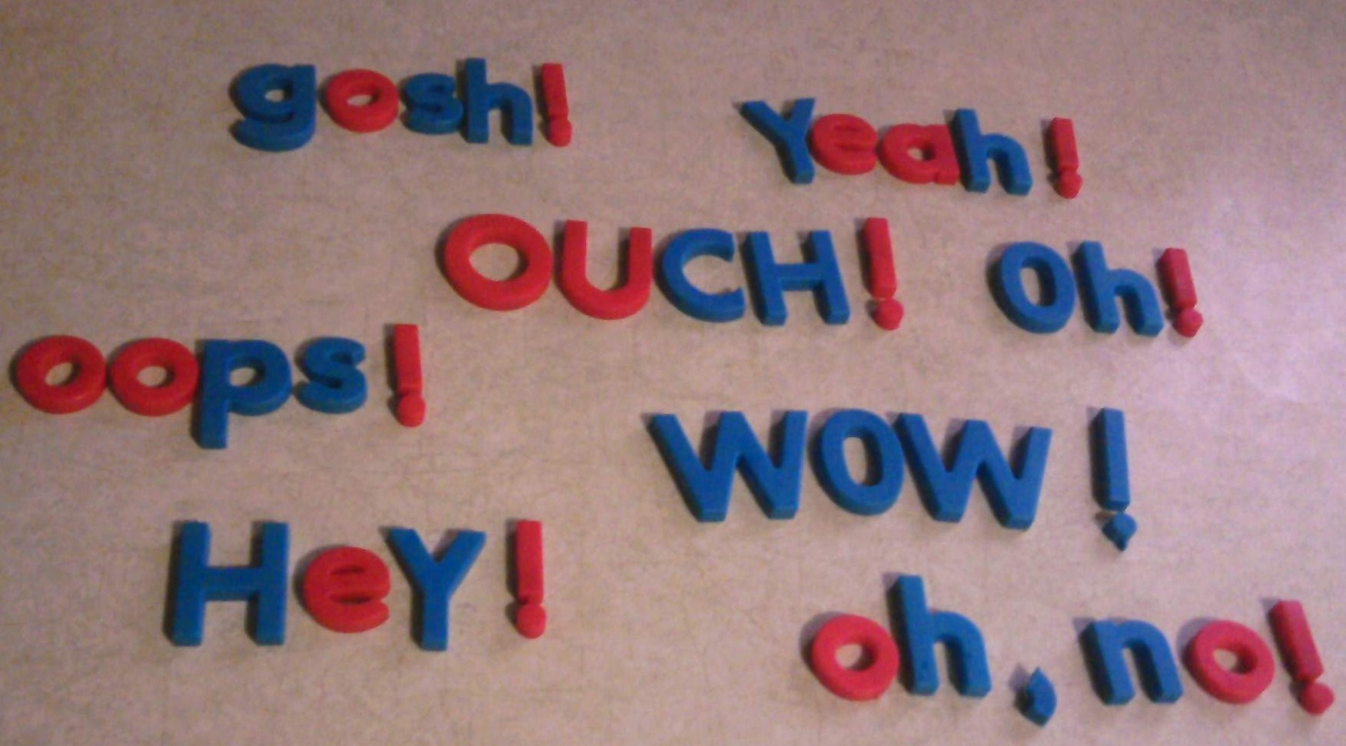

Slide 25
Interjections
are words or phrases used to exclaim or protest or command. They sometimes stand by themselves, but they are often contained within larger structures.

Slide 26
Conventions like Hi, Bye and Goodbye are interjections, as are exclamations like Cheers! and Hooray!. In fact, like a noun or a pronoun, they are very often characterized by exclamation marks depending on the stress of the attitude or the force of the emotion they are expressing. Well (a short form of "that is well") can also be used as an interjection: "Well! That's great!" or "Well, don't worry." Much profanitytakes the form of interjections. Some linguists consider the pro-sentences yes, no, amen and okay as interjections, since they have no syntactical connection with other words and rather work as sentences themselves. Expressions such as "Excuse me!", "Sorry!", "No thank you!", "Oh dear!", "Hey that's mine!", and similar ones often serve as interjections. Interjections can be phrases or even sentences, as well as words, such as "Oh!" "Pooh!" "Wow!" or "sup!".

Slide 27
Several English interjections contain sounds that do not (or very rarely) exist in regular English phonological inventory.
For example:
Ahem is common in American English, some British dialects, and in other languages, such as German.
Oops, an interjection made in response to the observation of a minor mistake, usually written as "Oops!" or "Whoops!"
Psst [psː] ("here!"), is another entirely consonantal syllable-word, and its consonant cluster does not occur initially in regular English words.

Slide 28
Shh [ʃːː] ("quiet!") is an entirely consonantal syllable.
Tut-tut [ǀ ǀ] ("shame..."), also spelled tsk-tsk, is made up entirely of clicks, which are an active part of regular speech in several African languages.
Ugh [ʌx] ("disgusting!") ends with a velar fricative consonant, which otherwise does not exist in English, though is common in languages like Spanish, German, and Gaelic.
Whew or phew ("what a relief!"), also spelled shew, this sound is a common phoneme in such languages as Suki (a language of New Guinea) and Ewe and Logba(both spoken in Ghana).
Yeah ("yes") ends with the short vowel [ɛ], or in some dialects [æ], neither of which are found at the end of any regular English words.

Slide 29
ARTICLES

Slide 30
An article (abbreviated art) is a word (or prefix or suffix) that is used with a noun to indicate the type of reference being made by the noun. Articles specify grammatical definiteness of the noun, in some languages extending to volume or numerical scope. The articles in the English language are the and a/an, and (in some contexts) some. 'An' and 'a' are modern forms of the Old English 'an', which in Anglian dialects was the number 'one' (compare 'on', in Saxon dialects) and survived into Modern Scots as the number 'ane'. Both 'on' (respelled 'one' by the Normans) and 'an' survived into Modern English, with 'one' used as the number and 'an' ('a', before nouns that begin with a consonant sound) as an indefinite article.

Slide 31
Traditionally in English, an article is usually considered to be a type of adjective. In some languages, articles are a special part of speech, which cannot easily be combined with other parts of speech. It is also possible for articles to be part of another part of speech category such as a determiner, an English part of speech category that combines articles and demonstratives (such as 'this' and 'that').
In languages that employ articles, every common noun, with some exceptions, is expressed with a certain definiteness (e.g., definite or indefinite), just as many languages express every noun with a certain grammatical number (e.g., singular or plural). Every noun must be accompanied by the article, if any, corresponding to its definiteness, and the lack of an article (considered a zero article) itself specifies a certain definiteness. This is in contrast to other adjectives and determiners, which are typically optional.

Slide 32
This obligatory nature of articles makes them among the most common words in many languages—in English, for example, the most frequent word is the.^{[1]}
Articles are usually characterized as either definite or indefinite.^{[2]} A few languages with well-developed systems of articles may distinguish additional subtypes. Within each type, languages may have various forms of each article, according to grammatical attributes such as gender, number, or case, or according to adjacent sounds.

Slide 33
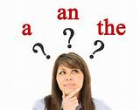

Slide 35
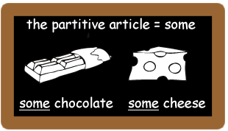

Slide 36
negative article
specifies none of its noun, and can thus be regarded as neither definite nor indefinite. On the other hand, some consider such a word to be a simple determiner rather than an article. In English, this function is fulfilled by no, which can appear before a singular or plural noun:

Slide 37
e.g
No man has been on this island.
No dogs are allowed here.
No one is in London.

