Slide 1
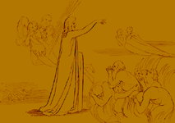
1st Ring: Limbo
Luke Warm. Neither sinned nor believed in Christ.
Heaven does not claim them, Hell does not want them.

Slide 2
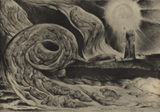
2nd Ring: Lustful
Blown about in darkness.

Slide 3
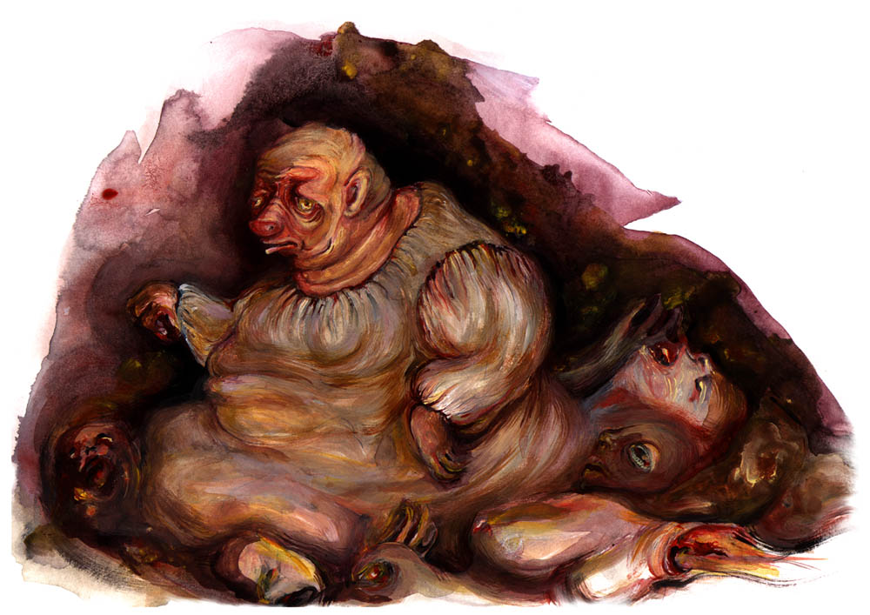
3rd Ring: Gluttonous
Deprived of individuality. Each is alone, cold, and miserable.

Slide 4
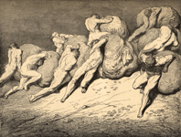
4th Ring: Avaricious
Greedy
Must roll their wealth back and forth forever.

Slide 5
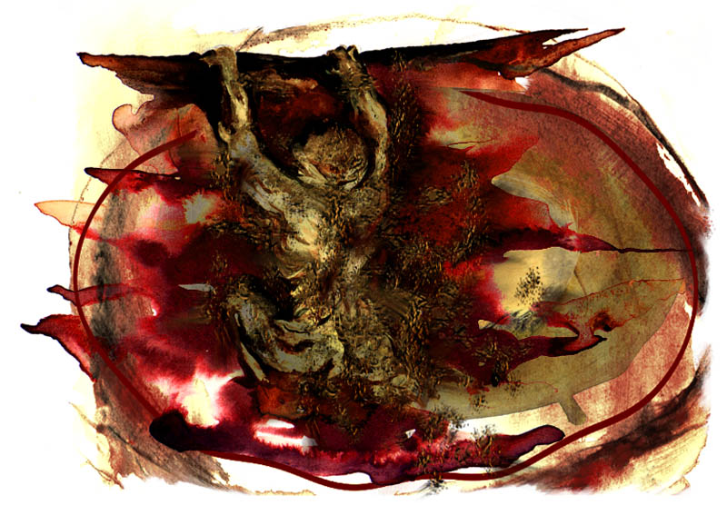
5th Ring: Wrathful and Sullen
“Wrathful”
Muddy figures attack one another.
“Sullen”
Sink beneath the surface in filthy slime.

Slide 6
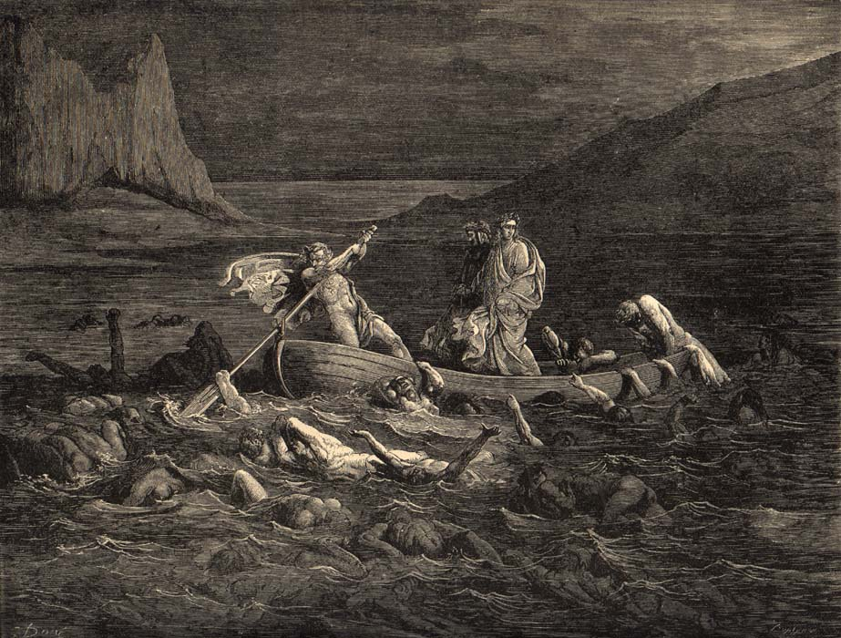
Marsh of Styx

Slide 7
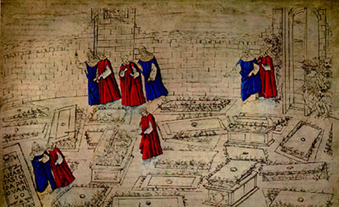
6th Ring: Heretics
Confined in tombs.

Slide 8
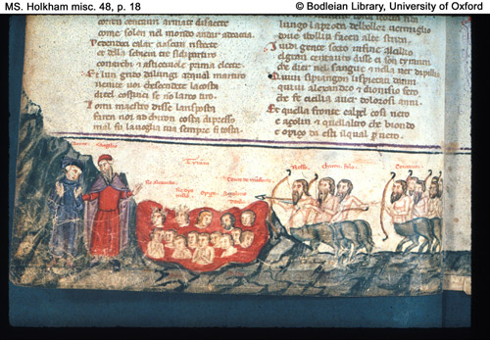
7th Ring: Violent
AGAINST OTHERS:
Immersed in a river of boiling blood.

Slide 9
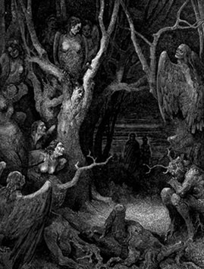
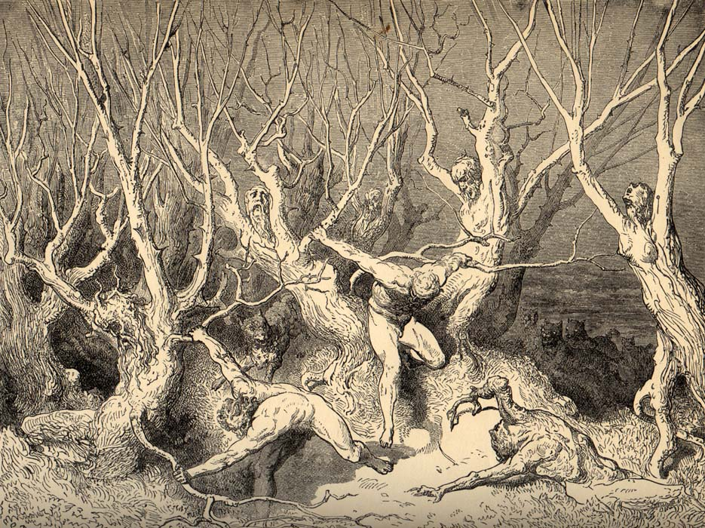
7th Ring: Violent
AGAINST SELF
Twisted plants that cannot move

Slide 10
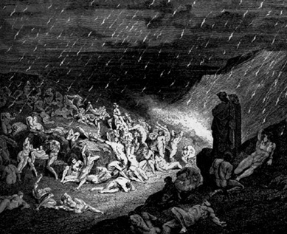
7th Ring: Violent
AGAINST GOD: Must lie facing upward toward heaven
AGAINST NATURE: Must run forever
AGAINST ART: Forced to crouch over moneybags.

Slide 11
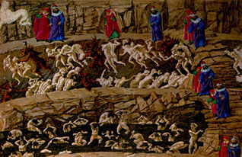
8th Ring: Fraudulent
SEDUCERS:
Driven by horned demons

Slide 12
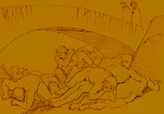
8th Ring: Fraudulent
FLATTERERS:
Forced to wallow in a floor of excrement

Slide 13
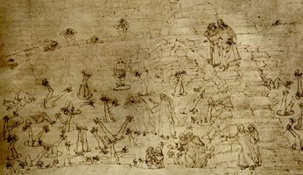
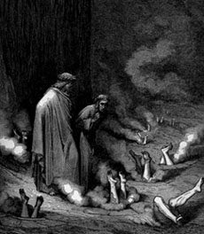
8th Ring: Fraudulent
SIMONISTS (Those who attempt to purchase the power of the holy spirit):
Buried head down and burned on the soles of their feet.

Slide 14
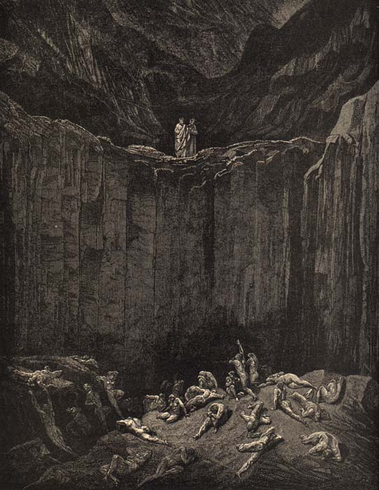
8th Ring: Fraudulent
FORTUNE TELLERS/ SOOTHSAYERS
Bodies distorted so that the head is twisted around to only view his back.

Slide 15
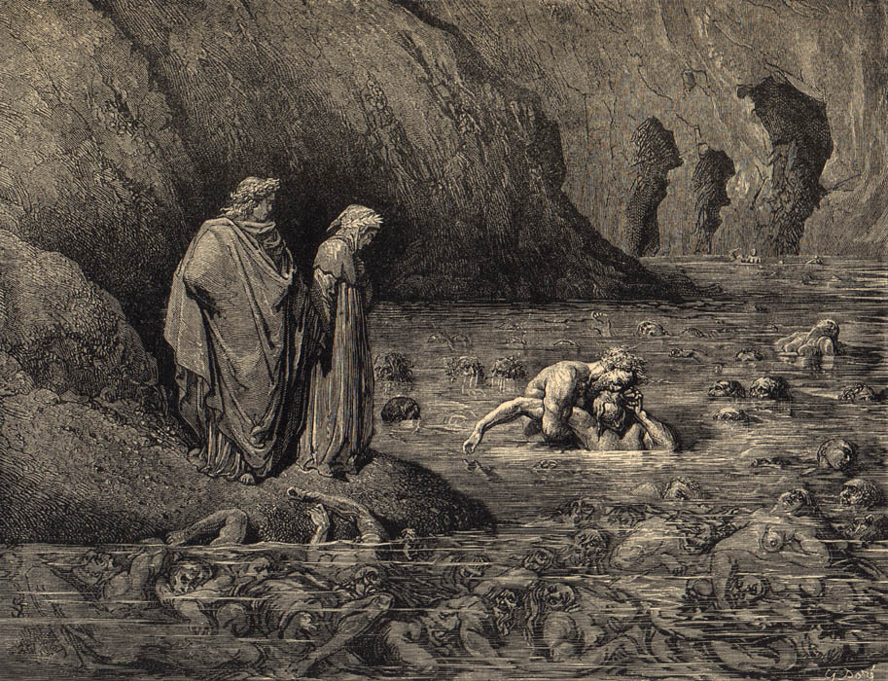
8th Ring: Fraudulent
GRAFTERS
Dipped into boiling tar. Demon holds down the sinners with a pitchfork.

Slide 16
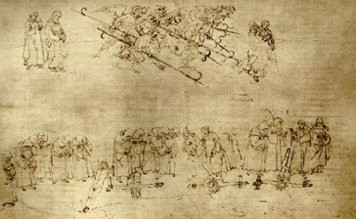
8th Ring: Fraudulent
HYPOCRITES
Must always walk at a steady pace.

Slide 17
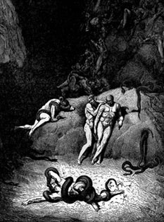
8th Ring: Fraudulent
THEIVES
Snakes coil and bind these sinners

Slide 18
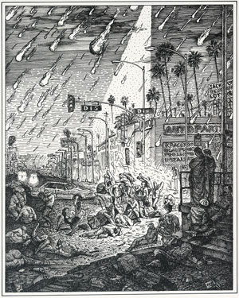
8th Ring: Fraudulent
DECIEVERS
Wrapped in fire

Slide 19
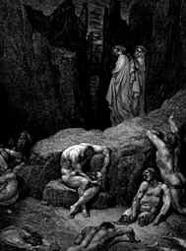
8th Ring: Fraudulent
SCANDALS
Hacked to pieces, put back together, and hacked up again.

Slide 20
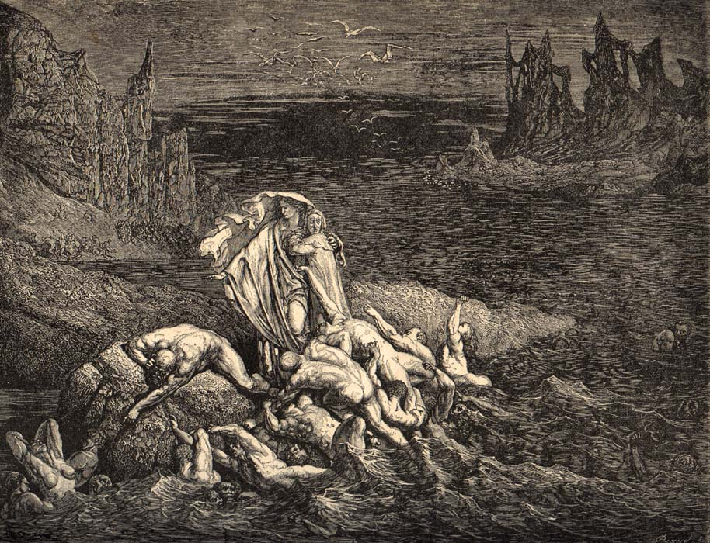
8th Ring: Fraudulent
FALSIFIERS
Made insane; plagued with all types of illnesses and diseases.

Slide 21
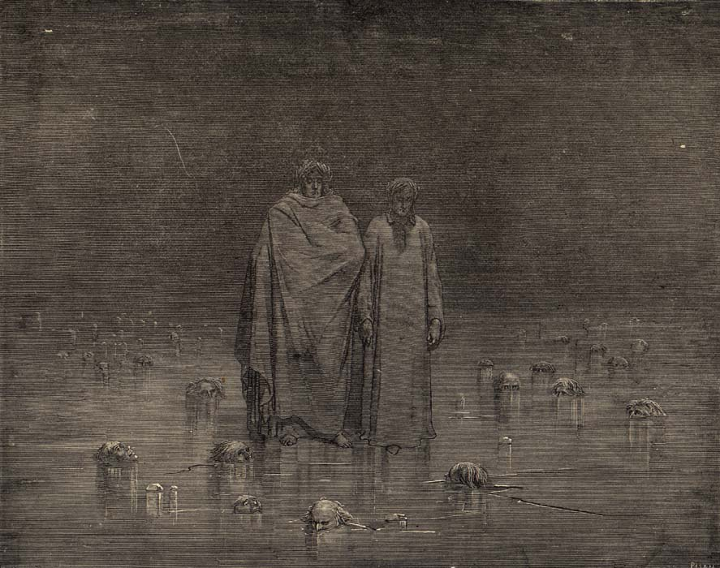
9th Ring: Treachery
TO FAMILY, COUNTRY, AND FRIENDS
Frozen in a sheet of ice with only their face exposed to show the pain.

Slide 22
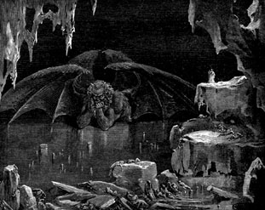
Center of 9th Ring: Lucifer

Slide 23
This powerpoint was kindly donated to www.worldofteaching.com
http://www.worldofteaching.com is home to over a thousand powerpoints submitted by teachers. This is a completely free site and requires no registration. Please visit and I hope it will help in your teaching.

