Slide 1
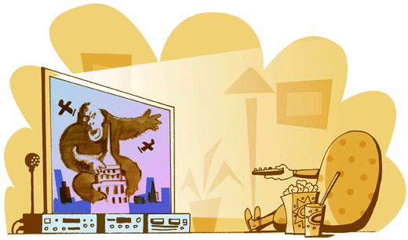
Film Genres
A genre is a ‘type’ of film. Take a moment or two to name as many film types as you can.

Slide 2
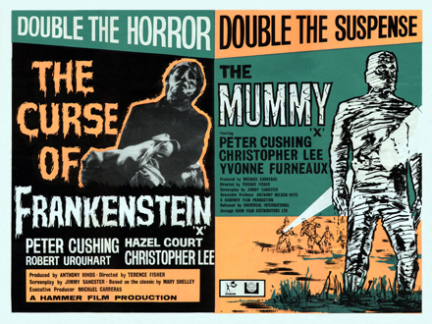
Film Genres
Perhaps you thought of the following:
Westerns, Spaghetti Westerns, War films, Thrillers, Sci-Fi, Rom Coms, ‘Chick’ flicks, Foreign films, Musicals, Comedies, Anime.
Now take a little longer and try to name at least one movie for each of these categories…

Slide 3
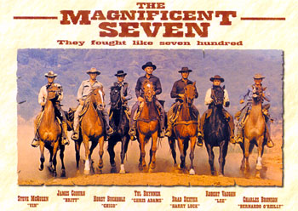
Film Genres
How did you do?
Now look at the pictures on the following slides. They each represent a particular type, or genre of movie. Can you fit the genre to the picture?
1.

Slide 4

Film Genres
2.

Slide 5

Film Genres
Now to finish off, write down your favourite genre of movie, and briefly say what it is about this type of movie that you like.

Slide 6

Film Genres
3.

Slide 7

Film Genres
4.

Slide 8

Film Genres
5.

Slide 9

Film Genres
6.

Slide 10

Film Genres
7.

Slide 11


Film Genres
8.

Slide 12

Film Genres
9.

Slide 13

Film Genres
9.

Slide 14

Film Genres
10.

Slide 15

Film Genres
11. And finally…

Slide 16
This powerpoint was kindly donated to www.worldofteaching.com
http://www.worldofteaching.com is home to over a thousand powerpoints submitted by teachers. This is a completely free site and requires no registration. Please visit and I hope it will help in your teaching.

