Slide 1
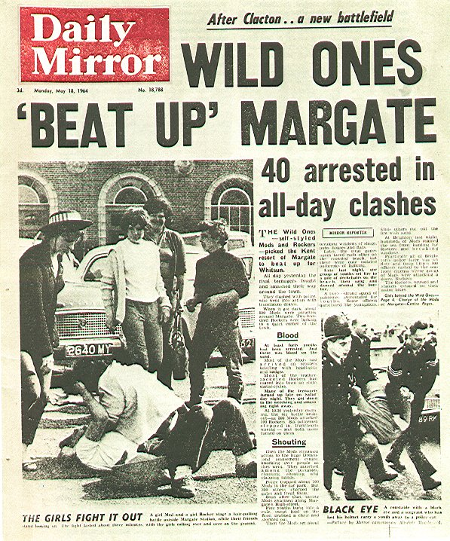
‘Folk Devils and Moral Panics’ –Stanley Cohen

Slide 2
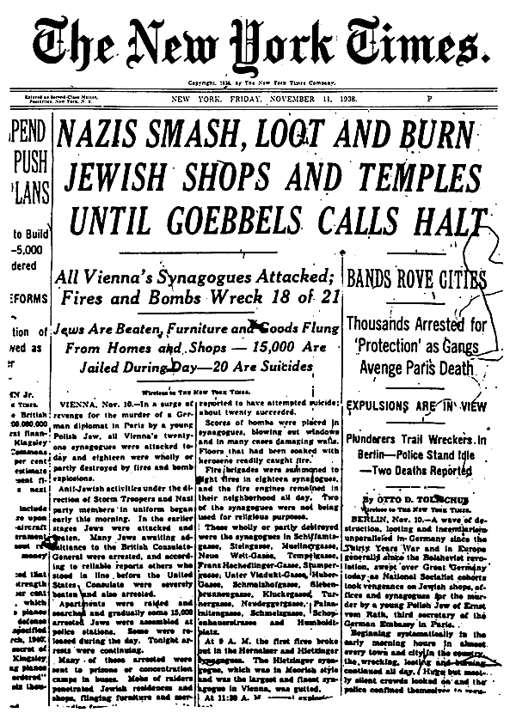
“If we do not take steps to preserve the purity of blood, the Jew will destroy civilisation by poisoning us all.” (Hitler, 1938)
“Surely if the human race is
under threat, it is reasonable
to segregate AIDS victims,
otherwise the whole of man-
- kind could be engulfed.”
(Daily Star, 1988)

Slide 3

Moral Panics
“The more comfortable the language of anti-terrorism is to us, the more familiar the terrorist figure who haunts us, the more entrenched that seizure of our political imagination.” (Fortin)

Slide 4
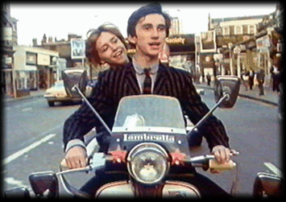
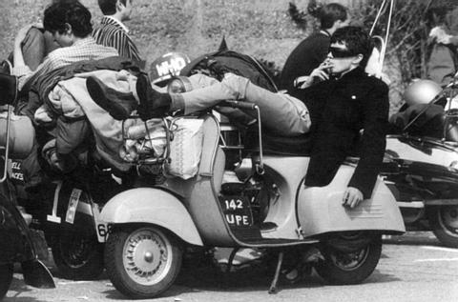

Cohen’s research was a departure from traditional subcultural theory – his emphasis was on the reaction to the disturbances which took place in Clacton, Easter 1964. Cohen’s work deployed a synthesis of structural and labelling theories.
The amount of serious violence had been minimal.
Most young people who had gone to the seaside did not identify with either Mods or Rockers.
In short, the mass media had painted a distorted picture of events.
This set in process a ‘deviancy amplification spiral.’ As public concern was ratcheted up, the police became sensitised to the phenomena…

Slide 5
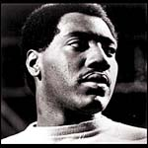

The police made more arrests, the media reported more deviance, more young people readily identified with the Mods and Rockers…the initial disproportionate response of various state and media control agencies generated more, not less ‘deviance.’
Cohen went further; the media had created a moral panic; ‘a condition, episode, person or group of persons emerges to become defined as a threat to societal values and interests.’ These ‘folk devils’ constituted a threat to the prevailing social order.

Slide 6
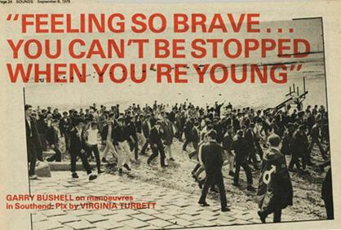
Deviancy Amplification Spiral
* ‘Law and public opinion stipulate that there are many ideas and opinions which are to be condemned as outside the pale of consensus.’ (Fowler, 1991)
* ‘Deviancy amplification’ – Selective attention of crime control agencies, news and public concern on particular aspects of perceived and real increases in deviance = MORAL PANIC!!

Slide 7

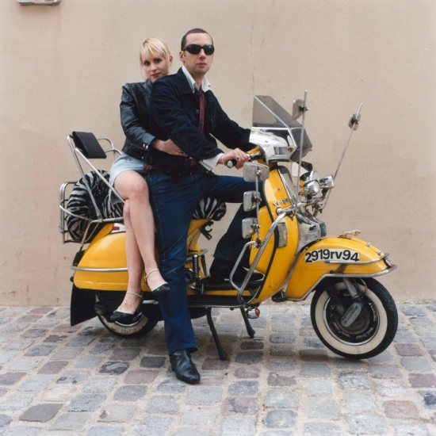
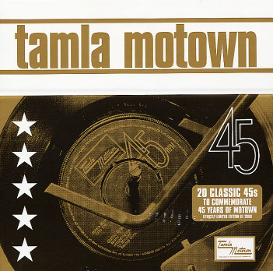
Moral Panics and Social Control
Identification of a subversive minority
Simplification of cause
Stigmatisation of those involved
Stirring of public indignation
Stamping down hard. (Adapted from Muncie, 1987).

Slide 8


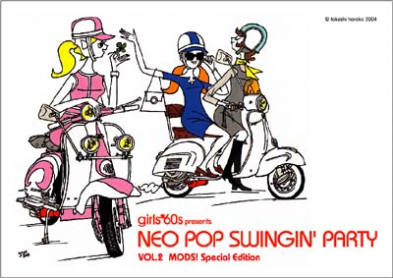
So, ‘the media, wittingly or unwittingly, reproduce the definitions of the powerful.’ (Eldridge, 1997)
‘More moral panics will be generated and other, as yet nameless folk devils will be created. This is not because such developments have an inexorable inner logic, but because our society as presently structured will continue to generate problems for some of its members…and then condemn whatever solution these groups find.’ (Cohen, 1987)

Slide 9
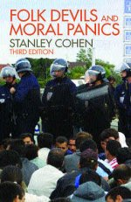

Stanley Cohen
So, who might these other ‘nameless folk devils’ be?
* Trade Unionists
* Punks
* Black muggers
* Football hooligans
* Ravers
* Goths
* Young Muslims
* ‘NEDS’
* ???

Slide 10
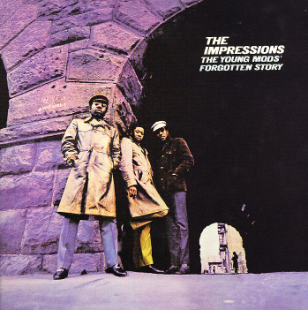

‘Hard to imagine in our corporate ‘now,’ but on every level of British society in the 60s, massive, fundamental changes were taking place. In music, in fashion, in cinema, in theatre, in literature, in politics, in public morality, on television and on radio, new ideas were taking a strong hold. British society, now buoyed by a healthy economy, not only made cash available but, it seemed, confidence as well. It was everywhere. In such a world, the Modernist with his obsessive and crafty nature was inevitable.’ (Soul Stylists, P. Hewitt, 2003).
Who would stand to gain or lose in such circumstances? Could it be that in times such as this, ‘folk devils’ become an indispensable means of reasserting social control?

Slide 11

Folk Devils and Moral Panics
Some closing thoughts…
‘Quietly disrupting the orderly sequence which leads from signifier to signified, the mods undermined the conventional meaning of ‘collar, suit and tie,’ pushing neatness to the point of absurdity. ..they were a little too smart, somewhat too alert, thanks to amphetamines.’ (Hebdige, 1979)
Is that all there was too it, re-investing consumer goods such as Vespas with alternative meanings? As you will no doubt know by now, Sociologists present a number of diverse positions on any given topic. Matza would argue that ‘delinquent’ youth offer no serious challenge to prevailing norms and values. Sub cultural theorists argue that quite separate norms are gestating within these groups, while both Left Idealists and Realists would reassert the wider structure within which labelling and criminalising takes place. What do you think?

Slide 12
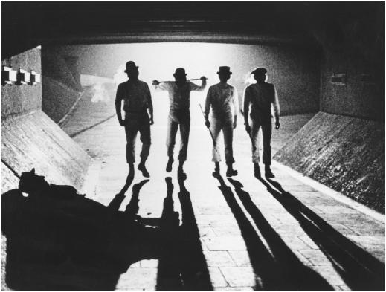
Moral Panics
The media used the case of James Bulger to symbolise all that was wrong with Britain. As Bradley points out, ‘as the media pursued each new sub-plot of the courtroom saga, it issued another little moral message to the nation to take on board: ‘it’s an evil world and we need strict rules.’ (Bradley 1994). Rational explanations for why the crime occurred were not the concern of the press, rather they chose to focus attention on the differences between innocence and evil. Bradley sites the Times as an example of this; they used the opportunity (often using the language of Criminology: ‘moral evil, the choice of vice over virtue’) to ‘restore the notions of pure innocence (little James) and born evil (his killers) in a way that few were prepared to question.’ (Bradley 1994)
And this had political repercussions; Tory Home Secretary Michael Howard illegally attempted to intervene to increase the tariff passed on Jamie Bulger’s killers, and not for the last time, Tony Blair successfully identified with this public mood, promising a new Britain where such criminals would not prevail. A few years later New Labour won the 1997 General Election, due
at least in part to Blair’s ability
to ally himself with this moral panic.

Slide 13
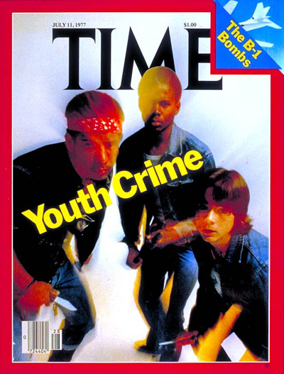
Contemporary Research
The charity NACRO ( National Association for the Care and Resettlement of Offenders) suggests in a recent report (2008) that the police criminalise young to hit arrest targets set by the government.
Police figures suggest reported minor offences by young people soared by 38.9% from 2003-96, while serious offences rose by 19%.
But NACRO says this rise has more top do with police criminalising minor teenage misdemeanours – previously they would have been dealt with by an informal ticking off.
The charity says that police, under pressure to improve clear-up rates, are dealing with more teenagers through the criminal justice system.
NACRO argues that, using data from the police and other sources suggest youth crime has been stable since 2003.

Slide 14
This powerpoint was kindly donated to www.worldofteaching.com
http://www.worldofteaching.com is home to over a thousand powerpoints submitted by teachers. This is a completely free site and requires no registration. Please visit and I hope it will help in your teaching.

