Slide 1
Art of the Renaissance:
Two Paintings
Music: ‘Miserere Mei, Deus’ by Gregorio Allegri
performed by the Tallis Scholars
General Studies at NSG

Slide 2
Exam questions
1) ‘Only those who have participated in the arts can understand the arts.’ To what extent do you agree with this statement?
2) Select a well-known example of one of the following:
a) a building b) a sculpture c) a painting. You should consider its intended message, its aesthetic* appeal and your personal response.
* by ‘aesthetic’ we refer to considerations of beauty and taste

Slide 3
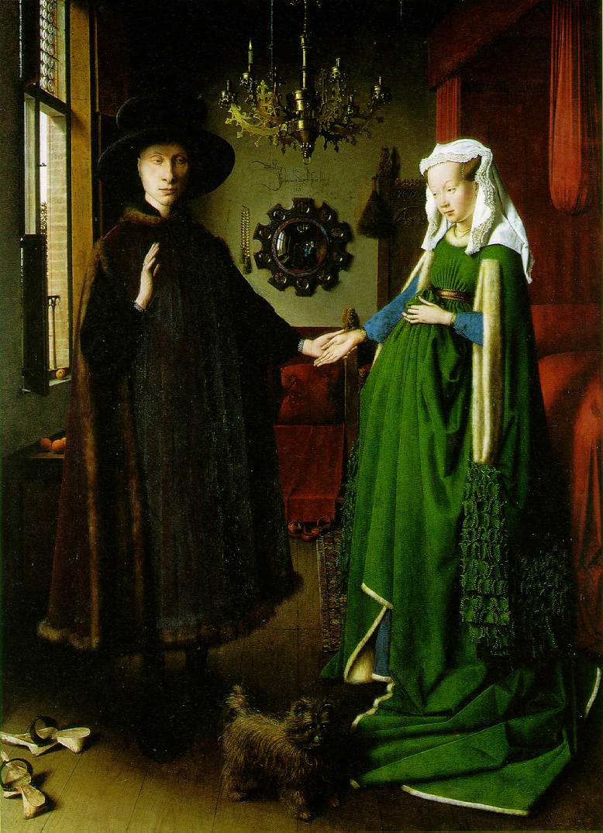

Slide 4
Look carefully at everything in the picture
Memorise it

Slide 5
What can we remember?
Now return to the picture.
Describe the possible significance of what you see in the painting.

Slide 6
Placement of the two figures
Clothing
Cherries
Patten clogs
Griffon dog
Candle
Finial
Mirror
Brush
Rosary

Slide 7
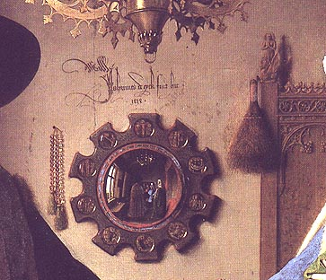
Johannes van eyck fuit hic. (was here).1434
Finial of St Margaret, patron saint of pregnancy and childbirth
Rosary and brush ora et labora (pray and work)
Two men in the background, the one in blue presumably the artist
Depictions of the Passions of Christ around the mirror

Slide 8
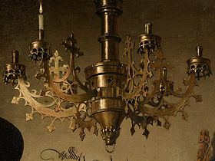
One candle alight, the other burnt out
The absent chain and pulley for lowering
Chandelier as a symbol of wealth

Slide 9
The Arnolfini Portrait (1434)
by Jan van Eyck
(1387-1441)
Bought in 1842 for £600
by the
National Gallery
Trafalgar Square
London

Slide 10
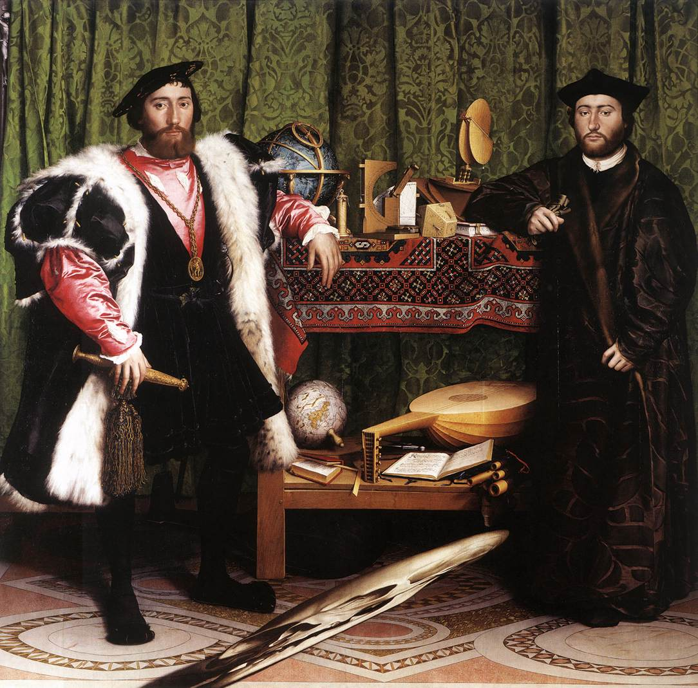

Slide 11
Look carefully at everything in the picture
Memorise it

Slide 12
What can we remember?
Now return to the picture.
Describe the possible significance of what you see in the painting.

Slide 13
Two globes
Quadrant, torquetum, sundial
Oriental carpet
Clothing (secular and clerical)
Books
Anamorphic skull
Men (bishops/ ambassadors)
Crucifix

Slide 14
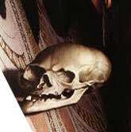

Slide 15
The Ambassadors (1533)
by Hans Holbein the Younger (1497/8-1543)
National Gallery
Trafalgar Square
London

Slide 16
Email received 17 Nov 08
Hi Sir I hope you’re well,
I was hoping that you might be able to help me, well basically the type of people I am in acquaintance with are people from private/ public schools who are studying history, English literature, philosophy, politics etc and I'm finding it really hard to keep up and participate in any interesting conversation on an intellectual level. Therefore I want to read to books, journals etc to increase my knowledge, and the only person I thought would be able to recommend a good book list to me would be you!!!!!!! I'd really appreciate it if you could spare me a couple of minutes and help me not feel like a silly billy. Thank you VERY VERY much

Slide 17
This powerpoint was kindly donated to
www.worldofteaching.com
http://www.worldofteaching.com
Is home to well over a thousand powerpoints submitted by teachers. This a free site. Please visit and I hope it will help in your teaching
Notes:
17

