Slide 1


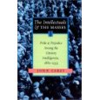
General Studies at NSG
What good are the arts?

Slide 2
A2 Scientific and Cultural Domain question:
Explain how two of the following creative activities contribute to our understanding, as well as our appreciation, of the more pleasant aspects of life such as happiness, love, beauty and friendship.
You must select two from the following:
a) architecture b) photography c) the screen d) fashion
e) sculpture f) music g) painting h) the stage i) writing
[50 marks]

Slide 3
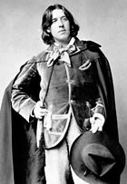
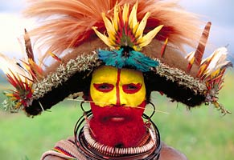
What is a work of art?
‘Art’ as we understand it did not exist before the C18th
Music, paintings and sculptures were produced by ‘artisans’ i.e. skilled tradesmen
People have always artistically decorated themselves with clothing and
makeup.
Does that mean that
everyone is an artist?
Write down your definition
of a work of art

Slide 4
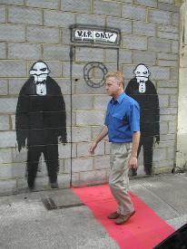
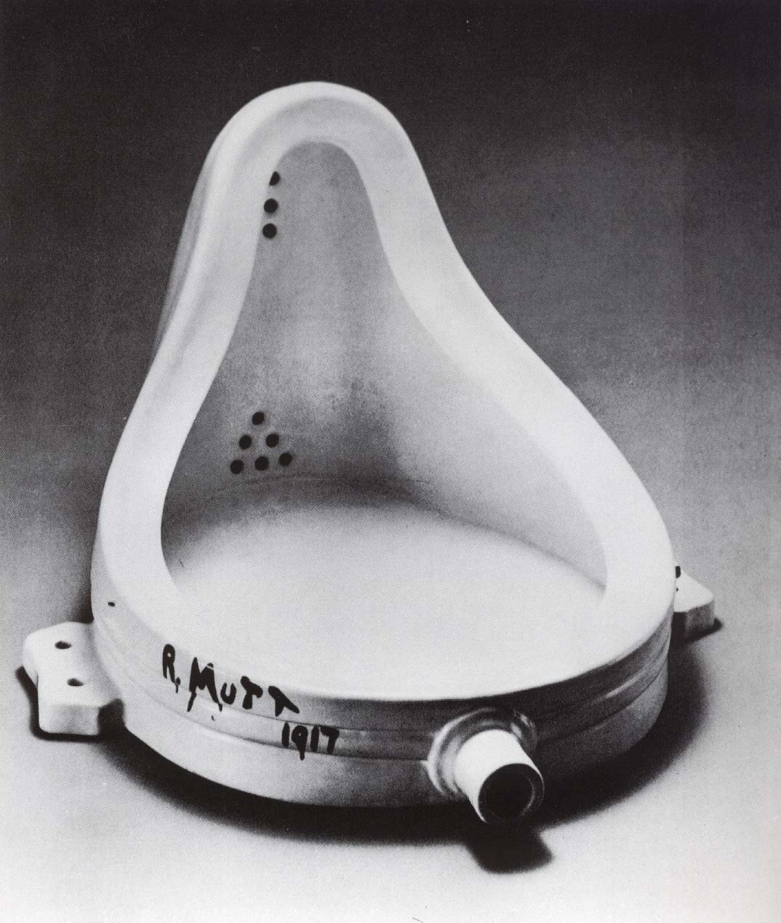
Is art only to be found in galleries, theatres and concert halls?
Do academics and critics have a greater appreciation of what is and what is not art?

Slide 5
Is ‘high’ art superior?
Add responses and supporting statements to the following:
Is opera superior to hip hop?
Are paintings in galleries superior to advertising images?
Are bronze and marble superior to pottery?
What makes Picasso with his brushes an artist but
not you with your makeup brushes?
Can ‘high art’ only be appreciated by the select few?

Slide 6

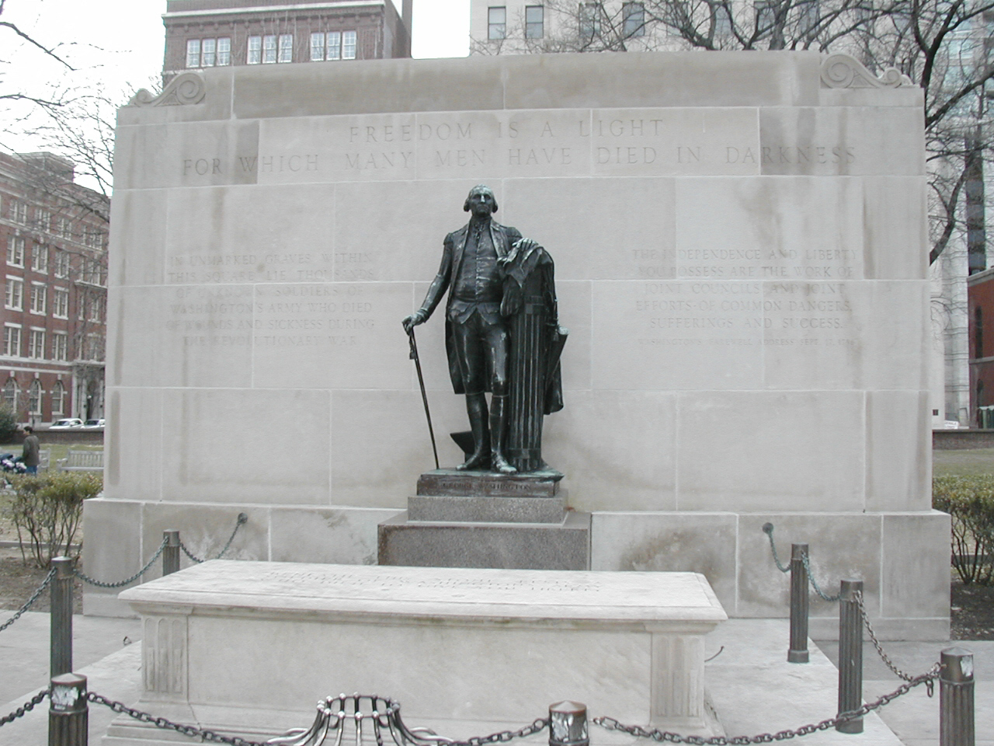
Do the arts make us better?
Does art make us more civilised, happy and loving?
Does art not just emphasize obedience, duty, service,
superiority and inferiority?
.
Nazi art
Tomb of the unknown soldier

Slide 7
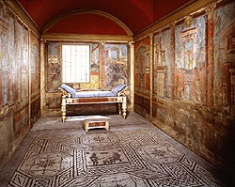
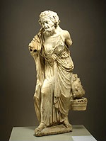
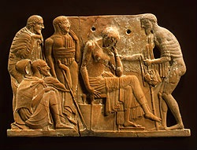
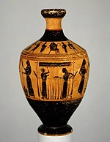
Greek and Roman art from 550 BCE to 100 AD
What purposes did it serve?

Slide 8
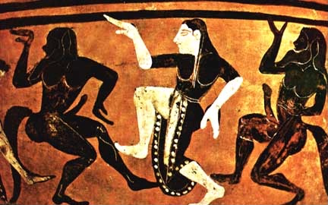
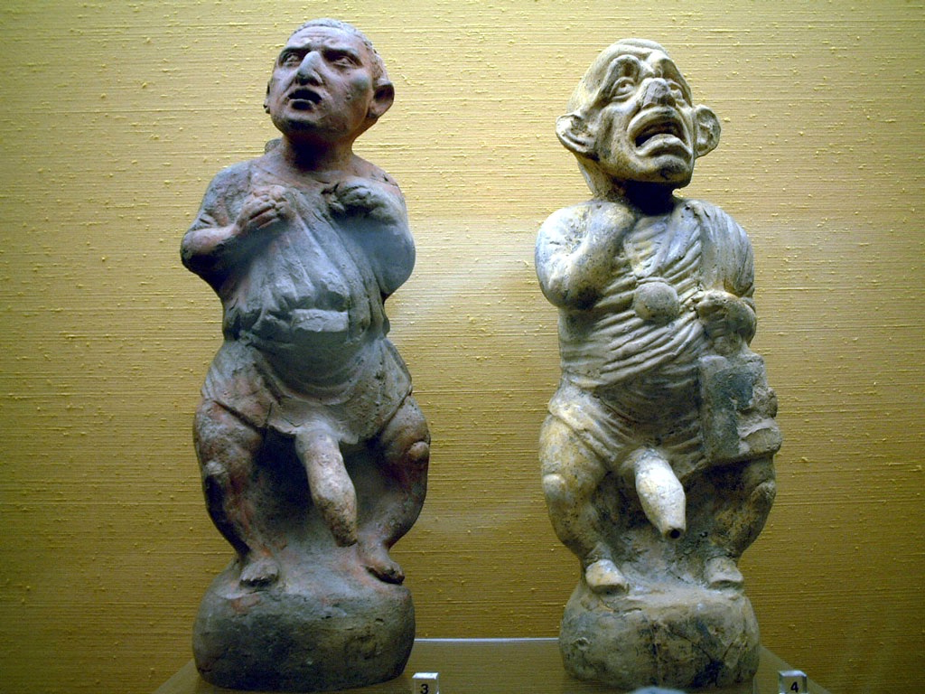

More Roman art
Is it artistic or pornographic?

Slide 9
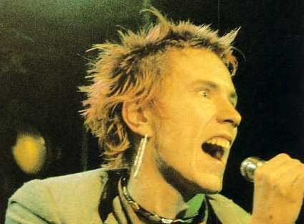
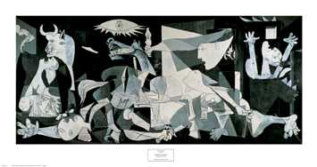
Can art lead people to behave in rebellious ways?
Should art be censored?
Can we learn important lessons from art?

Slide 10
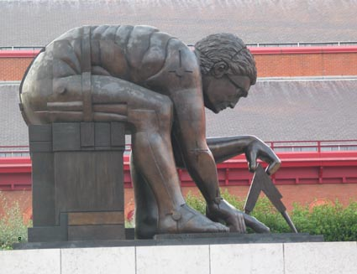
Is literature superior to the visual arts?
1. Does literature develop more complex images and ideas?
Give a response and supporting statement
2. Does a book provide better value for money?
3. Are books more accessible?
4. Is painting more immediate?
5. Is sculpture more accessible?

Slide 11
Explain how two of the following creative activities contribute to our understanding, as well as our appreciation, of the more pleasant aspects of life such as happiness, love, beauty and friendship.
HAPPINESS LOVE BEAUTY FRIENDSHIP
MUSIC
PAINTING
SCULPTURE
SCREEN
WRITING
Feed back!
What is your definition of a work of art?

Slide 12
Q: What is a work of art?
One answer is: ‘A work of art is anything that anyone has ever considered a work of art.’
John Carey, formerly Merton Professor of English, Oxford University
Your definition is correct!

Slide 13
This powerpoint was kindly donated to
www.worldofteaching.com
http://www.worldofteaching.com
Is home to well over a thousand powerpoints submitted by teachers. This a free site. Please visit and I hope it will help in your teaching
Notes:
13

