Slide 1
Greek Cultural Contributions
Religious Practices
Theater
Science/Philosophy
Discoveries/Inventions

Slide 2

www.mythweb.com
Go to this website to learn more about Greek gods and heroes.

Slide 3
Olympics - to honor Zeus
Boxing - fought until one was knocked out or gave up
Equestrian Events - chariot racing and riding - jockeys rode without stirrups
Pankration - boxing and wrestling
Pentathlon - combination of 5 events: discus, javelin, jumping, running, wrestling
Running - 4 types of races
**Jumping - they carried stone or lead weights

Slide 4
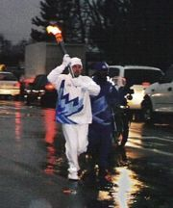

Slide 5
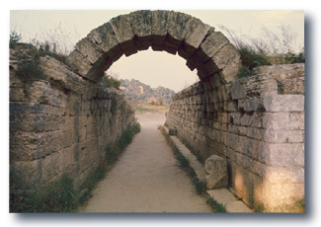
Entrance to the Olympic Stadium
At Olympia

Slide 6
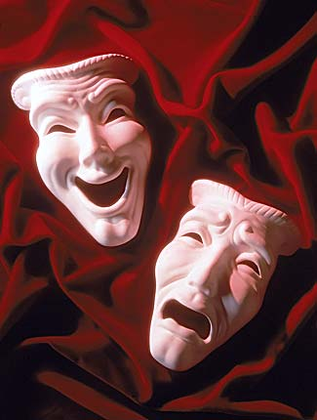

Slide 7
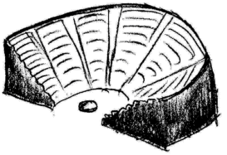
Theater
Ancient Greek theater has been fascinating. Aeschylus, Sophocles, Euripides, Aristophanes and others, have been the teachers of morality, nobleness, courage and patriotism across the centuries.
Theater originated as a festival to the god Dionysus, the god of joyous life and hospitality.

Slide 8
Tragedy
set in the past
relationships between people and gods
not all had unhappy endings
though people suffered, most still carried on despite their suffering

Slide 9
Writers of Tragedy
Aeschylus - wrote about power and its effect on people
Sophocles - suffering was due to sins and mistakes and suffering could make someone a better person
Euripides - people suffered because they did bad things

Slide 10


Slide 11
Comedy
set in the present
had a happy ending
poked fun at certain politicians in the audience (not the brightest idea!)
later poked fun at a certain kind of person

Slide 12
Writers of Comedy
Aristophanes - found something funny about every one
Did you know that the first Shrek movie followed the rules for Shakespearean and ancient Greek comedy? Check it out.

Slide 13
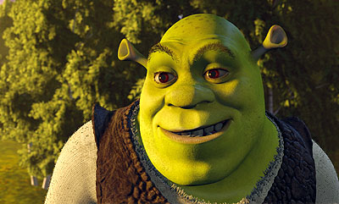

Slide 14
Shrek
A typical comedy:
• contains comic devices such as puns (Donkey calls Shrek “really tall” instead of “ogre”), slapstick antics (Shrek’s wax, mud shower, barrel, Donkey can fly), misunderstandings (Shrek thinks Fiona can’t stand him, Fiona thinks a handsome prince rescued her), mistaken or hidden identities (Shrek is not a handsome prince, the dragon is nice, Fiona is an ogre) and eavesdropping (Shrek overhears Fiona and Donkey talking).
• is set (at least in part) in the country, which is often depicted as a magic, idealized place (coming back from rescuing Fiona, Shrek’s swamp).

Slide 15
Shrek - a classic comedy
• has shepherds, farmers and other middle-class people as characters (though it may have royal and upper-class characters, as well) - (townsfolk, soldiers, Monsieur Hood, fairy tale characters, ogre/hero, prince/villain).
• opens by showing the hero in some kind of distress, troubled by a problem and trying to figure out a way to solve it (fairy tale characters move to Shrek’s swamp after being evicted, he wants them to leave).

Slide 16
Shrek - a classic comedy
• criticizes society or specific people in society in a funny way (prince is small and compensates for his size with gigantic surroundings).
• ends with the hero’s triumph (Shrek gets Fiona and his swamp back).
• frequently closes with a scene in which a wedding or another type of celebration takes place (Shrek marries Fiona).
• ends with the reestablishment of order and a sense that a new “golden age” is beginning (song “I’m A Believer,” prince is killed, soldiers become nice, Shrek and Fiona ride off in a carriage, - they all lived happily ever after).

Slide 17
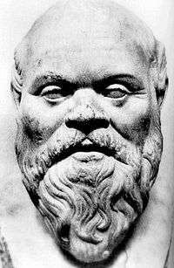
Science/Philosophy
Science - studying the laws of nature; scientists
Philosophy - loving wisdom; philosophers
Together they were called philosophia
Socrates (below)

Slide 18
Socrates
History for kids
Go to this website:
www.historyforkids.org/learn/greeks/philosophy/socrates.htm

Slide 19
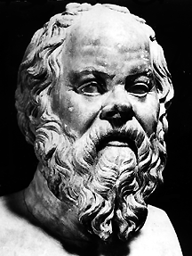
Socrates
This is supposed to be of Socrates,
but it was made after he had already been dead for some time,
by someone who did not know what Socrates looked like.
He believed people could discover truth if they knew how to think.
Plato was his pupil.

Slide 20
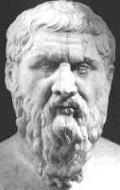
Plato
A student of Socrates
His school was called the Academy
He wrote The Republic about an ideal state
Truth could be found after a long, hard search
One of his brightest pupils was Aristotle

Slide 21
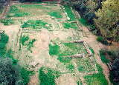
Plato’s Academy

Slide 22
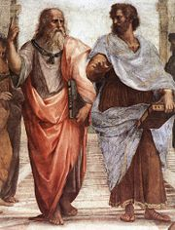
Plato and Aristotle

Slide 23
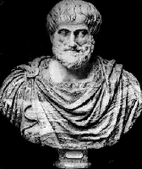
Aristotle
Pupil of Plato
“the master of them that know”
Provided the third step to the scientific method - testing the hypothesis
Developed the syllogism
Taught Alexander the Great
First to classify plants and animals

Slide 24
Discoveries/Inventions
Natural events are not caused by the way the gods behave
The world is governed by natural laws
They predicted the eclipse of the sun
They believed diseases came from natural sources
Hippocratic Oath: doctors should honor their teachers, do their best for the sick, never give poisons and keep the secrets of their patients

Slide 25
The end.

Slide 26
