Slide 1


Psychology Sociology General Studies
The High
Price of Materialism
Adapted from the work of
Prof Tim Kasser,
Knox College, Illinois

Slide 2
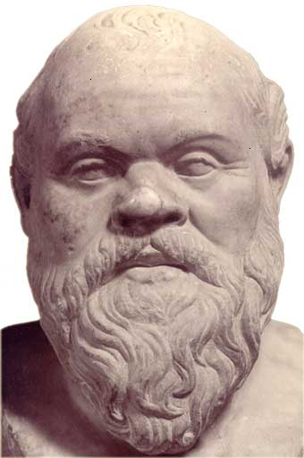
Socrates (B.C. 469-399)
He who is not contented with what he has, would not be contented with what he would like to have.
Contentment is natural wealth; luxury, artificial poverty.

Slide 3
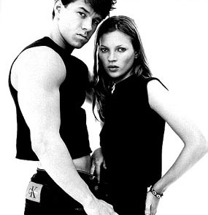

Advertisements

Slide 4
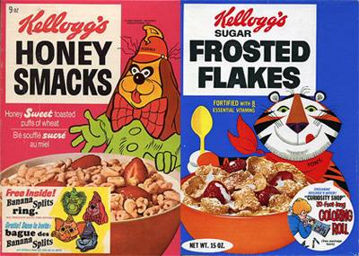

Advertisements
It starts like this ….and ends like this

Slide 5
Politics of Materialism
“…the American people have got to go about their business. We cannot let the terrorists achieve the objective of frightening our nation to the point where we don’t conduct business, where people don’t shop.”
George W Bush quoted in The New York Times, October 12, 2001

Slide 6
Corporate Power
In 2000, 52 of the largest 100 economic organizations in the world were not nations, but corporations

Slide 7
The Power of Materialism
The percentage of incoming American First-year college students reporting it is “very important” or “essential” to be “financially well-off”:
  42% in the mid 1960s
  75% in the mid 2000s

Slide 8
The Message of Materialism
You can purchase happiness
It is important to work and consume
Life is meaningful and people are successful to the extent they have money, possessions, and the right image

Slide 9
Is this true?
Psychological costs?
Social costs?
Ecological costs?

Slide 10

Psychological Costs

Slide 11
Diminished Happiness
Higher Materialism:
  Anxiety
  Depression
  Physical Symptoms
  Unpleasant emotions
  Drug & Alcohol Use
Lower Materialism
  Self-actualization
  Vitality
  Life Satisfaction
  Pleasant Emotions
Activity: Youtube and Google: ‘Reverend Billy and the Church of Stop Shopping’ and ‘Adbusters’

Slide 12
A meta-analysis of 170 studies of students and 99 studies of children showed that between 1952 and 1993 there was an increase of almost a full standard deviation in anxiety among both college student and child samples.
The 1990s median anxiety level was equivalent to the 84th percentile in the 1950s.
"The average American child in 1980 reported more anxiety than child psychiatric patients in the 1950s."
Twenge JM. The age of anxiety? Birth cohort change in anxiety and neuroticism, 1952-1993. Journal of Personality and Social Psychology 2000; 79(6): 1007-21.

Slide 13
Flow model
• The universe was not built for our happiness we have to make it happen
• Optimal experiences involve control and mastery
• Flow experiences lead to growth
• Flow experiences relate to sex, work, friendship, sport, interests and lifelong learning
“…being completely involved in an activity for its own sake. The ego falls away. Time flies. Every action, movement, and thought follows inevitably from the previous one, like playing jazz. Your whole being is involved, and you're using your skills to the utmost."
Mihaly Csikszentmihalyi
(pronounced chick-sent-me-high-ee)

Slide 14

Social Costs of Materialism

Slide 15
Social Behavior
Less pro-social and more anti-social behavior
Less empathy
More competitive and less cooperative
Decreased sharing and generosity
Less social capital

Slide 16
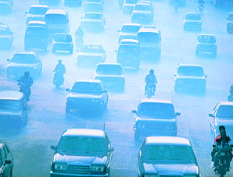
Ecological Costs

Slide 17
Ecological Behaviour
Care less about the environment
Fewer pro-environmental activities
More greed, consumption and waste
Higher Ecological Footprints

Slide 18
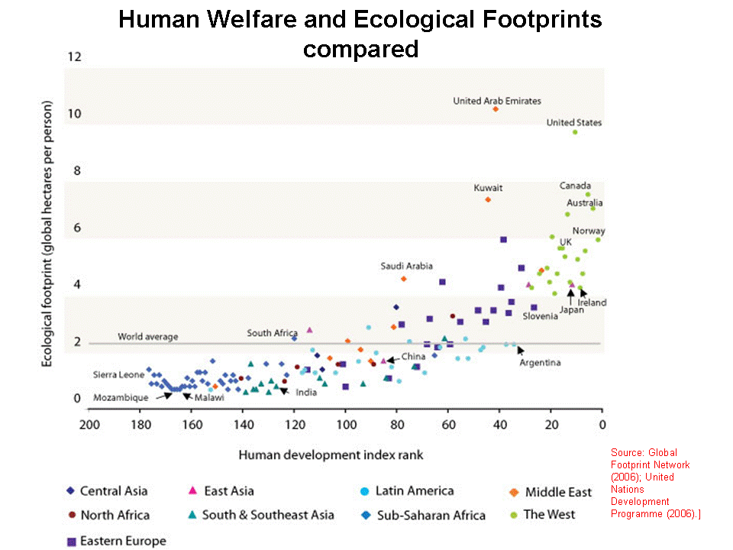

Slide 19
A Problem of Values
Organization of Values and Goals
Circumplex models
  Adjacent goals are consistent
  Opposing goals are conflictual
Same basic pattern across multiple studies in dozens of nations

Slide 22
Grouzet et al., 2005, JPSP

Slide 23
Intrinsic Values
Self-acceptance
  “I will follow my interests and curiosity where they take me.”
Affiliation
  “I will express my love for special people.”
Community Feeling
  “I will help the world become a better place.”

Slide 24

Psychological Benefits
More happiness
More life satisfaction
Higher vitality
Less depression
Less anxiety
Fewer physical symptoms
Live longer

Slide 25
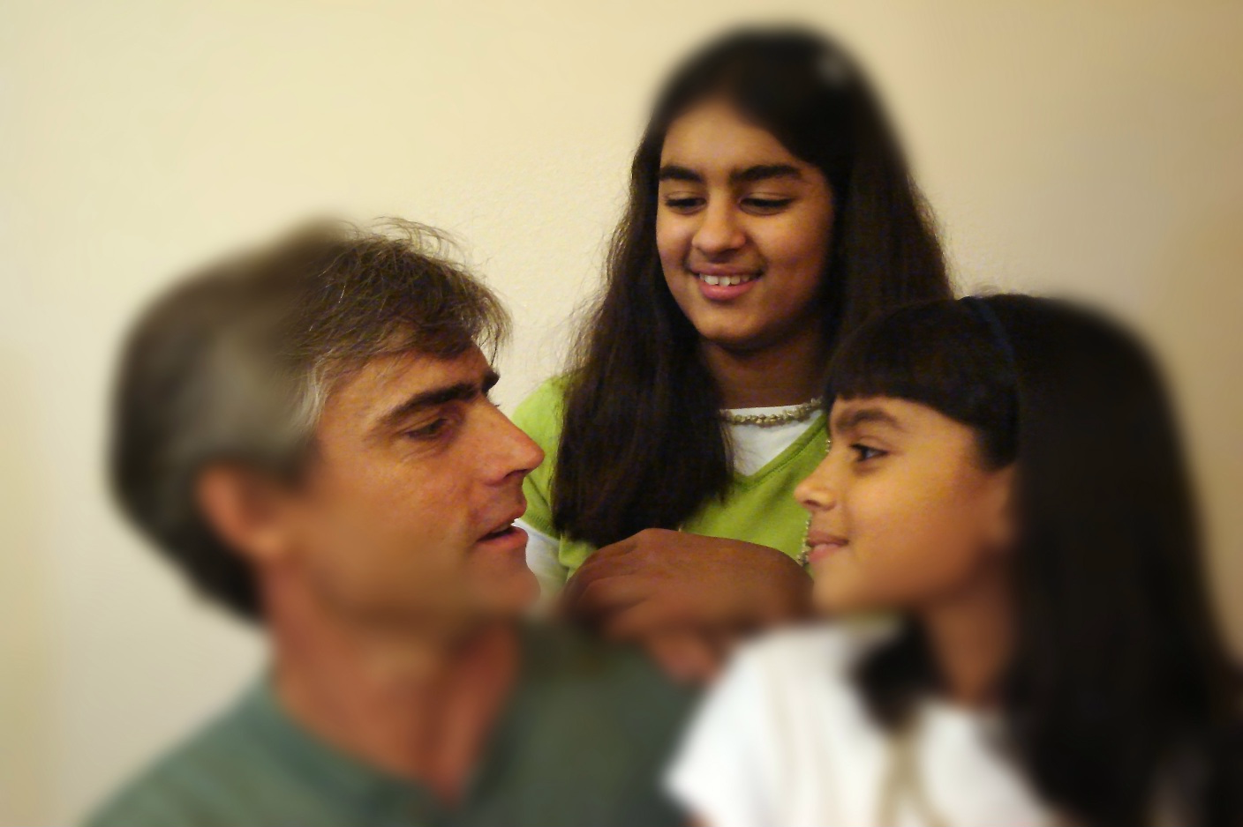
Social Benefits
More pro-social behaviour
More empathy
More cooperation
Less anti-social behaviour

Slide 26

Ecological Benefits
More environmentally friendly behaviour
Lower Ecological Footprint
Less consumption

Slide 27
Policies for Change
Educate people about happiness, values, & ecology
Educate people about debt (in the US, which tends to lead European trends, the share of credit card to total debt is now approaching 50%, and in the UK the share is 30% and growing)
Encourage participation in physical activities and sport…flow

Slide 28
Time Affluence
Time Poverty in America
  Americans work 160 hours per year more than 30 years ago
  Americans work 9 weeks more per year than most Europeans
Less time available for personal interests, family, and community

Slide 29
Ecological Benefits of
Time Affluence
“If, by 2050, the world works as many hours as do Americans, it could consume 15-30 percent more energy than it would by following Europe. The additional carbon emissions could result in 1 to 2 degrees Celsius in extra global warming.”

Slide 30
Time Affluence - Policies
Provide more family leave
Pass minimum vacation laws
Enforce overtime legislation
Recommend shorter working weeks
Reduce housing costs

Slide 31
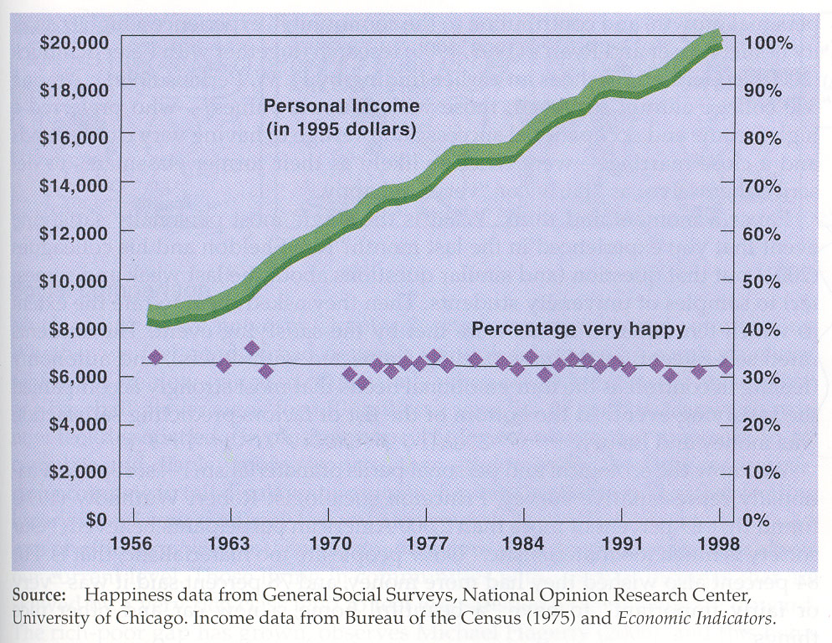

Slide 32
Revolution of Values
Necessity of changing lifestyles and social practices
Policies needed to:
  Decrease emphasis on materialism
  Increase opportunities for expressing intrinsic values

Slide 33
Thirteen suggested steps for enhancing happiness
1 Be active 7 Be positive
2 Be outgoing 8 Be aware
3 Be flexible 9 Be a problem solver
4 Be passionate 10 Be a sensory seeker
5 Be compassionate 11 Be connected
6 Be focused 12 Behave in a happy manner
13 Turn off the TV
Write down what you could do to achieve all 13. Report back.

Slide 34
This powerpoint was kindly donated to
www.worldofteaching.com
http://www.worldofteaching.com
Is home to well over a thousand powerpoints submitted by teachers. This a free site. Please visit and I hope it will help in your teaching
Notes:
34

