Slide 1

General Studies at NSG Do we really need a government?

Slide 2
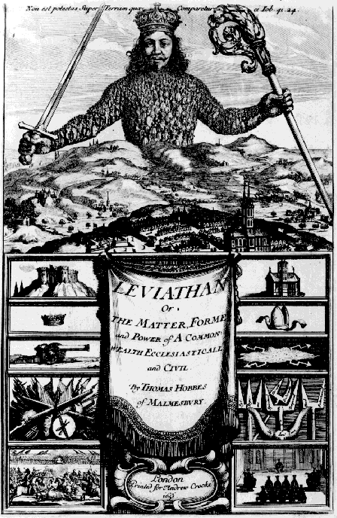
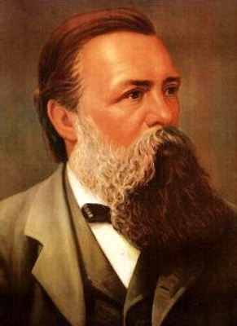
General Studies at NSG
Thomas Hobbes
‘The Leviathan’ (1651)
Friedrich Engels ‘Origins of the
Family, Private Property and
the State’ (1884)

Slide 3
Hobbes’ question
How is social order possible?
Hobbes aimed to produce evidence for why we need a government based on rational argument and evidence without reference to the ‘divine right of kings’

Slide 4
Hobbes’ assumptions:
All men seek to avoid death and injury
Because men want a happy life, they seek sufficient power to ensure that happy life
All men have a ‘restless desire for power’
This leads to an ‘equality of hope in the achieving of our aims’

Slide 5
Hobbes’ assumptions:
Without a power able to enforce rules, there is chaos and misery
3 causes of conflict
men fight for gain
men fight for security
men fight for reputation

Slide 6
Implications
Everyone is pulled into a constant competitive struggle for power
the natural state of man is a war of all against all (‘the state of nature’)
People are insecure, and live in a constant fear of injury and death
There is no place for industry in the state of nature, because the fruit of it is uncertain. Hence, no agriculture, navigation, building, culture, science
Life in a state of nature is
"solitary, poor, nasty, brutish, and short"

Slide 7


Hobbes’ evidence to support his assumptions
The fact that people lock their doors
provides support for Hobbes’ view that
people are naturally inclined to fight each other.

Slide 8
Hobbes’ solution
Under these conditions, how can social order be achieved?
In the state of nature, people have liberty
Since man is rational, he will never use his power to harm himself
Man will try to achieve peace only if he is convinced that everyone else will do the same

Slide 9
How to make sure that everyone would seek peace?
No use for everyone to merely agree to give up their individual freedom and power (‘sovereignty’) because people would cheat whenever it was to their advantage
They would have to transfer power to some sovereign state (‘the Leviathan’) which could make an agreement stick by having the authority to maintain order and use force against all lawbreakers

Slide 10
Hobbes’ conclusion:
Government is necessary if :
People are not to live in a state of nature
People are to pursue individual happiness
People are to engage in industry and commerce
People are to sleep safely in their beds

Slide 11
Engels’ question: What are the origins of the state?
Assumptions:
Before the development of private property there was no need for a state
People lived in cooperative groups in ‘primitive communism’
N.B. Anthropological evidence seems to support Engels’ not Hobbes’s assumptions

Slide 12
Engels (1820-95) on the state
Like Hobbes, Engels’ views the state as necessary for social order
However, for Engels the state´s role is different
It creates social order by regulating conflict between competing classes
The state functions to benefit the whole of the ruling class by maintaining the status quo at the expense of the ruled

Slide 13
How do Marx and Engels define classes?
Classes are by their relation to the means of production:
Owners and controllers of the means of production ( ‘bourgeoisie’ )
Non-owners of the means of production who have ‘nothing to sell but their labour power’ (‘proletariat’)

Slide 14
How the state produces social order
It represents the interests of the ruling the bourgeoisie as against the proletariat through:
laws, coercion, force, ideology, religion, education, mass media, social division,
individualism, consumerism, competition

Slide 15
Under communism, however
The state will ‘wither away’
Production will take place to meet the needs of everyone rather than to make profits for a ruling minority
Cooperation will prevail
No need for war (nor locking your door)

Slide 16
Conclusions
Hobbes sees the state as representing everyone’s interests, it is therefore an agency for peace
Engels sees the state as representing the interests of the ruling class, it is therefore a tool in class conflict

Slide 17
This powerpoint was kindly donated to
www.worldofteaching.com
http://www.worldofteaching.com
Is home to well over a thousand powerpoints submitted by teachers. This a free site. Please visit and I hope it will help in your teaching
Notes:
17

