Slide 1

Idiom Dictionary
Isabelle Evans
Gwin Oaks Elementary
Media Festival
2007

Slide 2
What is an idiom?
An idiom is an expression whose meaning cannot be understood based on the definition of its constitutional elements

Slide 3

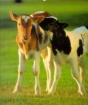
He spilled the beans
He told the secret

Slide 4


Get off my back!
Leave me alone!

Slide 5
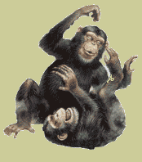
We were in stitches!
We were laughing very hard!

Slide 6
He kicked the bucket!
He died

Slide 7
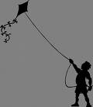

Go fly a kite!
Go away!

Slide 8
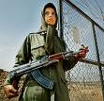

She was dressed to kill
She was dressed in her finest clothing

Slide 9
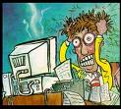

I’m at the end of my rope!
I am so-o-o frustrated!

Slide 10


You have to bite the bullet
You need to put up with this difficult situation

Slide 11

Teachers always stick to their guns
Teachers never change their opinions

Slide 12
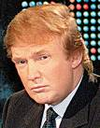
Money talks
Money influences a lot of people.
Have you heard about that new TV?

Slide 13
So I hope you enjoyed my idiom presentation because I…
bent over backwards to do it for you!

Slide 14
This powerpoint was kindly donated to www.worldofteaching.com
http://www.worldofteaching.com is home to over a thousand powerpoints submitted by teachers. This is a completely free site and requires no registration. Please visit and I hope it will help in your teaching.

