Slide 1
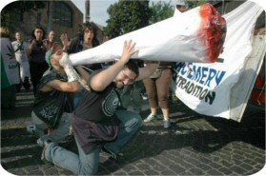

Illegal drugs
Marijuana – otherwise known as ‘dope,’ ‘weed,’ ‘hash,’ ‘skunk,’ ‘grass,’ ‘solid’etc.
Do you know what class of drug the Government classifies marijuana as?
That’s right, Class C. What would happen to you if the police caught you in possession of this substance?
Do you know how long-term use might affect you?
From where is this drug
extracted?

Slide 2
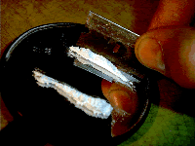
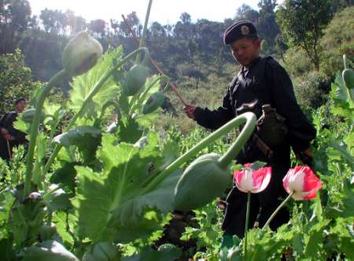
Cocaine
What Class of drug is this?
Is it addictive?
From where is it extracted?
What are it’s affects, and
what dangers
does it hold for
users?
How is it usually
taken?

Slide 3
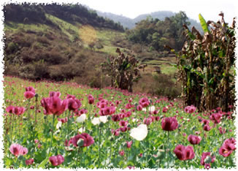
Heroin
From which plant is this drug extracted?
What class is this drug?
Do you know it’s affects?
Is it addictive, and what
are it’s long-term affects?

Slide 4
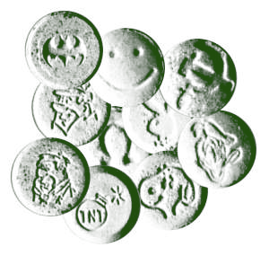
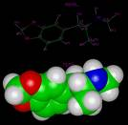
Ecstasy
What class is this drug,
and what type of people
use it?
Does it kill more people than, for example, alcohol?
How much does a typical tablet cost?
What dangers can you think of in buying Ecstasy?

Slide 5
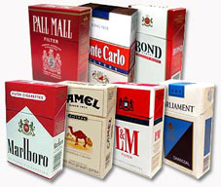
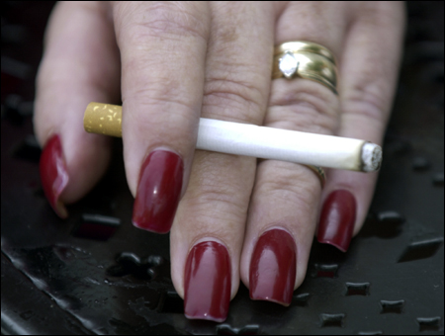
Cigarettes
Do any of you, your
friends or parents smoke?
What brands can you name?
Should the smoking age be raised? What is it now?
What law related to smoking was recently passed in Scotland? Do you think it is a good law?
What health dangers are there in
smoking? Is there a safe level? Is it
More, or less dangerous than, say, heroin?

Slide 6
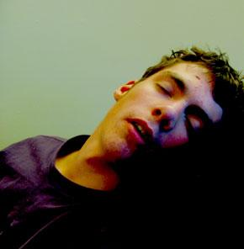

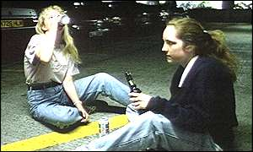
Alcohol
When did you first taste an alcoholic drink? What did you think of it?
What health dangers are related to over-drinking?
When is it legal to drink in Scotland? Is it the same throughout the world? Do you think it ought to be lowered, or perhaps raised?
Is alcohol too cheap? Would higher prices discourage young drinkers from over-indulging?
Some facts; the effects of alcohol cost the NHS £1.7 billion per year.
Q.How many drink-drive accidents take place every month?
A.80,000!
Q. Is alcohol cheaper, or more
expensive than it was in 1980?
A. 54% cheaper!

