Slide 1
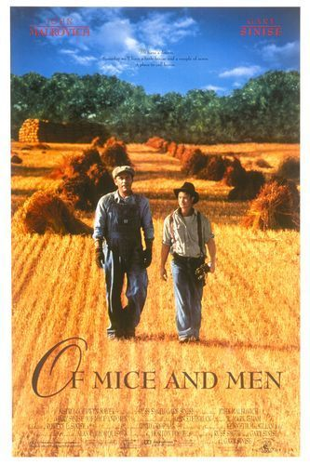
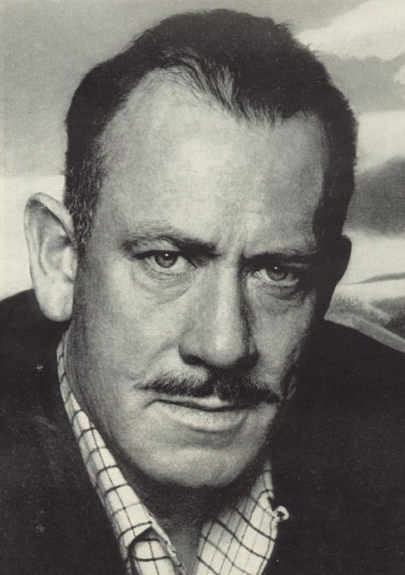
Of Mice and Men
By John Steinbeck

Slide 2
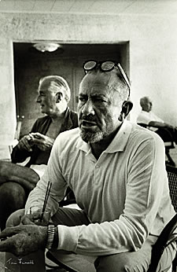
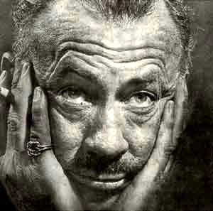
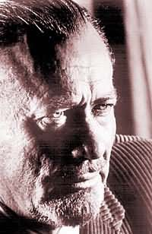
John Steinbeck One of The Great American Writers of the 20th Century

Slide 3
A Look at the Author
Born February 27th in 1902 in Salinas, California,
John was the third of four children, and the only son.
During his childhood, Steinbeck
learned to appreciate his surroundings,
and loved the Salinas countryside and
the nearby Pacific Ocean; it would be
this appreciation that would later come
out in his writing.
Steinbeck worked during his summers as a hired
hand in nearby ranches.

Slide 4
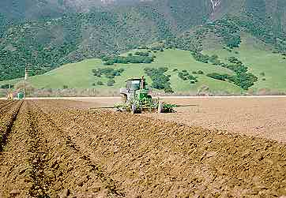
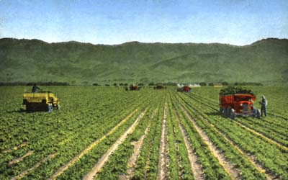
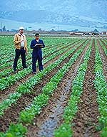
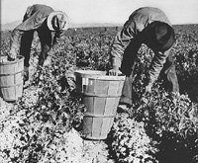
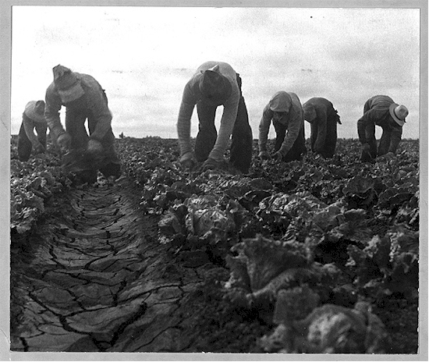
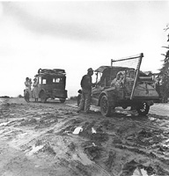
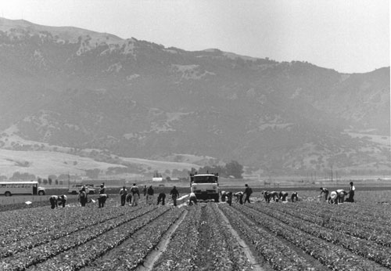
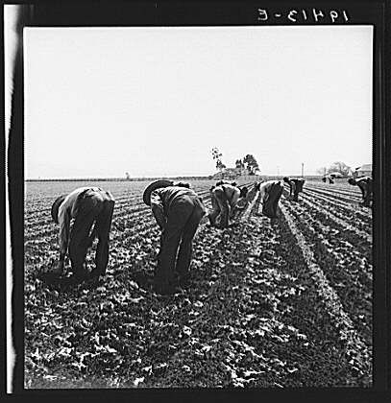
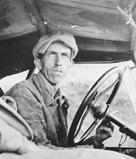
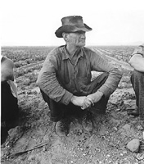
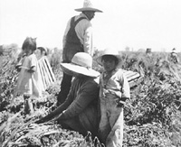
The Fields of Salinas, California

Slide 5
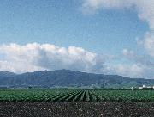
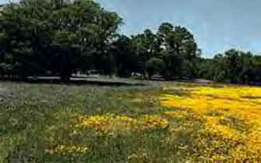
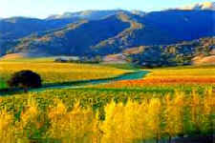
The Beauty of Salinas
Rich, fertile soil

Slide 6
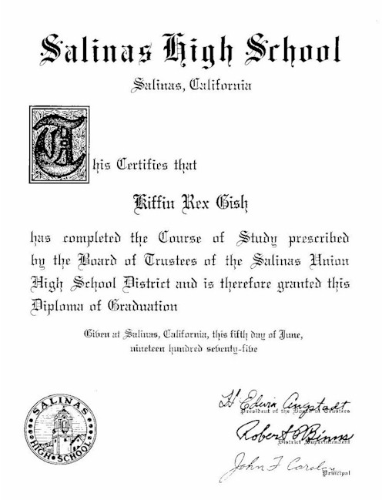
At the age of 14 he decided to be a writer
and spent a lot of time writing in his room.
In high school, Steinbeck did well in English
and edited the school yearbook.
From 1919-1925 Steinbeck attended Stanford
University to please his parents, but only chose
courses that interested him, classical and British
Literature, writing courses, and an odd science
course.
However, Steinbeck did not receive a degree because he would drop in and out of school, sometimes to work with migrant workers and bindlestiffs on California ranches.

Slide 7
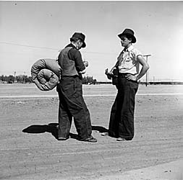
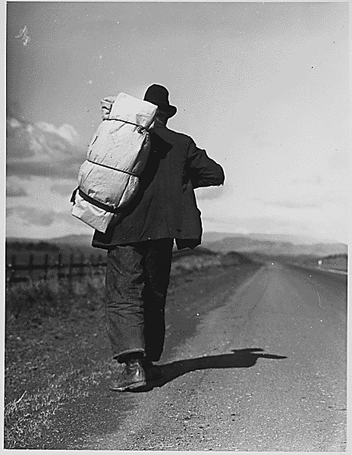
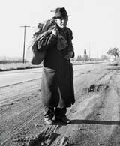
What’s a Bindlestiff?
A hobo, especially one who carries a bedroll.

Slide 8

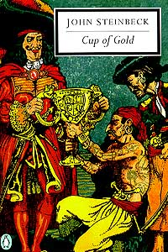




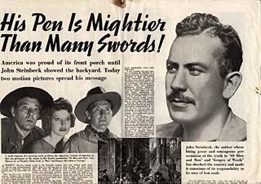
During the late 1920s and 1930s, he concentrated on writing and wrote several novels set in California.
Steinbeck gained
great success by
readers and critics.

Slide 9
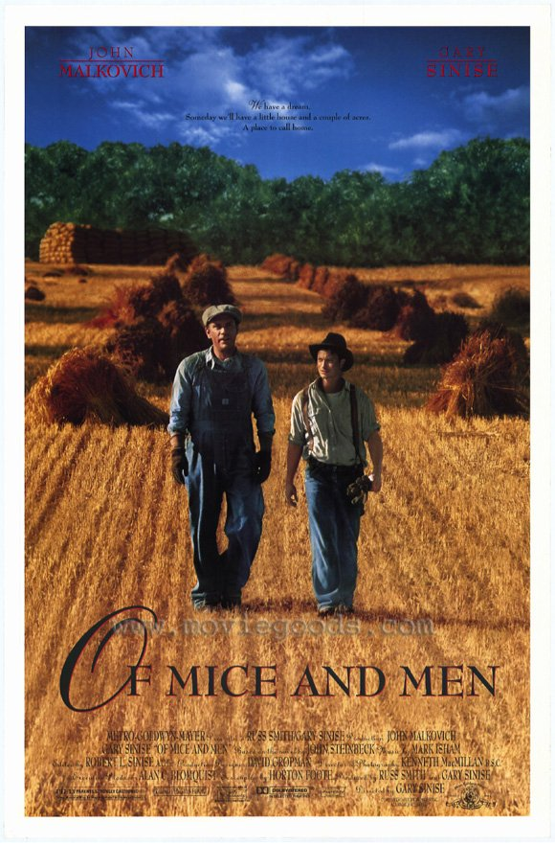
In 1929, he published his first novel, Cup of Gold
In 1930, Steinbeck married Carol Henning, and they
moved into his family’s home. His father helped support
the struggling couple, but unfortunately, they divorced in
1942.
In 1935, he won his first literary prize,
Commonwealth Club of California
Gold Medal for Best Novel by a
Californian for his novel, Tortilla Flat.
In 1936, Of Mice and Men was published,
and was so widely accepted that Steinbeck
began a book tour that led him to Europe.

Slide 10
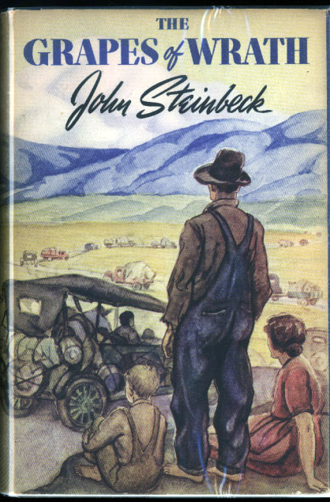
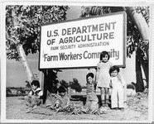
In 1939, The Grapes of Wrath
was published and became an
instant best-seller; in 1940 it was
awarded the Pulitzer Prize, one
of the most prestigious literary
awards in the world.
This novel, just like Of Mice and Men,
stemmed from his experience working
among migrant workers.
Steinbeck’s experiences in the fields
researching migrant workers led him to
have more compassion for these workers,
and stirred up his concern for social
justice.

Slide 11


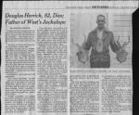
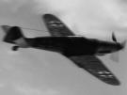

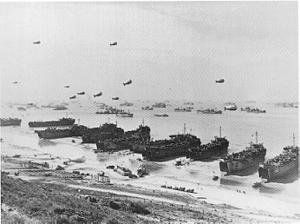
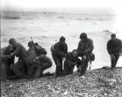
In 1943 he married Gwendolyn
Conger who would father him two
sons before their divorce in 1948.
In 1943 Steinbeck
worked as a war corre-
spondent for the New
York newspaper, Herald
Tribune.

Slide 12
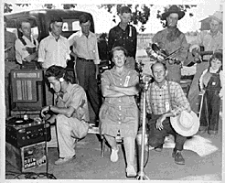
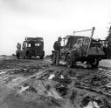

While living in Monterey, California, Steinbeck said that he felt unwelcome as no one would rent him an office for writing, and he was harassed when trying to get fuel and wood from a local wartime rations board.
Steinbeck wrote that his old friends did not want to be around him, partly because of his works, and partly because he was so successful: “This isn't my country anymore. And it won't be until I am dead. It makes me very sad.” He left Monterey the next year and moved to New York.

Slide 13
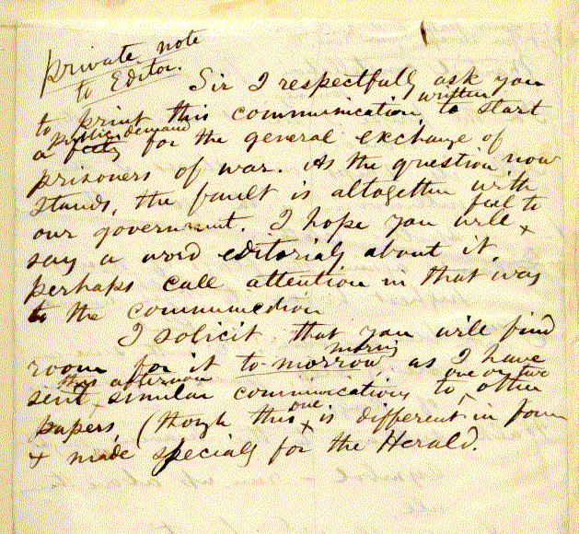
In 1948 he moved back to Monterey. A year later he met Elaine Scott, who in 1950 became his third wife.
Although he continued to write and publish, he never felt at ease in his life, and once wrote to an aspiring writer from Salinas:
“Don't think for a moment that you will ever be forgiven for being what they call ‘different.’ You won’t! I still have not been forgiven. Only when I am delivered in a pine box will I be considered ‘safe.’ After I had written the Grapes of Wrath the librarians at the Salinas Public Library, who had known my folks remarked that is was lucky my parents were dead so that they did not have to suffer this shame.”

Slide 14

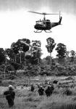


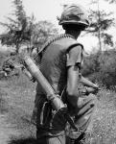



One of Steinbeck’s two sons fought in the Vietnam War, while Steinbeck himself was in Asia covering the war for Newsday, a Long Island newspaper.
Steinbeck lost a number of friends
during the anti-war movement due to
his open support of the war and
America’s involvement.

Slide 15
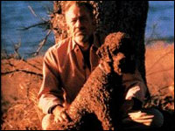


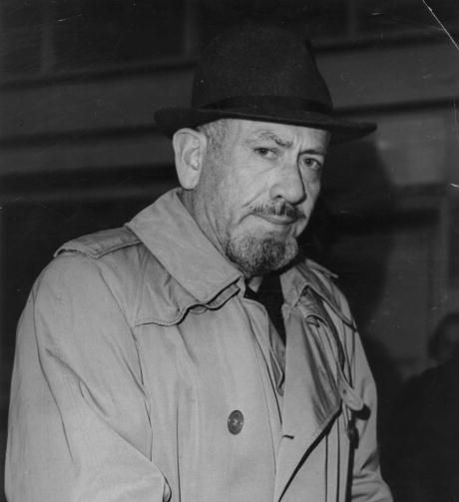
Steinbeck’s last two books were nonfiction.
Travels with Charley in Search of America was an account of his trip from Maine to California with his poodle, Charley.
His final book, America and the Americans, was about his belief that in time, America would once again feel united.

Slide 16


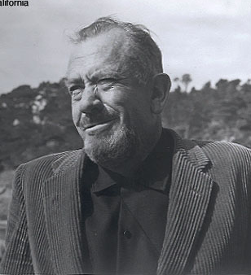
John Steinbeck died on December 20, 1968, at his apartment in New York City.
His wife took him home to Salinas to be buried near the land that he spent his life writing about.

Slide 17
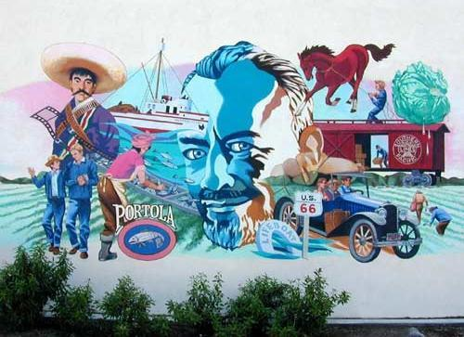
Mural overlooking The National Steinbeck Center in Salinas

Slide 18
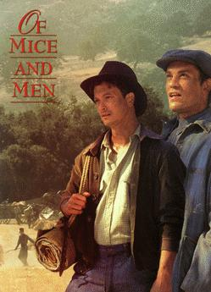

Slide 19
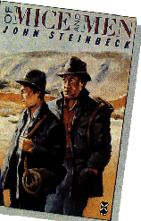
The Book
Of Mice and Men was originally called Something That Happened.
When Steinbeck first thought of the idea for the book he intended it to be for children. Steinbeck told a friend that he was experimenting with a new “dramatic form.”
In May 1936, he wrote a manuscript, but his puppy (a setter called Toby) ate it!
He said of the book:
"It is an experiment and I don't know how successful."

Slide 20
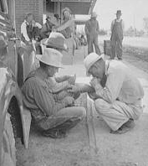
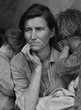
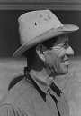
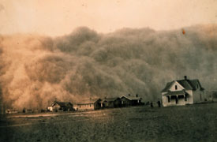
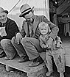
Of Mice and Men
The novel deals with the issues dear to Steinbeck’s heart - poverty, homelessness, the exploitation of itinerant workers, the failure of the Dream, America’s general moral decline.

Slide 21
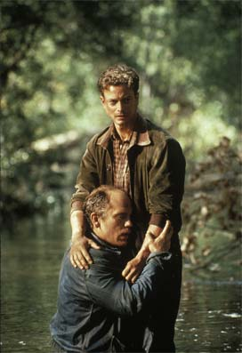
Main Characters: Lennie & George

Slide 22
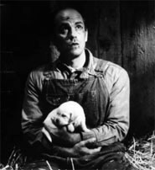


Lennie Small
Lennie is a large, lumbering, childlike migrant worker. Due to his mild mental disability, Lennie completely depends upon George, his friend and traveling companion, for guidance and protection. The two men share a vision of a farm that they will own together, a vision that Lennie believes in wholeheartedly. Gentle and kind, Lennie nevertheless does not understand his own strength. His love of petting soft things, such as small animals, dresses, and people’s hair, leads to disaster.

Slide 23




George Milton
George is a small, wiry, quick-witted man who travels with, and cares for, Lennie. Although he frequently speaks of how much better his life would be without his caretaking responsibilities, George is obviously devoted to Lennie. George’s behavior is motivated by the desire to protect Lennie and, eventually, deliver them both to the farm of their dreams. Though George is the source for the often-told story of life on their future farm, it is Lennie’s childlike faith that enables George to actually believe his account of their future.

Slide 24
Introduction
George and Lennie go to a ranch near Salinas, California, to
work. George is Lennie’s keeper, and Lennie imitates
everything that George does. Lennie previously had been
kicked out of a town for grabbing a girl’s dress. He simply
liked to touch soft items. That is also the reason that he has
a dead mouse in his pocket: Lennie petted him too hardly.
George promises Lennie that some day they will have their
own farm and raise rabbits as well as other animals.

Slide 25


The setting in Of Mice and Men
The novel is set in the farmland of the Salinas valley, where John Steinbeck was born.
The ranch in the novel is near Soledad, which is south-east of Salinas on the Salinas river.
The countryside described at the beginning of the novel, and the ranch itself is based on Steinbeck’s own experiences.

Slide 26



Soledad, California

Slide 27



California in the 1930s

Slide 28





Why Migrant Workers?
Before technology created farm machinery, humans had to do a lot of the farm work by hand.
Between the 1880s and the 1930s, thousands of men would travel the countryside in search of work.
Such work included the harvesting of wheat and barley.

Slide 29



Migrant Workers
These workers would earn $2.50 or $3.00 a day, plus food and shelter.
During the 1930s, the unemployment rate was high in the U.S., and with so many men searching for work, agencies were set up to send farm workers to where they were needed.
In the novel, George and Lennie (the two main characters) were given work cards from Murray and Ready’s, which was one of the farm work agencies.

Slide 30

Chasing the American Dream
“Give me your tired, your poor, your huddled masses yearning to breathe free, the wretched refuse of your teeming shore.
Send these, the homeless, tempest tost to me,
I lift my lamp beside the golden door.”
( Emma Lazarus)
Written on the base of the Statue of Liberty

Slide 31


The American Dream
You can be successful if you work hard and live morally.
America is the land of opportunity.
Freedom to work hard and be happy is enshrined in the Constitution.
The Dream assumes equality of opportunity, no discrimination, freedom to follow goals and freedom from victimization.

Slide 32


The American Dream
From the 17th Century onwards, immigrants have dreamed of a better life in America.
Many people immigrated to America in search of a new life for themselves or their families.
Many others immigrated to escape persecution or poverty in their homeland.

Slide 33






Immigrants dreamed of making their fortunes in America.
For many this dream of riches became a nightmare.
there were horrors of slavery,
there were horrors of the American Civil War,
there was a growing number of slums that were just as bad as those in Europe,
there was also great corruption in the American political system which led to many shattered hopes.

Slide 34





The idea of an American Dream for many was broken when in 1929, the Wall Street crashed, marking the beginning of the Great Depression.
This era affected the whole world during the 1930s, but even in the midst of hardship, some people’s dreams survived.
Thousands of people made their way west towards California to escape from their farmlands in the Midwest that were failing due to drought.
The characters of George and Lennie dreamt of having a “little house and a couple of acres” which was their own dream.

Slide 35

Is the American dream possible in the historical context of the novel?

Slide 36


Dreams
George and Lennie have a dream, even before they arrive at their new job on the ranch, to make enough money to live "off the fat of the land" and be their own bosses. Lennie will be permitted, then, to tend the rabbits.

Slide 37
Dreams
When George goes into a full description of the dream farm, its Eden-like qualities become even more apparent. All the food they want will be right there, with minimal effort. As Lennie says:
"We could live offa the fatta the lan'."
When George talks about their farm, he twice describes it in terms of things he loved in childhood:
"I could build a smoke house like the one gran'pa had..."
George yearns for his future to reflect the beauty of his childhood.
"An' we'd keep a few pigeons to go flyin' around the win'mill like they done when I was a kid."

Slide 38
Meet the Other Characters
Candy
Curley
Curley’s Wife
Crooks
Slim
Carlson

Slide 39


Candy
Candy is an aging ranch handyman, Candy lost his hand in an accident and worries about his future on the ranch. Fearing that his age is making him useless, he seizes on George’s description of the farm he and Lennie will have, offering his life’s savings if he can join George and Lennie in owning the land. The fate of Candy’s ancient dog, which Carlson shoots in the back of the head in an alleged act of mercy, foreshadows the manner of Lennie’s death.

Slide 40


Curley
Curley is the boss’s son, Curley wears high-heeled boots to distinguish himself from the field hands. Rumored to be a champion prizefighter, he is a confrontational, mean-spirited, and aggressive young man who seeks to compensate for his small stature by picking fights with larger men. Recently married, Curley is plagued with jealous suspicions and is extremely possessive of his flirtatious young wife.

Slide 41

Curley’s Wife
Curley’s wife is the only female character in the novel, Curley’s wife is never given a name and is only referred to in reference to her husband. The men on the farm refer to her as a “tramp,” a “tart,” and a “looloo.” Dressed in fancy, feathered red shoes, she represents the temptation of female sexuality in a male-dominated world. Steinbeck depicts Curley’s wife not as a villain, but rather as a victim. Like the ranch-hands, she is desperately lonely and has broken dreams of a better life.

Slide 42

Crooks
Crooks, the black stable-hand, gets his name from his crooked back. Proud, bitter, and caustically funny, he is isolated from the other men because of the color of his skin. Despite himself, Crooks becomes fond of Lennie, and though he derisively claims to have seen countless men following empty dreams of buying their own land, he asks Lennie if he can go with them and hoe in the garden.

Slide 43

Slim
A highly skilled mule driver and the acknowledged “prince” of the ranch, Slim is the only character who seems to be at peace with himself. The other characters often look to Slim for advice. For instance, only after Slim agrees that Candy should put his decrepit dog out of its misery, does the old man agree to let Carlson shoot it. A quiet, insightful man, Slim alone understands the nature of the bond between George and Lennie, and comforts George at the novel’s tragic ending.

Slide 44
Other Characters
Carlson - A ranch-hand, Carlson complains bitterly about Candy’s old, smelly dog. He convinces Candy to put the dog out of its misery. When Candy finally agrees, Carlson promises to execute the task without causing the animal any suffering. Later, George uses Carlson’s gun to shoot Lennie.
The Boss - The stocky, well-dressed man in charge of the ranch, and Curley’s father. He is never named and appears only once, but seems to be a fair-minded man. Candy happily reports that he once delivered a gallon of whiskey to the ranch-hands on Christmas Day.
Aunt Clara - Lennie’s aunt, who cared for him until her death, does not actually appear in the novel except in the end, as a vision chastising Lennie for causing trouble for George. By all accounts, she was a kind, patient woman who took good care of Lennie and gave him plenty of mice to pet.

Slide 45
Themes in Of Mice and Men
The Nature of Dreams
In essence, Of Mice and Men is as much a story about the nature of human dreams and aspirations and the forces that work against them as it is the story of two men.
Humans give meaning to their lives—and to their futures—by creating dreams. Without dreams and goals, life is an endless stream of days that have little connection or meaning.
George and Lennie’s dream—to own a little farm of their own—is so central to Of Mice and Men that it appears in some form in five of the six chapters.
Loneliness
In addition to dreams, humans crave contact with others to give life meaning. Loneliness is present throughout this novel.

Slide 46

Themes in Of Mice and Men
Powerlessness
Steinbeck’s characters are often the underdogs, and he shows compassion toward them throughout the body of his writings. Powerlessness takes many forms—intellectual, financial, societal—and Steinbeck touches on them all.
Fate
Life’s unpredictable nature is another subject that defines the human condition. Just when it appears that George and Lennie will get their farm, fate steps in.
My Brother’s Keeper
Steinbeck makes the reader wonder whether mankind should go alone in the world or be responsible and helpful to others who are less fortunate.
Nature
Steinbeck uses nature images to reinforce his themes and to set the mood.

Slide 47

Of Mice and Men – Title’s Origin
The title of the novel comes from a poem by the Scottish poet Robert Burns (1759 -96)
The best laid schemes o’ mice and men
Gang aft agley [often go wrong]
And leave us nought but grief and pain
For promised joy!
The best laid schemes of mice and men often go wrong- referring to a little mouse who had so carefully built her burrow in a field to protect herself and her little mice babies – and the burrow is turned over and destroyed by the man plowing.

Slide 48
This powerpoint was kindly donated to www.worldofteaching.com
http://www.worldofteaching.com is home to over a thousand powerpoints submitted by teachers. This is a completely free site and requires no registration. Please visit and I hope it will help in your teaching.

