Slide 1
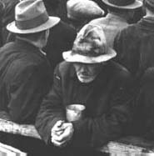
Loneliness and Isolation in “Of mice and Men”
John Steinbeck's novel, Of Mice and Men, is a story in which a dominating idea of inescapable loneliness prevails.
"A guy needs somebody to be near him. A guy goes nuts if he ain't got nobody. Don't make no difference who the guy is, long's he's with you. I tell ya, a guy gets lonely an' he gets sick."

Slide 2
Of Mice and Men is filled with characters such as this, who are unable to find a way out of their lonely lives. The loneliness in this story builds and builds and never is allowed to escape.
By never allowing its escape, Steinbeck effectively forms a solid backing for the characters and events in his novel.

Slide 3
Lennie
Lennie's loneliness chiefly stems from the fact that he is both mentally retarded and very big and strong. His retardation sometimes causes others at the ranch to shun him, even to the point of thinking he is "cuckoo." Since Lennie cannot think as quickly as the other men, he is often set aside and isolated from them. He is unable to take an active part in conversations because George, Lennie's best friend and travelling companion, is the only one who can understand him.

Slide 4
Lennie is frequently off in his own dream world and is constantly preoccupied with dreams of the farm which he and George someday hope to buy. As a result, Lennie is unable to face reality at times, a fact which puts him even more out of touch with the real world and with other workers.
Lennie is just like a big baby. He refuses to defend himself and often cannot be held responsible for his actions. This irresponsibility, combined with Lennie's abnormal size and strength, causes many of the other ranch hands to shy away and fear him.

Slide 5
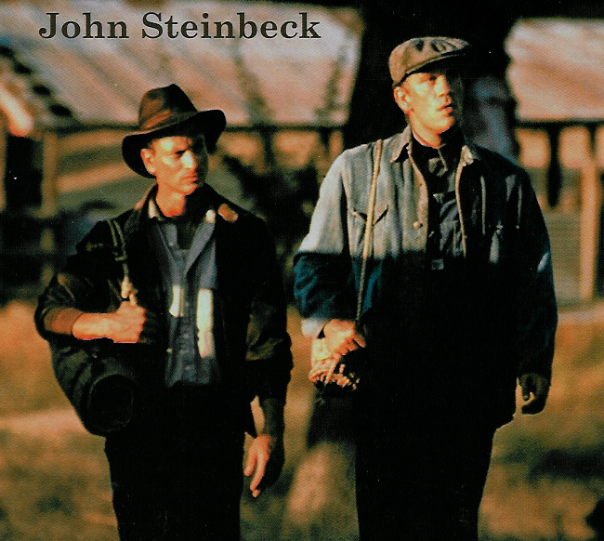
The men are afraid of Lennie because they know that if his great strength were ever to go uncontrolled, it could easily overwhelm any one of them.
This constant rejection by others increases the depth of Lennie's loneliness and adds to the theme of loneliness running through the novel.

Slide 6
Crooks, the stable-hand
Crooks, stable-hand, is another lonely character at the ranch. The chief cause of Crook's loneliness centres on the fact that he is black.
Most of the men constantly put down Crooks and use him as a scapegoat, even to the point of calling him the "n" word.

Slide 7
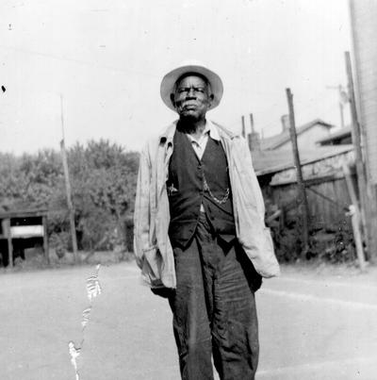
Because of his colour, Crooks must live by himself in a small room in the barn. Crooks becomes so accustomed to this constant isolation, that he is suspicious of any man who suddenly tries to make friends with him.
When Lennie accidentally stumbles onto Crooks' room one night in the barn and tries to sit down and talk, Crooks becomes so suspicious that he actually tries to drive Lennie away before giving up and allowing Lennie to come in.

Slide 8
Crooks' deformed back deprives him of working with the other men, thereby denying him his last opportunity for personal contact with them. While the other men work together in the fields "bucking" grain sacks or harvesting crops, Crooks must sit all alone in his little room in the barn mending harnesses and doing other menial labour.
Crooks is perhaps the only man on the ranch who does a substantial amount of reading, vainly hoping it will help him pass his lonely hours. Unlike Lennie, Crooks has no dreams for the future, which gives him the feeling that he is trapped on this lonely ranch for the rest of his life.

Slide 9
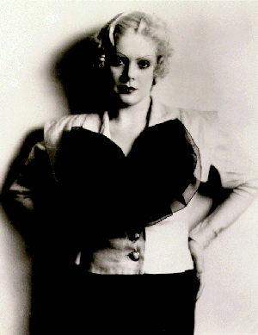
Curley’s Wife
Curley's wife is perhaps the loneliest person of all on the ranch. Since she is the only woman on the ranch, she is set apart from the others. Curley, her own husband, ignores her. He does not regard his wife as a person needing love and companionship, but rather as an object which can be put aside, pushed around.

Slide 10
Instead of being attentive to his wife, Curley is frequently going out with "the boys" instead of with his wife.
Curley's wife has no love for her husband and wishes to leave him, but her final escape route is blocked since her father is dead and her mother doesn't want her.

Slide 11
Curley's wife tries to find companionship with the other men on the ranch but they ignore her or try to brush her off fearing that if they are caught associating with her, they will lose their jobs.
Curley's wife's loneliness finally becomes so severe that she resorts to fantasizing herself as a famous actress just to feel wanted and more popular with others.

Slide 12
Loneliness
Loneliness affects many of the characters, and Steinbeck seems to show that it is a natural and inevitable result of the kind of life they are forced to lead.
The itinerant workers are caught in a trap of loneliness - they never stay in one place long enough to form permanent relationships. Even if such relationships existed, they would probably be destroyed by the demands of the itinerant life.
Let's examine the lonely situation of some of the characters, see how they try to deal with it, and the result.
Candy is lonely because he is old, and is different from the other hands. His only comfort is his old dog, which keeps him company and reminds him of days when he was young and whole.
He has no relatives, and once his dog is killed is totally alone. He eagerly clutches at the idea of buying a farm with George and Lennie, but of course this all comes to nothing.
Candy's disappointment is expressed in the bitter words he utters to the body of Curley's wife, whom he blames for spoiling his dream.
George is also caught in the trap of loneliness. Just as Candy has his dog for company, George has Lennie (who is often described in animal-like terms). Continuing the parallel, George too is left completely alone when Lennie is killed.
The dream farm is his idea, and he says 'We'd belong there ... no more runnin' around the country...'.
Another lonely character is Curley's wife. Newly married and in a strange place, she is forbidden by Curley to talk to anyone but him. To counter this, she constantly approaches the ranch hands on the excuse of looking for Curley. The only result is that the men regard her as a slut, and Curley becomes even more intensely jealous. Finally, her loneliness leads to her death as she makes the ' serious error of trying to overcome it by playing the tease with Lennie.
Curley himself is lonely. His new wife hates him as do all the ranch hands who despise him for his cowardice.
He has married in an attempt to overcome his loneliness, but has blindly chosen a wife totally inappropriate for the kind of life he leads.
His feelings are all channelled into aggressive behaviour which further isolates his wife and leads to the incident with Lennie where his hand is crushed.
Crooks is another who is isolated because he is different. He copes with it by keeping a distance between himself and the other hands. When he does allow himself to be drawn into the dream of working on George and Lennie's dream farm, he is immediately shut out by George's anger.

Slide 13
This powerpoint was kindly donated to www.worldofteaching.com
http://www.worldofteaching.com is home to over a thousand powerpoints submitted by teachers. This is a completely free site and requires no registration. Please visit and I hope it will help in your teaching.

