Slide 1
Past Modals
Interchange 2 – Unit 15

Slide 2
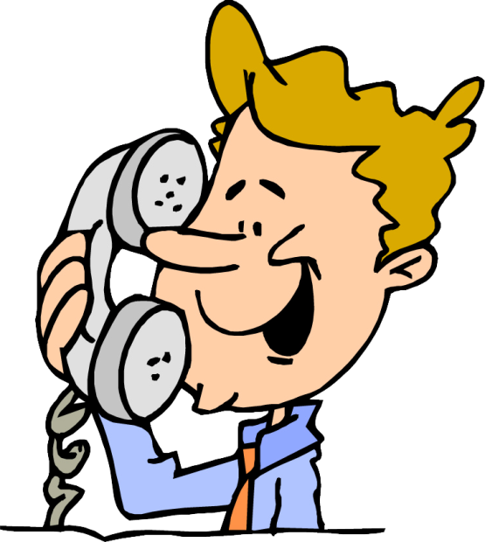
Past Modals
I would have
called him right away.
We use “I would have” to give an opinion about an action in the past.

Slide 3
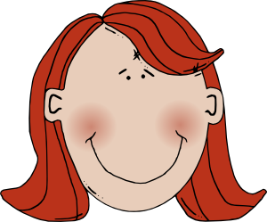
Past Modals
You should have
cleaned it immediately.
We use “you should have” to to make a suggestion about a past event.

Slide 4
Past Modals
What would you have done?
pronoun
past participle
Wh-
would
have

Slide 5
Past Modals
I would have sent him a nice birthday present.
past participle
subject
would have
rest

Slide 6
Past Modals
What should I have done?
pronoun
past participle
Wh-
should
have

Slide 7
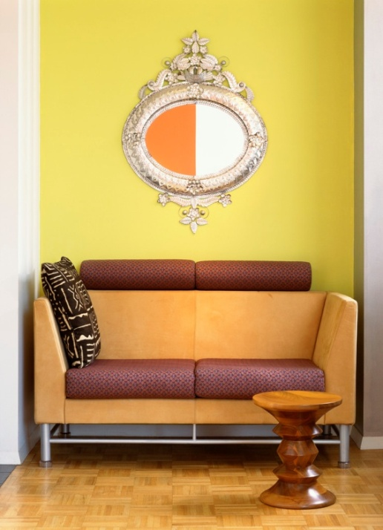
Past Modals
You should have told them about it.
subject
past participle
should have
rest

Slide 8
This powerpoint was kindly donated to
www.worldofteaching.com
http://www.worldofteaching.com
Is home to well over a thousand powerpoints submitted by teachers. This a free site. Please visit and I hope it will help in your teaching
Notes:
8

