Slide 1
Poetry Introduction & Poetic Devices
By Mary Qualey
Airline High School

Slide 2
Poetic License
“The freedom given to poets to ignore standard rules of grammar or proper diction in order to create a desired artistic effect.”
Glencoe Literature Book

Slide 3
Poetry Redefined Literary expression that emphasizes the line, not the sentence, as the unit of composition. Traditional characteristics: • emotional, imaginative language • use of metaphor, similie, & other figures of speech • divided into stanzas • use of rhyme and regular patterns of meter

Slide 4
Types of Poetry • Lyrical poetry •Narrative poetry • Imagist Poetry • “Confessional poetry” • Ballad • Elegy • Haiku

Slide 5
Ballad A form of verse to be sung or recited. F. B. Gum describes the ballad as "a poem meant for singing, quite impersonal in material, probably connected in its origins with the communal dance."

Slide 6
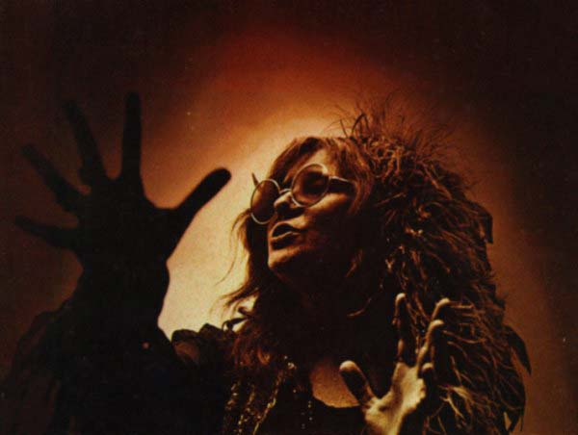
Me & Bobby McGee
by Janis Joplin

Slide 7
Busted flat in Baton Rouge, waiting for a train And I’s feeling nearly as faded as my jeans. Bobby thumbed a diesel down just before it rained, It rode us all the way to New Orleans. I pulled my harpoon out of my dirty red bandanna, I was playing soft while Bobby sang the blues. Windshield wipers slapping time, I was holding Bobby’s hand in mine, We sang every song that driver knew. Freedom is just another word for nothing left to lose, Nothing don’t mean nothing honey if it ain’t free. And feeling good was easy, Lord, when he sang the blues, You know feeling good was good enough for me, Good enough for me and my Bobby McGee.

Slide 8
From the Kentucky coal mines to the California sun, Hey, Bobby shared the secrets of my soul. Through all kinds of weather, through everything that we done, Hey Bobby baby kept me from the cold. One day up near Salinas, Lord, I let him slip away, He’s looking for that home and I hope he finds it, But I’d trade all of my tomorrows for one single yesterday To be holding Bobby’s body next to mine. Freedom is just another word for nothing left to lose, Nothing, that’s all that Bobby left me, yeah, But feeling good was easy, Lord, when he sang the blues, Hey, feeling good was good enough for me, hmm hmm, Good enough for me and my Bobby McGee.

Slide 9
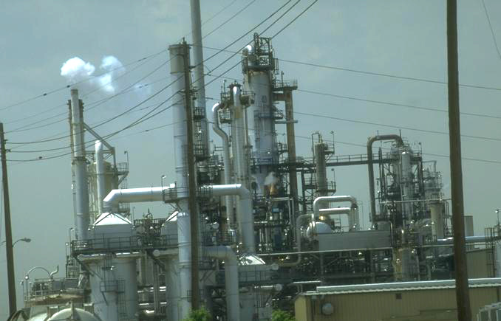
Richard Cory by Paul Simon

Slide 10
They say that Richard Cory owns one half of this whole town, With political connections to spread his wealth around. Born into society, a banker's only child, He had everything a man could want: power, grace and style. But I work in his factory And I curse the life I'm living And I curse my poverty And I wish that I could be, Oh, I wish that I could be, Oh, I wish that I could be Richard Cory.

Slide 11
Confessional Poetry Movement started in the 1950s Poets write about their own personal experience in an open, direct style Examples: Robert Lowell, Anne Sexton, Sylvia Plath

Slide 12
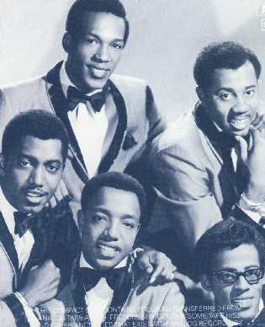
Papa was a Rolling Stone
by The Temptations

Slide 13
It was the third of September; that day I'll always remember, 'cause that was the day that my daddy died. I never got a chance to see him;never heard nothin' but bad things about him. Mama I'm depending on you to tell me the truth.(Spoken)Mama just looked at him and said, "Son,(Sung)Papa was a rollin' stone. Wherever he laid his hat was his home. And when his died, All he left us was alone.” Verse 2 Hey, mama, I heard Papa call himself a jack of all trades. Tell me, is that what sent Papa to an early grave? Folks say Papa would beg, borrow or steal to pay his bills. Hey, Mama, folks say Papa was never much on thinkin'; Spend most of his time chasin' women and drinkin'! Mama, I'm depending on you to tell me the truth. (Spoken) Mama just hung her head and said, "Son, (To Chorus)

Slide 14
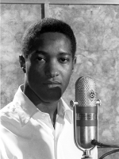
Change Gon’ Come
by Sam Cooke

Slide 15
I was born by the river in a little tent Oh and just like the river I been a runnin' ever since It's been a long, a long time coming but I know A change gon' come oh yes it will It's been too hard living but I'm afraid to die Cuz I don't know what's up there beyond the sky It's been a long, a long time coming but I know A change gon' come oh yes it will I go to the movie, and I go downtown Somebody keep tellin me "don't hang around"It's been a long, a long time coming, but i know A change gon' come oh yes it will Then I go to my brother And I say "brother, help me please" But he winds up knocking me Back down on my knees There been times that I thought I wouldn't last for long Now think I'm able to carry on It's been a long, along time coming but I know A change gon' come, oh yes it will

Slide 16
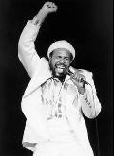
What’s Going On
by Marvin Gaye

Slide 17
Mother, mother There's too many of you crying
Brother, brother, brother There's far too many of you dying
You know we've got to find a way
To bring some lovin' here today
Ya Father, father We don't need to escalate
You see, war is not the answer For only love can conquer hate
You know we've got to find a way To bring some lovin' here today
Picket lines and picket signs Don't punish me with brutality
Talk to me, so you can see Oh, what's going on
What's going on Ya, what's going on Ah, what's going on
In the mean time Right on, baby Right on Right

Slide 18
Elegy Poem that mourns a death or other great loss

Slide 19
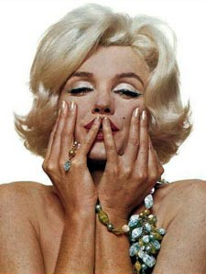
Candle in the Wind
by Elton John

Slide 20
Goodbye Norma Jean
Though I never knew you at all
You had the grace to hold yourself
While those around you crawled
They crawled out of the woodwork
And they whispered into your brain
They set you on the treadmill
And they made you change your name
And it seems to me you lived your life
Like a candle in the wind
Never knowing who to cling to
When the rain set in
And I would have liked to have known you
But I was just a kid
Your candle burned out long before
Your legend ever did

Slide 21
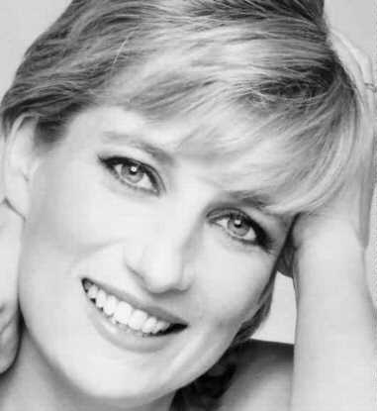
Candle in the Wind
by Elton John

Slide 22
Goodbye England's rose;
may you ever grow in our hearts.
You were the grace that placed itself
where lives were torn apart.
You called out to our country,
and you whispered to those in pain.
Now you belong to heaven,
and the stars spell out your name.
And it seems to me you lived your life l
ike a candle in the wind:
never fading with the sunset
when the rain set in.
And your footsteps will always fall here, among England's greenest hills;
your candle's burned out long before
your legend ever will.

Slide 23
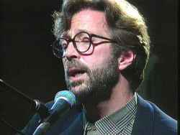
Tears in Heaven
by Eric Clapton

Slide 24
Clapton wrote this about his
4-year-old son, Conor, who died when he fell out of a 53rd floor window in his mother's apartment in New York City. At the time, Conor was Clapton's only child.

Slide 25
would you know my name
if i saw you in heaven
would it be the same
if i saw you in heaven
i must be stong and carry on
'cause i know i don't belong
here in heaven
would you hold my hand
if i saw you in heaven
would you help me stand
if i saw you in heaven
i'll find my way
through night and day
cause i know i just can't stay
here in heaven beyond the door
there's peace i'm sure
but i know there'll be no more
tears in heaven
time can bring you down
time can bend your knees
time can break your heart
have you beggin
please beggin please
would you know my name
if i saw you in heaven
would it be the same if i saw you in heaven
beyond the door there's peace i'm sure
but i know there'll be no more tears in heaven

Slide 26
Imagist Poetry Name given to a movement in poetry, originating in 1912 and represented by Ezra Pound, Amy Lowell, and others, aiming at clarity of expression through the use of precise visual images.

Slide 27

Bag Lady
by Eryka Badu

Slide 28
Bag lady you gone hurt your back
Dragging all them bags like that
I guess nobody ever told you
All you must hold on toIs you, is you, is you
One day all them bags gone get in your way
One day all them bags gone get in your way
I said one day all them bags gone get in your way
One Day all them bags gone get in your way
So pack lightPack lightPack light
Ooh oohBag lady you gone miss your bus
You can't hurry up Cause you got too much stuff
When they see you cominNiggas take off runnin
From you it's true oh yes they do
One day he gone say you crowdin my space
One day he gone say you crowdin my space
I said one day he gone say you crowdin my space
One day he gone say you crowdin my space
So pack light Pack light Pack light Ooh ooh

Slide 29
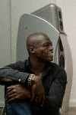
Kiss from a Rose
by Seal

Slide 30
There used to be a greying tower alone on the sea
You, became the light on the dark side of me
Love remains, a drug that's the high and not the pill
But did you know that when it snows
My eyes become large
And the light that you shine can't be seen?
Baby, I compare you to a kiss from a rose on the grey
Ooh, the more I get of you, the stranger it feels yeah
Now that your rose is in bloom
A light hits the gloom on the grey
There is so much a man can tell you
So much he can say
You remain my power, my pleasure, my pain
Baby, To me, you're like a growing
Addiction that I can't deny
Won't you tell me, is that healthy, baby?
But did you know that when it snows
My eyes become large
And the light that you shine can't be seen?
Baby, I compare you to a kiss from a rose on the grey

Slide 31
Lyrical Poetry Expresses a speaker’s personal thoughts and feelings An ode is an elaborate lyric poem expressed in a dignified and sincere way Ex. “The Road Not Taken” Robert Frost “New York State of Mind” Billy Joel

Slide 32
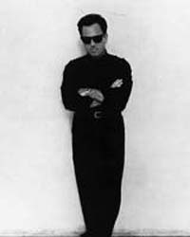
New York State of Mind
by Billy Joel

Slide 33
Some folks like to get away
Take a holiday from the neighborhood
Hop a flight to Miami Beach
Or to Hollywood
But I'm talking a Greyhound
On the Hudson River Line
I'm in a New York state of mind
I've seen all the movie stars
In their fancy cars and their limousines
Been high in the Rockies under the evergreens
But I know what I'm needing
And I don't want to waste more time
I'm in a New York state of mind
It was so easy living day by day
Out of touch with the rhythm and blues
But now I need a little give and take
The New York Times, The Daily News

Slide 34
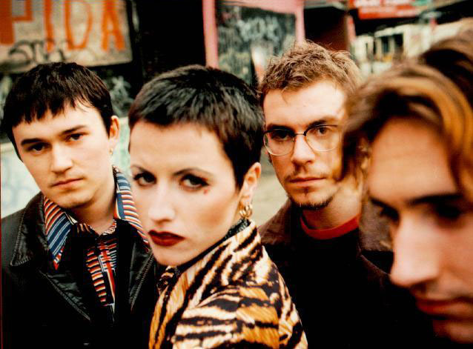
Ode to my Family
by the Cranberries

Slide 35
Doo, doo, doo, doo, doo, doo, doo, doo...
Understand the things I say, don't turn away from me,
'Cause I've spent half my life out there, you wouldn't disagree.
Do you see me? Do you see? Do you like me?
Do you like me standing there? Do you notice? Do you know?
Do you see me? Do you see me? Does anyone care?
Unhappiness where's when I was young,
And we didn't give a damn,
'Cause we were raised, To see life as fun and take it if we can.
My mother, my mother,
She hold me, she hold me, when I was out there.
My father, my father,
He liked me, oh, he liked me. Does anyone care?
Understand what I've become, it wasn't my desing.
And people ev'rywhere think, something better than I am.
But I miss you, I miss, 'cause I liked it,
'Cause I liked it, when I was out there.
Do you know this? Do you know you did not find me.
You did not find. Does anyone care?

Slide 36
Narrative Poetry Verse that tells a story Many types of poetry fall under this umbrella: ballads epics elegies

Slide 37
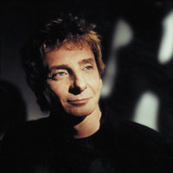
Copa Cabana by Barry Manilow

Slide 38
Her name was Lola, she was a showgirl with yellow feathers in her hair and a dress cut down to there she would merengue and do the cha-cha and while she tried to be a star Tony always tended bar across the crowded floor, they worked from 8 til 4 they were young and they had each other who could ask for more?
CHORUS: At the copa (CO!) Copacabana (Copacabana) the hottest spot north of Havana (here) at the copa (CO!) Copacabana music and passion were always in fashion At the copa.... they fell in love
His name was Rico he wore a diamond he was escorted to his chair, he saw Lola dancing there and when she finished, he called her over but Rico went a bit to far Tony sailed across the bar and then the punches flew and chairs were smashed in two there was blood and a single gun shot but just who shot who?
REPEAT CHORUS
At the copa... she lost her love Her name is Lola, she was a showgirl, but that was 30 years ago, when they used to have a show now it's a disco, but not for Lola, still in the dress she used to wear, faded feathers in her hair she sits there so refined,and drinks herself half-blind she lost her youth and she lost her Tony now she's lost her mind REPEAT CHORUS
At the copa... don't fall in love don't fall in love

Slide 39
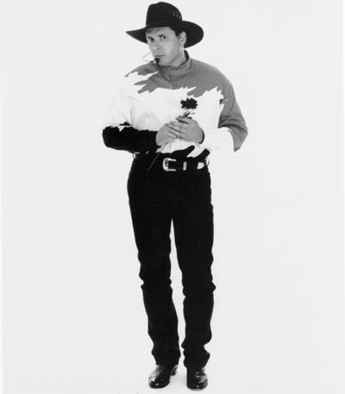
Thunder Rolls
by Garth Brooks

Slide 40
Three thirty in the morning
Not a soul insight
The city's lookin' like a ghost town
On a moonless summer night
Raindrops on the windshield
There's a åstorm moving in
He's headin' back from somewhere
That he never should have been
And the thunder rolls
And the thunder rolls
Every light is burnin'
In a house across town
She's pacin' by the telephone
In her faded flannel gown
Askin' for miracle
Hopin' she's not right
Prayin' it's the weather
That's kept him out all night
And the thunder rolls
And the thunder rolls
The thunder rolls
And the lightnin' strikes
Another love grows cold
On a sleepless night
As the storm blows on
Out of control
Deep in her heart
The thunder rolls
She's waitin' by the window When he pulls into the drive She rushes out to hold him Thankful he's alive
But on the wind and rain
A strange new perfume blows
And the lightnin' flashes in her eyes

Slide 41
And he knows that she knows And the thunder rolls
And the thunder rolls
The thunder rolls
And the lightnin' strikes
Another love grows cold
On a sleepless night
As the storm blows on
Out of control
Deep in her heart
The thunder rolls
She runs back down the hallway
To the bedroom door
She reaches for the pistol
Kept in the dresser drawer
Tells the lady in the mirror
He won't do this again
Cause tonight will be the last time
She'll wonder where he's been

Slide 42
This powerpoint was kindly donated to www.worldofteaching.com
http://www.worldofteaching.com is home to over a thousand powerpoints submitted by teachers. This is a completely free site and requires no registration. Please visit and I hope it will help in your teaching.

